Slide 1
MAP Training and Testing Updates
Medication Administration Program (MAP)
Notes:
Welcome to the MAP Training and Testing updates overview. By viewing webinars marked as required, within the specified time period, you’ll meet the MAP Trainer meeting attendance requirement. I’m Gina Hunt, a Department of Developmental Services MAP Coordinator and I’m your webinar presenter.
The Department of Public Health (DPH), Drug Control Program (DCP), recently issued an advisory and amended MAP policies that in turn impact MAP Training and Testing.

Slide 2
Transcription Test Component Removed
Certification Test
Recertification Test
Knowledge Multiple-Choice, 50 Questions
Medication Administration Demonstration
Medication Administration Demonstration
Transcription
Transcription
Notes:
As of February 1, 2023, the transcription component is no longer a requirement of the Certification and Recertification Test Processes.

Slide 3
Certification and Recertification Test Components
Certification Test
Recertification Test
Knowledge Multiple-Choice, 50-Questions
Medication Administration Demonstration
Medication Administration Demonstration
Notes:
The new process will allow staff to become MAP Certified after successfully completing the Certification Knowledge Test and the Medication Administration Demonstration skills test.
Between August 1, 2022, and February 1, 2023, any candidate who has passed both the Knowledge and Medication Administration Demonstration components of the Certification Test, will be automatically updated in the Massachusetts MAP Registry as ‘Certified’.
As of February 1, 2023, a Recertification Test candidate is only required to complete a Medication Administration Demonstration skill test.

Slide 4
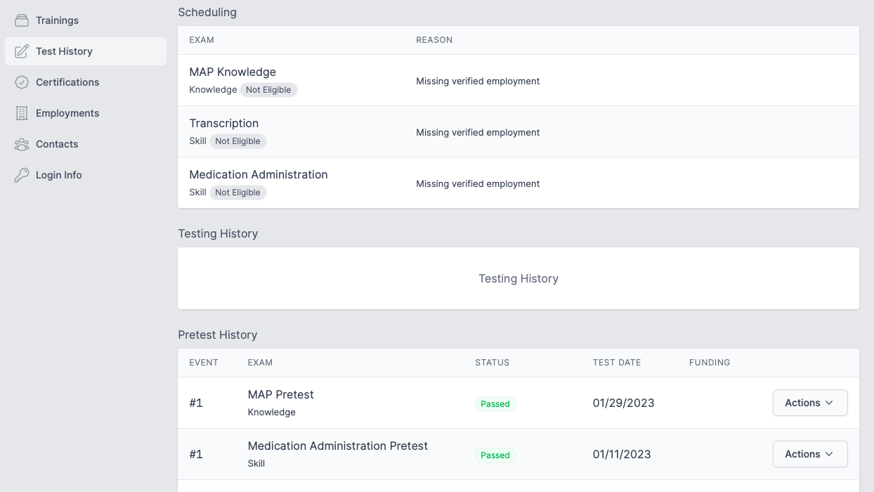
ma.tmuniverse.com Certification Test Eligibility
Notes:
Regarding Certification Test eligibility, between August 1, 2022, and February 1, 2023, any student who has not yet completed the transcription pretest is ‘grandfathered’ as eligible to test with D&S, provided they have successfully completed the training content, and the Knowledge and Medication Administration demonstration pretests.
The student TMU© record will look like the one on your screen. This is a current student, who after having their employment verified, may schedule to take the Certification Test.
The ‘grandfathered’ transition does not extend the testing period.
You will continue to see transcription pretest and transcription skill test areas in the student TMU© record, however, the fields are deactivated.

Slide 5
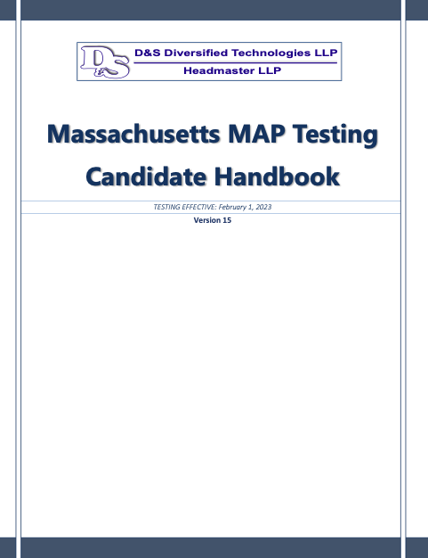
www.hdmaster.com D&S Candidate Handbook
Notes:
The D&S Candidate Handbook, Version 15, dated 2-1-23, was revised to reflect the removal of the transcription test component and is located at the hdmaster.com website.

Slide 6
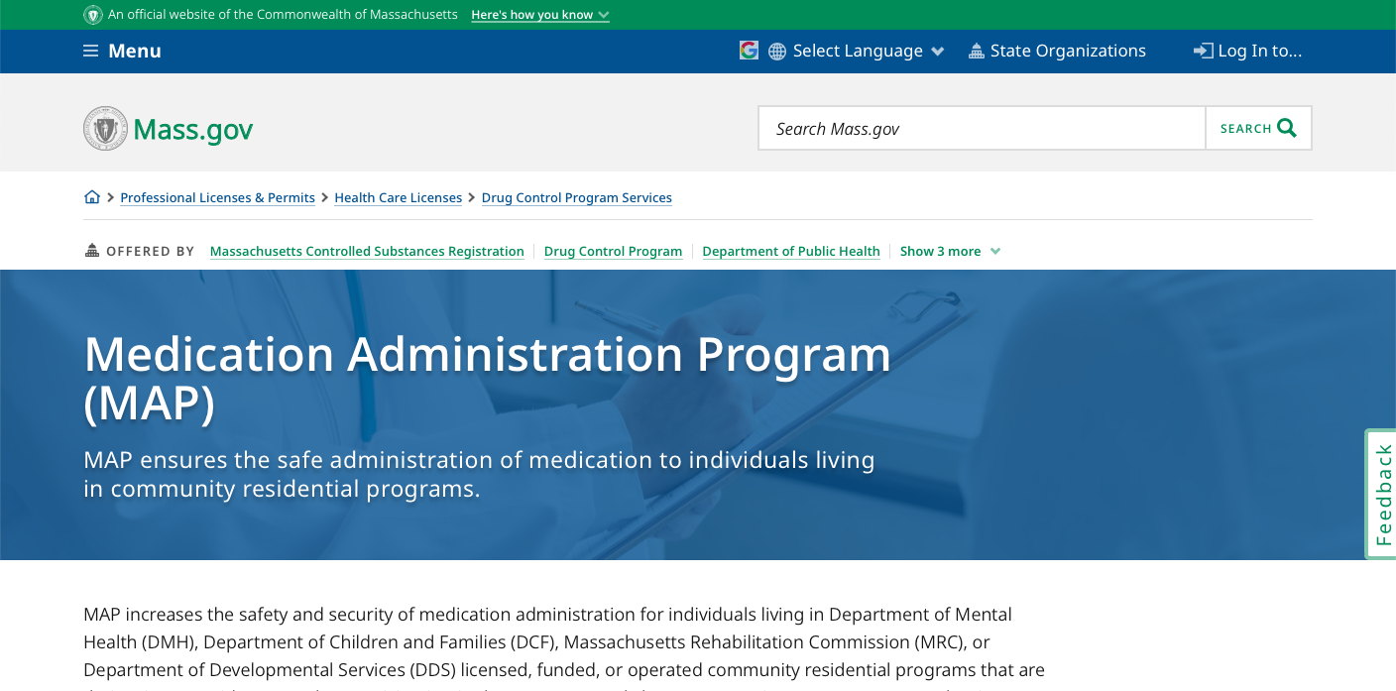
mass.gov/dph/map
Notes:
To access the advisory and related policies, use the ‘MAP-friendly’ URL on your screen. Once you locate this page…

Slide 7
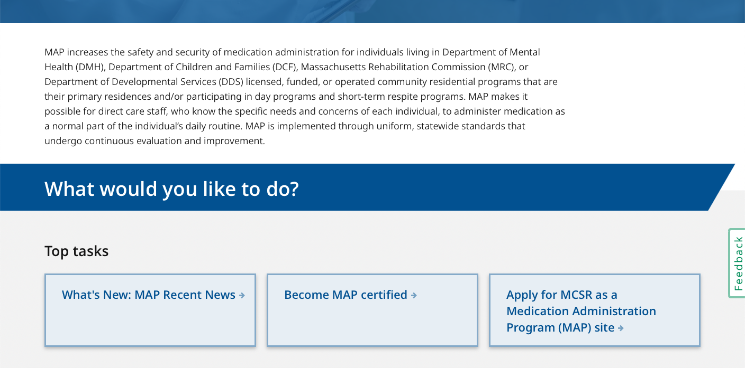
mass.gov/dph/map
Notes:
…scroll down until you see the ‘What’s New: MAP Recent News’ selection and click.

Slide 8
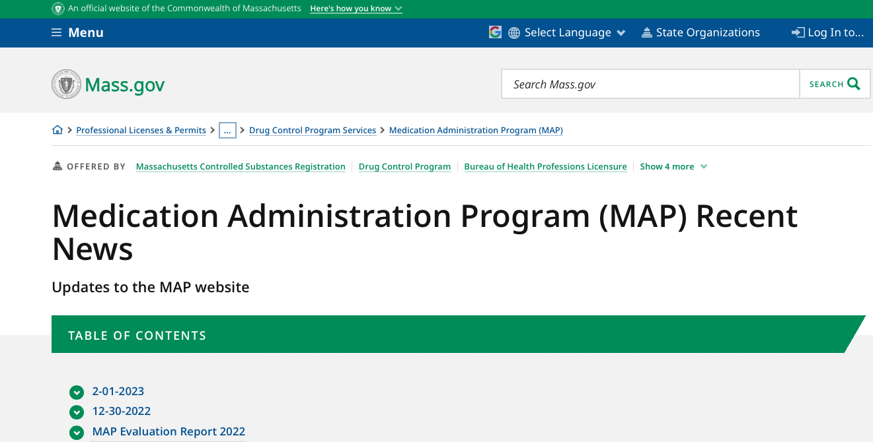
mass.gov/dph/map
Notes:
This brings you to the ‘Table of Contents’. Click on 02-01-23.

Slide 9
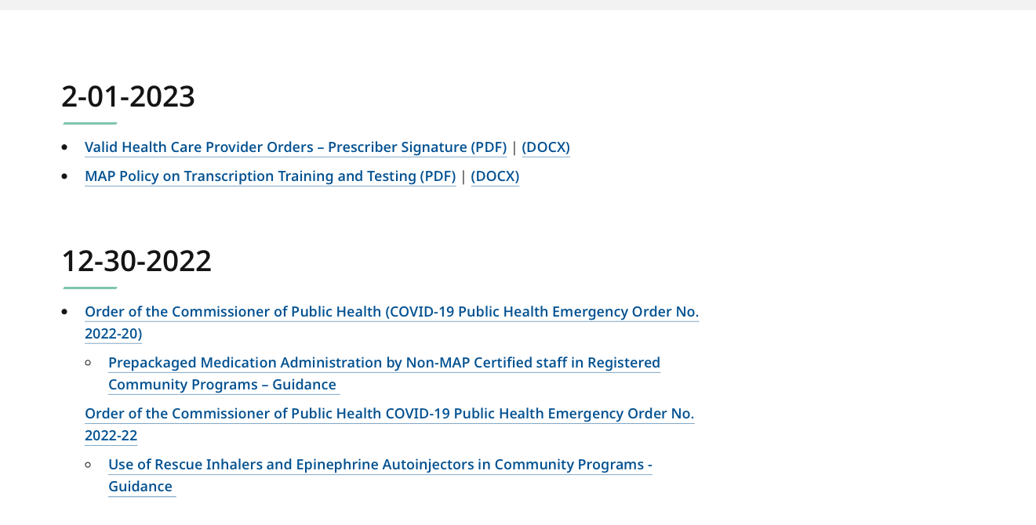
mass.gov/dph/map
Notes:
Click ‘MAP Policy on Transcription Training and Testing’.

Slide 10
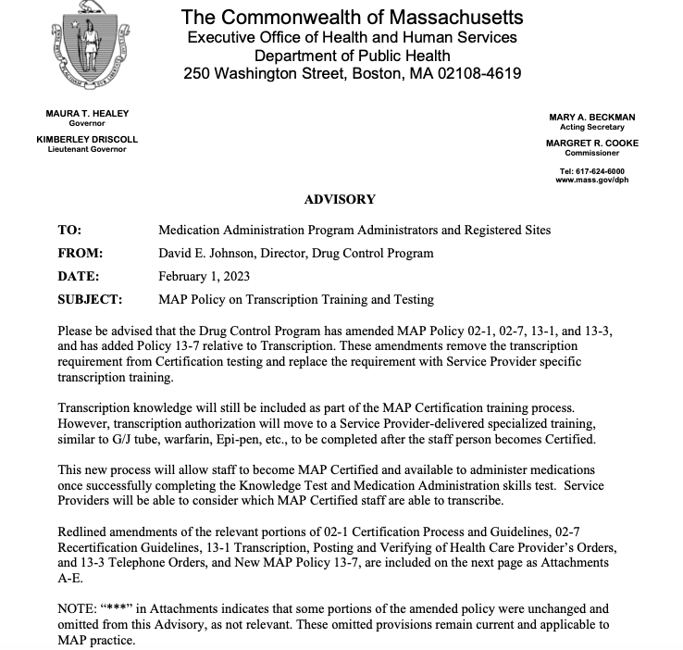
mass.gov/dph/map
Notes:
This brings you to the DCP Advisory, followed by the amended policies and the new policy with details regarding:
Certification training relative to transcription content,
Removal of the transcription test component requirement, which is replaced with a
Service Provider specific transcription training.

Slide 11
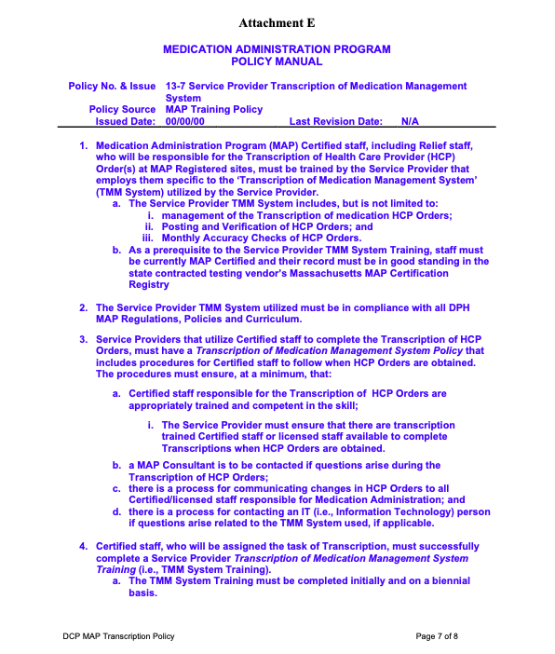
MAP Policy 13-7 Service Provider Transcription of Medication Management (TMM) System
Notes:
Service Providers will determine which MAP Certified staff may be authorized to transcribe after receiving the specialized training as outlined in the new MAP Policy, 13-7.
The Service Provider TMM System includes, but is not limited to:
Management of the Transcription of medication HCP Orders;
Posting and Verification of HCP Orders; and
Monthly Accuracy Checks of HCP Orders.

Slide 12
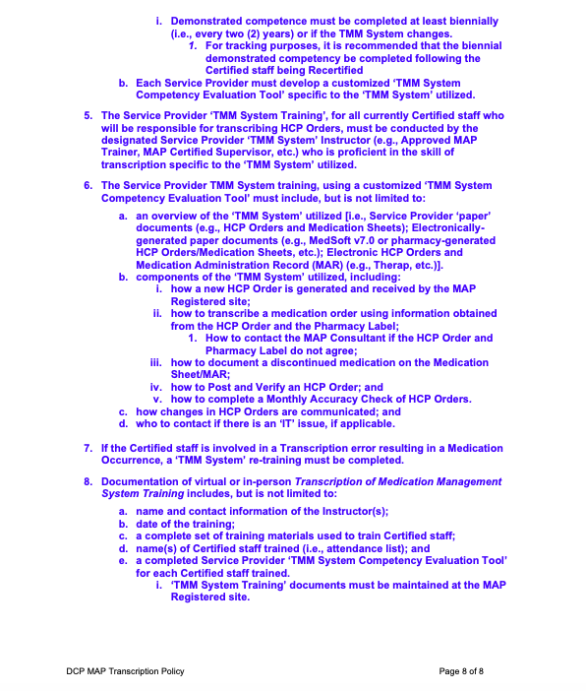
MAP Policy 13-7 Service Provider Transcription of Medication Management (TMM) System
Notes:
Staff must be currently MAP Certified and their record must be in good standing in the MAP Certification Registry before receiving this training.
The Service Provider ‘TMM System Training’, must be conducted by the designated Service Provider ‘TMM System’ Instructor (e.g., Approved MAP Trainer, MAP Certified Supervisor, etc.) who is proficient in the skill of transcription specific to the ‘TMM System’ utilized.
If MAP Certified staff will not be responsible for transcribing, posting and verifying or monthly accuracy checks, then the Service Provider specific transcription training is not required.

Slide 13
Online MAP Certification Training
Required
‘Responsibilities in Action’ Content
Skills Check Practice/Assignments
Unit 6-Transcription
Unit 7-Medication Administration
Notes:
Beginning with the February 2, 2023 online MAP Certification course, you’ll notice the removal of all references to the transcription pretest and Certification test components.
The transcription knowledge content and skills practice remain, with the addition of a Skill Check Assignment in Unit 6.
The next series of slides highlight the modifications.

Slide 14
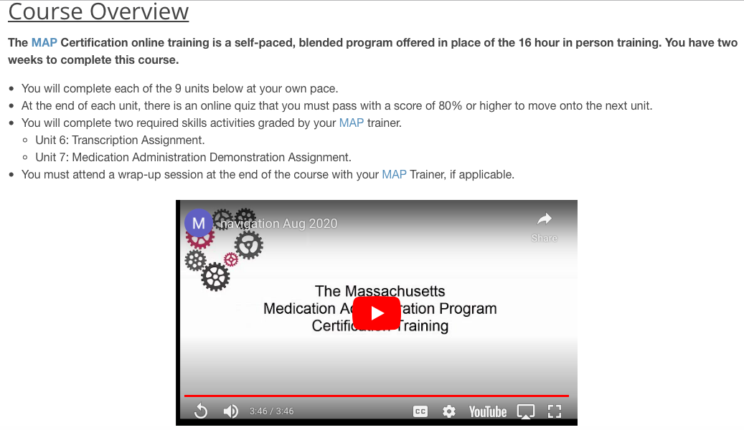
Course Overview
Notes:
The Course Overview highlights the two required skills activities graded by you, the Trainer.
Unit 6-Transcription Assignment and the
Unit 7-Medication Administration Demonstration Assignment.

Slide 15
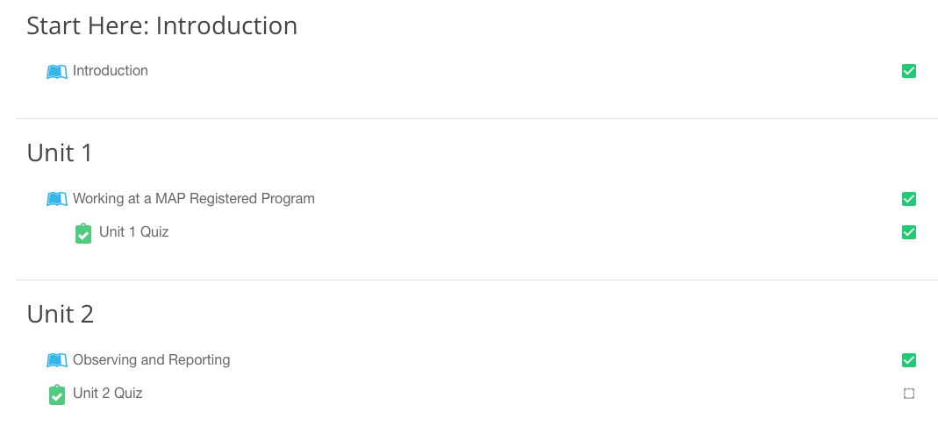
Start Here: Introduction
Notes:
The ‘Introduction’ content slides were modified and include the new requirement to pass a Transcription Assignment.
In addition, the Recertification Test is described as requiring only the Medication Administration Demonstration test.
There were no content changes in Units 1-5.

Slide 16
Units 1-5 Summary and Preview
Slide 8 Skills Practice
Assignment Instructions
Slide 9 Unit 6 Activity Prep for Transcription Practice
Transcription Assignment
paper or using computer and how to access in TMU
Transcription
paper or
using computer
Medication Administration Demonstration
face-to-face (virtual or in-person) or
video submission
Slide 10 Unit 7 Medication Administration Demonstration
Medication Administration Demonstration
face-to-face (virtual or in-person) or video submission and how to submit
Notes:
Modifications to the course begin again after the halfway point; Units 1-5 Summary and Preview of Units 6-9.
Slides 8, 9, and 10 provide details regarding the transcription and medication administration demonstration practices and assignments.
The content references the importance of a student checking with their MAP Trainer regarding the preferred method of completing the assignments.

Slide 17
Transcription Assignment Requirement
Criteria
DC Medication
Transcribe new ‘Time Limited’ Medication
Notes:
The Unit 6 Skill Check Transcription Assignment replaces the Transcription Pretest.

Slide 18
Unit 6 Transcription Assignment
Material Options
Resource Packet
Activity Numbers 2, 3, 4, 5, 6, 7
Transcription Workbook 1
Exercise Numbers 2, 3, 4, 5, 6, 7
TestMaster Universe© (TMU)
Any transcription practice
Notes:
You will let you your student group know whether to complete the transcription assignment on paper or using their computer.
It is the MAP Trainer’s discretion to have students use the Resource Packet materials, or have students complete a transcription practice using Transcription Workbook #1 or by completing the online practice in TMU©, which is now untimed.
Each student may complete their assignment with your assistance, using the curriculum, their notes, etc. for reference.
You will focus on the transcription exercises that include an HCP order in which a current medication has been discontinued and a new ‘time limited’ medication has been ordered.
On the screen are examples of specific activities and exercises that meet these criteria.
If using TMU© for this assignment, all transcriptions meet these criteria.

Slide 19
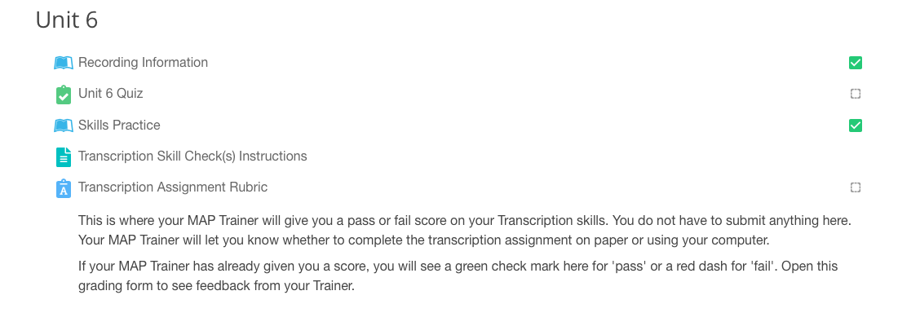
Unit 6 Skill Check Student Dashboard
Notes:
In Unit 6, on their dashboard, following the ‘Skills Practice’ icon, your students will see the transcription assignment instructions and where the assignment will be scored by you.

Slide 20
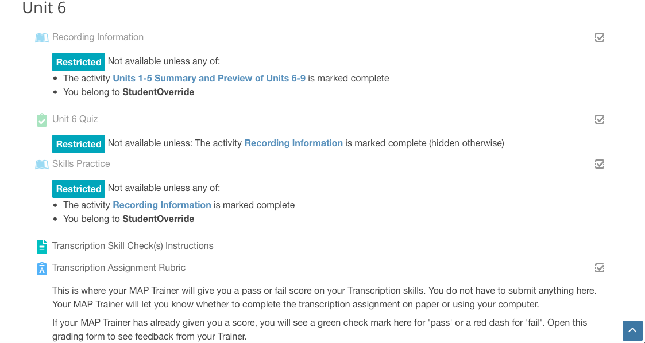
Unit 6 Skill Check Trainer Dashboard
Notes:
This is your Trainer Dashboard view. From this area you can access the transcription instructions and the grading rubric.

Slide 21
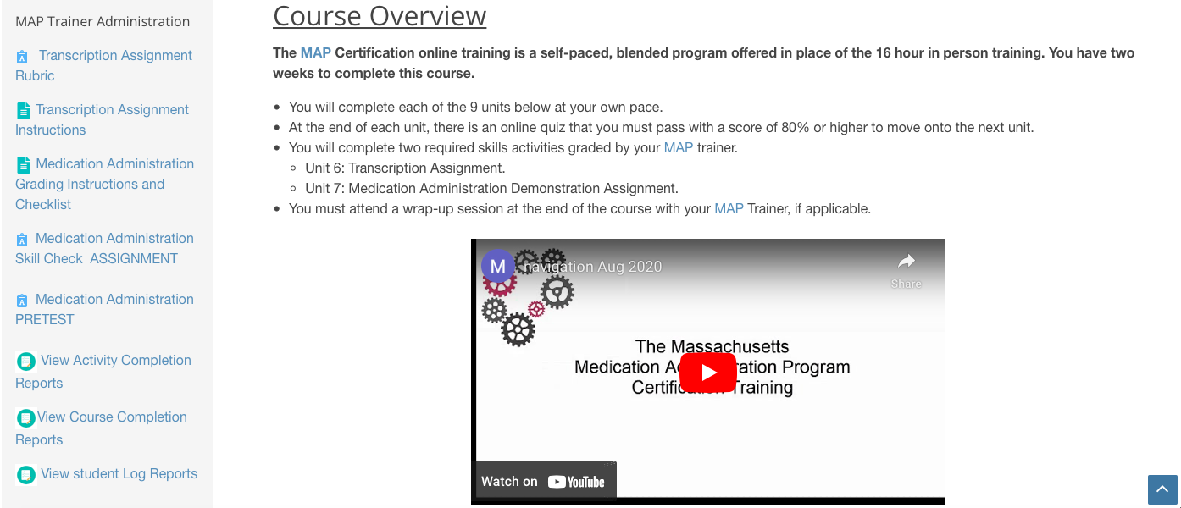
MAP Trainer Administration Box
Notes:
In addition to your dashboard, the MAP Trainer Administration box now includes a grading link to the ‘Transcription Assignment Rubric’ and the instructions.
When you click on the rubric link…

Slide 22
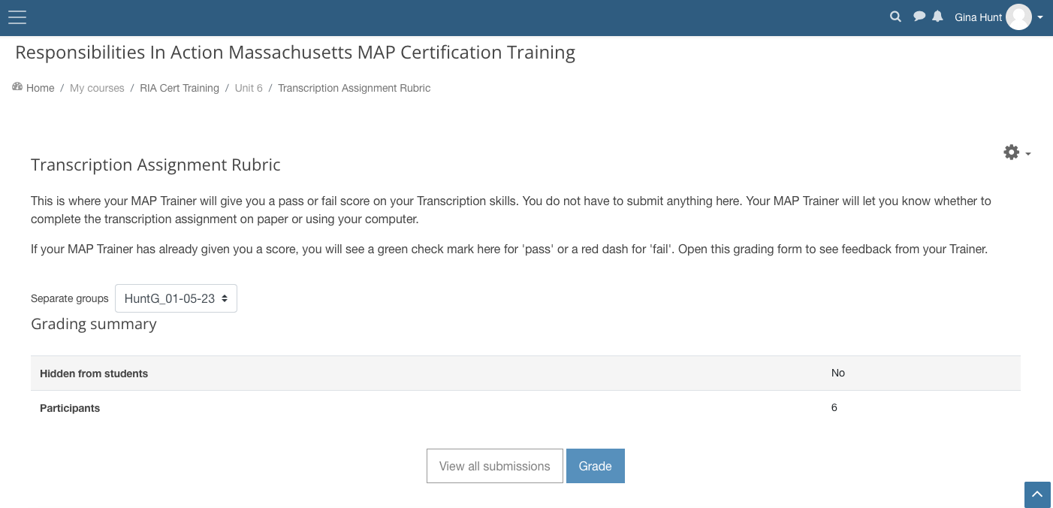
Transcription Assignment Rubric
Notes:
You’ll see this page. Select your training program group, then click ‘grade’.

Slide 23
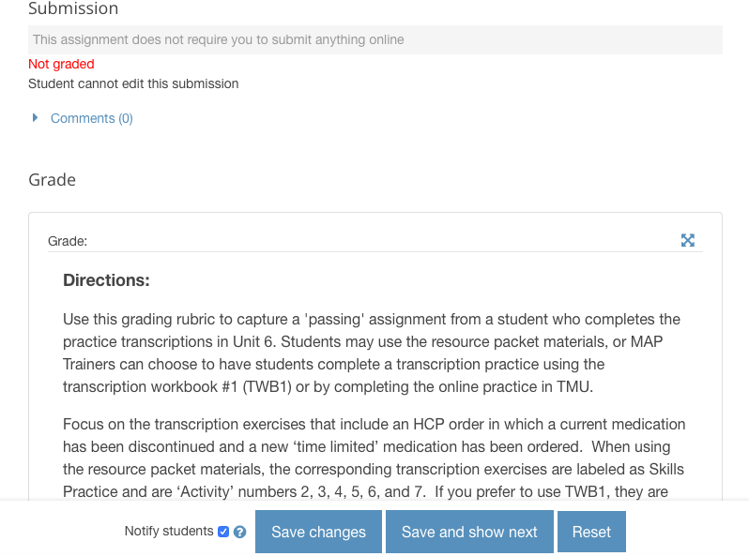
Grading Rubric Directions
Notes:
You’ll see detailed instructions.

Slide 24
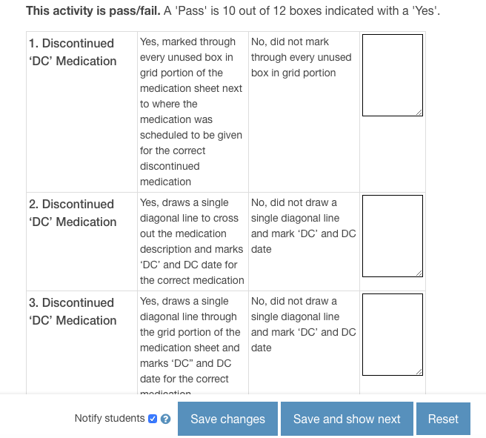
Grading Rubric
Notes:
Then you’ll scroll down to see the grading rubric which triggers a pass/fail score.
A passing score is equivalent to 10 of 12 boxes successfully completed on the rubric.
You’ll use this rubric to score a student’s transcription, regardless of the method of completion that you choose (paper, in-person, or through TMU©).
You can choose to download a hard copy listing all the steps contained on the grading rubric and grade on paper. However, you must still open the electronic rubric in Moodle to enter a yes/no status for each of the scored items. This creates a consistent place to record every student’s score.
If a student does not successfully complete how to DC a current medication and transcribe a new medication on their first attempt, they may continue to practice until they successfully pass the assignment.

Slide 25
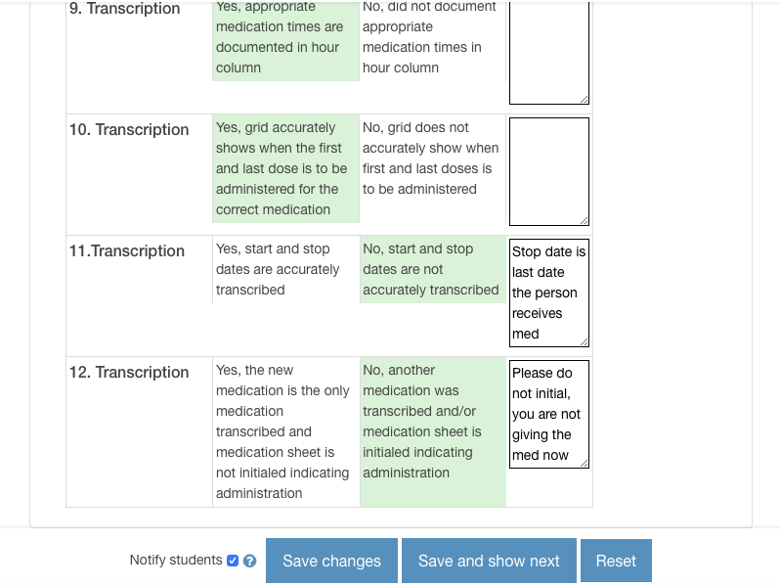
Grading Rubric
Notes:
After you grade the transcription, this is what the student sees.
Your feedback to each student as they practice transcriptions is crucial so that they know how to correct an issue you identify going forward.
It’s important for you to know that if a student does not pass the transcription assignment on their first attempt, they may continue through the course content.

Slide 26
MAP Trainer Administration Box
Notes:
Alternately, from the MAP Trainer Administration Box, when you click ‘Transcription Assignment Instructions’…

Slide 27
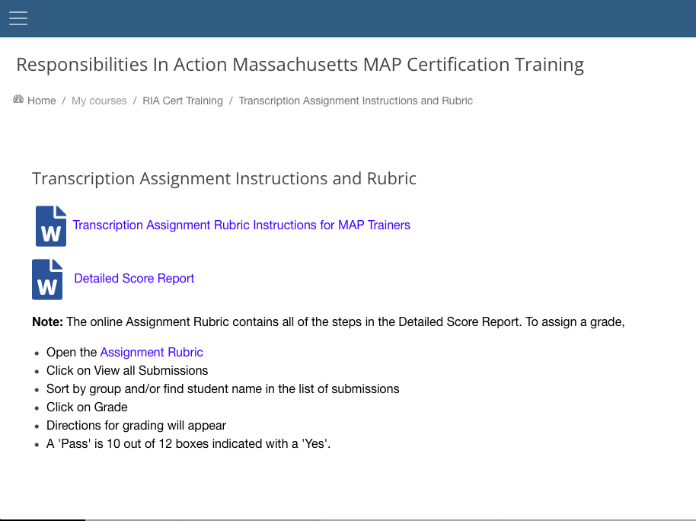
Transcription Assignment Instructions and Rubric
Notes:
…you can access two word documents that include the ‘Transcription Assignment Rubric Instructions’ and a ’Detailed Score Report’ that corresponds with the rubric.
There is also another link to the ‘Assignment Rubric’.

Slide 28
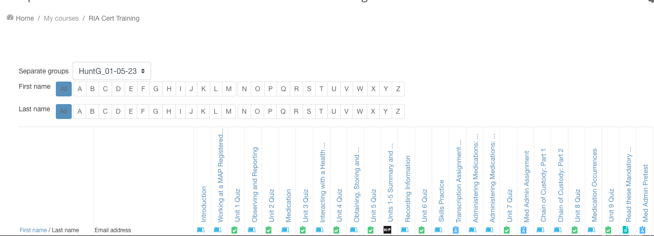
Activity Completion Report
Notes:
Once graded, a pass or fail icon will appear in the Activity Completion report and on the student’s dashboard.
Be mindful that the rubric will only be available for grading 6 months from the course start date as the student's profile will be archived after 6 months.

Slide 29
Course Completion/Requirements
Online RIA ‘Course Completion’
Viewing 9 Units and passing 9 Unit Quizzes
Passing Unit 9 Quiz=Course Completion Date Trainer Enters in TMU
Requirements
Transcription Assignment
Passing score in Unit 6 or by end of course
Medication Administration Demonstration
Passing score in Unit 7 or Pretest at end of course
Knowledge Pretest
Passing score in TMU© at end of course
Notes:
Successful completion of the online course continues to be defined as viewing the 9 Units and passing the 9 Unit quizzes. Passing the Unit 9 quiz is the date you will enter in TMU as the date the training ended.
The Transcription assignment can be done at any time before the student registers for testing (similar to the Medication Administration and Knowledge Pretests).
The expectation is that when the MAP Trainer says the student is ready to test, the student has:
completed the online RIA course,
passed the Transcription Assignment, the Medication Administration Demonstration and the Knowledge Pretest.

Slide 30
Almost Done! Next Steps
Notes:
There were no changes in Units 7-9.
This is the last section of the online course that was modified and now includes only instructions pertaining to the Medication Administration demonstration and Knowledge Pretests.

Slide 31
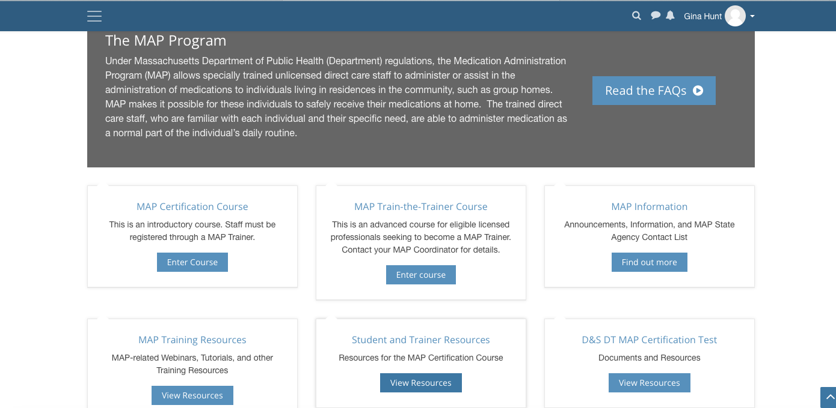
www.mapmass.com
Notes:
Introduced in 2020, the online MAP Certification training continues to be the gold standard of knowledge content, by providing your student group with a consistent, standardized method of ‘RIA’ instruction in an interactive manner with accompanying skills practice.
The standardized content sets your student group up for test success.
As they proceed through the 9 Units, they ‘test their knowledge’ of the content covered by engaging in various types of knowledge checks and activities allowing them to apply what they’ve learned.
At the conclusion of each unit, there is a 10-question multiple-choice quiz that measures student comprehension of the material covered.
Think of it as 9 mini knowledge tests, at which point when they’ve finished the online course; your students will have answered 90 test questions in the same format and subject areas as the Knowledge Pretest and the Certification Knowledge test.

Slide 32
Blended Certification Training
Online, Self-Paced, 24/7 Access
In-Person Skills Session(s)
Notes:
The preferred training format to present the online Certification course is a blended training.
The blended training format consists of the 9 units and quizzes completed in the online course and a ‘face-to-face’ (either virtual or in-person) session or sessions with the MAP Trainer to present or review content and practice the transcription and medication administration skills.

Slide 33
Student Benefits
Course Accessibility 24/7 ​
Enhanced Learning Features
‘ReadSpeaker’ Tool
Accessibility Box
Font size and color
Background contrast ​
Interactive Glossary ​
Multiple Course Videos ​
Interactive Knowledge Check Activities
Basic Computer Skill Exposure
​
Notes:
Many of you who have trained extensively know how common it is to ‘see’ staff engaged in the online course at all hours.
The 24/7 course accessibility feature allows students to complete the course at their convenience within the timeframe allowed.
In addition, the enhanced learning features may be helpful to those for whom English is a second language, have a learning disability and/or who are visual learners.
The exposure to basic computer skills may enhance a student's comfort level with technology in the event an eMAR system is used at their work location or if staff support is needed for a person who may benefit from the use of assistive technology.

Slide 34
Trainer Benefits
Decrease in Trainer Prep Time
Additional Time for:
Skills Practice/Assignments/Pretest Session(s)
‘Live’ via ZOOM, TEAMS, etc.
In-Person
Students needing more support
Remedial Training
​
Notes:
In addition to the Student benefits, the MAP Trainer Benefits when facilitating the online Certification Course are listed on your screen.
There is a decrease in Trainer preparation time as training materials are incorporated within the online course.
This allows additional time for the skills practice, assignments, and pretest sessions or for those students who require additional support.
In the event remedial training is needed, students may access the online course for review before retesting.

Slide 35
Presentation of Online Content
Student Accesses Independently
Trainer presents Brief Content Overview (in-person/virtual)
Student then logs in to online course
Trainer on site while student group logs in
Computer lab
Classroom with iPad/laptops
Trainer projects Online Course material in classroom
Large screen to view units
Students can review units & complete end of unit quizzes during class or later as homework
Student then proceeds through online course
Notes:
During the Blended Certification training, any of these suggested formats may be used to present the online content.

Slide 36
Skills Knowledge Content and Practice Session(s)
Trainer pre-schedules
Virtual or In-person Session(s)
Unit 6 and Unit 7
content
practice
transcription
medication administration process
May use optional Skills PowerPoints
Notes:
The face-to-face skill sessions can be conducted in-person or via a virtual process, or even a combination of the two.
If you’ll be conducting in-person ‘face-to-face’ skill sessions, be sure to check with your Service Provider for training safety guidelines.
Typically, in these sessions, your student group will also complete both required skills assignments.

Slide 37
www.mapmass.com Blended Training Tools
Unit 6
Unit 7
Optional Skills Session PowerPoint
Optional Skills Session PowerPoint
Notes:
To help you conduct a ‘Blended Training’, there are updated optional Power Points available on the mapmass site that may be used as resource materials when conducting the ‘face-to-face’ skill portions of the training.

Slide 38
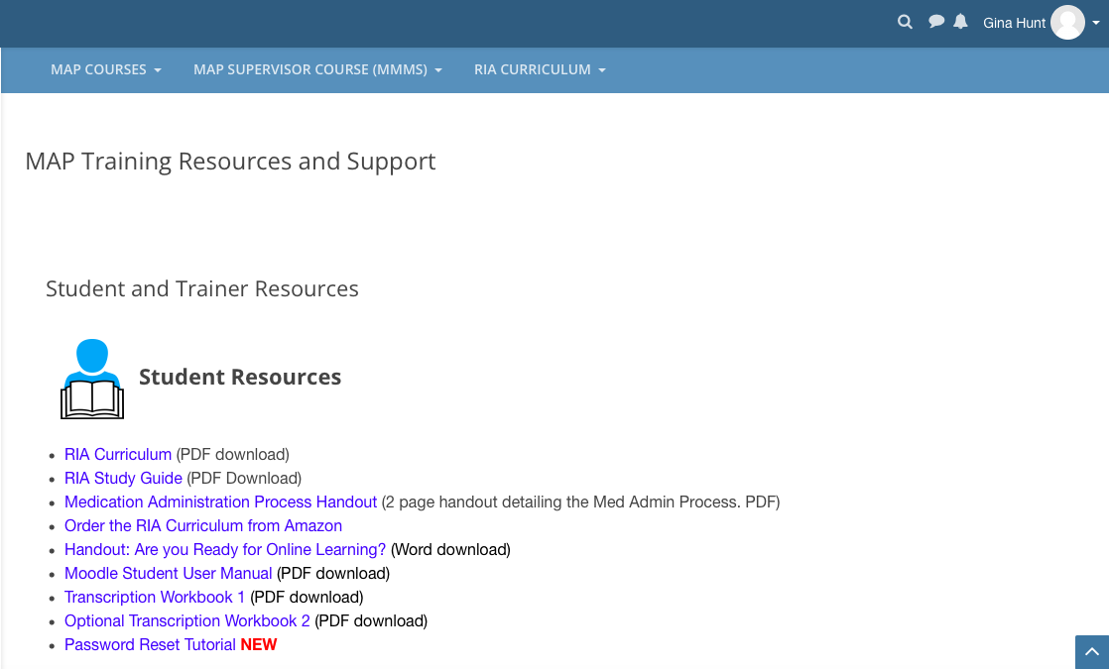
www.mapmass.com MAP Training Resources & Support
Notes:
The last slides in this presentation are a look at the newest ‘Student, Trainer, and Course Supporter Resources’ that are available at the mapmass site.
The newest Student Resource is the ‘Password Reset Tutorial’.
When you click here…

Slide 39
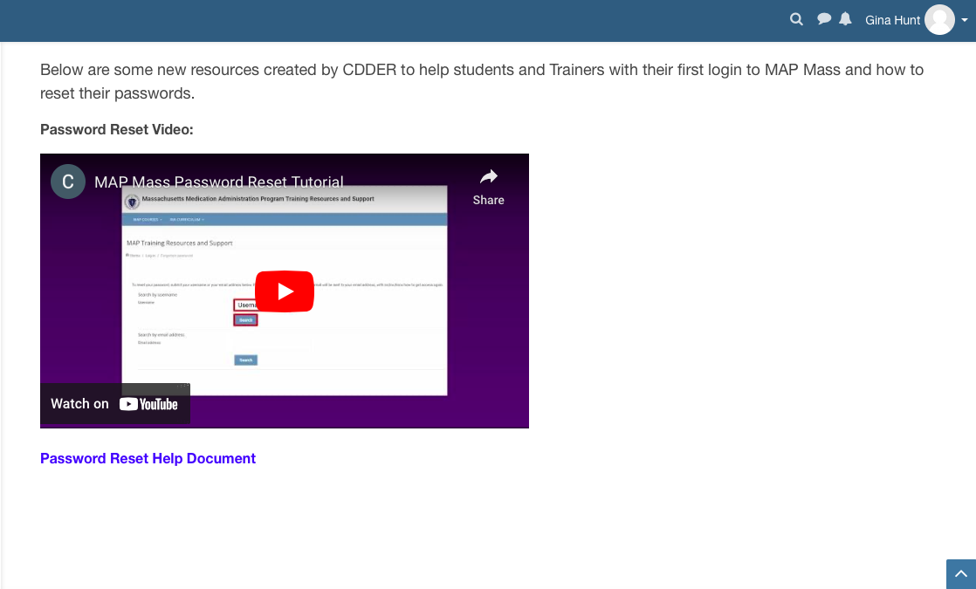
Student Resources
Notes:
…You see the tutorial, and a corresponding ‘Password Reset Help Document’ that includes 4 key points:
Getting to login,
Logging in,
Resetting Your Password, and
Things to Keep in Mind.

Slide 40
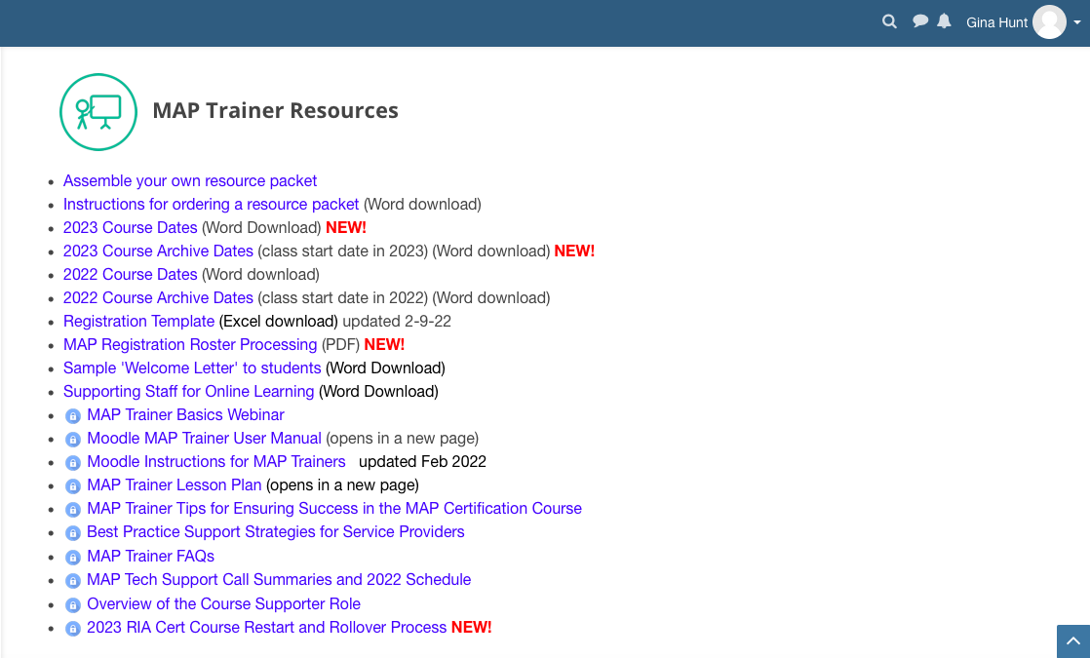
www.mapmass.com MAP Training Resources & Support
Notes:
In addition to the resources you already use, such as the 2020 ’Responsibilities in Action’ curriculum and the Study Guide, the newest MAP Trainer Resources include the 2023 Course Dates and corresponding Archive Dates; and the RIA Cert Course Restart and Rollover Process.
You should visit this site frequently for the latest updates.

Slide 41
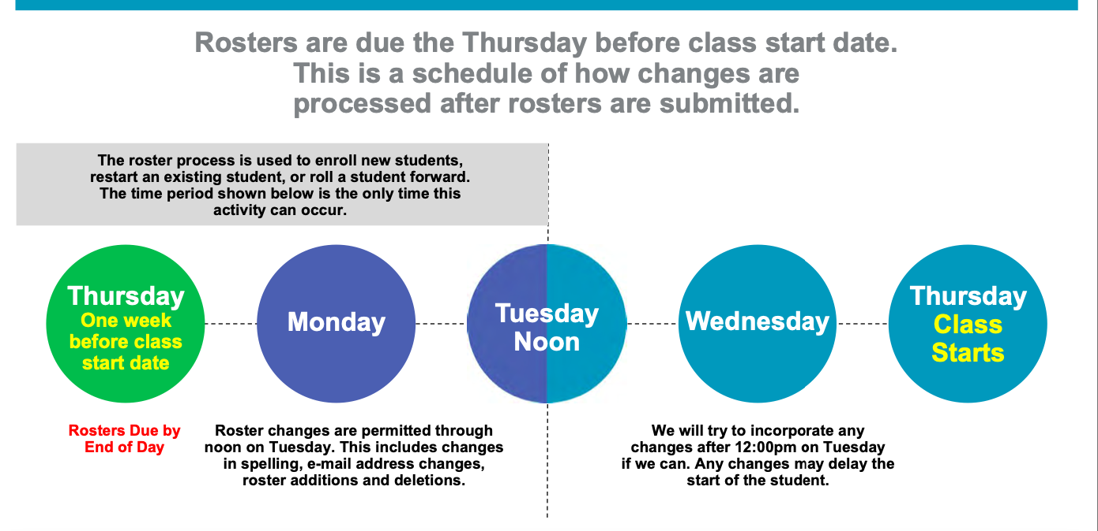
Roster Submission/Change Schedule
Notes:
Also located here, listed as a MAP Trainer Resource is the updated Certification Course Roster Submission and Change Schedule.

Slide 42
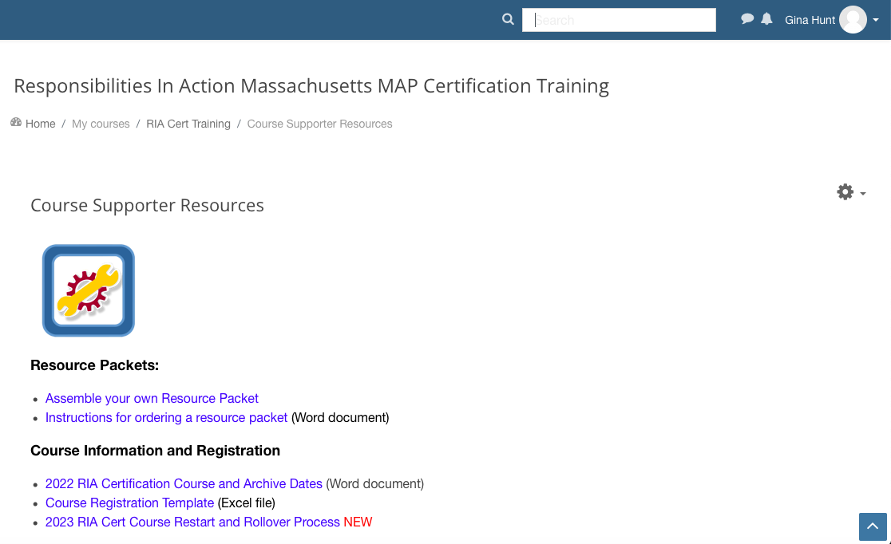
www.mapmass.com MAP Training Resources & Support
Notes:
Below the Student and MAP Trainer Resources, are the Course Supporter Resources.

Slide 43
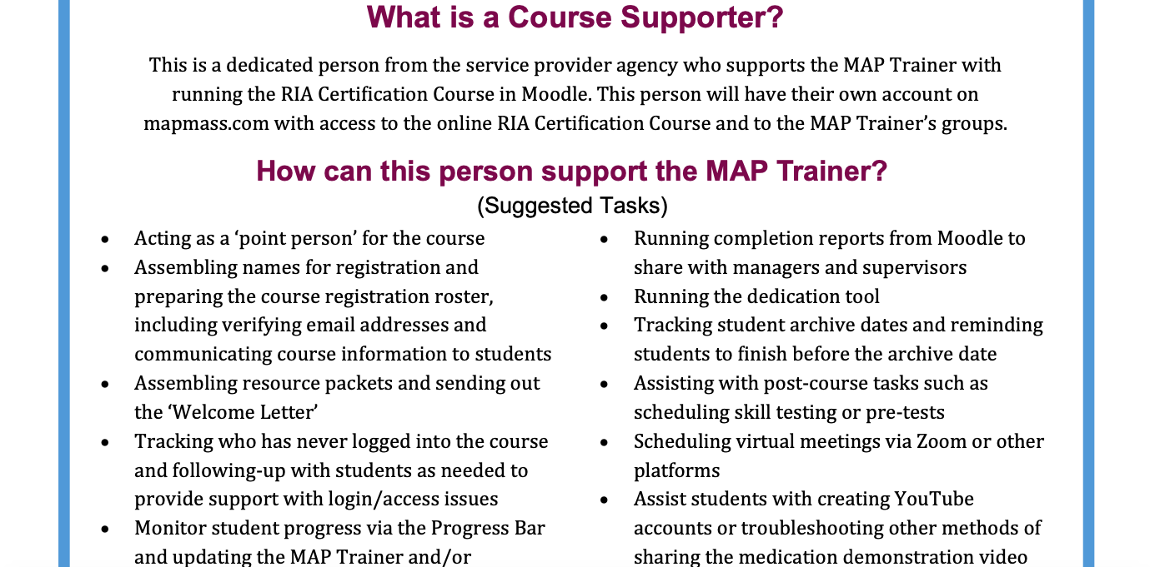
Course Supporter Role
Notes:
The Service Provider ‘Course Supporter’ may assist the MAP Trainer before, during and after the online Certification training.

Slide 44
Questions
Notes:
You’re encouraged to contact your MAP Coordinator if you have a question or need further clarification on a topic presented.
Thank you for listening.

