Slide 1
MAP Trainer Webinar
July 2022
Notes:
Welcome to the semi-annual DDS MAP Trainer webinar.
I’m Mary Despres, a Department of Developmental Services MAP Coordinator and I’m your webinar presenter.
By viewing webinars marked as ‘required’ within the specific time period, you’ll meet the MAP Trainer meeting ‘attendance’ requirement.
After the webinar, you’re encouraged to contact your MAP Coordinator if you have a question or need further clarification on a topic presented.

Slide 2
Agenda
What’s New
Reminders
Issues in the Field
D&S DT, Diversified Technologies
Updates
Notes:
On your screen are the agenda items that I will be covering today.

Slide 3
What's New
Medication Administration Program
Notes:
We will start with 'What’s New regarding the MAP Community'.

Slide 4

Welcome
Department of Public Health
Carolyn Whittemore, RN
New DPH Clinical Reviewer
Department of Developmental Services
Smita Chirayath, RN
Carminda Andrade, RN
Department of Mental Health
New DDS Northeast Regional MAP Coordinator
New DMH MAP Director
Notes:
Carolyn Whittemore, the former DDS Central West MAP Coordinator is now the DPH Clinical Reviewer. Carminda Andrade, the former DCF MAP Coordinator is now the DMH MAP Director. Also, Smita Chirayath is the new DDS Northeast Regional MAP Coordinator. We welcome them all in their new roles.

Slide 5
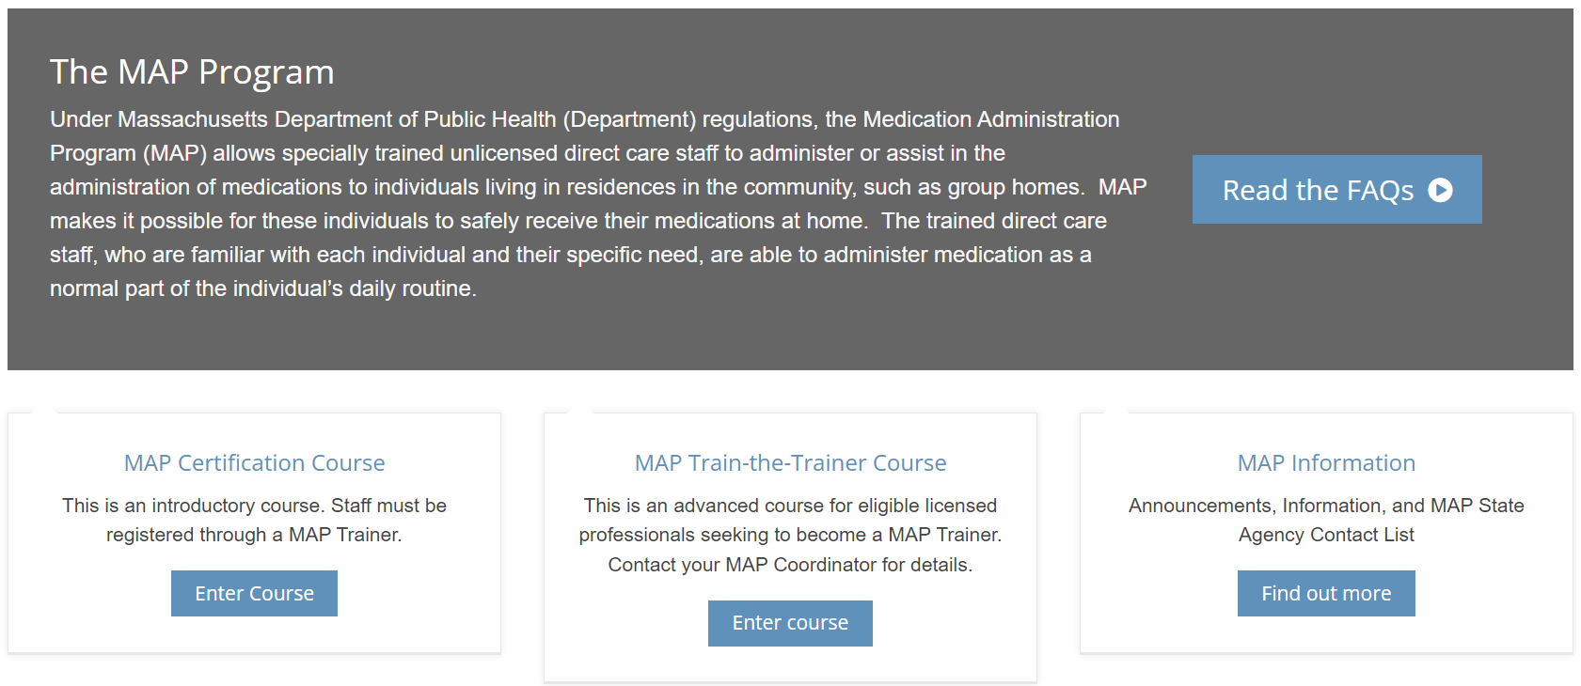
mapmass.com
Notes:
Their contact information can be found on the updated MAP State Agency Contact List. Historically, the list was referred to as the MAP Organizational Chart and an updated copy was attached to the Trainer webinars. Moving forward, the most current MAP State Agency Contact List can be found at mapmass.com by clicking on the bucket titled 'MAP Information'.

Slide 6
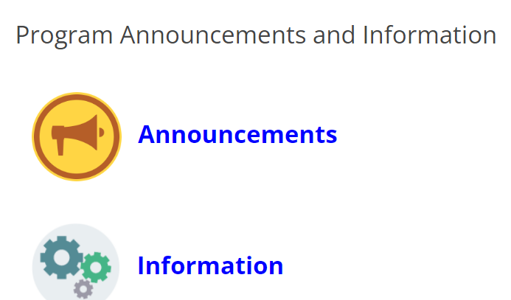
MAP Information
Notes:
After selecting 'Find out More', you can access any recent MAP Announcements and Information. Select ‘Information’ to see the available options.

Slide 7
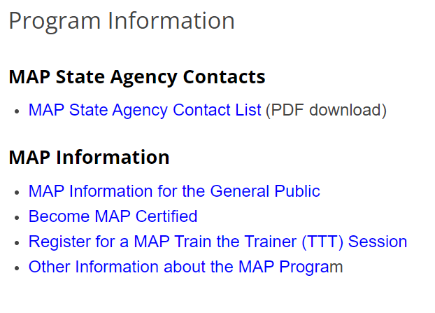
MAP Information
Notes:
Click on the 'MAP State Agency Contact List' to view the most current MAP State Agency Contacts.

Slide 8
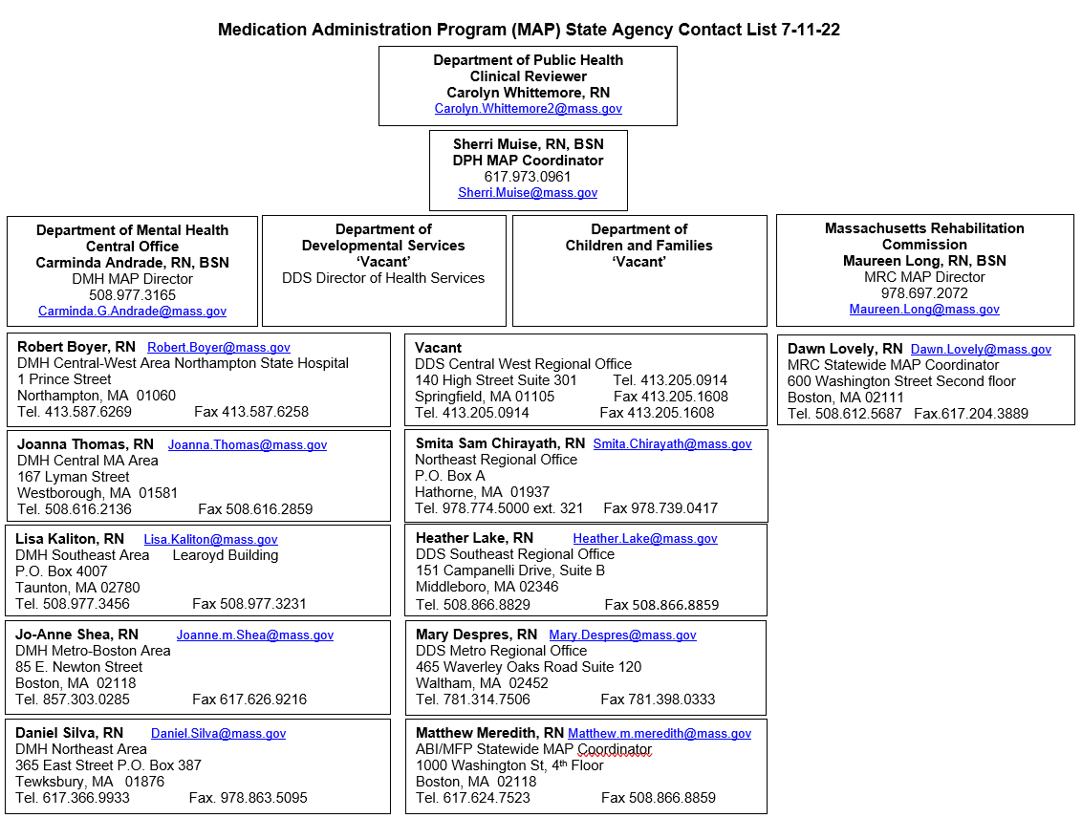
MAP State Agency Contact List
Notes:
The list will be updated as needed.

Slide 9
Eastern Research Group (ERG)
Contracted by Department of Public Health (DPH)
Evaluation period March 2022 through August 2022
ERG Report to Follow
Notes:
ERG is an independent consulting firm, contracted by DPH to evaluate the Medication Administration Program. The evaluation started in March 2022 and will continue through August 2022. Following the evaluation, ERG will prepare a report to include findings and recommendations.

Slide 10
New 'Course Supporter' Role
Online Certification Training
  'Course Supporter' Role
    Supports MAP Trainer
      mapmass.com account
        Access to MAP Trainer’s groups
Notes:
Now 'What’s New in Moodle’? There was a new role created for the MAP Certification Course-The Course Supporter. This is a dedicated person from the Service Provider agency who supports the MAP Trainer during the online RIA Certification Course. This person will have their own account on mapmass.com with access to the online RIA Certification Course and to the MAP Trainer’s groups.

Slide 11
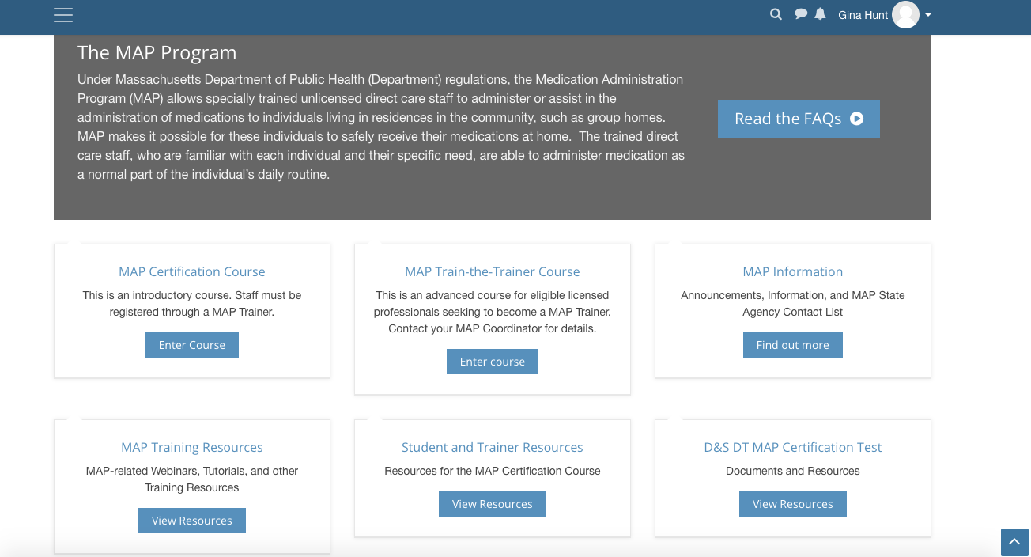
mapmass.com
Notes:
Course Supporter resources are available on mapmass.com in the Student and Trainer Resources 'bucket'. Click on 'View Resources'.

Slide 12
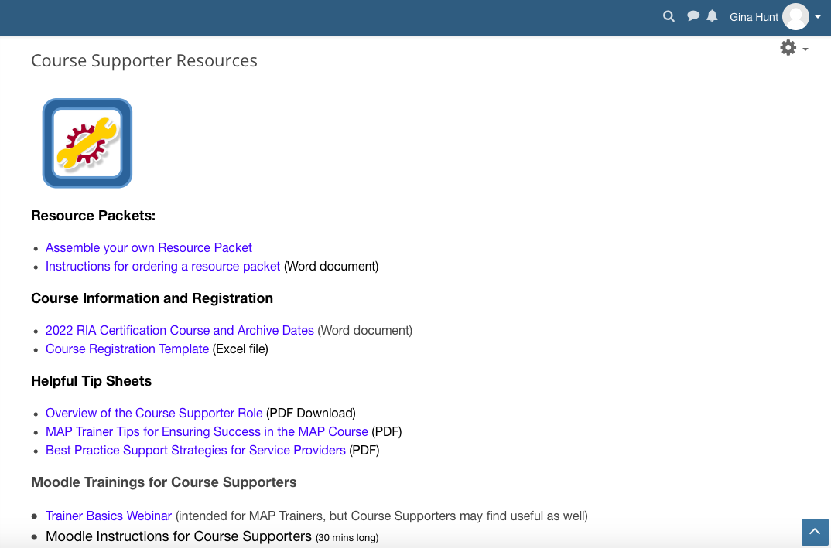
Notes:
This brings you to Student, Trainer and Course Supporter Resource options. When you select the Course Supporter Resources link, you see this screen.

Slide 13


'Course Supporter'
Notes:
The resources include an Overview of the Course Supporter role and Moodle Instructions for the Course Supporter. Having a Course Supporter can free up the Trainer to provide more instruction time to students as the ‘clerical’ component’ and following up student’s progress can be performed by the Course Supporter.

Slide 14
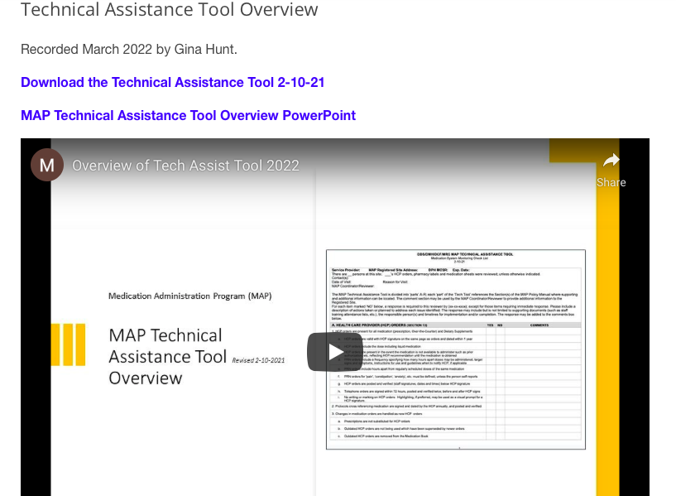
Webinar and Tech Tool
Notes:
Also new at mapmass.com, a webinar was completed to assist Supervisor’s managing a MAP Medication System. This webinar is part of the new Management of a Medication System Course that will be discussed later in the webinar. It is however available for others to view such as nurses providing oversight using the MAP Tech Tool or something similar. It reviews in detail each category and what is required based on MAP Policy and Procedure. The webinar is one hour in length and has a convenient table of contents identifying the different sections. There is also a downloadable copy of the Technical Assistance Tool for ease of reference.

Slide 15
mapmass.com
Notes:
The webinar can be found at mapmass.com in the MAP Training Resources bucket by clicking on 'View Resources'.

Slide 16
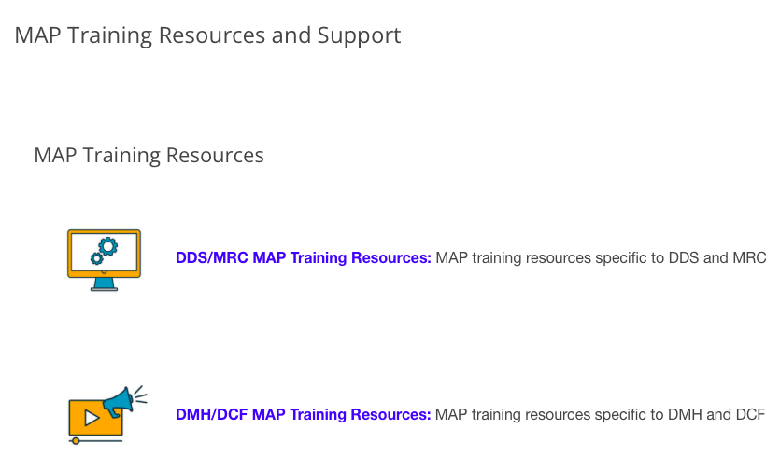
MAP Training Resources
Notes:
Then click the agency specific MAP Training Resources link.

Slide 17
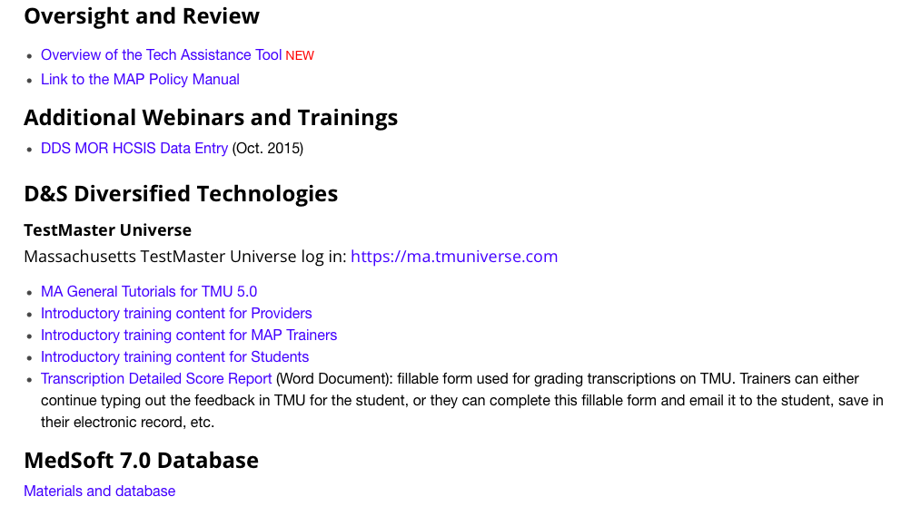
Oversight and Review
Notes:
Once there, scroll down and click the 'Overview of the Tech Assistance Tool' link.

Slide 18
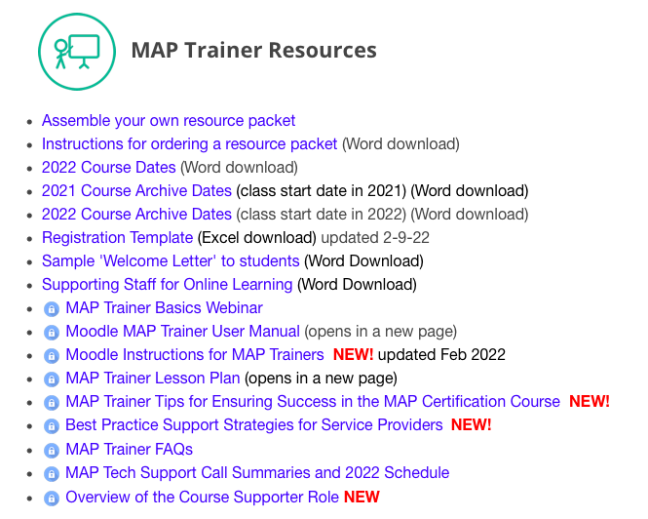
Trainer Resources
Notes:
Speaking of new resources, it’s advisable that you frequently visit the MAP Trainer Resources at mapmass.com as new items continue to be added or updated. They will be highlighted 'NEW' in red. We will continue to notify you via email or the semi-annual required Training webinars of any updated or new training material, but a frequent visit will ensure that you are aware of any changes as they occur.

Slide 19
Reminders
Medication Administration Program
Notes:
Now for Reminders

Slide 20

Curriculum
Notes:
In the last webinar, it was stated that copies of the new Curriculum (revised Sept 2020) would need to replace the older copies of the Curriculum by July 1, 2022. We have since extended that deadline to December 30, 2022. The Curriculum was updated in 2020 and is a great resource with the addition of more exercises, graphics and a detailed Appendix depicting many of the issues involving medication administration at MAP sites. The curriculum can be downloaded for free at mapmass.com or ordered from Amazon.

Slide 21
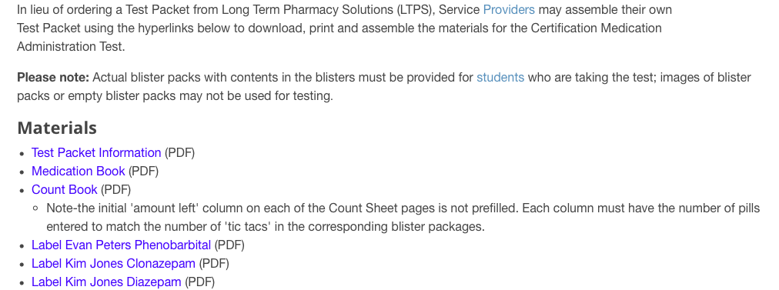

Certification Testing Process Supplies
Notes:
Certification Testing Process Supplies. There have been reports of the inappropriate use of Certification Test supplies. The test supplies may not be used to practice and/or to complete the pretest component for medication administration. Test supplies may only be used for the Certification Testing Process. The supplies can be ordered from Long Term Pharmacy Solutions or assembled using the hyperlinks located at the 'D&S DT MAP Certification Test' bucket at mapmass.com.

Slide 22
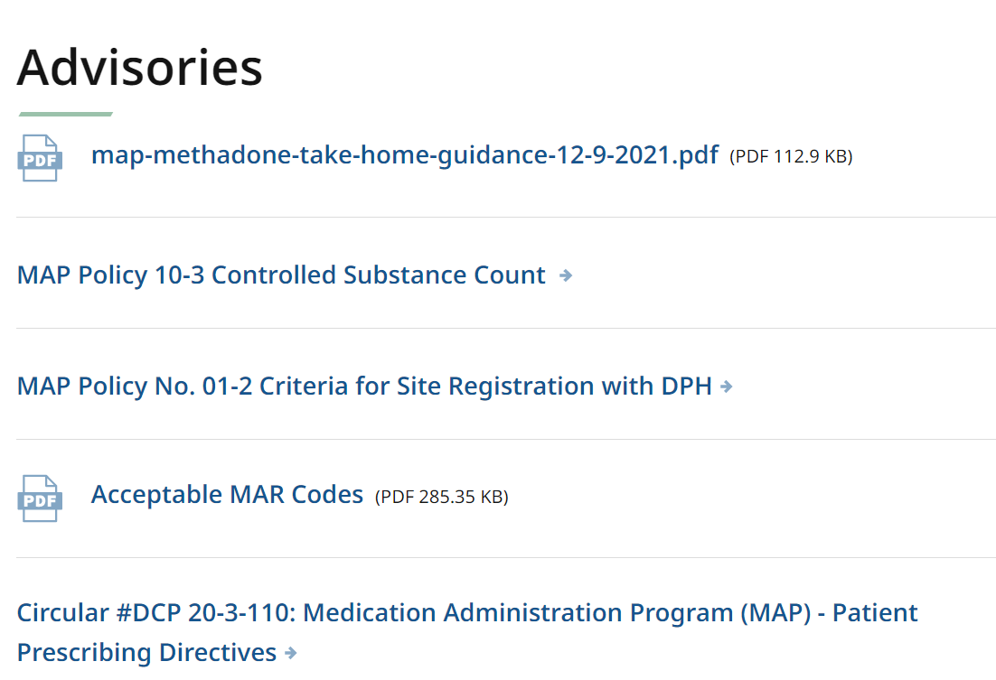
Policy Manual and Advisories
MAP Policy Manual
  under revision
Advisories
  www.mass.gov/dph/map
  check frequently for updates
Notes:
The MAP Policy Manual remains under revision but until it is finished, DCP DPH issues Advisories relating to pertinent issues or updates to existing MAP Policies. It is a reference requirement that the Advisories be available for review along with the MAP Policy at each MAP Registered site. Advisories can be downloaded using the MAP friendly URL, then under the heading What You Need to Know, select ‘MAP Resources’. You will see a list of all the current Advisories or updated Policies that can be easily downloaded. For example, the most recent Advisory, which is at the top of the list on the screen, was regarding Methadone Take Home Guidance and dated 12/9/21.

Slide 23
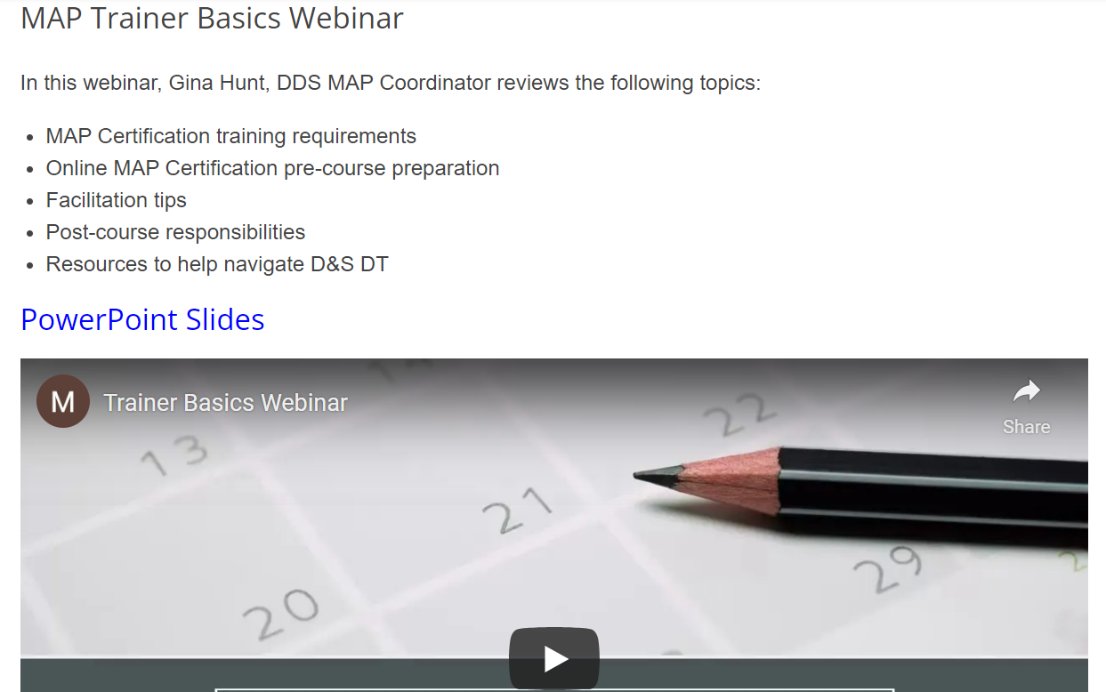
MAP Trainer Basics
Revisit
Step by Step
  How to
    Prepare
    Conduct and
    Complete online course
Notes:
Another reminder, if it is has been a while since teaching your last Certification Course, this webinar which was created last year is a great review and goes through step by step how to prepare, conduct and complete a MAP Certification course. It has a convenient table of contents at the beginning of the webinar that correlates to the slides and sections covered, if you need to only review specific training actions.

Slide 24
Issues in the Field
Medication Administration Program
Notes:
Now we will review some Issues in the Field.

Slide 25
Verifying Countable Medication Refill
MAP requires 2nd Certified staff verify a countable medication refill
Staffing issues may prevent from occurring at time of delivery
Verification process must be completed in ‘real time’
May be completed later when MAP staff is available
Notes:
Verifying Countable Medication Refill. There may not be another MAP staff available to verify the amount received of a Countable medication when delivered. The expectation is that as soon as another MAP staff is available, they will verify the amount and document. Staff should not leave a space for this documentation but instead it should be completed in real time.

Slide 26
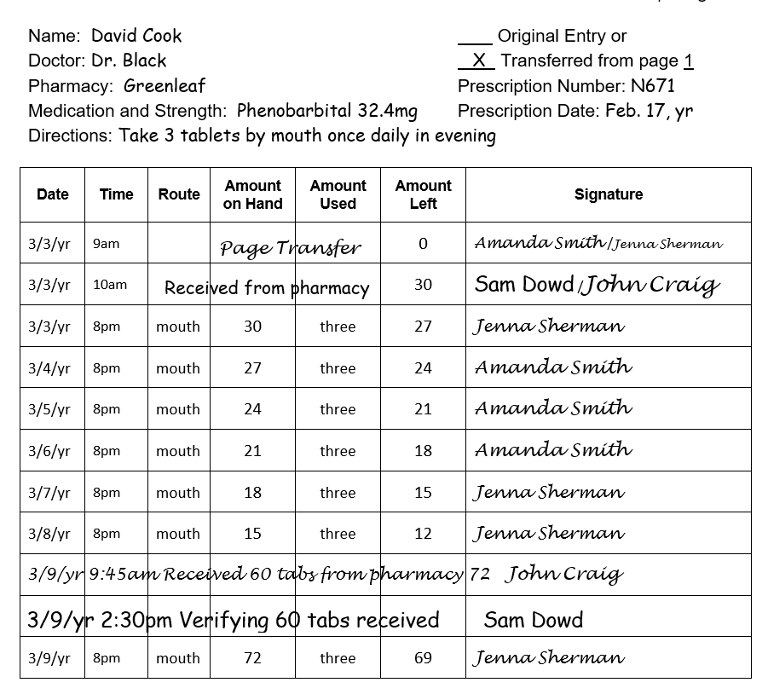
Count Book Documentation
Notes:
On the screen is an example of ‘real time’ documentation. On 3/9/yr at 9:45am, John Craig documented that he received 60 tabs from the pharmacy. There was no other MAP staff on site until Sam Dowd came in later that day. On 3/9/yr at 2:30pm, Sam Dowd documented “verifying” 60 tabs received.

Slide 27
Prescription Renewal
HCP Requirement
  Telehealth or in person visit
    before prescription renewal
Result
  omission of medication
  submission of MOR form
Recommendations:
  contact HCP for prescription renewal when ‘1’ refill remains
  implement tracking system for HCP visits
    Calendar, Scheduling Log, etc.
  obtain an HCP Order
Notes:
Prescription Renewal: There has been an upward trend in medication omissions due to the HCP requiring the individual to be seen before a prescription renewal is granted.
For example, staff notice “0” refills when logging in a medication. Immediately, the HCP is contacted to request a prescription be submitted to the pharmacy. However, the HCP will provide a prescription only after the person is seen via Telehealth or in-person. As a result, there are omissions because the medication ran out prior to the office visit.
Recommendations to consider include:
Contacting the HCP for a renewal when there is ‘1’ refill remaining instead of ‘0’.
Implementing a tracking system to monitor HCP appointments.
And when the HCP is contacted regarding the need for the refill and the HCP requests the visit, have staff inquire and obtain an HCP order to ‘hold’ the medication until the visit can take place or request a partial refill to cover the needed administrations until the visit can take place.

Slide 28
Blank Space on MAR
Medication Occurrence
  Determine if medication was not administered i.e.,
    review blister pack
    ask staff responsible for administration medication etc.,
  If determined medication was not administered
    Submit MOR
Notes:
Blank Space on an MAR: When a blank space is noted on the medication grid where the staff should have documented the medication administration status, it is not automatically considered an MOR. An omission needs to be conclusively determined as the medication may have been administered but not documented. Ways to verify an omission include reviewing the blister pack (if blister pack monitoring is used) or asking the staff responsible for the medication administration if the medication was administered.
If blister pack monitoring confirms that the medication was not administered or the staff verbally admits the omission, then it would be considered an omission and an MOR is submitted. However,

Slide 29
DDS Only
Blank Space on MAR
Medication Issue
  If it cannot be conclusively determined that the medication was not administered i.e.,
  blister pack monitoring not used
  no verbal admission by staff
  staff cannot remember
  etc.,
  Not an MOR but a Medication Issue requiring:
  documentation of issue
  responses to lessen the chances of the issue recurring, i.e.
    follow up staff training/retraining
    closer monitoring of MAR documentation
    etc.,
Notes:
Currently for DDS individuals, if it cannot be conclusively determined that the medication was not administered, it is a Medication Issue that requires documentation of the issue and responses to lessen the chances of the issue recurring. In this case, possible staff retraining regarding documenting administration on MARs and/or closer monitoring of MARs to discover any blank spaces in a timely manner for follow up.
For DMH, MRC and DCF individuals, this would be considered a Medication Occurrence and an MOR would need to be filed.

Slide 30
D&S DT, Diversified Technologies
TestMaster Universe (TMU©)
Notes:
Now for some information regarding D&S.

Slide 31

TestMaster
Universe
(TMU©)
Updated Students Screen
  Expanded Sorting Capabilities/Filters
Notes:
When accessing TMU, you may notice your Students screen looks a little different. It was updated to include easier to use and more detailed sorting options. Simply select Filters….

Slide 32
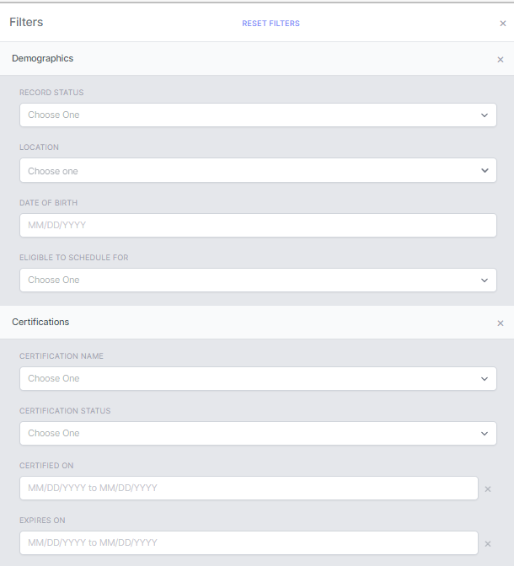
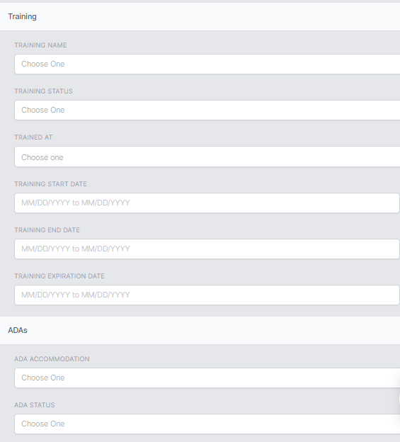
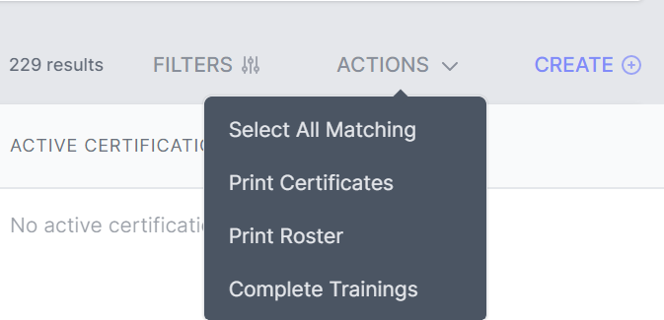
Notes:
and using the drop-down menu you can select sorting options regarding Demographics, Certifications, Training or ADAs. After selecting your filters and searching your student database, you can print Certificates, a roster or complete trainings for the sorted group.

Slide 33

www.hdmaster.com
Notes:
Remember, each student must receive a Candidate Handbook. The Handbook is frequently updated with information regarding testing policies and procedures, so be sure to provide the most updated version to students. The latest is Version 14 Dated March 15, 2022. It can be downloaded from the D&S website listed on the screen and then clicking on ‘Massachusetts MAP Testing & Registry’.

Slide 34
Testing Issues
Medication Sheet
  Initials
    Correspond with Legal Name
    Legible
Count Sheet
  Signature
    Full First and Last Name
    Legible
Notes:
The D&S Massachusetts Team has identified the most recent testing issues. The initials staff use to document medication administration must be the same first letters of the legal name used for identification purposes. For instance, if the staff is referred to as 'Peggy' by her coworkers and friends, however her legal name is 'Margaret Jones', 'MJ' must be used when documenting, not 'PJ'. If the initials used do not match the legal name, the med sheet is marked as incorrect.
When staff are documenting their signature on the Count Sheet page, a signature is defined as a full first and last name; the use of staff's initials is not acceptable and if used in place of a signature is marked as incorrect.
All documentation must be legible. A Tester will not 'interpret' what a staff meant to write; the documentation is marked as incorrect.

Slide 35
Testing Issues
Count Sheet page
  Spelling
    Route
    Numbers
  Documentation
    missing ‘a’ or ‘p’ on time entry
      i.e., 4m or 8m instead of 4pm or 8am
Notes:
Additional issues involve spelling and incomplete documentation. Remind students to copy the information exactly as written. Misspelling the 'route' continues to be an issue. If staff spell numbers for the amount of medication on hand and the amount left, this is acceptable as long as the word is spelled correctly. If an incomplete time is documented, the time is marked as incorrect.

Slide 36
Testing Issues
Medication Administration Process
  3 Checks of the 5 Rights
    Verbalize and Point
Notes:
The biggest issue identified by D&S by far involves the Medication Administration Process demonstration. In general, many candidates do not point to where information is found and/or verbalize the 5 Rights as they complete the 3 Checks.
Many times, the person's name is not verbalized and pointed out during Check 2 and Check 3. Other times, the name is stated from memory and the entire time the candidate's hand is hovering over the lower portion of the med sheet.
Another repeat mistake involves completing Check 3 before popping the medication or staff complete a Silent Check instead of Check 3 after popping the medication. Finally, some candidates simply don't make comparisons and just randomly say things.
Please use this information to enhance your training and practice session of the Medication Administration Process for improved testing outcomes.

Slide 37
Onsite
Test Proctor
  Medication Administration Documents to D&S
  Recommendations
    Flat Surface
    Separate images
Notes:
And finally, D&S has asked Onsite Test Proctors to assist with improving the clarity of documents sent to D&S for grading. One suggestion is to place the document on a flat surface to photograph. It is also preferred that each document is photographed separately.

Slide 38
Updates
Medication Administration Program
Notes:
Our last topic is Updates. In the previous webinar, two new online courses were mentioned as in process of development.

Slide 39
New Online Course
Management of a MAP Medication System (MMMS)
Audience:
Launch Date:
www.mapmass.com
MAP Certified Site Supervisors
6-8-22
Location:
Notes:
The first course, Management of a MAP Medication System, is designed for MAP Certified Site Supervisors. The course identifies the four specific responsibilities of a Site Supervisor and much more. The course takes approximately 3 hours and 15 minutes to read every page and do every activity. It concludes with a 1-hour Tech Assist Tool webinar overview. A 'Certificate of Achievement' is available upon completion of the course. Supervisors or interested parties can go to the mapmass website and the registration information is in the blue bar at the top of the homepage.
Licensed staff may also find the course beneficial.

Slide 40
New Online Course Pending
Overview of the Medication Administration Program
Audience:
Launch Date:
Location:
Office of Quality Enhancement
Investigations
Disabled Persons Protection Commission
Executive Directors
Coming Soon
www.mapmass.com
Notes:
The second course, the Overview of the Medication Administration program is for anyone interested in general information about the Medication Administration Program. An announcement will be sent out prior to the launch date, with information regarding how interested parties can register for the course.

Slide 41
Completion of MAP Certification Online Course
9 Units and
Corresponding Quizzes
‘Face-to-Face’ Session or Sessions (Virtual or In-Person)
Status re: Required 'Blended' MAP Certification Training
Skills Content
Review/Practice/Pretest
Medication Administration
Transcription
Notes:
Also mentioned in the last webinar, the requirement of a 'Blended' MAP Certification Training continues to be under review by the MAP Administrators. A set of guidelines and optional PowerPoint training material will be posted on the mapmass website once finalized.

Slide 42
Transcription Training will remain
Status re: Removal of Transcription Test Component from Certification Test
Certified Staff Responsible for Transcription
Trained by Service Provider specific to system used
MedSoft
Pharmacy Generated Med Sheets
Etc.
Certification
Notes:
Removing the transcription test component requirement from the MAP Certification Testing Process continues to be under review by the MAP Administrators.
Once removed, Certified staff responsible for transcribing, posting and verifying and monthly accuracy checks, will receive training from the Service Provider specific to the system used in their organization.

Slide 43
Status re: Shortened Training and Testing Timeline Proposal
Decreasing MAP Training completion from six months from training start date entered in TMU
Decreasing MAP Testing completion from six months from training end date entered in TMU
Notes:
Shortening the training and testing timelines continues to be under review by the MAP Administrators.
The proposal is based on statistics reflecting that staff have a higher probability of finishing their MAP Certification training and successfully passing the Certification tests when completed in a shorter timeframe.

Slide 44
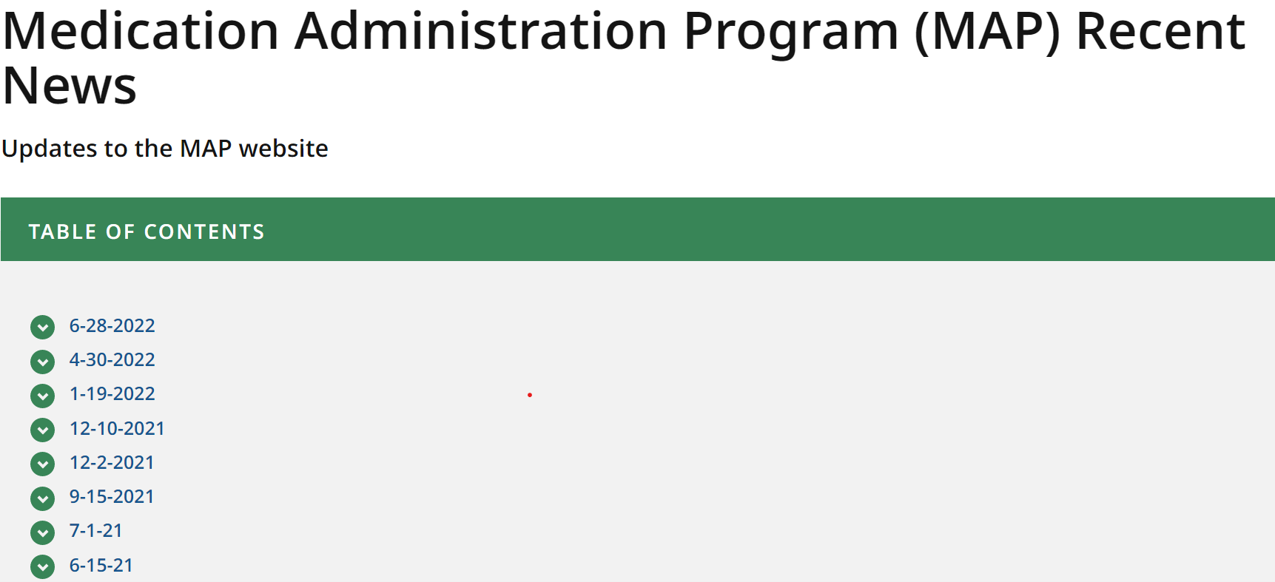
MAP Flexibilities Status
Flexibilities
  Extended to December 31, 2022
  Others continue to have Waiver Options
Most updated information at
  www.mass.gov/dph/map
    ‘What’s New: MAP Recent News’
Notes:
MAP flexibilities that were created during the COVID-19 emergency period to reduce barriers have been extended to December 31, 2022, and others continue to have waiver opportunities. The most current information is listed by date of order, notice, or advisory by accessing the MAP friendly URL, listed on the screen and then selecting ‘What’s New: MAP Recent News’.

Slide 45

Electronic Health Record (EHR)
Specification Document
  List of Required Components for an EHR/eMAR in Compliance with MAP Policy
  Initially distributed to Service Providers looking for participation in Pilot Program
    Project on hold
Notes:
The Electronic Health Record Work Group developed a specification document that listed the required components for an Electronic Health Record EHR or eMAR to meet MAP Policy Requirements. It was distributed in anticipation of starting a Pilot Program, however, the project is currently on hold while a DPH funded consultant reviews MAP Policies for safety and efficiency. This could lead to significant changes in the specification document.

Slide 46
Next MAP Trainer Webinar
Fall/Winter 2022
Notes:
This concludes the July 2022 MAP Trainer webinar. If you have any questions regarding topics presented today, please contact your area or regional MAP Coordinator.
The next MAP Trainer Webinar will be in the Fall or Winter of 2022.

