Slide 1
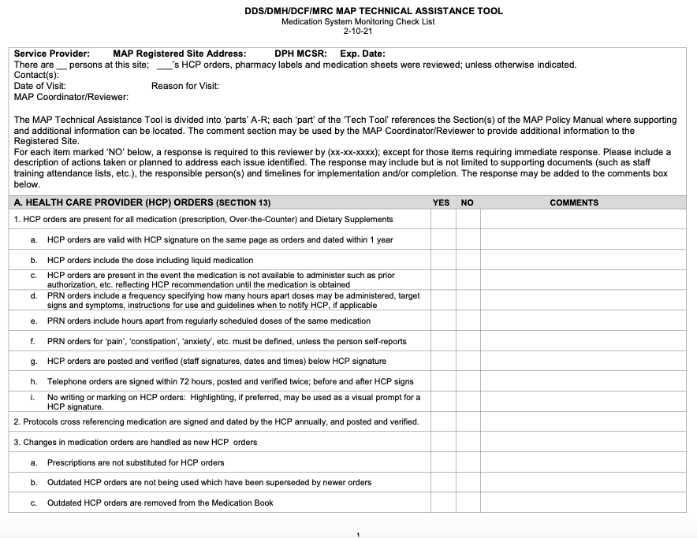
MAP Technical Assistance Tool Revised 2-10-2021 Overview
Medication Administration Program (MAP)
Notes:
Welcome to the MAP Technical Assistance Tool Overview.
The document itself, known as the Tech Assist Tool, is posted with this webinar for your convenience.
I’m Gina Hunt, a Department of Developmental Services MAP Coordinator and I’m your webinar presenter.
MAP Certified Site Supervisors are the target audience for this overview.
A Site Supervisor is defined as the managerial staff, for example, House Manager, Residential Supervisor, Program Supervisor, etc.; responsible for supervising other Certified staff.
The Site Supervisor has the responsibility for
assigning the task of administering medications
being present and signing as a witness for disposal of all expired and/or discontinued medication
ensuring that the ‘Index’ of the Countable Controlled Substance Book is accurate and
completing the supervisory review of all medication occurrences.
If you’re a Registered Nurse, whose job duties include oversight of med systems or a licensed practical nurse who may assist an RN, and use the exact tool or a variation, you may find the overview useful as well.

Slide 2
Tech Assist Tool Sections
Section A Health Care Provider Orders
Section B Over the Counter (OTC) Method B, if applicable
Section C Vital Signs
Section D Medication Documentation
Section E Staff Certification
Section F Ancillary Practices
Section G Countable Controlled Substance Packaging
Section H Countable Controlled Substance Documentation
Section I Transitioning to Self-Administering, if applicable
Section J Self-Administering, if applicable
Section K Leave of Absence (LOA) and other Off-Site Administration
Section L Medication Ordering/Receiving
Section M Storage and Security
Section N Mass Controlled Substances Registration
Section O Medication Disposal
Section P Program Resources
Section Q Provider Policies and Procedures
Section R Medication Occurrence Reports
Notes:
On your screen is a quick reference guide to locate the various topics and corresponding sections of the Tech Assist Tool.
Ultimately, you, the Site Supervisor are responsible for managing the medication system.
The purpose of a medication system is 2-fold; to protect the people you support and staff, by ensuring safe medication administration.

Slide 3

Objectives
Technical Assistance Tool
  Familiarization
Access MAP Resources
  Required
  Informational
  Training
Notes:
The goals for today’s webinar are:
to provide you with a general overview of requirements in a DPH MAP Registered site using the Tech Assist Tool as your guide and
to know where to access online MAP resources.

Slide 4
Medication System
Evaluation
Tech Assist Tool
  Evaluates medication system
    Sections within tool
      Correspond with MAP Policies
Notes:
The management of a medication system requires continuous monitoring to ensure regulatory compliance.
Monitoring will be completed routinely by you, the Site Supervisor and in the form of oversight by Service Provider licensed staff.
You may experience monitoring by the Department of Public Health MAP Coordinator or Clinical Reviewer.
In addition, monitoring of MAP Registered sites is completed at differing frequencies by the MAP Coordinator of the applicable sister agency, the Department of Developmental Services (DDS), Mental Health (DMH), Children and Families (DCF) and the Massachusetts Rehabilitation Commission (MRC).
All state agency MAP Coordinators use the Tech Assist Tool to evaluate a DPH MAP Registered site’s med system for safety.
As I move through the slides, you’ll notice that the bottom right corner of each ‘section’ slide has the corresponding MAP policy reference.

Slide 5
Section A
Health Care Provider (HCP) Orders
MAP Policy Section 13
Notes:
There must be an HCP Order present for all medication (prescription and Over-the-Counter) as well as Dietary Supplements.

Slide 6
Valid HCP Orders
‘5 Rights’
Person
Medication
Dose
including liquid meds
Time
‘once daily’ further clarified
Route
Dated
Within 1 Year
Acceptable Signatures
Name
Allergies
Wet
Image
Electronic
Notes:
There is no required HCP Order form, however, there are HCP Order form requirements.
Specific to the ‘5 Rights’, as you know, the HCP orders the ‘dose’ of the medication, typically in milligrams.
This should include if the medication is in a liquid form.
For example, the dose for an order for Milk of Magnesia would be expected to be written as 2400 milligrams and not 30 milliliters.
Each page of orders must be signed and dated within 1 year by the HCP.

Slide 7

Medication Ordered but Not Available
HCP Order present
  Reflects HCP recommendation
    until medication obtained
Notes:
If a medication is ordered by the HCP and there is a delay in obtaining the med from the pharmacy for any reason, such as when prior authorization is needed from an insurance company, if a parent or guardian consent is required, or if an antipsychotic med prescribed requires court approval under a Rogers Decision; you must contact the HCP immediately and obtain orders stating what should be done until the medication is obtained.
If you don’t obtain an HCP Order, the omitted doses are considered med occurrences.

Slide 8
PRN Medication HCP Order Details
Measurable Objective Criteria
when needed
Parameters for Use
Frequency
Target Signs and Symptoms
hours between doses
Notes:
When monitoring the medication system, there are additional details required in a PRN medication HCP Order.

Slide 9
PRN HCP Order Details
Hours apart doses may be administered
Hours apart from regularly scheduled doses of same medication, if applicable
Example
‘Do not give within 4 hours of regularly scheduled dose’
Examples
every 8 hours PRN
three times daily PRN, must separate doses by at least 6 hours
Notes:
The frequency in a PRN medication order must specify how many hours apart the doses may be administered.
In addition, the frequency in a PRN medication order must specify how many hours apart the PRN med doses may be administered from regularly scheduled doses of the same med, if applicable.

Slide 10
PRN Medication HCP Order Details
Reason Ordered
Measurable Objective Criteria
Headache
Parameters for Use
If 3 doses are administered within 24 hours, notify HCP
Headache defined as ‘head slapping for more than 5 minutes’
Constipation
Constipation defined as no bowel movement (BM) in 3 days
Target Signs & Symptoms
Self reports ‘headache’
Self reports ‘constipation’
Contact HCP if no BM by next morning
Notes:
A PRN medication may only be administered for the target signs and symptoms ordered by the HCP.
If the person doesn't self-report, for example, constipation, the order must include target signs and symptoms in the form of measurable objective criteria, requiring data collection to cross-reference to determine whether to administer the medication.
In addition, the HCP Order should include guidelines to follow so that staff know what to do if the medication is administered and not effective.

Slide 11
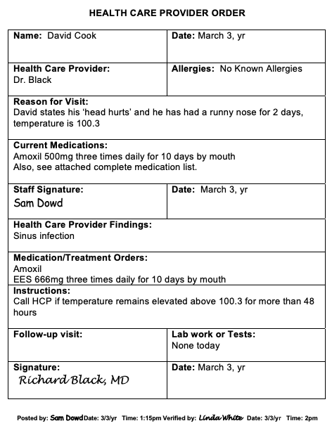
HCP Orders
  Posted and Verified
    Below HCP Signature
      Staff signatures
      Dates
      Times
Notes:
All HCP Orders must be reviewed to ensure they were posted and verified.
This includes orders for lab work, or when the HCP notes, “no new orders” or “no medication changes”.

Slide 12
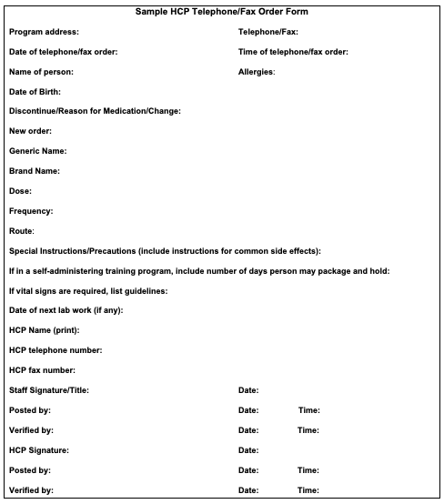
HCP Telephone/Fax Order
Signed by HCP
  within 72 hours
Posted & Verified
  twice
Notes:
Telephone orders should be reviewed to ensure they were posted and verified twice, and that the HCP signed the order within 72 hours.
You’ll also want to review supporting documents of efforts to obtain the HCP signature within the 72-hour time frame, if applicable.

Slide 13
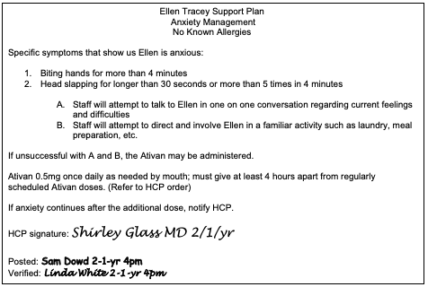
  Protocol HCP Order
Signed and Dated Annually by HCP
Posted and Verified
Notes:
A protocol is considered an extension of an HCP order.
Any time there’s a protocol which provides details regarding med administration, the protocol must be signed and dated annually by the HCP; as well as posted and verified.

Slide 14
Health Care Provider Orders
HCP Order Change
Prescription
Handled as new Order
Outdated HCP Order
Removed from Med Book
Not used in place of an order
Notes:
When there’s any change in an HCP Order, the old order is marked as discontinued, and the new order is transcribed onto the med sheet.
A prescription may not be substituted for an HCP Order.
You want to review that:
outdated HCP Orders are not being used which have been superseded by newer orders and that
outdated HCP Orders are removed from the Medication Book.

Slide 15
  Medication Reconciliation
  Comparison of
    Hospital Discharge Orders to
    HCP Orders prior to admission
      Before person is discharged home
Notes:
After a hospital admission, before a person is discharged, medication reconciliation is required.
Medication reconciliation is comparing the hospital discharge HCP Orders to the HCP Orders in the person’s home, prior to admission.
Any discrepancies must be clarified with the HCP.
Medication reconciliation ensures that new medication ordered during a hospital stay is not omitted when the person returns home.
It also ensures medication discontinued during a hospital stay is not administered when the person returns home.
Because the HCP Orders prior to the hospital admission are no longer valid, review to ensure hospital discharge HCP Orders were transcribed.
Review to check if the PCP and any other prescribing HCPs were contacted to ask if they wanted any previously ordered medications reordered.
If the answer was yes, those orders will have been re-written.
If a person was learning to self administer prior to the hospitalization, they may not resume packing the medications under the old HCP Orders.
HCP Orders from all providers who prescribe medications must be received before the person may prepare their meds for self administration.
An emergency room visit is not considered a hospital admission.

Slide 16
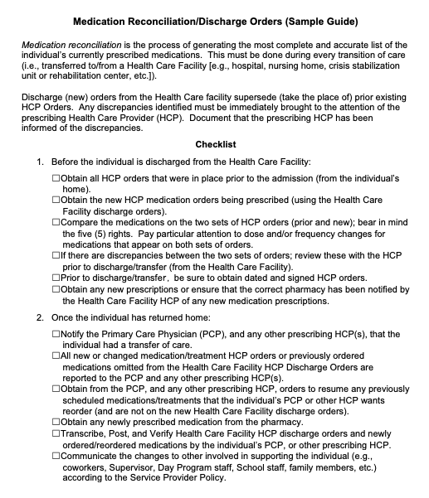
Medication Reconciliation
Discharge Checklist
Notes:
There’s a Medication Reconciliation Discharge Checklist available, located in Section 13 of the Policy manual.
It was created as a tool to help you in the event of a hospital discharge.

Slide 17
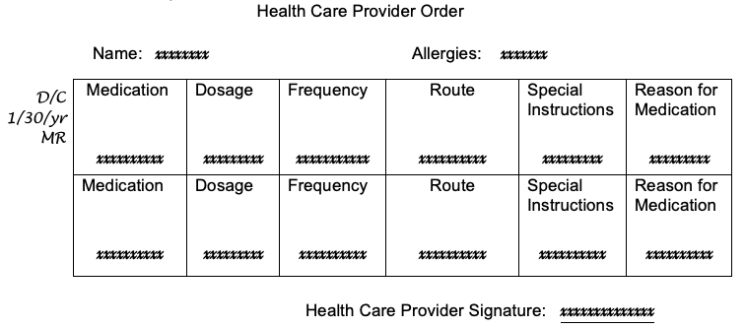
  Health Care Provider Orders
HCP Order forms listing multiple meds
  If med DC’d
    Staff may print in margin
      DC, date, initials and
      ‘see new order’, if applicable
Notes:
If an HCP Order form contains multiple medication orders, and one of the orders is DC’d or is superseded by a newer order, staff may indicate the change by marking in the margin of the HCP Order, near the specific medication, by writing ‘DC, the date and their initials’.

Slide 18
Notes:
Other than what was mentioned on the previous slide, your review should ensure that there is no other marking or writing on HCP Orders.
Highlighting, if preferred, may be used as a visual prompt for an HCP signature.

Slide 19

  Exhausting Current Medication Supply
New medication HCP Order
Verify with Pharmacist
Notes:
If there is a new HCP order to change the dose or frequency of a medication a person is currently on, it is acceptable to exhaust the current supply of medication until the new prescription is filled.
Staff must verify with the pharmacist that the medication strength on hand may be used according to the new prescription directions.

Slide 20
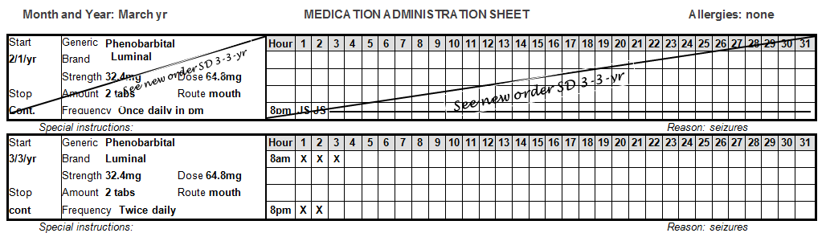
  HCP Orders
  Old Order
    Discontinued
  New Order
    Transcribed
Notes:
The old order must be marked as DC’d, and the new order transcribed.

Slide 21
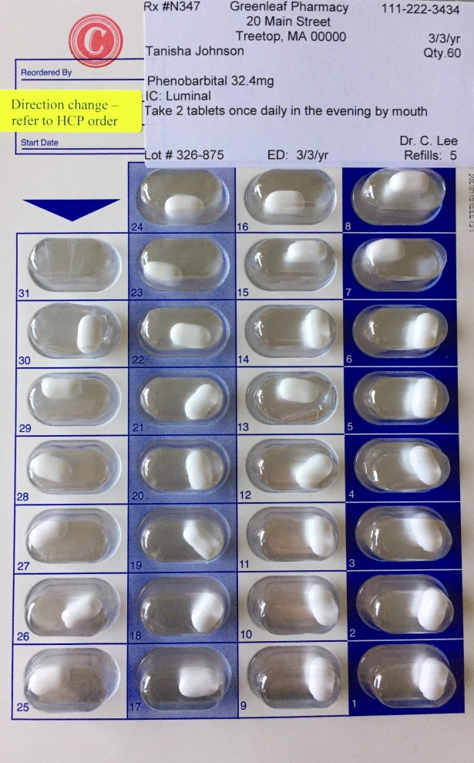
HCP Orders
  Medication Container
    ‘Directions Change’ sticker
Notes:
In addition, the medication container should have a ‘directions change’ or brightly colored sticker that does not cover the label directions.
Within 30 days of receiving the new HCP Order, the pharmacy label must reflect the new order.

Slide 22

  HCP Orders
Health Care Provider Order
Name: | Date:
Health Care Provider: | Allergies:
Reason for Visit:
Current Medications:
Staff Signature: | Date:
Health Care Provider Findings:
Medication/Treatment Orders:
Instructions:
Follow-up visit: | Lab work or Tests:
Signature: | Date:
HCP Orders
Pharmacy Labels
Medication Sheets
  Must Agree!
Pharmacy
Label
Medication Sheet
Notes:
During your review, when compared, HCP Orders, pharmacy labels and medication sheets must agree.
The medication name, as it appears on the HCP Order, must be printed on the pharmacy label and the medication sheet; letter for letter.

Slide 23

Internal MAP Monitoring System
Checklist
Blister Pack Monitoring
Notes:
When conducted routinely, your internal MAP monitoring system will help to ensure that the site you manage meets all regulatory requirements.
There are no specifics of what your system should consist of, or how often you should monitor, however, the most common systems include a simple checklist (with a monitoring timeline built in), in conjunction with Blister Pack Monitoring to ensure medications are administered as prescribed.

Slide 24
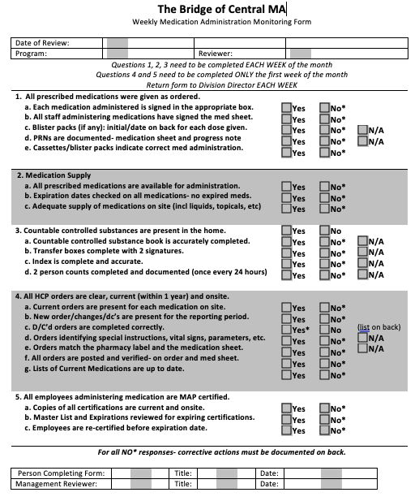
Checklist
Notes:
Although not as detailed as the Tech Assist Tool, there are multiple sample checklists available from your MAP Coordinator that can be modified as needed.
When you identify an area as requiring corrective action, your checklist should have a section to indicate who’s responsible, the corrective action planned, and the target date of completion.

Slide 25
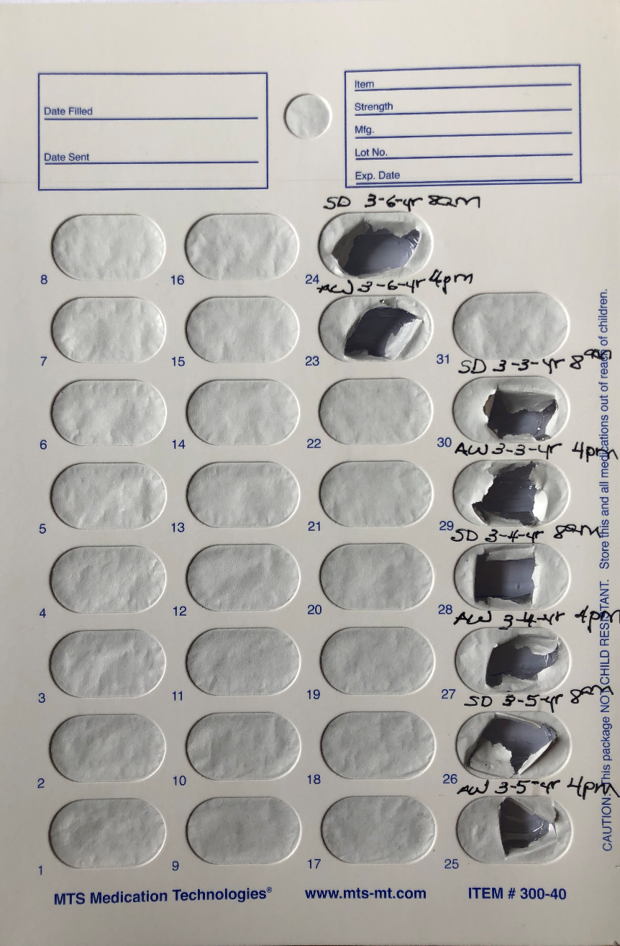
Blister Pack Monitoring
Notes:
Although not required, many Service Providers include ‘Blister Pack Monitoring’ as part of their internal monitoring system.
It’s a very effective method used to determine whether meds were administered as prescribed.
If used, staff initial, date and time only on the back of the blister package each time a tablet was removed.
The packages are then routinely reviewed by you, the Site Supervisor and/or the oversight nurse.
Some Site Supervisors choose to monitor daily, especially when there have been issues; many review the packages at least weekly.
Ensure Count Book page numbers are not written on blister packs.
When blister pack monitoring is used, you should remind staff to look at the set of documentation before theirs.
If they notice there’s no documentation for an earlier dose of medication that should have been administered by a previous staff, a MAP Consultant must be contacted immediately.

Slide 26
Section B
Over the Counter (OTC) Method B
MAP Policy Section 06
Notes:
For a pharmacy to label an over-the-counter product, staff must ask the HCP for a prescription.
If the pharmacy does not label an OTC medication or a Dietary Supplement, staff may use what is known as OTC Method B.

Slide 27
OTC Method B
Requirements
  Service Provider Policy
  Verification Process
  Staff Training
Notes:
Requirements for use of OTC Method B include:
a Service Provider Policy
a Verification Process and
Staff Training.

Slide 28
Service Provider Policy
Management of
  OTC Medication and
  Dietary Supplements
    with no Pharmacy Label
Notes:
The Service Provider policy is required only if OTC Method B is used.

Slide 29
OTC Method B
Verification Process
  Completed Each Time
    HCP Order is updated
    New purchase
      OTC Medication
      Dietary Supplement
Notes:
The verification process must be completed each time the HCP Order is renewed or re-written and/or each time a new container of the product is purchased.

Slide 30
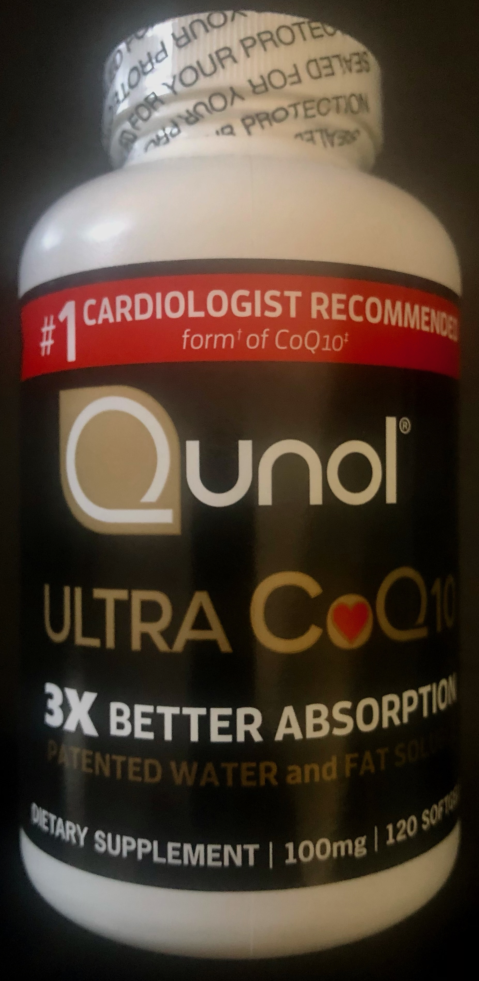
OTC Method B
Verification Process
    Container is marked with
      person’s name
      nurse initials
      date
David Cook
HL 9-6-yr
Notes:
The OTC med or Dietary Supplement with only the manufacturer’s label, must be verified by a licensed professional (typically the nurse) ensuring that the product purchased is what the HCP ordered.
Documentation of the verification is completed by the nurse writing the person’s name, date and their initials, directly on the unopened container of medication.

Slide 31
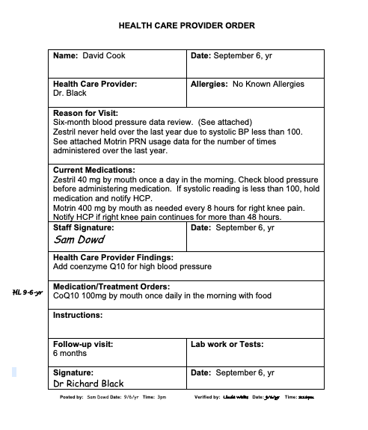
OTC Method B
Notes:
The nurse will also ‘note’ the HCP Order with their initials and the date, indicating the verification process was completed.

Slide 32
OTC Method B
OTC Method B Training
  Trainer Name and contact info
  Dated attendance list of staff trained
  Complete set of training materials (product specific)
    OTC Medication
    Dietary Supplement
Notes:
Staff must be trained in OTC Method B as they will be using a manufacturers label instead of a pharmacy label to complete the 3 Checks of the 5 Rights.
The training is product specific, meaning if the person you support has an order for both Vitamin D3 and Shark’s Cartilage, you will review to see that a training was completed for each product.
Training documentation must be maintained on site.
Most Supervisors use a 3-ring binder to keep all training material organized.

Slide 33
Section C
Vital Signs
MAP Policy Sections 03 & 08
Notes:
Each Health Care Provider must be consulted so that staff know if vital signs are required for medication administration.

Slide 34

Consult each HCP
  Determine if
    Vital Signs (VS) required
Notes:
To meet this requirement, HCP Order forms typically include a statement such as ‘If vital signs are required, please include the parameters.'
The HCP includes the parameters, if applicable, in the HCP Order so that staff know what to do if the vital signs they take are not within the parameter as ordered and what to do next.

Slide 35
Vital Signs
  Documented on med sheet
    above, below, or electronically tied to corresponding med
Notes:
This is an example of the requirement to document the vital sign taken (in this case, a pulse) on the med sheet, near the corresponding medication.
You can see in the special instructions section, the parameters ordered, what staff are to do if the pulse is outside of the parameters and when to notify the HCP.
You can also see that the pulse was outside of the parameters ordered on the 4th and the 5th.

Slide 36
Vital Signs
HCP notified if
  VS outside of ordered parameters, if applicable
  VS not obtained
  Parameters not followed
    Instructions received are documented
Date | Time | Medication | Reason | Response | Signature
12/5/yr | 9:30am
Notified Dr. Jones that Digoxin was held for the second day in a row. Pulse was 54 yesterday and 52 this morning. Dr. Jones said to continue with the med as ordered. He said if the pulse is less than 56 tomorrow morning to call back. He may change the dose at that time. _________________________Don Stevens
Notes:
When the vital sign is outside of the ordered parameters, your staff must document a corresponding med progress note explaining what happened, that the HCP was notified and what they’re expected to do next.
If staff use medication progress notes with headings and columns such as this example, notice that staff documented ‘through the boxes and columns’ using as many lines as needed to write a thorough note.

Slide 37

Vital Signs
VS Training includes
  Trainer Name and contact info
  Dated attendance list of staff trained
  Equipment specific instructions for use
  Complete set of training materials
Notes:
A nurse, an HCP, pharmacist, paramedic or EMT can provide Vital Signs training.
Documentation of the training must be maintained on site.
The instructions for use for each piece of equipment staff have been taught to use must also be on site.
If the blood pressure cuff staff have been taught to use breaks and a new electronic model is purchased, a re-training must take place to teach the staff how to use the new piece of equipment.

Slide 38
Section D
Medication Documentation
MAP Policy Sections 06, 08 & 13
Notes:
Your review of medication documentation, to ensure HCP Orders are correctly transcribed onto the medication sheets, is critical to safe medication administration.

Slide 39
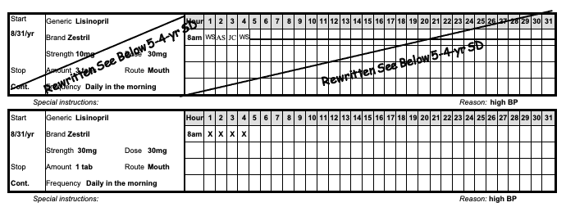
Transcription Re-Written
Notes:
If a change is needed to an existing transcription, due to a documentation error, a change in the strength of the tablet supplied by the pharmacy, or a change in the HCP Order itself, etc., edits are never made to an existing transcription.
If this is applicable during your review. ensure the transcription was marked through and re-written.

Slide 40
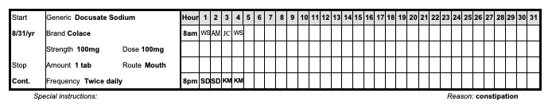
Medication Sheet Documentation
‘Reason’
Ink color
Blue or Black
Notes:
The reason a med is ordered must be obtained from and documented by the prescribing HCP and then documented on the med sheet.
If the reason doesn’t change, historical HCP documentation stating the reason for the med is acceptable and may be filed in the person’s health record.
You should see documentation completed in only blue or black ink.

Slide 41
Medication Sheet Documentation
Med Sheet boxes initialed and/or
  Acceptable Codes
    Documented in Real Time
  Progress Note
    Written by staff administering med but
      Forgot to initial
Notes:
When you’re reviewing medication documentation, you should see all boxes in the medication sheets initialed, indicating the medication was administered.
You should also review that staff administering medication have signed the signature list using their first and last name with corresponding initials.

Slide 42
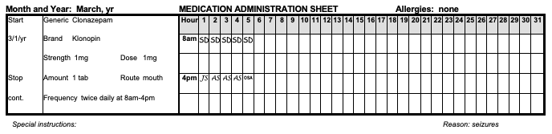
Acceptable Codes
Notes:
If you see a code, in place of initials, review to ensure only acceptable codes and any necessary corresponding documentation is completed and that the codes are listed on the med sheet.
Acceptable Codes must be documented in real time.

Slide 43
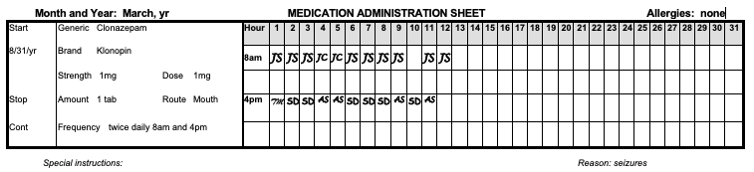
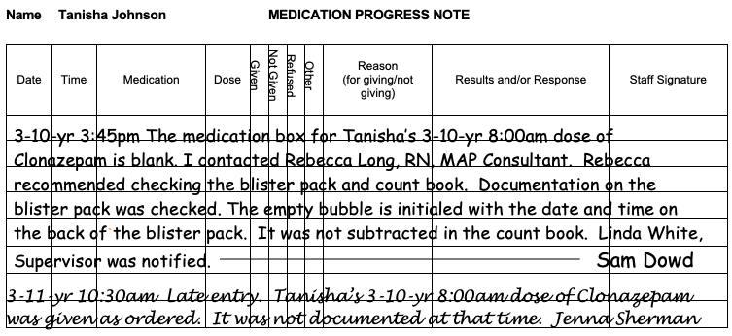
Med Sheet Documentation
Notes:
If you notice a blank space on the med sheet and the corresponding count sheet, however, through blister pack monitoring, determine the med was administered, ensure the following takes place as illustrated on your screen:
the medication box stays empty
the staff who discovers the empty box writes a progress note telling a story of what they found, etc. and
the staff who forgot to document after med administration writes a late entry on the medication progress note

Slide 44
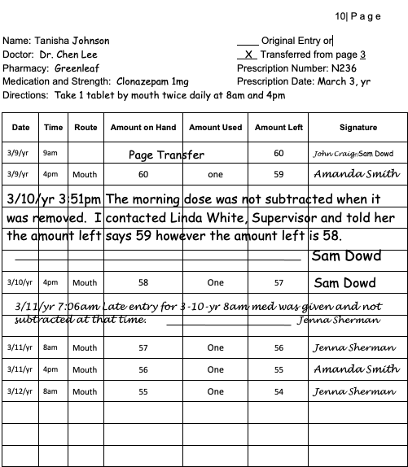
Count Sheet
‘Late Entry’
Notes:
In addition, the staff who discovered the med issue will document what happened on the corresponding Count Sheet page.
The staff who initially forgot to document must write a ‘late entry’ the next time they’re working.
Of note, if you see a blank space on a med sheet and it’s determined that the med was not given, this is a medication occurrence, a MAP Consultant must be notified immediately, and a medication occurrence report submitted.

Slide 45
Medication Refusal Documentation
Circled Initials on Med Sheet
Corresponding Progress Note
  Explanation
    What Happened
  HCP Notification
    Recommendation, if applicable
  Site Supervisor Notification
Notes:
If a med is refused you should see circled initials on the front side of the med sheet, with a corresponding progress note that includes HCP and Site Supervisor notification.

Slide 46
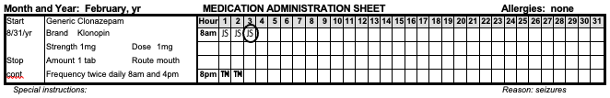
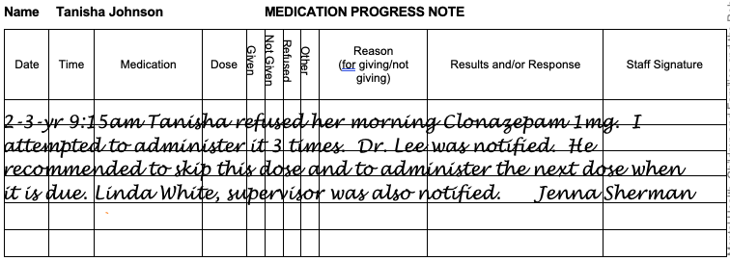
Medication Refusal Documentation
Notes:
On your screen is a documentation example of a refused medication and the corresponding progress note.

Slide 47
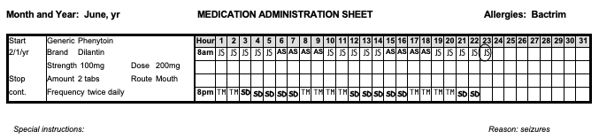
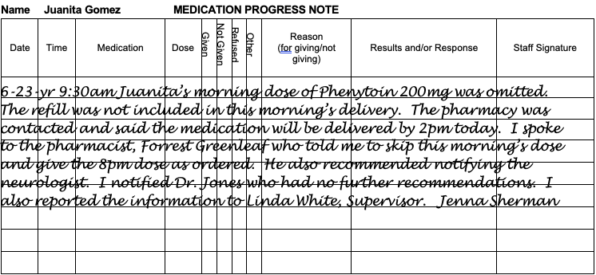
Medication Omitted
Notes:
This is a documentation example of a medication that was omitted due to issues with the pharmacy delivery service, indicating who was notified, and what staff were to do next.

Slide 48
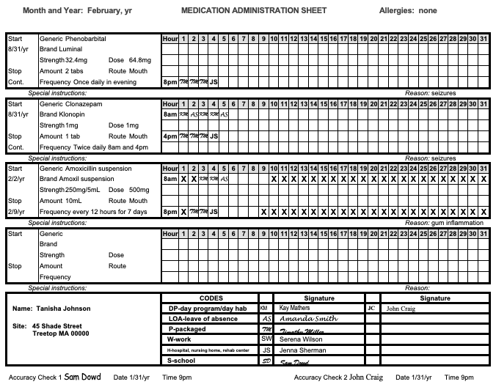
Monthly Accuracy Checks
Notes:
Review documentation to ensure accuracy checks were completed prior to the first medication administration of the new month by 2 staff, preferably together.
Documentation of a completed accuracy check includes a signature, the date, and the time completed.

Slide 49
Data Tracking
Cross reference for medication administration
  Bowel Movements
  Blood Glucose Monitoring
  Weight
  Vital Signs
  Seizures
Recorded on Med Sheet
Notes:
Review any form of data tracking needed to cross reference before med administration to ensure meds were administered per the HCP Order.

Slide 50
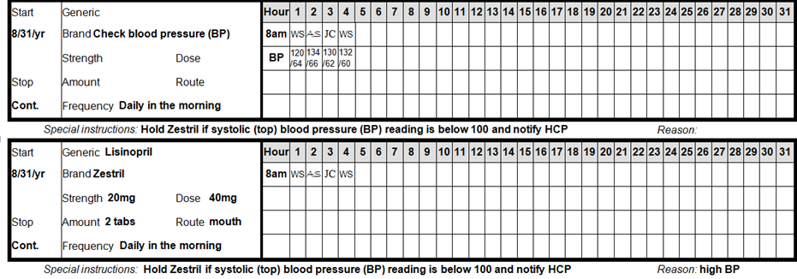
Data Tracking Documentation
Notes:
The data required for medication administration must be documented on the med sheet above, below or consecutive to the medication.
This is one example.

Slide 51
Seizure Record
Seizure Record
  Available to cross reference for med administration, if applicable
Notes:
If you support a person who has a seizure disorder, there must be documentation of their last known seizure.
If it’s unknown, the record would simply state, ‘date of last seizure unknown’.

Slide 52
Emergency Fact Sheet
(EFS)
Includes
  Current Medications
    Dosages
    Frequencies
  Listed or Attached
Notes:
Ensure an Emergency Fact Sheet is present for each person.
The EFS should be updated any time a new medication is ordered, or a medication is DC’d to ensure it reflects current medications, including dosages and frequencies.
A medication list with the same information on a separate document near the EFS is acceptable.

Slide 53

Medication Documentation
Allergies included
  HCP Order
  Consult Form
  Med Sheet
  EFS, etc.
Notes:
Ensure allergies are documented on all med sheets, HCP Orders, Emergency Fact Sheets, etc.
Remember, if there are none, you should see ‘no known allergies.’

Slide 54
Section E
Staff Certification
MAP Policy Section 02
Notes:
Staff, including relief staff, initialing the med sheets as administering meds must have documented proof of current MAP Certification on site.

Slide 55
MAP Certification
Acceptable Proof
  Massachusetts MAP Certification letter or
  Master List with Expiration Date or
  MAP Recertification Competency Evaluation form
    replaced ASAP with MAP Certification letter
Notes:
Acceptable proof of MAP Certification is the Massachusetts MAP Certification letter for each staff, a master list with the expiration date or a signed copy of a successfully completed MAP Recertification Competency Evaluation form.
If you need to print a current Certification letter you can access the Massachusetts MAP Registry.

Slide 56

https://ma.tmuniverse.com/
Notes:
To access the Registry, locate the state contracted testing company website as seen on your screen.
Click ‘Search Massachusetts Registry’ and follow the prompts.

Slide 57
Section F
Ancillary Practices
MAP Policy Sections 08 & 14
Notes:
This section covers various ancillary practices that may or may not be applicable to the people you support.

Slide 58

Ancillary Practices
CLIA Waiver
  laboratory testing on site
Notes:
CLIA is an abbreviation for ‘Clinical Laboratory Improvements Amendment’.
A CLIA Waiver allows Certified or licensed staff to conduct lab testing, such as blood glucose monitoring or a urine dip, in a MAP Registered site.
To obtain a waiver, there’s an application process.

Slide 59

www.mass.gov
Notes:
To locate the process, go to the mass.gov website, type ‘CLIA’ into the search bar, click to search…

Slide 60
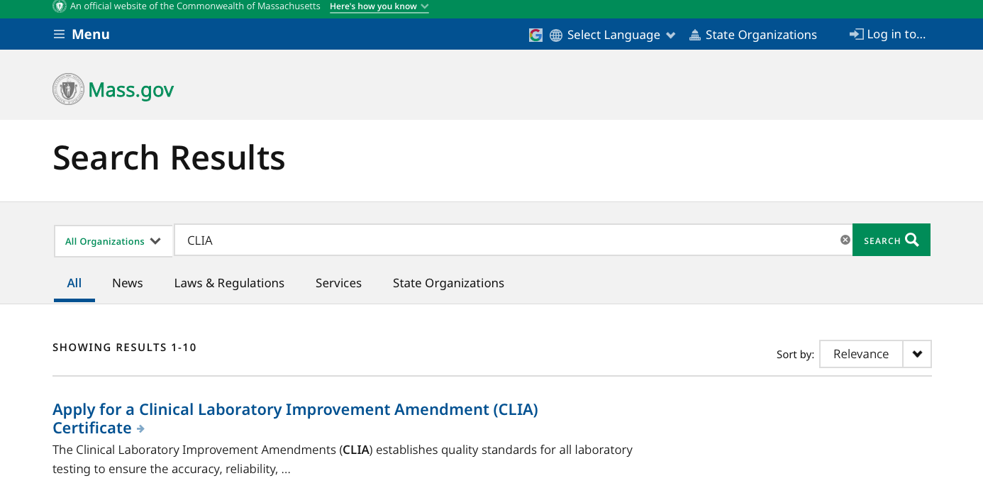
CLIA Certificate
Notes:
then click the ‘Apply for a CLIA Certificate’ link.

Slide 61
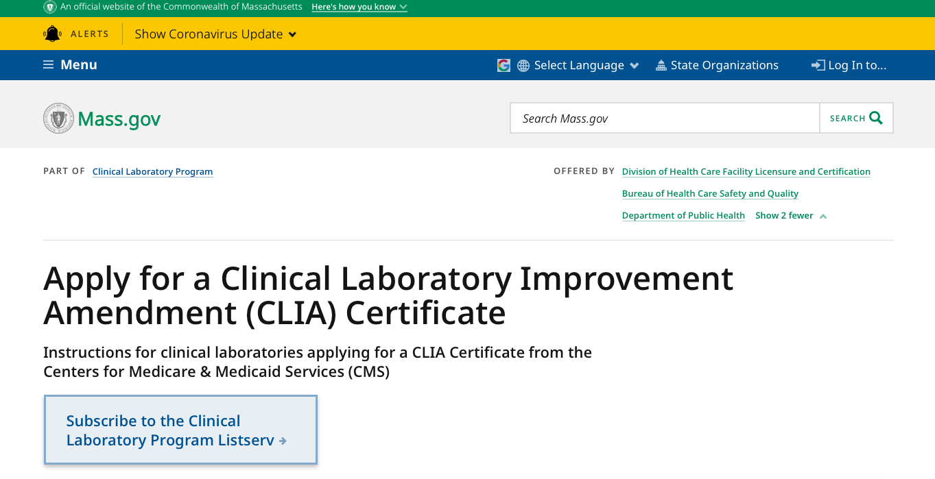
CLIA Application Process
Notes:
That brings you to this page, providing you detailed instructions of the application process.
The associated fee is $200.
DPH issues one CLIA Certificate to the Service Provider, which covers all applicable site addresses, if identified on the application form.
The certificate is good for 2 years & a copy should be kept on site, if applicable to your work location.

Slide 62

Blood Glucose Monitoring (BGM)
HCP Order and/or Protocol for BGM
  Specific written upper/lower parameters
  Steps to take when outside parameters
  BGM monitored as ordered
Notes:
If a person has blood glucose monitoring conducted, review the data to ensure monitoring was completed as ordered.

Slide 63
Blood Glucose Monitoring (BGM)
HCP Notification
BGM not completed
Parameter steps not followed
After Notification
Document HCP Orders and/or Instructions
Notes:
If BGM was not completed or a parameter step was not followed, review documentation of HCP notification, instructions received, and subsequent actions taken.

Slide 64

Blood Glucose Monitoring (BGM) Training
Training Documentation
  Trainer name & contact info
  Dated attendance list
  Equipment specific instructions for use
  Complete set of training materials
Notes:
Staff must be MAP Certified to perform blood glucose monitoring.
The policy manual outlines blood glucose training requirements and specifies that the training must be conducted by an RN, LPN, pharmacist, or an HCP.
Documentation of the BGM training must be maintained on site.

Slide 65

Insulin
Managed by licensed nurses or
  Person transitioning to self-administration with only licensed staff support
    Supporting Documentation
Person self-administers
  Meets criteria
    Supporting Documentation
Notes:
When insulin is ordered for a person you support, it must be managed in one of two ways; either by a nursing service or a service provider nurse; or the person meets all criteria for self-administration and supporting documentation is on site.
If the person is ‘in process of learning to self-administer’, meaning the goal of self-administration has not been met; the process of learning to self-administer must be carried out by only licensed staff.

Slide 66

Medication Security
Access Insulin
  through Certified staff
Storage Options
  Locked box
  Locked bank bag
Notes:
Regarding insulin and medication security, a nursing service, such as the VNA, should NOT have a key or know the combination to access the MAP med storage area.
Access to supplies or insulin is through contact with Certified staff.
Ensure the insulin is kept in a separate locked box or bank bag and stored per manufacturer’s recommendation.
If kept in the refrigerator in the locked med room, Certified staff can retrieve the locked box or bank bag and hand to licensed staff.

Slide 67

Communication System
Notes:
If managed by a nursing service, the nursing service typically has its own documentation requirements, consisting of a file maintained in the home. The nursing service may communicate directly with the HCP and obtain new insulin orders if needed. Any time the nurse obtains a new insulin order ask for a copy so you can DC the old order, transcribe the new insulin order and place the HCP Order in the med book.
If staff are taking the person to medical appointments and receiving changes in insulin orders, staff are expected to communicate those changes with the nursing service or Service Provider nurse. The nursing service will need you to copy the HCP Order for their file. Licensed staff need an HCP Order to administer insulin.
Ensure there is a communication system (established with nursing service or Service Provider nurse input) at the site.

Slide 68
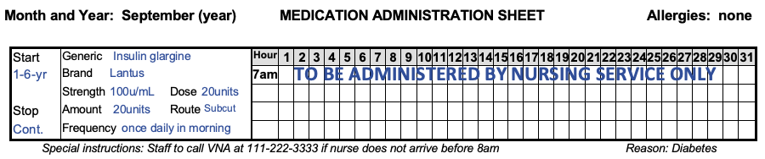
Insulin
Notes:
Review the insulin transcription on the med sheet, it should clearly indicate that the insulin is administered by licensed staff.
Certified staff do not initial the med sheet next to the insulin.
A special instruction should be included on the med sheet for staff, with a telephone number to call, regarding at what time the nursing service or Service Provider nurse are to be notified if they have not yet arrived to administer the insulin. This will help to ensure the medication is administered as ordered.

Slide 69

Auto-Injectable Epinephrine
HCP order and/or Protocol
Notes:
There must be an HCP Order and/or Protocol for epinephrine via auto-injector administration, if applicable.

Slide 70
Auto-Injectable Epinephrine
Competency Evaluation Tool
First Aid and CPR Training
Vital Signs Training
Notes:
The policy manual outlines auto-injectable epinephrine training requirements and specifies that the training must be conducted by an RN, HCP, pharmacist, paramedic, or EMT.
Subsequent annual reviews may be conducted by an LPN.
If you support a person who has an order for auto-injectable epinephrine you should check training records to ensure each staff has the required competency evaluation tool per staff, per person, and is current in First Aid, CPR and Vital Signs training.

Slide 71
Auto-Injectable Epinephrine Training
Documentation
  Trainer name & contact info
  Dated attendance list
  Complete set of training materials
  Competency Evaluation Tool
Notes:
Documentation of the training, must be maintained on site.
Auto-injectable epinephrine training is good for 1 year unless there’s a change in the HCP Order; retraining is required anytime the HCP Order changes.
Except for auto-injectable epinephrine, there is no approved specialized training program for any other injectable medication.

Slide 72

Medication Administration via Gastrostomy (G) or Jejunostomy (J) Tube
Notes:
There must be an HCP Order indicating medication administration via a G or J tube route, if applicable.
Certified staff may administer meds through G and J tubes with additional specialized training.

Slide 73
Gastrostomy or Jejunostomy Tube
Competency Evaluation Tools
First Aid and CPR
Vital Signs Training
Notes:
The policy manual outlines the training requirements and specifies that the training must be conducted by an HCP or an RN.
If you have a person with orders to administer medication via a G or J tube, you should check training records to ensure that each staff has the required competency evaluation tools for medication administration and water flushes, per staff, per person, and is current in First Aid, CPR and Vital Signs training.

Slide 74

Medication Administration via Gastrostomy (G) or Jejunostomy (J) Tube Training
Documentation
  Trainer Name and contact info
  Dated attendance list
  Complete set of training materials
  Competency Evaluation Tools
Notes:
Documentation of the training must be maintained on site.
G or J tube training is good for 2 years if staff routinely administer meds via these routes.
A review is required if:
the HCP Order changes or
six months has lapsed since staff administered medication via these routes.
Subsequent retraining is by an RN or HCP.

Slide 75

Oxygen Therapy
HCP Order and/or Protocol
Notes:
Oxygen is a schedule VI, controlled medication.
There must be an HCP Order and/or Protocol for oxygen administration, if applicable.
The HCP order should include specific written parameters including what staff are to do when the reading is outside of the parameters.

Slide 76

Oxygen Therapy
HCP Notification
  Oxygen not given and/or
  Parameters not followed
After Notification
  Document HCP Orders and/or instructions
Notes:
If oxygen was not administered as ordered or parameters are not followed, review documentation of HCP notification, instructions received, and subsequent actions taken.

Slide 77
Oxygen Therapy
Optional Competency Evaluation Tool
Vital Signs Training
Notes:
The policy manual outlines the training requirements and specifies that the training must be conducted by an HCP, an RN, LPN, Respiratory Therapist or the vendor who supplies the equipment.
If you support a person who has orders to receive Oxygen, you should check training records to ensure each staff has an optional competency evaluation tool, if applicable and is current in Vital Signs training.

Slide 78

Oxygen Therapy Training
Documentation
  Trainer Name and contact info
  Dated attendance list
  Complete set of training materials
  Competency Evaluation Tool
Notes:
Documentation of the training must be maintained on site.

Slide 79

PT/INR Test Process
If PT/INR self-testing is managed on site
  Testing is conducted by licensed staff only
Notes:
If you support a person who receives a blood thinner, such as Coumadin you may be very familiar with the PT/INR testing process. This type of test is usually completed at an anticoagulant management service. Please note that if PT/INR self-testing is managed in your site, it may NOT be done by Certified staff.
If a person is capable of self-testing which means; performing the test, keeping control of the equipment, reporting results, receiving the dosing instructions from the HCP, and so on, it can be done by the person.
If a person requires any support in the process; it is not self-testing; Certified staff may not assist; however, licensed staff may.

Slide 80

Warfarin Sodium Therapy
HCP Order includes
  Specific medical diagnosis
  INR target range/goal
Notes:
Warfarin sodium is identified by DPH as a high-alert medication.
Certified staff may administer this medication after completing both the ‘General Knowledge’ Warfarin sodium Therapy Training and the ‘Individual-Specific’ Protocol Warfarin sodium Therapy Training.
Each person who has an HCP Order for this medication must have a supporting medical diagnosis and an INR target range included in the order.

Slide 81
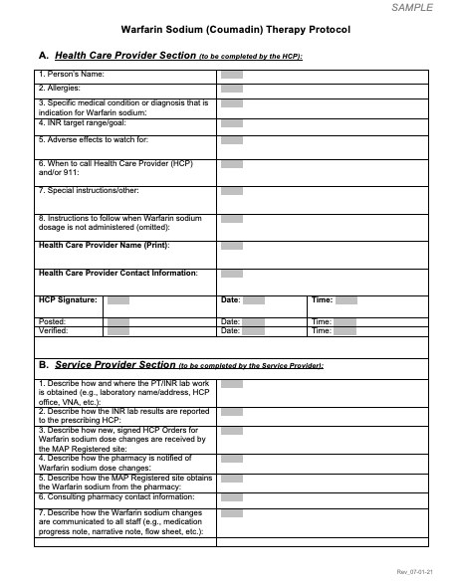
Individualized Protocol
Notes:
Each person must also have an individualized Warfarin sodium protocol.
Ensure the protocol is signed and dated by the HCP and posted and verified by Certified staff.

Slide 82

Warfarin Sodium Therapy
Anticoagulation Management Service
  Dose Changes
Notes:
If an anticoagulant management service is used, review the HCP Orders to ensure dose changes were ordered, signed, and dated by the HCP.

Slide 83
Warfarin Sodium Therapy
Tracking System
Blister Pack Monitoring
Added to Count
Accounting Documentation Procedure, etc.
Dose Change Documentation System
Progress Note
Chronological Event Sheet, etc.
Narrative Note
Notes:
Additional requirements include:
your choice of a tracking system, to ensure the medication is administered as prescribed and
a documentation system, to ensure dose changes are communicated to all staff.

Slide 84
Warfarin Sodium Therapy
Medication Sheet Requirements
  Upcoming INR lab draw date
  Space for second staff to verify dose/initial
    Acceptable Code ‘NSS’ = no second staff
Notes:
During your review of the required Warfarin sodium specific med sheet, check to see that the upcoming INR lab draw date was transcribed onto the med sheet in a med box and that staff initialed the appropriate box after the lab was drawn.
In addition, ensure that a second Certified staff initials are present indicating verification that the correct dose was prepared prior to administration.
If a second staff was unavailable, the dose still should have been administered, and you should see the acceptable code, ‘NSS’, representing ‘no second staff’, on the med sheet.

Slide 85

Warfarin Sodium Therapy
Competency Evaluation Tool
Notes:
The policy manual outlines the training requirements and specifies that the training must be conducted by an HCP, RN, NP, PA or Pharmacist.
Subsequent reviews may be conducted by an LPN.
Each Certified staff administering Warfarin sodium must have a completed individual specific evaluation tool per staff, per person, as part of the training materials.

Slide 86

Warfarin Sodium Therapy Training
Documentation
  Trainer Name and contact info
  Dated attendance list
  Complete set of training materials
Notes:
Documentation of the training must be maintained on site.

Slide 87

Optional Training Tool
Notes:
If the Trainer chooses, there is a PowerPoint presentation that may be used to meet the ‘Warfarin Sodium Therapy General Knowledge Training’ Policy Requirement.

Slide 88
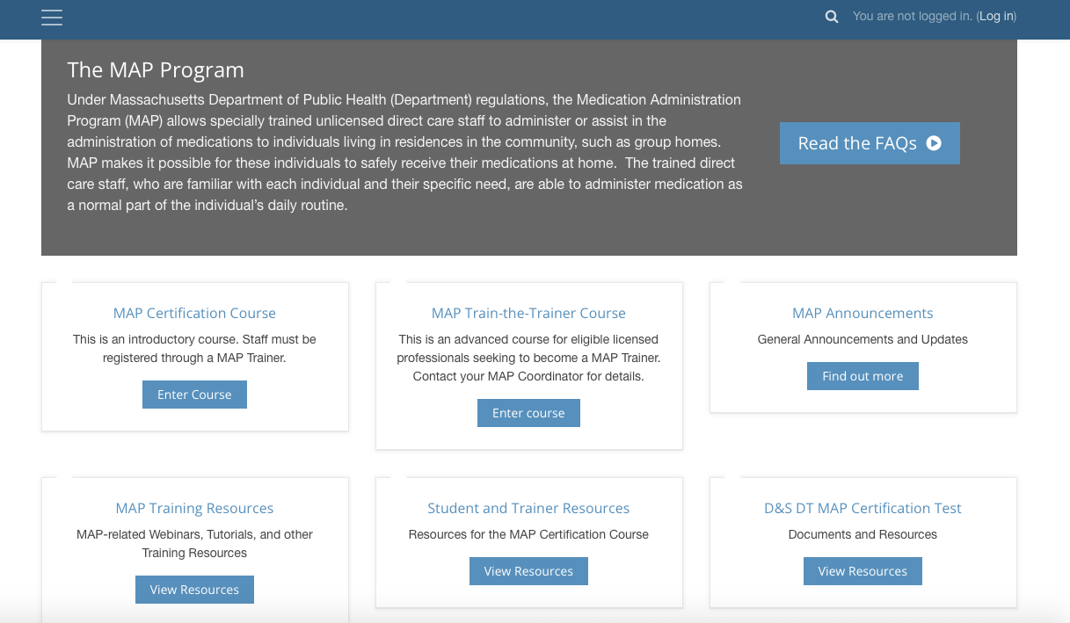
mapmass.com
Notes:
The PowerPoint may be accessed from the homepage of the mapmass website, in the MAP Training Resources ‘bucket’.

Slide 89

Clozapine Therapy
HCP Order
  Specific medical condition or diagnosis
  Individualized instructions if dose is omitted, including if dose is omitted for 2 days or more
Notes:
Clozapine is identified by DPH as a high-alert medication.
Certified staff may administer this medication after completing both the ‘General Knowledge’ Clozapine Therapy Training and the ‘Individual-Specific’ Protocol Clozapine Therapy Training.
A person who has an HCP Order for this medication must have a supporting medical diagnosis and instructions if a dose is omitted, including if doses are omitted for 2 days or more.

Slide 90
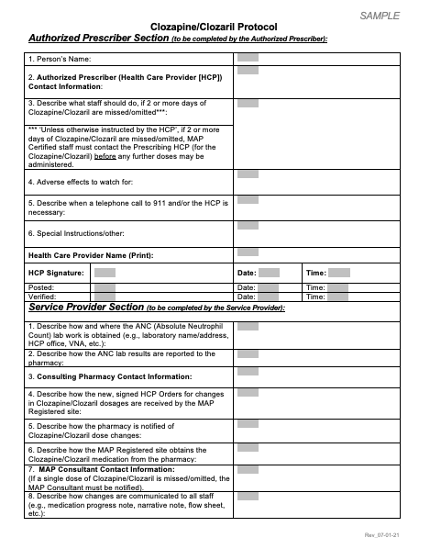
Individualized Protocol
Notes:
Each person must have an individualized clozapine protocol that includes:
when to contact the Clozapine Therapy prescriber and/or the MAP Consultant
adverse effects of Clozapine Therapy and the
emergency procedure to follow including calling 911, as well as prescriber notification.
Ensure the protocol is signed and dated by the HCP and posted and verified by Certified staff.

Slide 91
Clozapine Therapy
Medication Sheet Requirement
  Upcoming lab draw dates
    Initialed after lab draw completion
Notes:
During your review, check to see that the upcoming lab draw dates are transcribed onto the med sheet in a med box and that staff initialed the appropriate box after the lab was drawn.

Slide 92
Clozapine Therapy
Competency Evaluation Tool
First Aid and CPR
Vital Signs Training
Notes:
The policy manual outlines the training requirements and specifies that the training must be conducted by an HCP, RN, NP, PA, or Pharmacist.
Subsequent reviews may be conducted by an LPN.
If you support a person who has orders to administer clozapine, check the training records to ensure each staff has the required competency evaluation tool, per staff, per person, and is current in First Aid, CPR and Vital Signs Training.

Slide 93

Optional Training Tool
Notes:
If the Trainer chooses, there is a PowerPoint presentation that may be used to meet the ‘Clozapine Therapy General Knowledge Training’ Policy Requirement.

Slide 94
mapmass.com
Notes:
The PowerPoint may be accessed from the homepage of the mapmass website, in the MAP Training Resources ‘bucket’.

Slide 95

Clozapine Therapy Training
Documentation
  Trainer Name and contact info
  Dated attendance list
  Complete set of training materials
Notes:
Documentation of the training must be maintained on site.

Slide 96
Section G
Countable Controlled Substance Packaging
MAP Policy Section 10
Notes:
All schedule II-V countable controlled medications must be received from the pharmacy in tamper resistant packaging.

Slide 97
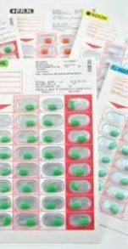


Countable Controlled Substance Packaging
Schedule II-V countable controlled medication
  Tamper resistant packaging types
Notes:
Ensure Schedule II-V countable meds have only one tablet packaged per ‘blister’ or ‘well’.
If you see evidence (glue, tape, or staples) of possible tampering (which is altering or substituting a medication or the packaging of the medication), this is reportable to the Drug Control Program.

Slide 98
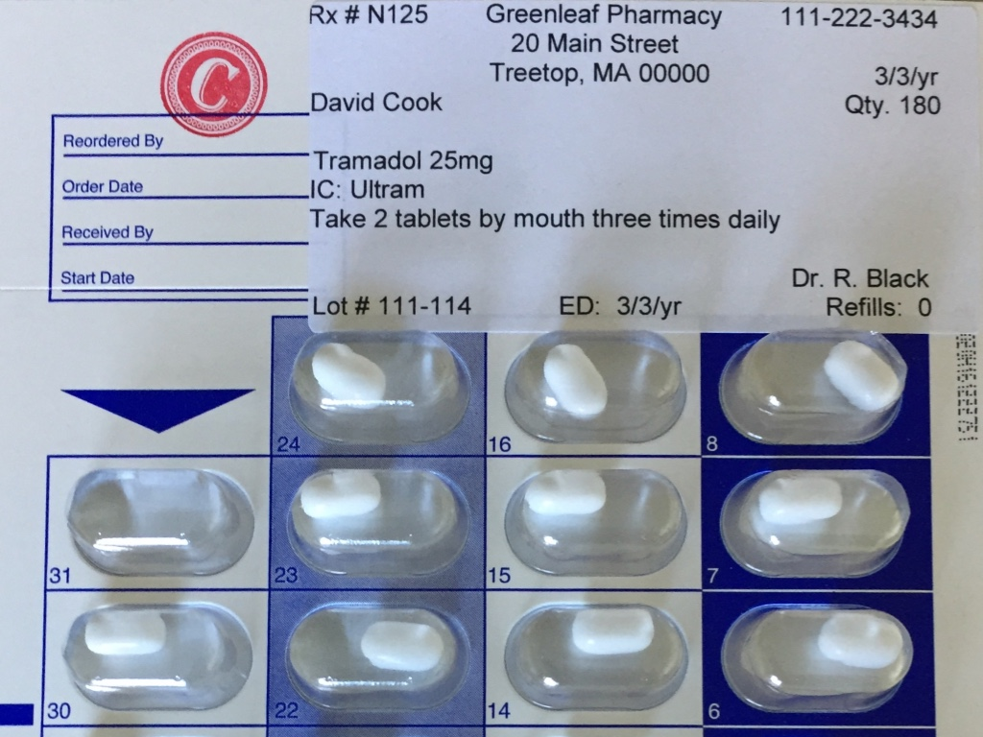
Countable Controlled Substance Packaging
Notes:
Ensure that Count Book page numbers are not written on the packaging.

Slide 99

Liquid Countable Controlled Substance Packaging
Notes:
The tamper resistant packaging requirement also applies to liquid countable meds; which must be packaged by the pharmacy in unit dosed containers.
This is an example of tamper resistant syringes; when the red cap is unscrewed, the seal is broken, and the cap cannot be replaced.
If you have this type of syringe in your program, the total number of prefilled syringes received from the pharmacy are added into the count.
Each syringe is subtracted from count as ‘one’ rather than subtracting the total number of milliliters in each syringe.

Slide 100
OPUS Cassette Management of Spare Tabs
If med is countable
  there are no spare tabs
If med is not countable
  there are no spare tabs or choose
    spare tab management options
Notes:
If your site uses the OPUS cassette packaging system, there shouldn't be any spare tablets included in the cassette if the med is a schedule II-V; if the med is a non-countable, spare tabs are allowed, with additional guidelines.

Slide 101

OPUS Cassette Management of ‘Spare’ Tabs
Three Options
Ask pharmacy not to include spares
If spare tabs are supplied, spares are disposed if not used, before cassette returned
Inventory tracking system
Notes:
You're viewing a non-countable medication in an OPUS cassette with spare tabs.
If the med is non-countable, there are 3 options to choose from for managing ‘spare’ tablets if they’re included in the cassette:
Option 1 is
Ask the pharmacy not to include them going forward.
Option 2 is
2. Prior to returning the cassette, dispose of the spare tabs following disposal guidelines, so that the cassettes are returned empty or
Option 3 is
3. Develop an inventory system of the spare tablets returned. This could be difficult if any of the plastic ‘tabs’ covering the ‘well’ of the cassette containing the spares are opaque so that you can’t see the tab.

Slide 102
Section H
Countable Controlled Substance Documentation
MAP Policy Section 10
Notes:
Countable Controlled Substances require entry into a Countable Controlled Substance Book, known as the Count Book.

Slide 103

Count Book Basics
Book Numbered
Preprinted, consecutively numbered pages
Bound
Notes:
Ensure the book itself has a Count Book number documented and is intact, with no loose pages.
If you notice a Count Book section is full of entries or a new Count Book is required for a different reason, the count balance of all medication must be transferred from the old Count Book to the new Count Book.
This process requires you, the Site Supervisor and another Certified or licensed staff to transfer the balance.
Only one Count Book may be in use at a time.

Slide 104
Countable Controlled Substance Documentation
Clear and easy to read
If more than 1 line necessary, use as many as needed
Errors corrected accurately
Count Sheet pages used consecutively
Notes:
When reviewing documentation, you should not see:
entries that are illegible, squeezed between lines or written in the page margins
skipped lines or blank spaces
scribbling, marking over or the use of White-Out or
skipped Count Sheet pages

Slide 105
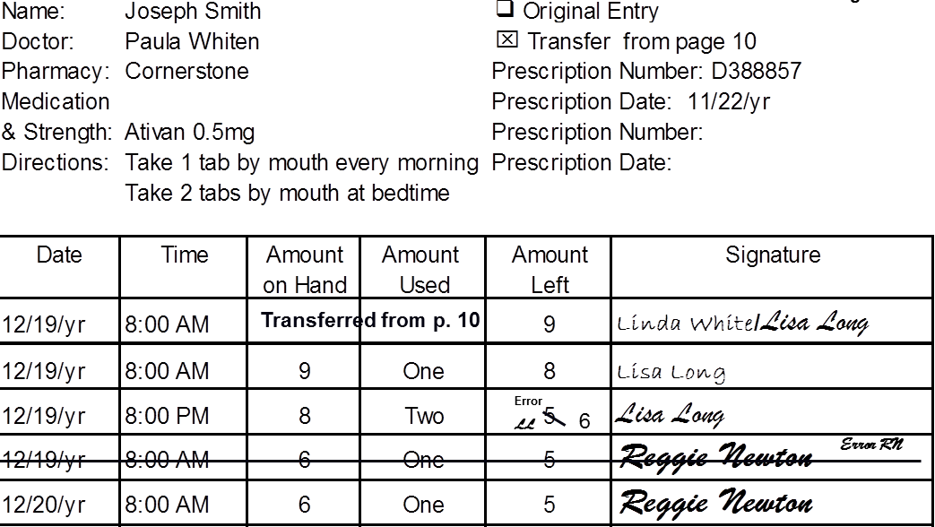
Error Correction
Notes:
On this Count Sheet page, both Lisa and Reggie made an error in their entries and corrected them the right way.
Either method is acceptable.
Only the staff who makes the error may correct their documentation.

Slide 106
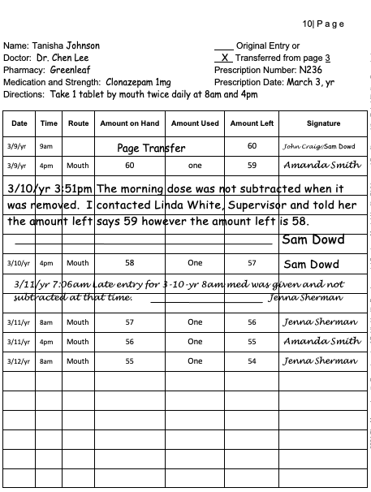
Error Correction
Late Entry
Notes:
Late entries explain what happened earlier.
This is an example of documentation you should see if staff discover someone did not document when a med was removed.
Look for:
a progress note explaining the discovery and
a ‘late entry note’ by the staff who forgot to document, explaining what happened.

Slide 107
Count Book Contents
Schedule II-V Medication
  including meds awaiting disposal
Schedule II-V Written Prescriptions
  awaiting drop off
Schedule VI Medication
  identified by DPH as having high potential for abuse
    currently, Gabapentin and Fioricet
Notes:
If a med is DC’d, expired, or the order changes so that the medication on hand may no longer be used and is awaiting disposal, each site should have a designated locked storage ‘bin’ or ‘area’ to store the med. If countable, the med must remain double key-locked and on count, until the disposal process is completed.
Prescriptions for countable medication, if at the site, must be added to the count. When the prescription is brought to the pharmacy to be filled, it is subtracted from the count. When the medication is received from the pharmacy, the tablets are added into the count, on a new Count Sheet page.
Schedule VI medication, identified by DPH to have a high potential for abuse, must also be added to the count.

Slide 108
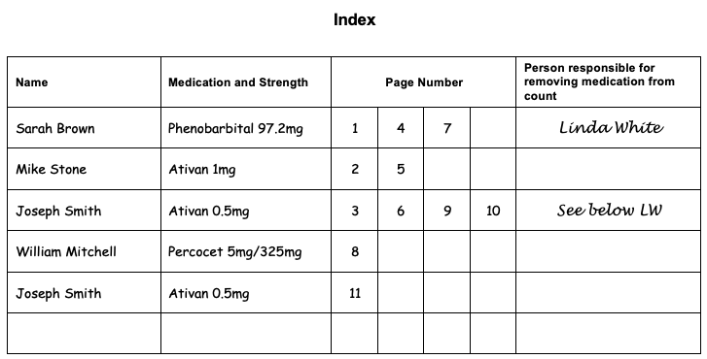
Documentation Review
Completeness
Accuracy
Notes:
Ensuring the Index identifies the Count Sheet pages currently in use is determined by conducting a 2-person, shoulder-to-shoulder count using the Index as your guide, when you take possession of the keys before you begin your review.
At the same time, you’ll determine if the count is correct.
Only you, the Site Supervisor may sign in the ‘Person removing Medication from Count’ column, indicating a medication is physically no longer present to count, when applicable.
Highlighting, if used, must be pale yellow and is only used in the Index to indicate a row is not active.

Slide 109
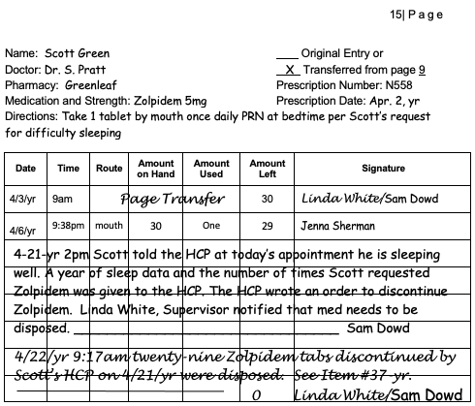
Documentation Review
Count Sheet Page
Heading
Two Signatures
  Addition to Count
    new medication
    medication refill
  Subtraction from Count
    disposal
  Page Transfer
Miscellaneous
  removed for administration
  Leave of Absence
  Off-Site Administration
  transferred to Day Program
  Etc.
Notes:
When reviewing a Count Sheet page, ensure the heading is complete and reflects the HCP Order and the pharmacy label. If a refill was received during the time period reviewed, check to see that the prescription number on the current blister pack is the same as the heading. If there was a change in the prescription number, the new number should have been documented when received.
In addition, you should review for two Certified or licensed staff signatures on a Count Sheet page in the event of a:
newly prescribed medication
medication refill
page transfer or
medication disposal
Specific to a med disposal, you should also see the entry explain the reason for disposal, such as refused, discontinued or dropped. At the same time, you can review the corresponding section of the Disposal Record form ensuring the reason is the same.
Specific to a page transfer, you should see the same two signatures on the top of the new page and the bottom of the old page.
You should also check that the amount of medication left on the old page is the same as the amount transferred to the new page, that the ‘continuation page’ is referenced correctly at the bottom of the old page, and in the Index.
The last number entered in the ‘amount left’ column on each page must indicate how many tabs are currently on hand.
If the medication has been disposed and the remainder is zero, ensure the ‘amount left’ column is marked as ‘0’.
The purpose of the two-signature requirement, verifying the amount of medication on count, whether it’s been added or subtracted, decreases the opportunity for theft.
You will also review the entries when countable meds have been subtracted for medication administration, transferred to Day Program or to a parent for a leave of absence, etc.

Slide 110
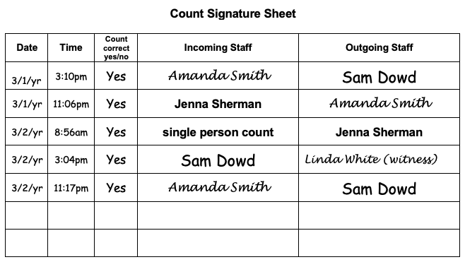
Documentation Review
Notes:
Review the Count Signature Sheet to ensure counts occur every time control of the med keys were passed.
Usually this happens at the change of shift, however, if control of the key changed several times within a shift due to appointments, breaks or other reasons, a count should have been conducted and documented each time the keys changed hands.
If a Certified staff was alone or another Certified staff was not present when coming onto or leaving a shift, then the staff must count the meds alone, and document ’single person count’ in the space near their name on the shift count sheet.
This is allowed as long as the count has been conducted by 2 staff in the previous 24 hours.
If there are no staff going off duty and 2 Certified staff were coming on duty, review that a 2-person count was conducted and that the second staff documented ’witness’ next to their name.
The count should be documented in ’real’ time.

Slide 111
Medication Supply Discrepancy
Non-Suspicious
Suspicious
Notes:
If medication supply discrepancies have occurred in your site, you’ve most likely seen documentation reflecting what happened and the actions that followed the discoveries.
All prescription (countable and non-countable) med losses must be reported to the Drug Control Program using a Drug Incident Report form.
The submission of the Drug Incident Report form satisfies DCP's requirements for both a telephonic and written report.
The loss of a written prescription is also considered a drug loss and must be reported.
Ideally, there should be no evidence of tampering or diversion upon review.

Slide 112
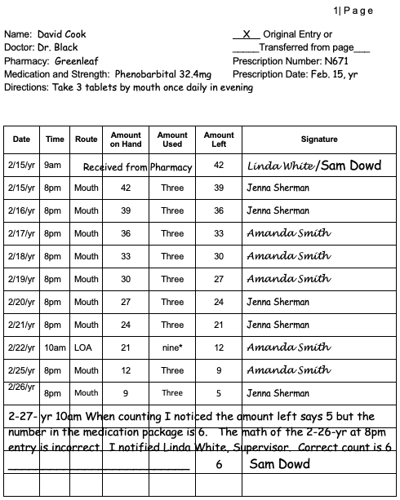
Non-Suspicious Discrepancy
Notes:
This is a documentation example of a non-suspicious count discrepancy discovered in which the math was incorrect, but the count was correct.

Slide 113
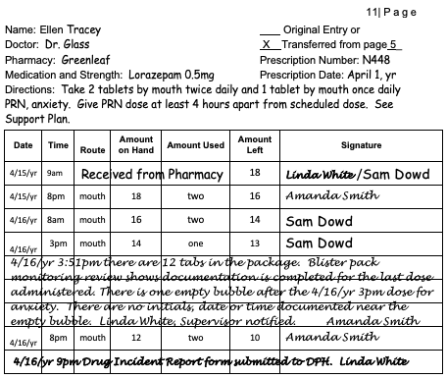
Suspicious Discrepancy
Notes:
If there was a medication supply discrepancy, and the med was not accounted for, this should have been explained on the Count Sheet page.

Slide 114
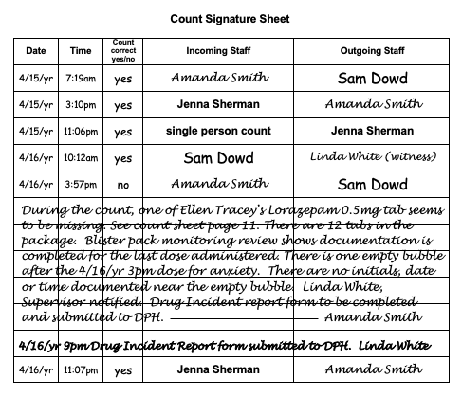
Suspicious Discrepancy
Notes:
In addition, the Count Signature sheet documentation should have reflected that the count was ‘incorrect’, reference the corresponding Count Sheet page number and the notification of the DCP.

Slide 115
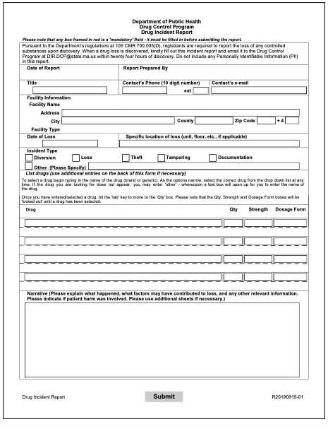
Drug Incident Report (DIR) Form
Notes:
If your site has any history of drug loss, you should ensure the Drug Incident Report form used to report the loss is maintained on site.

Slide 116
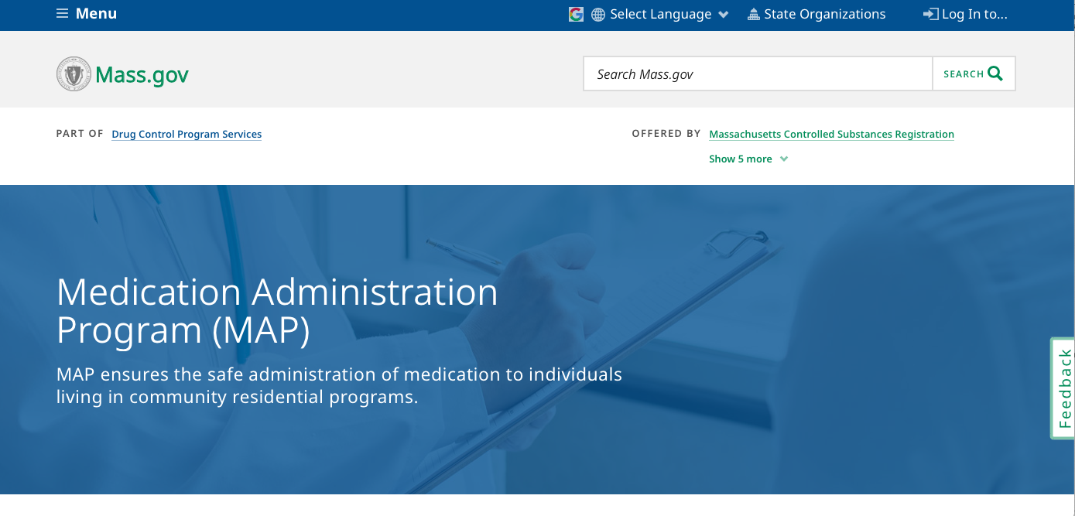
www.mass.gov/dph/map
Notes:
To access detailed information regarding Controlled Substance Loss Reporting, use the URL listed on the slide.
From this page, click the ‘Drug Control Program Services’ link.

Slide 117
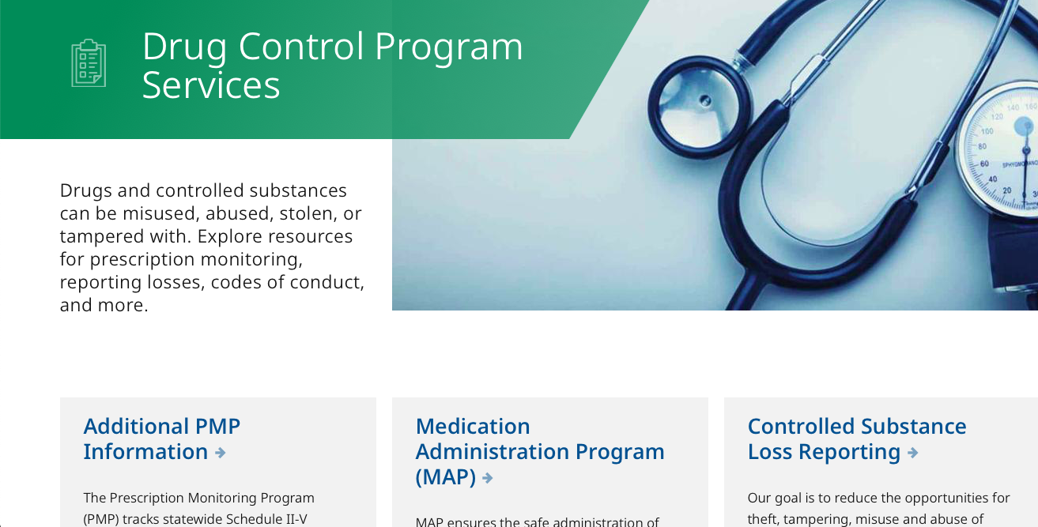
www.mass.gov/dph/map
Notes:
Clicking on the Controlled Substance Loss Reporting ‘bucket’ will guide you to the reporting process and the DIR form.

Slide 118
Section I
Transitioning to Self-Administration
MAP Policy Section 07
Notes:
If you support a person who is in the process of learning to self-administer their medication, all MAP policies apply.

Slide 119

Transition to Self-Administration of Medication Process
Supporting Documentation
  Self-Administration Assessment
    Dated within 1 year
  HCP Order
    Transition Approval
    Meds allowed to hold
      Number of days
  Reflected, as applicable, in
    Community Service Plan (CSP)
    Individual Treatment Plan (ITP)
    Individualized Service Plan (ISP)
    Individualized Medication Plan, etc.
MAP Policy Section 07
Notes:
You will ensure there is supporting documentation of the transition to self-administration of medication process.
The documentation includes:
a Self-Administration assessment, dated within 1 year
HCP documentation indicating approval of the transition
an HCP Order indicating the number of days a person may hold their meds
the transition is reflected in the applicable plan
progress of the teaching plan is on a data collection sheet and in
quarterly review notes.

Slide 120

Pill Organizer
Packaging by
  Pharmacist or
  Person Learning to Self-Administer
    Supervised by Certified staff
Notes:
If a pill organizer is used, the medication may only be transferred/packaged by
a pharmacist or
the person learning to self-administer, with Certified staff supervision.

Slide 121
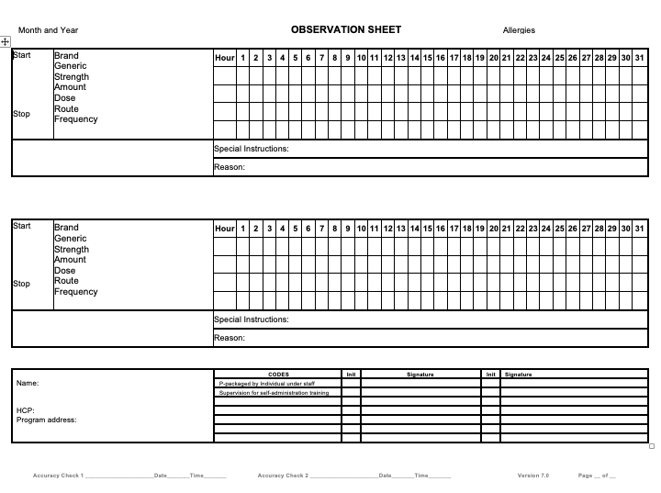
Observation Sheet
Notes:
Documentation of the transfer/repackaging of medication for scheduled and/or PRN medication is completed using an observation or medication sheet.
Following the transfer/repackaging, Certified staff document on the sheet, using the acceptable code, ’P’ in the appropriate date and time med boxes to indicate the:
medication was transferred/repackaged by the person
date medication was transferred/repackaged by the person
name, dosage, and quantity of medication transferred/repackaged with a medication progress note by the Certified staff supervising the person transferring/repackaging.
When the pill organizer is returned, the Certified staff will document their initials under the ‘P’ and write a corresponding progress note, indicating if it is empty or if medication remains.
If medication remains, the documentation should include notification of the HCP with further instructions.
Any returned medication is disposed per policy.
The process then repeats.

Slide 122
PRN Medication
Packed Separately
  from scheduled medication
Maximum 7 doses
Notes:
If a PRN med is packed, it must be packed separately from the scheduled meds, documentation must include the number of doses packed and if any of the doses were used.
Remember, only 7 doses of a PRN medication may be packed, regardless of the number of days that the person packs their scheduled medications.
A tracking system must be in place to follow up on the effectiveness of any PRN meds taken.

Slide 123
Section J
Self-Administering
MAP Policy Section 07
Notes:
Detailed information on this topic is in the policy manual.
Although there are no standardized DPH forms related to self administration, policy Section 07 does include sample forms for your use.

Slide 124

Self-Administering Medication
Supporting Documentation
  HCP approval to self-administer
  Valid HCP orders
  Self-administration assessment
  Self-administration status noted in ISP, ITP, CTP, etc.
  Quarterly reviews
  Written ‘back-up’ plan
  Meds stored in a secure area
Notes:
To be considered self-administering, the person must:
demonstrate an ability to take medication independently as evidenced by storing their meds so that they’re inaccessible to others
understand the type of medication they’re on, its purpose and for what symptoms or condition it’s prescribed
know how often to take the medication (staff may verbally remind them)
be familiar with the most common side effects, if any, and to
know when and how to dispose of medication, when needed.
Ensure supporting documentation, as seen on your screen, is on site.
If a person is transferring to your site and you’re told the person is self administering, it’s in your best interest to temporarily consider them non-self-administering until a self administration re-assessment has been completed, ensuring the definition is met per MAP requirements.

Slide 125
Section K
Leave of Absence & other
Off-site Medication Administration
MAP Policy Section 11
Notes:
When medication moves from one location to another location, a Medication Release document (either a Leave of Absence form or a Transfer form) is required to track the medication.

Slide 126
Medication Administration
Locations other than the Site
Leave of Absence
Day Program
Off-Site Administration
Certified/Licensed Staffed Vacations
Notes:
If any of the medication administration scenarios listed apply to the people you support, you’ll review the requirements specific to each.

Slide 127

Leave of Absence (LOA)
Pharmacy prepares meds when absence is:
  scheduled ahead or
  greater than 72 hours
If pharmacy is contacted & unable, Certified staff may prepare meds when absence is:
  unplanned and
  less than 72 hours
Notes:
As you know, LOA medication must be prepared according to the requirements listed.

Slide 128
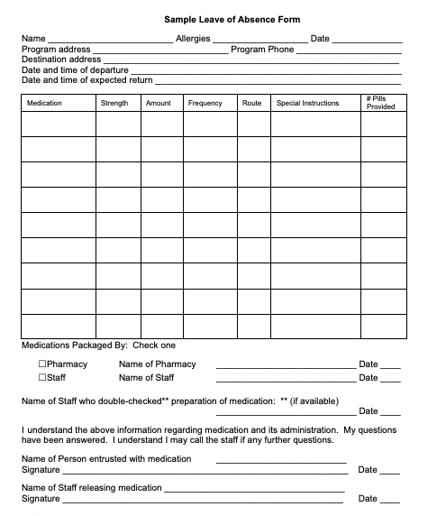
LOA Form
Must include
  Person’s Name
  Medication
  Strength
  Quantity
  Addresses
    From/To
  Signatures
    Release/Accept
Filed on site
Notes:
Review the corresponding LOA form ensuring there are 2 signatures, the Certified or licensed staff who released the medication and the responsible party, (family member, guardian, etc.) who accepted them.
Ensure the original, signed LOA form is filed in the person’s health record.

Slide 129
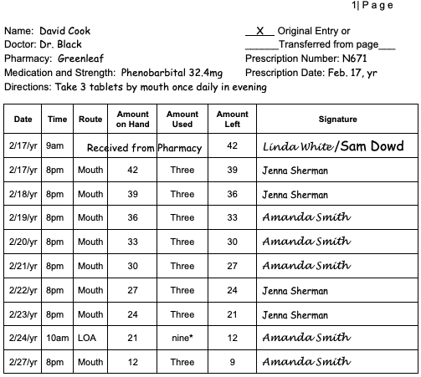
Count Book
Count Sheet page
  Must identify
    Countable meds, if applicable
Notes:
if any meds released were countable, review the Count Sheet page documentation.
In addition,
review the med sheet to ensure the acceptable code, LOA was placed in the appropriate med boxes
review your system to know what the family has on hand if the person returned early, and the family kept unused oral meds for the next visit.
ensure staff followed the procedure when a person returns to determine if meds were given as ordered during the LOA and if not
ensure unused oral meds were disposed per policy and the appropriate notifications were made.

Slide 130
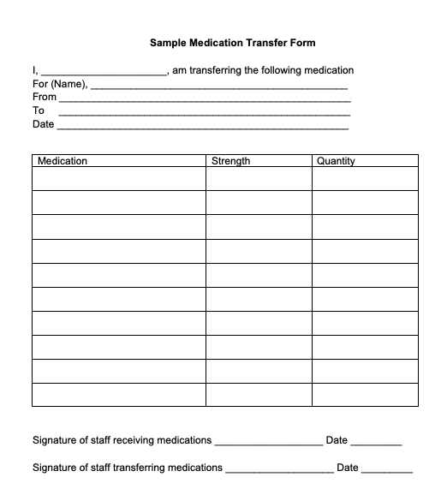
Transfer Form
Must include
  Person’s Name
  Medication
  Strength
  Quantity
  Addresses
    From/To
  Signatures
    Release/Accept
Filed on site
Notes:
If a medication was transferred from one location to another, such as between the residential site and the day program, ensure there was a corresponding transfer form with 2 signatures, the Certified or licensed staff who released the med and the Certified or licensed staff who accepted it.
Whether you’re a Residential Site Supervisor or a Day Program Site Supervisor, ensure appropriate requirements are met.

Slide 131
Residential Site & Day Program Meds
Residential Site
Current HCP Orders provided
Pharmacy labeled split-packaged medication provided
Transfer Form
Communication System
Notes:
Specific to the Residential Site Supervisor, review documentation ensuring the Day Program has
current copies of all HCP orders and
medication provided was pharmacy labeled, split-packaged and subtracted from the count, if applicable.

Slide 132
Day Program & Day Program Meds
Day Program
HCP Order copies
Verify amount of medication received
Communication system
Transcribe only meds administered during Day Program Hours
Post/Verify orders transcribed
Transfer Form copy or other system
Notes:
If you are a Day Program Site Supervisor, ensure there’s a system in place so that staff verify the amount of medication received to ensure the supply is not too much or too little.
Review med sheets to ensure only meds scheduled during day program hours and PRN meds that may be needed during day program hours were transcribed.
Review that transcribed HCP Orders were posted and verified under the post/verify section completed by residential staff.

Slide 133

Residential & Day Program Site Communication
Notes:
For both Residential and Day Program Site Supervisors, ensure your communication systems include notification of when medication is administered according to data collection, such as bowel meds or seizure meds, and when PRN medication is administered that would impact when administered at the Day Program and vice versa.

Slide 134
Transfer Form
Day Habilitation = ‘DP’
School = ‘S’
Hospital = ‘H’
Different Residential program
Pharmacy
  repackaging
  relabeling
Notes:
Transfer forms would also be maintained on site in any of the situations listed.
In the event of medication administered off-site, at a Day Habilitation, school or hospital, review that acceptable codes are used on the med sheet.

Slide 135
Off-Site Administration (OSA)
Preparation of Off-Site Medication
After Preparation of Off-Site Medication
During Off-Site Medication Administration
Return from Off-Site Medication Administration
Unused Off-Site Oral Medication
Notes:
Off-site administration of medication is defined as medication administration administered by a Certified or licensed staff, at an off-site location during the hours a person would typically receive medication in the home or day program.
If applicable to the people you support, you can find detailed information and examples of documentation expectations located in the Responsibilities in Action (RIA) training curriculum.
In addition, detailed information regarding staffed vacation requirements are in the policy manual.

Slide 136
Section L
Medication Ordering/Receiving
MAP Policy Sections 10 and 12
Notes:
Documentation of medication ordered and received must be on site.
This includes medication on ‘automatic refill’.

Slide 137
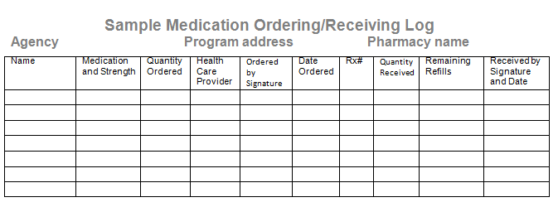
Medication Ordering/Receiving
Notes:
Review your system.
The system should have supporting documentation of
how you know medication has been ordered and
how you know it’s been received.
Pharmacy receipts must be kept on site for 90 days.
If pharmacy receipts or manifests are used as the medication ordering and receiving system, they are kept indefinitely and one year of documentation should be readily available on site.

Slide 138
Section M
Storage and Security
MAP Policy Section 10
Notes:
Inspect the medication storage area for cleanliness, that only supplies needed for med administration are present and that unauthorized personnel cannot gain access.

Slide 139

Storage
Prescription (Schedule VI)
Over the Counter
Dietary Supplement
Packaging
  Varying strengths separated
  Whole tabs separated from ½ tabs
  37-day supply
Notes:
Each person must have their own med storage container; including a refrigerated container when needed.
Ensure internal meds are stored separate from external meds.
Tabs of varying strengths must be packaged separately; whole tabs may not be packaged with ½ tabs.
If a person’s prescription plan requires that meds be filled in excess of a 37-day supply, ensure supporting documentation is in the med book; either a copy of the prescription plan requirement or a copy of the insurance card.

Slide 140

Expiration Dates
Notes:
Ensure medication is in date.
If medications expire; the meds should be removed from the person’s med storage container and placed elsewhere in the locked med area to await disposal. If the med is countable, it continues to be double locked and counted until disposed, as mentioned earlier.
Needles awaiting disposal must also be in a secure container or area.

Slide 141

Security
Med Area Locked
  Countable Meds Double Key Locked
Emergency Plan
  Back up Key access
Notes:
The medication storage area should be locked when not in use.
Meds are accessed using a key in addition to a combination code; countable, schedule II-V meds are double key locked.
‘Other’ keys are not stored with medication keys.
The combination to access the med keys is known only to Certified staff.
Keys stay with the Certified staff assigned med duties for the shift.
Medication storage keys are locked when Certified staff are not on site.
For emergency purposes, there should be a back up set of keys accessible only to administrative staff and a procedure in place regarding back up key usage.
As the Site Supervisor, you would not have access to back-up keys.

Slide 142
Section N
Massachusetts Controlled Substances Registration
MAP Policy Section 01
Notes:
The Massachusetts Controlled Substances Registration allows medication to be stored on site and permits Certified staff to administer medication.

Slide 143
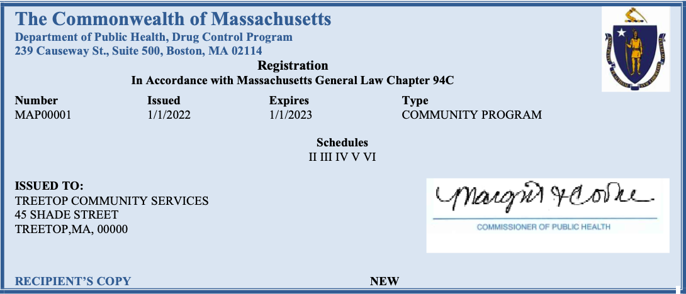
Massachusetts Controlled Substances Registration (MCSR)
Notes:
Check the MCSR to ensure it’s in date and readily accessible where meds are stored at the site.
The registration is renewed yearly.

Slide 144
Section O
Medication Disposal
MAP Policy Section 10
Notes:
In general, dispose of medication in a timely fashion.
You want to be sure you’re using the current disposal process and the current DPH disposal form.
The process is detailed in the policy manual.
The form must be used to document the disposal of all prescription meds, Schedule II-VI.
Although not required, over-the-counter meds and Dietary Supplement disposals may be tracked on the DPH disposal form.

Slide 145
www.mass.gov/dph/map
Notes:
To access the current form, use the MAP friendly URL.
Scroll down…

Slide 146
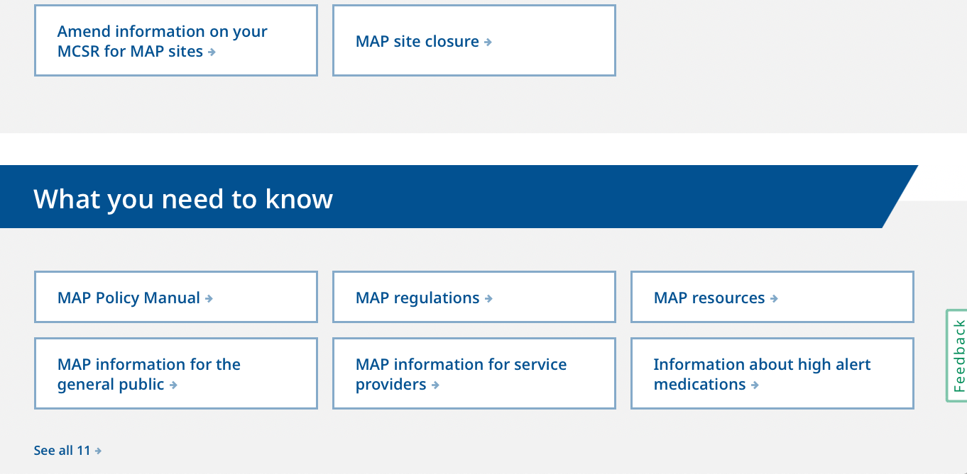
www.mass.gov/dph/map
Notes:
Click ‘MAP Policy Manual’

Slide 147

www.mass.gov/dph/map
Notes:
Click ‘forms’

Slide 148

www.mass.gov/dph/map
Notes:
This brings you to a lengthy list of all forms within the policy manual that you may print and use.

Slide 149

Controlled Substance Disposal
Record
Notes:
As you review the form, be sure that the heading is complete with the agency name, site address and MCSR #, labeled as the DPH Registration # on the form.
In addition, ensure all spaces are complete within a medication block.
The item number is a chronological listing of meds disposed. Each disposal form has room to document the disposal of 6 different meds, the next page would start with item number 7 and so on. You can categorize the disposal records year by year, starting each year with item number 1 followed by the current year.
Ensure disposal blocks are not skipped and the forms are not separated by person.
If the med is countable be sure to check that the Count Book # and count book page # were completed for cross referencing.
Ensure the bottom right corner of each disposal page is numbered.

Slide 150
Medication Disposal
Discontinued or Expired medication
Dropped or Refused medication
Notes:
For expired or discontinued meds, disposal always requires you, the Site Supervisor and a second MAP Certified or licensed staff to complete the disposal process.
Dropped or refused meds may be disposed with 2 Certified staff, if you’re unavailable, unless your Service Provider policy specifies that you must be involved in all disposals.
If a licensed nurse participates in the process, the nurse must always dispose of meds with you, the Site Supervisor and sign in the space labeled as ‘staff’ on a Disposal Record.

Slide 151

Cross Referencing Documentation
Disposal Record documentation matches
  Schedule II-V medication
Count Book documentation
Notes:
Review that the disposal record documentation of Schedule II-V countable medication matches the Count Book documentation.
Of note, during your documentation review, if you see prescription medication documented as disposed by one Certified or one licensed staff, this must be reported to the Drug Control Program (DCP) as a controlled substance loss.

Slide 152
Section P
Program Resources
MAP Policy Sections 01 & 10
Notes:
Each MAP Registered site must have required reference materials available to Certified and licensed staff.

Slide 153

Program Resources
Notes:
Check to see that there’s either a Drug Reference Book or printed Medication Information Sheets for all ordered medications and dietary supplements on site and current, within 2 years.

Slide 154

Program Resources
Notes:
Check to see that a copy of the MAP Policy Manual is on site; either as a hard copy or an electronic version.
As of today, the most current MAP Policy Manual is dated, 01-01-2015.
In addition, DPH Advisories issued after the policy manual date must be on site.

Slide 155

Program Resources
Notes:
Check to see that a copy of the Responsibilities in Action training curriculum is on site; either as a hard copy or an electronic version.
The curriculum may be downloaded from the www.massmap site or purchased from Amazon.
As of today, the most current training curriculum is dated, September 2020.

Slide 156

Electronic Versions
Accessible to all staff 24/7
On-line reference material maintained by government or other reputable source
Contingency plan in event computer not functioning
Notes:
If the required reference materials are stored on site electronically, ensure all additional requirements are met:
all staff must be trained on how to access the information and the training documentation is on site
the electronic versions must be available to staff 24/7
If the reference material is a website, it must be reputable and
there is a contingency plan in the event the computer is not functioning.

Slide 157
Section Q
Provider Policies
MAP Policy Sections 01 & 10
Notes:
Provider policies are based on the corresponding MAP policies but are customized to reflect the uniqueness of your provider. They’re meant to be a resource for your staff. They should be easy to understand and readily accessible.
For example, a person is going on an unplanned LOA for a weekend visit and the pharmacy can’t package the meds on short notice. Your staff should be able to quickly locate the agency policy for LOA meds and prepare them using the policy as their guide.

Slide 158

Provider Policies
Related to 24/7 access to MAP Consultant(s)
Medical emergencies related to medication administration
Leave of Absence (LOA)
  Identifying & educating staff/family/friends responsible for off-site medication administration
  Obtaining properly labeled containers when a med given in more than one location
Access to the medication area
Vital Signs
Medication administration times
Notes:
The Provider polices listed are required to be on site.
Consider flagging the provider policies for easy future reference.

Slide 159
Pertinent Medication Specific Policies
‘Method B’
administration of OTC medication & Dietary Supplements without a pharmacy label
Blood Glucose Monitoring
High Alert Medication Clozapine
High Alert Medication Warfarin sodium
Oxygen
Notes:
These Provider policies are required to be on site, only if applicable to the people you support.

Slide 160

Internal Procedure
Management/Reporting
  Refusals and/or
  other Medication Issues
Notes:
There should also be an internal procedure for your staff to report medication refusals and other medication issues.

Slide 161
Section R
Medication Occurrence Reports
MAP Policy Section 09
Notes:
Medication Occurrence Report forms, known as MORs, are tracked to monitor the MAP medication system.
The MOR data collected statewide is used in part to improve the medication administration program through policy and curriculum revision.

Slide 162

Medication Occurrence Reporting
Notes:
In the event of a medication occurrence, ensure that a single page of Emergency Contact numbers, such as 911, poison control, the pharmacy, MAP Consultants, etc., is near the phone.

Slide 163

Medication Occurrence Report Form
Notes:
DPH requires all agencies to submit this specific form for hotline MORs, regardless of the agency reporting.

Slide 164
www.mass.gov/dph/map
Notes:
To access the current MOR form, use the MAP friendly URL.
Scroll down…

Slide 165
www.mass.gov/dph/map
Notes:
Click ‘MAP Policy Manual’

Slide 166
www.mass.gov/dph/map
Notes:
Click ‘forms’

Slide 167
www.mass.gov/dph/map
Notes:
This brings you to the MOR form.

Slide 168
Medication Occurrence Report Timelines
MOR form
submitted to applicable MAP Coordinator
Hotline MOR form
submitted to DPH & applicable MAP Coordinator
within 7 days of discovery
within 24 hours of discovery
Notes:
Depending on the state agency, the method (the paper form, HCSIS, Qualtrics) used to submit an MOR form varies, however, all methods capture the same basic information, and the reporting timeline is the same for all sister agencies (DDS, DMH, DCF, and MRC.)

Slide 169

Minimize Future Medication Occurrences
Documentation
  Staff Training
  Supervised Medication Pass
  Policy Change
  Environmental Change
  Etc.
Notes:
Every MOR requires documented follow up to minimize an occurrence from happening again.
Ensure documentation of your follow up response as submitted on the MOR form is filed on site.

Slide 170

Original MOR Forms
‘Paper’ Version
Electronic Version
Notes:
Ensure all original MORs with corresponding training documentation are filed on site.
Electronic originals (when data is entered directly into the system used and no paper form is used) should be retrievable electronically on site.
For paper originals, most Site Supervisors use a 3-ring binder.

Slide 171

Online Resources
https://mapmass.com/
MAP Training Resources & Support
https://hdmaster.com/
Test Master Universe TMUⒸ
ma.tmuniverse.com
https://mass.gov
MAP Policy Manual
https://mass.gov/dph/map
Notes:
There are 3 major online resources.
The mass.gov site is the location of the Policy Manual, current DPH forms and ‘Recent News’ in MAP.
The mapmass site is the location of the online MAP courses and all MAP Training Resources and Support.
The hdmaster site is the location of Test Master Universe, known as TMUⒸ, the secure section of the D&S DT test vendor site,
TMUⒸ is also accessible via the direct link seen on your screen.

Slide 172

Questions
Notes:
Please direct any questions regarding the content of this webinar to the applicable MAP Coordinator.
This concludes the presentation.
Thank you for listening!

