Slide 1


Medication Administration Program
MAP trainer WEBINAR
Spring 2021
Notes:
Welcome to the semi-annual MAP Trainer webinar.
I’m Matthew Meredith, the ABI/MFP Statewide MAP Coordinator and I’m your webinar presenter.
By viewing webinars marked as ‘required’ within the specific time period, you’ll meet the MAP Trainer meeting ‘attendance’ requirement.
After the webinar, you’re encouraged to contact your MAP Coordinator if you have a question or need further clarification on a topic presented.
An updated MAP Organizational chart is included as a handout.

Slide 2
agenda
New Information
Updates
Online Training
Online Testing
Online Train the Trainer
Issues in the Field
Notes:
The agenda covers new information, updates related to MAP Policy and Covid-19, Online Learning, Online Testing and Issues in the Field.

Slide 3
New information
MAP
Notes:
Let’s start with ‘New Information’…

Slide 4
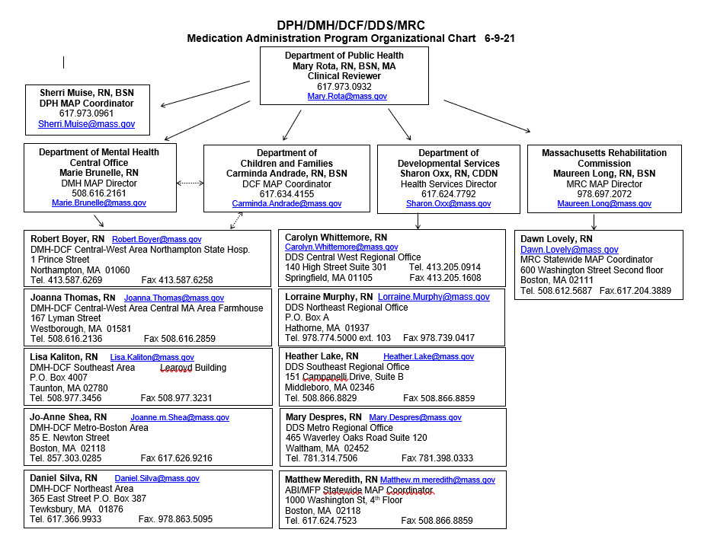
Notes:
You’ll notice the MAP Organizational chart has expanded!

Slide 5
DPH Drug Control Program
  DCP Organizational Structure
    DPH Clinical Reviewer
      Mary Rota, RN, BSN
    Statewide DPH MAP Coordinator
      Sherri Muise, RN, BSN
Notes:
The DPH Drug Control Program organizational structure now includes a position titled, ‘Statewide DPH MAP Coordinator’.
Sherri Muise joins the current DPH Clinical Reviewer, Mary Rota.
In her role, Sherri has also been conducting Clinical Reviews statewide for the purpose of evaluating the Medication Administration Program for safety and effectiveness.
In addition…

Slide 6
Massachusetts Rehabilitation Commission
MRC
  MRC MAP Director
    Maureen Long, RN, BSN
  Statewide MRC MAP Coordinator
    Dawn Lovely, RN, MSN
Notes:
The Massachusetts Rehabilitation Commission, known as MRC, which funds adult residential programs, officially joined MAP in December of 2020.
You’ll notice the organizational chart includes a new MRC section, contact information for Maureen Long and Dawn Lovely, as well as their respective titles, MAP Director and MAP Coordinator.

Slide 7
Department of Children and Families
DCF
  DCF MAP Coordinator
    Carminda Andrade, RN, BSN
Notes:
The last change to the org chart is that of the title of Carminda Andrade. Carminda is now the DCF MAP Coordinator.

Slide 8
UPDATES
MAP
Notes:
To convey new information, such as a change or an exception to a policy, DPH will typically communicate the new information by posting it online. To locate new information…

Slide 9
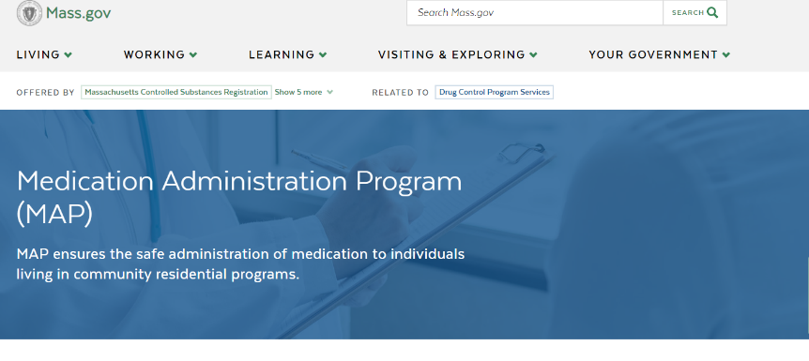
www.mass.gov/dph/map
Notes:
Using the MAP friendly URL, listed at the top of your screen, scroll down…

Slide 10
www.mass.gov/dph/map
Notes:
and click on the section titled ‘What’s New: MAP Recent News’.

Slide 11
www.mass.gov/dph/map
Notes:
Here you'll see a Table of Contents consisting of the specific date each ‘update' is added to the website.
The most current update is listed first.
You can either click on the date of interest or if you scroll down…

Slide 12
www.mass.gov/dph/map
Notes:
…you’ll see the subject of each update.
DPH typically issues an ‘Advisory’ when a clarification, modification or change is made to an existing MAP Policy or when there is no Policy that exists.
Many times, an ‘Advisory’ becomes Policy, reflected in a future MAP Policy Manual Revision.
One of the more recent ‘Advisories’ issued was in regard to ’MAP Policy 10-3 Controlled Substance Count’, which clarifies the ‘Shoulder-to-Shoulder’ Count Process.

Slide 13
www.mass.gov/dph/map
Notes:
Many ‘Notices’ were issued during COVID-19 regarding various MAP medication-related duties.
Be advised, that all COVID-19 Notices on the mass.gov website are subject to rescission without prior notice.
It is strongly recommended that you make a regular practice of reviewing online MAP-related information.
All current Notices and Advisories should be available at each MAP Registered site for staff reference.
After review of the ‘mass.gov’ website, if you’re unsure whether a Notice or an Advisory is still in effect, or you need clarification, please contact your Regional, Area or Statewide MAP Coordinator.

Slide 14
COVID-19 Notice of Rescission
MAP Certification Expiration Extension
  Ended December 31, 2020
Notes:
The DPH ‘Notice’ regarding MAP Certification Expiration Extension ended December 31, 2020.

Slide 15
COVID-19 Notice of Rescission
Massachusetts Controlled Substances Registration (MCSR)
  MCSR Expiration Extension
    Ended December 31, 2020
MAP Registered Sites must have an in-date MCSR
Notes:
Initially during COVID, all MCSR’s were allowed to extend beyond the expiration date.
As of December 31, 2020, the MCSR extension ended.
MAP Registered sites must have an in-date MCSR.

Slide 16
Massachusetts Controlled Substances Registration (MCSR)
MCSR Applications
  Application and Documents
  Email to MAP.MCSR@mass.gov
MCSR Certificates now sent via email
  Directly to Service Provider
MCSR Questions can be sent directly via email: Nathaniel.Furey-Moore@mass.gov
Notes:
Due to Covid and the work at home orders, completed MCSR applications and supporting documents are to be emailed to DPH at MAP.MCSR@mass.gov; this is the only method MCSR applications will be accepted. Once submitted, you will receive an email receipt; the email receipt along with the supporting documents which were submitted, should be maintained on site until the MCSR is issued. Please note: The MCSR application and supporting documents must be received six weeks prior to the expiration date listed on the current MCSR.
Once DPH receives the application and supporting documents, they are are reviewed and when approved, the Massachusetts Controlled Substance Registration certificates are now issued via email from DPH to the Service Provider.
This is an interim process. A new process is in development in which the application itself will be completed electronically. This process should be completed within the next 12 months.
For questions regarding the status of a MAP Registered site MCSR, please contact Nathaniel Furey-Moore at DPH via email at Nathaniel.Furey-Moore@mass.gov

Slide 17
attestation process
MAP Certification Reinstatement
  Attestation Process
    Continues as of Now
Notes:
The Attestation Process allowing Reinstatement of Expired/Lapsed MAP Certifications, continues as of now, however, in anticipation of ‘rescission without notice’ of this process, you should resume conducting in-house Recertification Testing.
Recertification testing can also be scheduled through D&S.

Slide 18
COVID-19 Flexibilities Ending
Medication Administration by
  Non-Certified staff
    Ends July 1, 2021
Notes:
During the pandemic, most Trainers maintained their ‘Approved MAP Trainer’ status by completing the online MAP Certification course, allowing a Trainer to be eligible to train their own student groups.
In addition, many new nurses have completed the Online Train-the-Trainer Program and are also eligible to train staff to become MAP Certified.
As a result, Service Provider staff shortages have decreased as more staff have completed the online training, have tested and are MAP Certified.
The COVID-19 flexibilities for non-MAP Certified staff to administer medications, will end July 1, 2021.

Slide 19
www.mass.gov/dph/map
Notes:
To access non-COVID related DPH MAP Communications, from the homepage…

Slide 20
www.mass.gov/dph/map
Notes:
…scroll down to the section titled, ‘What you need to know’.
Click on ‘MAP Resources’…

Slide 21
www.mass.gov/dph/map
Notes:
…once there, you’ll see a Table of Contents consisting of MAP Resource topics to choose from.

Slide 22
Technical Assistance Tool update
Notes:
As of 2/10/21, the Technical Assistance Tool (Medication System Monitoring Checklist) was updated and now includes DDS/DMH/DCF and MRC.
Please note that in the Medication Documentation section of the Tool that the item “Hospital Discharge orders are transcribed onto new medication sheets (prior med sheets are not used)” has been removed from the tool however, it remains best practice.

Slide 23
MAP Certification
Online training
Notes:
As of July 2020, DDS in partnership with The Center for Developmental Disabilities Evaluation and Research, known as CDDER, using the curriculum, ‘Responsibilities in Action’ as the framework, converted the in-person MAP Certification training to an online learning course.
The course meets MAP Certification Training requirements.

Slide 24
www.mapmass.com
Notes:
The mapmass site is the location of the online MAP Certification course and all MAP Training Resources and Support.
There are many areas of the homepage that are open to the public. MAP Trainers have access to all locked areas.
The site includes the Course Curriculum and Resources for both Trainers and Students.

Slide 25

Trainer Basics
Massachusetts Medication Administration Program
Notes:
The site also includes a MAP Trainer Basics webinar for Trainers new to facilitating online learning.
The goals of the webinar include reviews of:
MAP Certification Training requirements
Online MAP Certification pre-course preparation, facilitation tips, post course responsibilities and
Resources to help you navigate the state-contracted test vendor website, D&S Diversified Technologies, known as D&S DT.
It’s recommended even if you are not a new Trainer that you review this webinar as a refresher for online training tips and D&S DT testing information.

Slide 26
Notes:
On the mapmass site you will find an updated, PowerPoint presentation, posted in April, titled Warfarin Sodium, Anticoagulant Therapy, that can be used for general knowledge training as an optional resource if you choose.

Slide 27

Clozapine Therapy
General Knowledge Training
Notes:
Also updated and posted on the mapmass website as of May 2021, you will see the general knowledge Powerpoint for Clozapine Therapy.

Slide 28
MAP Certification
ONLINE TESTING
Notes:
During COVID-19, Certification Testing moved from an in-person test process to an online test process.
In addition, ‘TestMaster Universe’ known as TMU©, the secure section of the D&S DT website was revised after its implementation in January 2020.

Slide 29
www.hdmaster.com
Notes:
To access TMUⒸ, from the hdmaster website, click on ‘Massachusetts MAP Registry and Testing’.

Slide 30
Massachusetts Homepage
Notes:
This brings you to the Massachusetts homepage.
You can then access TMU© by clicking on ‘TestMaster Universe TMU© Start Page’.

Slide 31
ma.tmuniverse.com
Notes:
TMUⒸ is also accessible via the direct link seen on your screen.
On the homepage there’s a calendar for upcoming test dates, the option to search the public Massachusetts Registry or to read the Frequently Asked Questions (FAQs).

Slide 32
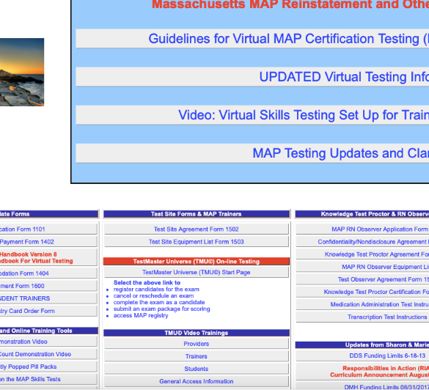
TMU© TUTORIALS
Introductory TMU© Video Trainings
  Providers
  Trainers
  Students
General Access Information
  How To:
    Sign In
    Retrieve Forgotten Password
    View Registry
Notes:
For assistance in navigating the various features of the TMUⒸ site, D&S DT developed sets of tutorials to assist Providers, Trainers and Students.
To view the tutorials, go to the Massachusetts homepage of the hdmaster website and click the category of your choice under ‘TMUⒸ video trainings’.

Slide 33
Pretest components in Tmu© available for MAP Trainers
Create Fake Student Account
  Log into TMU with your Trainer ID/Password
  Create your own student record
  Select yourself as the Trainer
  Select Provider that you train for
  Enter class start date
Notes:
As of 5/06/21, MAP Trainers now have access to both the 30-Question Multiple-Choice Knowledge Pretest and Transcription Pretest in TMU by creating a fake student account.
After following the steps above, a new “student account” will be available for you to access the pretests. Please remember to enter a start date.
Please note: To keep your new “student account” active, DO NOT enter a training completion date. Instead, after six months, update the ‘Class Start Date’ so that the record will not be archived.
(See notice from Sharon Oxx, DDS Health Services Director, which was distributed on 05/06/2021.

Slide 34
Accessible to MAP Trainers
Pretest Components
  Knowledge 30-Question Multiple-Choice
  Transcription
Notes:
Since the Knowledge Pretest is now accessible in TMU by a MAP Trainer, on the hdmaster website, under the labeled, ‘Trainer Tool only: Online Computer Based Pretest’, will be removed.

Slide 35
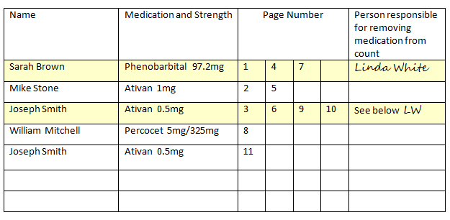
MAP CERTIFICATION Testing
Evolution from ‘in-person’ to online
Service Provider identified ‘Proctor’
  Medication Administration Test Component
    Responsibilities
      Test Scheduling
      ‘Test Packet’
      Room set up
      Hold camera, etc.
Notes:
MAP ‘in-person’ Certification Testing evolved to online testing by D&S DT during COVID-19 pandemic and remains online to present day.
The Knowledge and Transcription test components are both taken in TMU©. This allows them to be taken from any location as a D&S DT Test Observer looks on.
The Medication Administration Demonstration test component requires a Service Provider ‘Proctor’ in addition to the D&S DT Test Observer. The Medication Administration Demonstration test is conducted via the live video platform Zoom.
The Service Provider ‘Proctor’ may be a MAP Trainer or another designated person who has access to TMU©. Prior to the test, the Proctor must ensure there is a multi-use ‘Test Packet’ available for use by the student during the test process.
The Proctor will provide the ‘Test Packet’ materials, set up the test area for staff, and connect online with the D&S DT Test Observer prior to the start of the test.
The 3 test components may be taken in any order.
One of the TMU tutorials includes ‘How to Schedule Students’.

Slide 36
independent map trainers
Independent MAP Trainers Must
  Proctor the Medication Administration test
When
  Staff trained do not work for a Service Provider
Notes:
If a staff trained does not work for a Service Provider, the Independent MAP Trainer is responsible to identify a test location and be present as the ‘Proctor’ during the medication administration demonstration component of the test.

Slide 37
D&S Diversified Technologies
Massachusetts Team
  Anne Shields, MAP Program Manager
    877-851-2355
Notes:
Please contact a member of the D&S Massachusetts team for any test related or TMU© questions or issues.

Slide 38
Train-the-trainer
online Program
Notes:
The ‘traditional’ in-person TTT due to COVID, was converted to an online program.

Slide 39
Train-the-Trainer PROGRAM
TTT Program evolved from ‘in-person’ to online as of December 2020
  Four Step Online Program
      TTT Course
      MAP Certification Course
      Webinar (Moodle Instructions for MAP Trainers)
      Webinar (Trainer Basics)
Notes:
As always, qualified professionals interested in becoming a MAP Trainer, can register for the TTT program through a MAP Coordinator.
The online program is located at www.mapmass.com and consists of 4 Steps. DDS, DMH, and/or DCF MAP Coordinator ‘Overseers’ will support participants through the process.
The DPH Clinical Reviewer is also available, if needed for questions.

Slide 40
APPROVED MAP Trainer
MAP Certification Trainer
  Conduct a minimum of 1 MAP Certification training yearly
MAP Recertification Trainer
  Train/Test a minimum of 1 MAP Recertification every 6 months
View mandatory webinars created by MAP Coordinators and as determined by DPH regarding all DPH approved:
  Training and test materials
  Advisories and policies
  Any other changes
Notes:
The requirements to maintain your Approved MAP Trainer status are unchanged.

Slide 41
Issues in the field
MAP
Notes:
The last few slides identify trends noted statewide.

Slide 42
Medication Occurrences
Omission
  Most common Type of Occurrence
  Primarily due to not obtaining medication in a timely manner
Notes:
A contributing factor on medication occurrence reports reveal numerous omissions of medication due to lack of receiving the medication in a timely manner from the pharmacy. This type of omission can often be avoided by re-training staff on the MAP Registered sites’ ordering and receiving medication system, to ensure individuals receive their medication as prescribed.
When medication is received, remind staff to note the number of refills remaining so that the HCP can be contacted well in advance of running out of medication.
Sometimes omissions are out of staff’s control. If a medication has been ordered in a timely manner, and the pharmacy has not delivered it, correspondence with pharmacy personnel should be documented until the medication is received.
In addition, when there is a delay in receiving a medication due to other reasons (e.g., medication requiring a Prior Authorization, it’s out of stock etc.), the HCP should be immediately contacted, and orders obtained.
Obtaining an HCP order with instructions regarding what to do in the interim if a medication is not available, supports staff not administering the medication and is therefore not a medication occurrence.

Slide 43
Medication Occurrences
WRONG TIME
Selected when medication is
  administered outside of time ordered by the HCP; or
  when ordered parameters are not followed
    HCP Order: Hold Lisinopril if BP below 100/60
    What Happened: BP 90/55 and medication was administered
Notes:
The category of ‘Wrong Time’ is selected when a medication is administered outside of the time ordered by the HCP or outside of HCP ordered parameters.
Please note the example on your screen.

Slide 44
MEDICATION DOCUMENTATION ISSUES
Medication Administered
Staff forgot to Initial
  Next time on duty
    Documentation Process
      Box on front of MAR remains blank
      Staff write a ‘Late Entry’ on back of MAR
Notes:
There has been confusion regarding when a medication is administered but is not initialed as given on the medication sheet.
During the review of monthly medication administration record documentation, if a blank space is noted in the medication box, and a process such as blister pack monitoring is in place where it is determined the medication was administered as ordered, there is a ‘Late Entry’ documentation process that follows.
When the staff who forgot to initial following medication administered returns to work, they must document a ‘late entry’ progress note on the back of the MAR.
The expectation is that the box on the medication grid remains blank. The late entry progress note will explain the reason for the empty box.
Please remember it is only a Medication Occurrence if it is able to be determined that a medication was not in fact given.

Slide 45
Medication Occurrence Reporting
Timeline Reminder
  Hotline Medication Occurrence
    Must report within 24 hours of discovery
      DPH Clinical Reviewer
      MAP Coordinator
  Non-hotline Medication Occurrence
    Must report within 7 days of discovery
      MAP Coordinator
Notes:
As a reminder, Hotline MORs must be reported to the applicable MAP Coordinator and DPH within 24 hours of discovery/time of the occurrence.
Non-Hotline MORs must be reported with 7 days of discovery.
If you are unsure if a Medication Occurrence occurred, please reach out to your Regional/Area/Statewide MAP Coordinator.

Slide 46
www.mass.gov/dph/map
Notes:
The DPH medication occurrence report form is frequently revised. The most current DPH MOR form was revised on 1/06/2021.
To locate the form, from the DPH MAP homepage, click on ‘MAP Policy Manual’.

Slide 47
www.mass.gov/dph/map
Notes:
Clicking the ‘Forms’ link will bring you to a list of forms.

Slide 48
www.mass.gov/dph/map
Notes:
Scroll down to the MOR form.

Slide 49
‘Directions change’ sticker Reminder
Used only when ‘Exhausting Current Supply’
  Label Correction
    within 30-days or
    when next supply is delivered
Notes:
As a reminder, per MAP Policy 13-4, Exhausting Current Supply of Medication, a ‘directions change’ sticker is only to be used as a flag to alert the staff administering the medication to a new, changed HCP order.
The sticker placed on the pharmacy packaging indicates that there is a new Health Care Provider order and that the information on the label is no longer accurate.
A ‘directions change’ sticker should be adhered to the medication packaging as to not destroy or obstruct the original pharmacy label. Staff are never to write or mark directly on the medication label.
The pharmacy must be contacted so that the label is corrected within 30-days or when the next supply of medication is delivered, whichever comes first.

Slide 50
NO ‘Directions change’ sticker
A ‘directions change’ sticker may not be used
  To ‘flag’ a discrepancy between HCP order and pharmacy label
  In absence of a new HCP order
    The discrepancy must be corrected immediately
Notes:
A ‘directions change’ sticker cannot be used as a ‘flag’ to alert staff of a discrepancy between the pharmacy label and HCP order such as the medication name on the HCP order not agreeing with the medication name on the pharmacy label.
Any discrepancy must be reported to your MAP Consultant for a recommendation and the label must be corrected by the pharmacy immediately.

Slide 51
telephone HCP orders
Process
  Repeat back to HCP
  Post and Verify twice
  HCP signature within 72 hours
Reference MAP Policy 13-3
Notes:
Although MAP allows Certified staff to take telephone HCP orders, some Service Provider’s do not.
For those Service Providers who do allow the practice, trends identified show the process of taking a telephone order is not always carried out correctly. This has resulted in medication occurrences due to medication administered without a valid HCP order.
All telephone HCP orders must be repeated back to the HCP, posted and verified by certified staff and sent to the HCP for their signature. The order must be received back into the program and signed by the HCP within 72 hours, and posted and verified a second time. For details, please see MAP Policy 13-3.

Slide 52
DPH disposal form
Must be
  Completed when a Medication is Disposed
  Conducted with a MAP Certified Site Supervisor and another Certified/Licensed staff
    Licensed staff disposing of medication with a Supervisor, will sign off as 'staff' in space provided, and not ‘Supervisor’
Notes:
Disposal forms must be completed accurately to avoid reporting missed documentation as a drug loss.
Please keep in mind that all disposals require two Certified and/or licensed staff, one of which is a supervisor. If a dose of medication requires disposal (in cases of refusals, dropped medications etc.), two Certified staff on shift may dispose of the medication in the absence of the supervisor if also allowed by the Service Provider. Please make certain that both staff are signing off on the most current Medication Disposal Form.
Disposing of medication alone or a single signature on a Disposal Form is considered a drug loss and must be reported to the Drug Control Program. See MAP Policy No. 10-5 for details.

Slide 53
Service Provider Specific Training
Important Reminder: All staff, including MAP Certified relief staff and newly hired MAP staff, must receive Service Provider specific training (as applicable) in:
Obtaining vital signs
Administration of Coumadin
Administration of Clozaril
Administration of meds via G/J tube
Administration of Oxygen
Administration of Epinephrine via auto injector
Administration of medications via routes other than oral; and
Obtaining and monitoring of Blood Glucose
Notes:
As a reminder, MAP certified staff including relief staff must receive additional training if they are required to administer medication that requires vital signs monitoring or blood glucose monitoring prior to administration of a medication; will administer a medication via a route other than oral; and/or for any other specialized trainings listed on your screen.
Proof of the above trainings must be maintained at each program site.

Slide 54
Next webinar datE
Fall 2021
Notes:
This concludes today’s webinar, the next MAP Trainer webinar will be in the Fall of 2021, date to be determined.
Thank you for listening.

