Slide 1

Responsibilities in Action
Understanding the Connections
Notes:
Housekeeping-bathrooms, smoking area, scheduled break, cell phone silent
Training materials
-Massachusetts curriculum ‘Responsibilities in Action Understanding the Connections’
-Printed copy of MAP Candidate Handbook
MAP is overseen by DPH
Carried out jointly by DDS/DMH/DCF/MRC

Slide 2

Contact Information
Name
Email
Cell
Office
Fax
Notes:
Here is my contact information.

Slide 3

TestMaster Universe (TMU)
Notes:
D&S Diversified Technologies is the name of the testing company. All of you should have had your demographics entered into the testing company’s database before the start of class. Once your information is entered, you will be able to access your account.

Slide 4
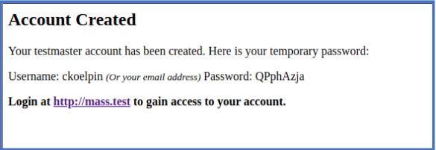
TMU
Notes:
Each of you should have received an email from D&S notifying you that a testmaster account has been created.

Slide 5

ma.tmuniverse.com
Notes:
Once you receive the email, you should access the home page using the web address listed above. Select the sign in box in the top right hand corner.

Slide 6
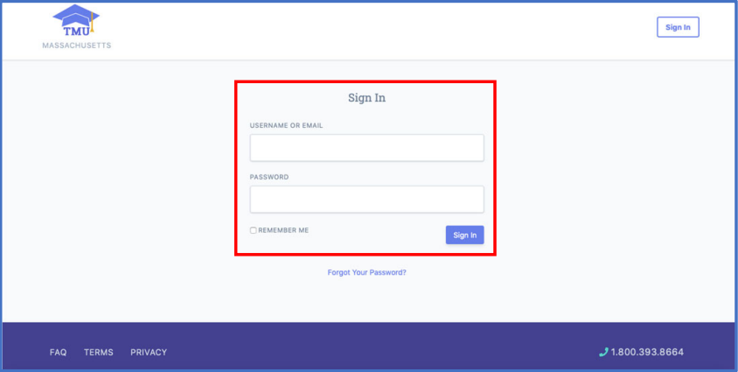
ma.tmuniverse.com
Notes:
Using the information provided in the email, enter your user name and temporary password.

Slide 7
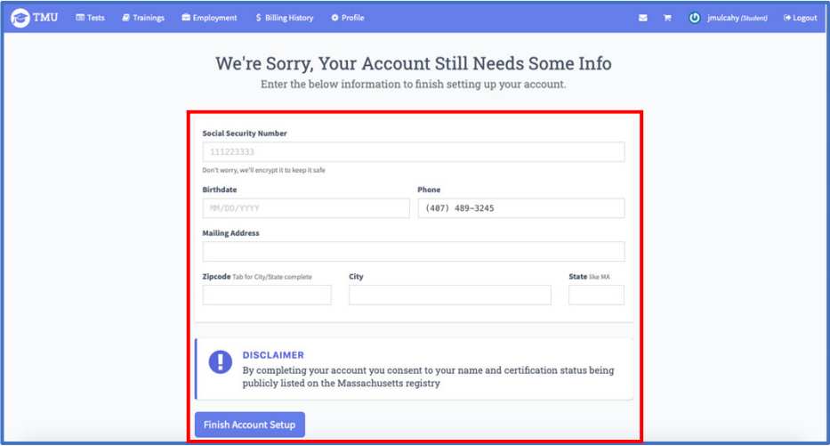
ma.tmuniverse.com
Notes:
You will then see this screen. You will need to complete your profile and change your temporary password. Then you will need to compare the name entered in your profile to your US government issued, non-expired photo ID that you plan to use when testing; such as a Driver’s License. Demographics must be updated to reflect the exact name on the ID, if needed.
Once completed select Finish Account setup (blue box at bottom left).

Slide 8
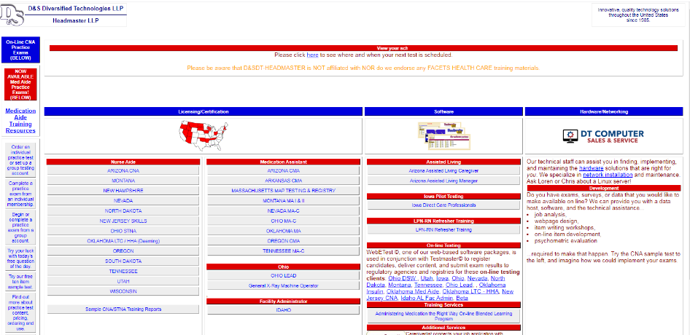
www.hdmaster.com
Notes:
There is also a tutorial available for you to review regarding accessing the homepage, located at www.hdmaster.com
Once there, ‘click’ on Massachusetts MAP Testing & Registry…

Slide 9
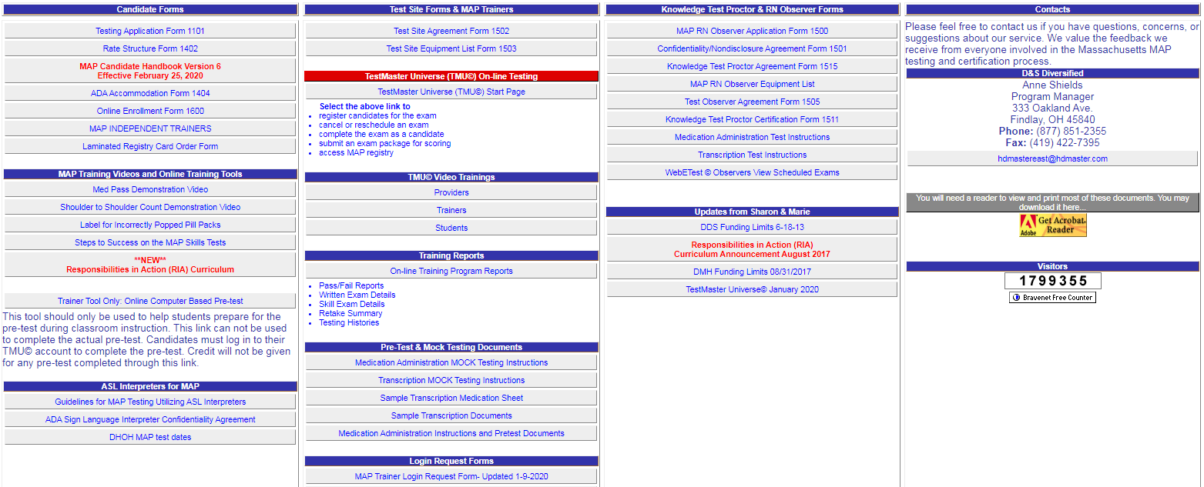
Student Tutorial
Notes:
….this will bring you to the Massachusetts MAP homepage where you can select the tutorial under TMU Video Trainings.
It is important that the you are aware of your responsibilities in accessing your testing profile and updating with any required corrections.
There are also other tutorials here that cover other aspects of certification testing. I encourage you to view them for any required assistance with scheduling and testing.

Slide 10
Successful Completion
100% Attendance
Pre-test(s)
  Computer Based Test (CBT)
  Medication Administration
  Transcription
Notes:
Tips for success:
-ask questions
-participate
-read training manual

Slide 11
Computer Based Pre-test
30 multiple choice questions
  General knowledge
35 minute time limit
80% or better is passing
Notes:
24/30 questions correct
This is a ‘take at home’ test. It is okay to use ‘Responsibilities in Action’ student manual to look up answers.
To the Trainer:
Remember, if at any time a MAP Trainer questions the veracity of the test results for any student they can require the student to take another CBT under supervision.
The following slides review how the student will access the CBT. If the trainer prefers they can also access the CBT for classroom demonstration at www.hdmaster.com, click on the MA homepage and in the first column select the CBT for classroom use.

Slide 12
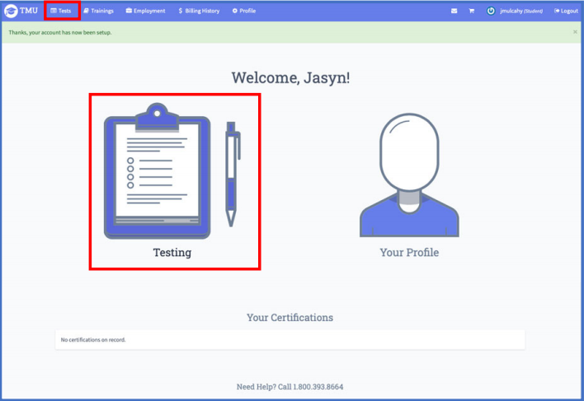
Computer Based Pre-test
Notes:
To access the Computer Based Pretest, you will login into your account and then click on either the ‘Test’ tab at the top of the page or the “Testing” box in the middle of the page.

Slide 13
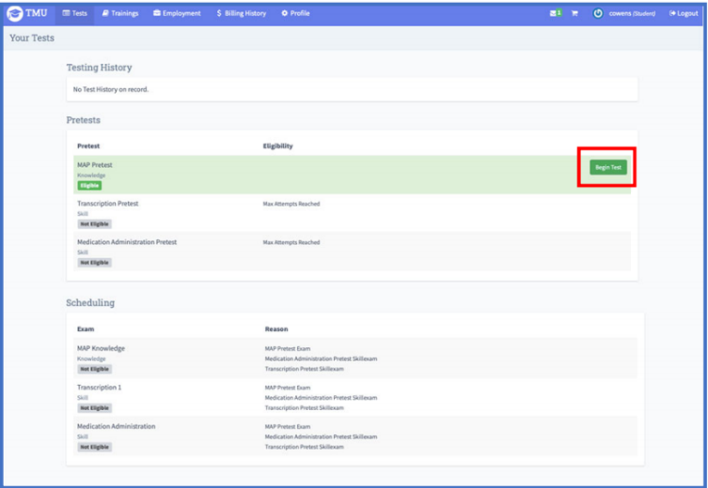
Computer Based Pre-test
Notes:
This will bring you to this page. Under the “Pretests” section, you will find “MAP Pretest”. This is the MAP Knowledge Computer Based Pretest (CBT). To begin the pretest, you will click ‘Begin Test’ on the right side of the Pretest section.

Slide 14
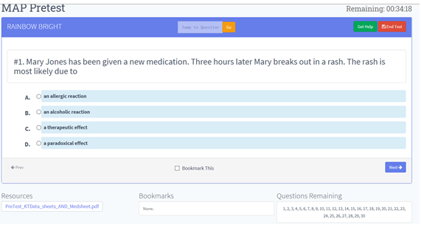
Computer Based Pre-test
Notes:
After you select “begin test”, the screen will look like this. To choose an answer, you will select the bubble next to your selected answer. If you are not ready to answer the question and would like to come back to it later, you can “bookmark” the question by checking the ‘Bookmark This’ box in the middle of the page. In the ‘Bookmarks’ section in the bottom left, if you have bookmarked a question, a clickable number will appear in the white space so that you can go back to that question. You can move to the next question by choosing the ‘Next’ button in the lower right corner. If you need to jump to a question, you may enter the number into the ‘Jump to Question’ box at the top of the page and then click ‘Go’. You may use this option if you did not bookmark a question and you know the number you had skipped.
All questions are multiple choice.

Slide 15
Computer Based Pre-test
Notes:
When you answer the last question, you will click on ‘End Test’ in the upper right corner of the screen.

Slide 16
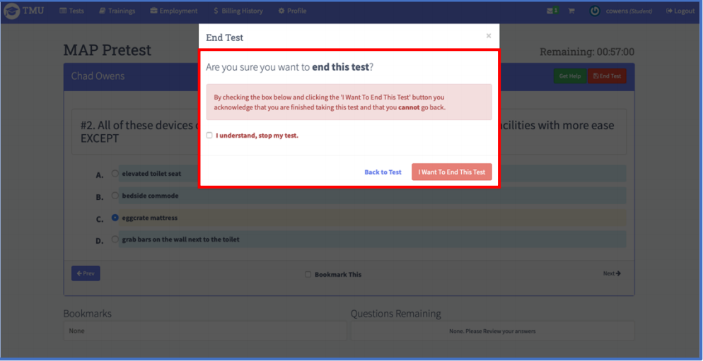
Computer Based Pre-test
Notes:
This box will pop up. The system will double check that you want to end your test. You will have to verify that you want to end or stop the test by checking the box ‘I understand, stop my test’ on the left side of the box. After checking the box, you will click ‘I Want To End This Test’ in the lower right side of the box. If you would like to go back to or continue your test you will click ‘Back to Test’.

Slide 17
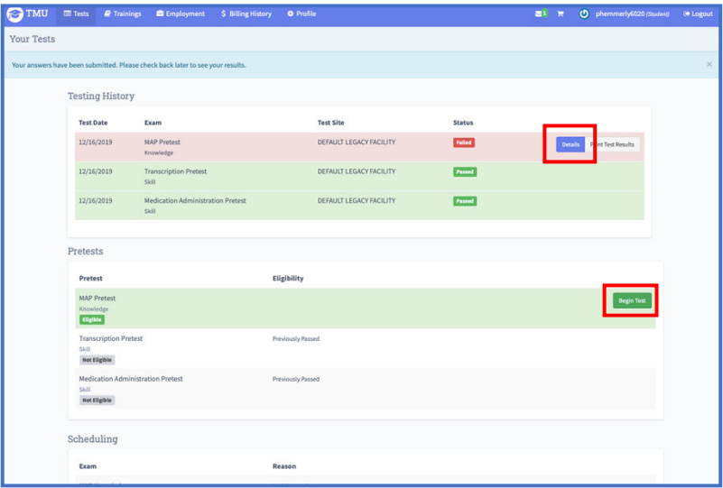
Computer Based Pre-test
Notes:
Upon ending the exam, you will be taken back to the ‘Test’ page The blue bar across the very top of the screen will inform you that your test was submitted properly. If you would like to take an exam over again, regardless of pass/fail, you have the option to take the test over again by clicking ’Begin Test’ next to the MAP Knowledge test in the ‘Pretest’ section. If you would like to review your test results you will click ‘Details’ next to the exam in the ‘Testing History’ in the upper right side of the page. You must get a 80% or higher score within the 35 minute time limit. You are encouraged to use the CBT as a study tool even after you pass. There are over 200 questions in the database.

Slide 18
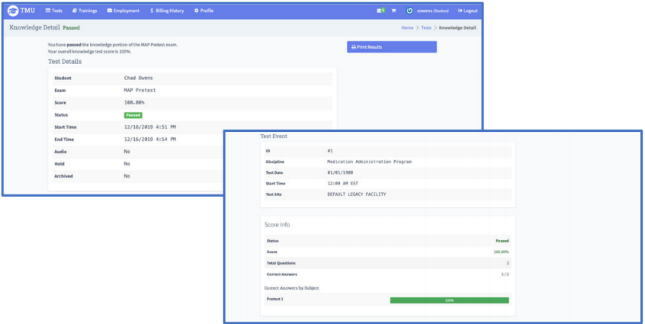
Computer Based Pre-test
Notes:
After selecting details, this screen will appear and it will show your test results.
There is a specific tutorial found along with the other tutorials titled “How to take the MAP knowledge Pretest” that reviews these steps in detail.
You can access the pretest any time.

Slide 19
Medication Pass Pre-test
Medication Administration
  You will be observed as you apply your knowledge of the 3 checks of the 5 rights
    Feedback by Trainer
      80% or better to pass
Notes:
The med pass is another pretest component.
Using a checklist, I will be observing each of you complete a med pass and provide feedback.

Slide 20
www.hdmaster.com
Notes:
You will see a medication administration video today before you start practicing med administration. It is located on the D&S website. You can watch it again on your own time. The demonstration reinforces what is expected during the med pass component of the skills test.

Slide 21
Transcription Pre-test
Transcription
  Discontinue (DC) one med
  Transcribe one new med
    15 minutes
    100% accuracy
Notes:
The last pretest component is the transcription. There is a 15 minute time limit. You must complete it without making a mistake.
The transcription is taken as a group on the last training day. We will spend most of the day on day 3 practicing how to transcribe.
You must pass all pretest components to be eligible to test with D&S. Once you have completed all pretest components successfully, I will update your file in the system, your employer will verify your employment, then you can schedule yourself to test.

Slide 22
D&S Diversified Technologies
Three Timed Test Components
Knowledge CBT
  50 questions
  75 minutes
Skills
Medication Administration
  Verbalize and point as you preform 3 checks of the 5 rights
  10 minutes
Transcription
  DC one medication and transcribe one medication
  15 minutes
Notes:
The pretests set you up for success and mirrors the D&S tests.
Test Preparation: read curriculum; watch the med admin demo, practice skills and take the computer pretest over and over, to review of content covered

Slide 23
Medication Certification
Meds may be administered in
  DDS adult
  DMH/DCF adult and youth
  MRC adult
  funded, operated or licensed programs
Good for 2 years
Notes:
Once you pass all test components, your can print out a copy of your MAP Certification letter from the TMU website using the MA registry.

Slide 24
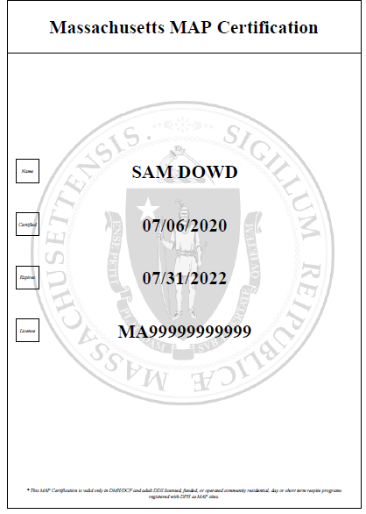
Certification Letter
Notes:
Proof of current med certification must be in every program where you give meds at all times.
Review pages 9 and 10 on your own for additional information specific to med certification.

Slide 25
Re·spon·si·bil·i·ties
Observe and Report
Assist with HCP visits
Obtain medication from pharmacy
Transcription
Medication security
Medication administration
Documentation
Notes:
Optional ask a volunteer read through page 2.
We will be covering these responsibilities (in detail) as they relate to medication administration throughout your training.

Slide 26
Let’s Begin!
Units 1-9
  Responsibilities you will learn
  Symbols
  Exercises
  Let’s Review
Case Studies
Appendix
Words You Should Know
Answer Key
Notes:
Each unit has a list of information you will learn, content, many exercises to help reinforce the content covered and ends with a review section.
Page 12-Symbols
Within the units are symbols-identify important facts, questions you need to ask your supervisor, references to the MAP Policy manual (link to policy manual page 11)
Appendix contains scenarios that you may encounter in your work setting and is a reference guide. There are no test questions from this section.
Lets turn to p. 13 and review the case studies.

Slide 27
Case Studies
Juanita Gomez
Ellen Tracey
Tanisha Johnson
David Cook
Notes:
Options To the Trainer:
-Divide into groups, assign each group to read info on their character; discuss, decide on a spokesperson then report back to the larger group.
-Have different staff read through each case study

Slide 28
Community Resources
Notes:
Before you start giving meds, if you have any questions about meds or medication administration you need to know who to ask…

Slide 29
MAP Consultant
Registered Nurse
Pharmacist
Authorized Prescriber
  Health Care Provider (HCP)
  Nurse Practitioner
  Dentist
  Etc.
Notes:
…in the setting you work in that would be a MAP consultant; RN, pharmacist or HCP (same as authorized prescriber.)
An authorized prescriber is someone who is registered in Massachusetts to prescribe medication.
Page 15
Each program is required to have 24/7 access to a MAP consultant.
Consultants will
-answer questions about medication procedures or questions specific to meds.
-provide recommendations if too much, too little or if a med is not given at all.
Find out who your MAP consultant(s) are and where phone numbers, including emergency numbers are located where you work.
Page 16 Example of Emergency Contact List
EXERCISE page 17
RAISE hand if you have taken or helped a family member with a prescription med
-why did you need it?
-how did you get it …sick, called HCP, went to doctor, med prescribed, pharmacy
-in addition to the medication, what else did you receive with the medication? (Medication information sheet.)
-did it work?
Specific to your work location you need the following to give medication…

Slide 30
Required for Medication Administration
HCP Order
Pharmacy Label
Medication (Med) Sheet
Notes:
A HCP order is needed for every medication you give.
Most of you are familiar with pharmacy labels.
Medication sheets are to document the meds you administer.

Slide 31
Medication Book
Contents
  HCP order(s)
    HCP visit encounter form if it includes an order
  Medication Sheet(s)
    Acceptable Codes
    Med progress notes
  Medication Information Sheet(s)
Notes:
Go through med book contents…
HCP orders must be renewed at least yearly. (Many times renewed in conjunction with yearly physical.)
For training purposes, the year of these documents is not specified. (yr.)
Initials are written every time after you give meds next to the name of the med across from the time given and under the corresponding date.
In signature key sign name/initial only once on each med sheet for the month.
Acceptable Codes at bottom next to signature key.

Slide 32
Count Book
Three Sections
  Index
    Used to locate the correct Count Sheet
  Count Sheets
    Used to document when a med has been added or subtracted from count
  Count Signature Sheets
    Used to document when the count has been conducted and the medication storage keys change hands
Notes:
In addition to keeping documentation of all prescription meds ordered and received, countable substances require entry into a Countable Controlled Substances book.

Slide 33
Responsibilities
Observing
  Helps to recognize changes
Reporting
  Helps to ensure best care possible
Notes:
Page 17
How did you first learn about the people you support? (Possible answers-watching, talking with and listening to the person, communicating with the person's family, your co-workers; reading the persons confidential file.)
Getting familiar with a person’s daily habits, routines is important because a big part of your job is looking for changes in their physical condition (nose is red/runny) or behavior(slapping/crying).
Once you are familiar with the people you support, recognizing and reporting changes will ensure they receive the best care possible.
There is basic information to remember as you administer medication to the people you support.

Slide 34
Medication Basics
Principles of medication administration
Rights related to medication
Daily routine
Notes:
The next few slides cover the basics.

Slide 35

Principles of Med Administration
Mindfulness
Supporting Abilities
Communication
Notes:
Page 18 To administer meds safely you must follow the same process every time while incorporating these principles.
Mindfulness means a few things:
pay attention
think about what you are doing
minimize distractions NO CELL PHONES
be observant
report observations
Never allow the medication administration process to be come routine (consider changing the order of who you administer medications to first)
Supporting abilities:
-helping a person to function as independently as possible
Communication:
-contacting a MAP consultant if needed
*other than talking give me examples of how we communicate…facial expressions, listening, written notes, body language, tone of voice
EXERCISE page 19
You have a responsibility to treat the people you support just as you or a family member would want to be treated.
We all have basic rights…tell me rights people have specific to med administration.

Slide 36
Respecting Rights
Everyone has the right to
  Privacy
  To be treated respectfully
  Know what meds they are taking
    How it will help
    Possible side effects
  Refuse medication
  Be given medication only as ordered by the HCP
Notes:
Page 20
If a person refuses, what is the first thing you should do?
-Ask them why, then report to prescriber and your supervisor
…Because the goal is for someone to take their meds and if there is a problem it needs to be solved.
Page 21
EXERCISE Related to medication only administered as ordered by the HCP. See Ellen Tracey’s Support Plan Anxiety Management

Slide 37
Daily Routine
When you arrive at work
  Greet the person
  Ask how they are doing
Pay attention to
  Behavior
  Physical condition
Receive shift report
  Changes must be communicated
Promote a home like environment
Notes:
Once you become Certified, you will want to find out if there are new orders since the last time you worked and how that is communicated.
Page 22 Ask for VOLUNTEER to read ‘Let’s Review’

Slide 38
Responsibilities
Observing
Reporting
Documenting
Notes:
Unit 2 Pages 23-31
Follow up on what you have reported to learn what was done.

Slide 39
Observation
Objective observation
  See
  Hear
  Feel
  Smell
  Measure
Notes:
Page 23
What does observation mean?
Observation-paying attention to the people you support and recognizing a change has occurred.
Objective-what you can see, hear, feel, smell AND things that can be measured, i.e., temp., BP

Slide 40

Observation
Subjective observation
  When a person tells you how they feel
Notes:
Page 24
Subjective-what/how a person tells you they feel
EXERCISE Page 24

Slide 41
Observations
Objective
Subjective
An observation based on fact
Fact- a piece of information that can be proven true with evidence
An observation based on opinion
Opinion- a statement that expresses feelings or emotions that cannot be proven true
Notes:
The differences between objective and subjective information.

Slide 42
Reporting
Everyday
  Between staff at shift change
Immediate
  As soon as possible after a change is observed
Notes:
Pages 24-27
Reporting is both verbal and written.
Report the facts.
Do not guess at what you think the issue might be.
Reporting immediately may prevent a small change from becoming a major health issue.
The more details you report the better the HCP can determine the most appropriate treatment.
The quality of the healthcare a person receives is only as good as the information you report to the HCP.

Slide 43
Reporting
If unsure…..
  Report anyway
Knowing who to report to
  Is your responsibility
Notes:
Why report if you are unsure???
Any change in physical condition or general behavior could be important.
Being aware of who to report to is an important part of your responsibilities. (Could be directly to the HCP, supervisor, MAP consultant.)
Find out from your supervisor-do you directly contact doctor if need info about a person’s health etc. Depending on the situation and the provider you work for the answer may be different. However, if a ? regarding meds and how to give…always contact MAP consultant first and directly.
Page 28 EXERCISE

Slide 44
Documentation
Tells a story from start to finish
  Include:
    Your question or concern
    The response given to you
    The name of who you contacted
    Date, time and your full name
Notes:
Pages 29-30
Make sure all of your questions are answered by the person you contacted and document the conversation
When documenting:
-use ink
-write clearly
-use complete sentences
Because we are all human, how do you correct a documentation mistake? (next slide)

Slide 45
Documentation Correction
Do
Do NOT
Draw a single line
Write
  Error
  Your initials
Scribble
Mark over
Use white out
Erase
Notes:
Review examples of corrected progress notes on pages 29 and 30 (See 3-4-yr 3:30pm note)
The same correction method is used if a mistake is made in a count book on a count sheet page (next slide.)

Slide 46
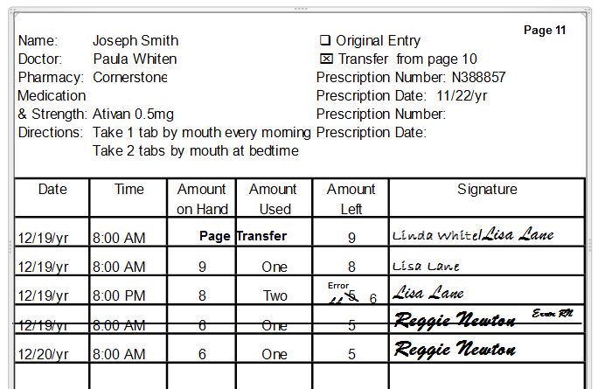
Correcting a Count Sheet
Notes:
This scenario includes examples of how to correct a documentation errors in a count book.
Lisa wrote small enough and neat enough to be able to correct on the same line. (She subtracted incorrectly.)
Reggie’s writing is bigger and he decided to mark a single line, error and initial through the entire row and rewrite the information. (His date was incorrect.)
You may only correct your own documentation errors. You never mark through someone else’s documentation.
Page 31
Ask for VOLUNTEER to read ‘Lets Review’
Approximately 11:00am-Ten minute break

Slide 47
Infection Control
How to Prevent and Control Infection
Notes:
What’s the best thing you can do to prevent spreading germs?

Slide 48

Handwashing
Handwashing
  When
  How
Notes:
In addition to before and after administering meds, tell when you should wash your hands.
How long should you rub together with soap and water? (At least 20 seconds.)
If you have not had an in-service on hand washing yet…review page 134

Slide 49
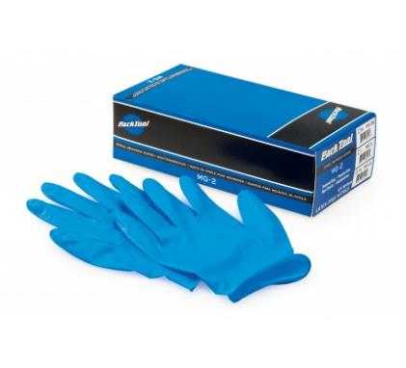
Glove Use
Glove use
  When
  How
Notes:
In addition to hand washing you may need to wear gloves.
If have not yet attended an in-service on putting on or taking off gloves read page 139.

Slide 50
Responsibilities
Medication Administration
  General Guidelines
Notes:
Who has heard of the 5 rights?
You will be checking the 5 rights as you compare them between the HCP order, label and med sheet to ensure the info agrees.
Individual
Medication
Dose
Time
Route

Slide 51
The Five Rights
Right Person
Right Medication
Right Dose
Right Time
Right Route
Notes:
Optional-Divide into groups each taking a “right”, read, talk about what it means and report back to group.
Right Person page 116-117
Right Medication page 118
Right Dose page 120
Right Time page 123
Right Route page 124

Slide 52
Right Person
If uncertain….
  Get help
  Ask another staff
  Check a picture
    Emergency Fact Sheet
Notes:
[EFS Page 117]
If you're not sure of the person, never ask them their name, such as , ‘Are you David Cook’? (Someone other than David may respond.)

Slide 53

Right Medication
If HCP writes brand name on prescription
  Pharmacist will usually substitute with generic
If unsure
  Ask pharmacist
Notes:
Page 118

Slide 54
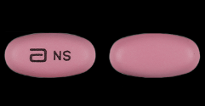

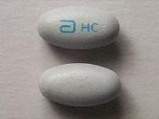
Right Medication
If familiar with med but notice a change in
  Color
  Shape
  Size
  Marking etc.
    Contact the pharmacist
Notes:
EXERCISE page 119

Slide 55
Right Dose
HCP orders the dose
  Usually written in ‘mgs’
    Milligrams
Notes:
Page 120
Review page 121 Dose = Strength X Amount
Exercise page 1232

Slide 56
Right Time
Particular time of day
Number of times per day
Time between doses
Notes:
Page 123
The words frequency (printed on a med sheet) and time are used interchangeably.

Slide 57


‘On time’
Meds may be given safely
  One hour before and
  Up to one hour after
    time scheduled on med sheet
If unsure,
  Ask a pharmacist
Notes:
If a med is scheduled for 5pm what is the timeframe that you have to administer the med?
What would you do if a med hasn’t been given, the med sheet hour is 7a and it is 8:05a, what do you do?

Slide 58
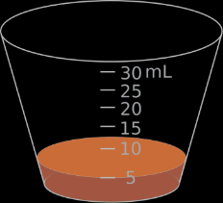
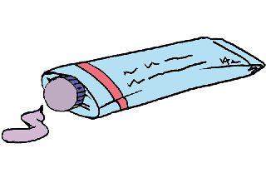
Right Route
The form of med determines route
  Tabs, caps, liquids
    Usually oral
  Ointments to skin
    Topical
Notes:
Page 124
The route ordered determines how the medication enters the body.

Slide 59

Other Routes
Never administer a med by any route
  Until you have received training in that route
Notes:
Focus of this training is on oral medication, other routes require additional training.
Page 124 has a list of other routes including meds via:
-g/j tube
-epi-pen
These are separate person specific specialized trainings by licensed staff not covered in this training.
EXERCISE page 125

Slide 60


General Guidelines
Three checks of the
  Five rights
    Before medication administration
Notes:
Page 126
What do you need to give meds?
-order-label-med sheet
Three checks of the 5 rights between HCP order, label and med sheet.
You will be reading the written info between these items to ensure all agree with each other.
Checks are absolutely necessary because there is always a possibility a change was ordered since the last time you worked.

Slide 61

T Three Checks
HCP order-Pharmacy label
Pharmacy label-Med sheet
Pharmacy label-Med sheet
Notes:
‘Visual’ of each check and rationale for each check
Check 1 Page 127
Check 2 Page 128
Check 3 Page 129
EXERCISES Pages 130-131

Slide 62
Medication Administration
Process
  Prepare
  Administer
  Complete
Notes:
Pages 134-136 (detailed written version of the medication administration process)
There are 3 parts to the process, what you do to prepare, administer and complete.
Optional- grid exercise OR if using pre-printed grid go through the next slides

Slide 63



Prepare
Wash
  Area
  Hands
Locate Med Book
  Figure out med to give
Unlock storage area
  Remove med from storage area
Open Count Book
  If needed
Notes:
Page 134 (details of preparing)
Review above to the first 3 pictures of the visual grid on page 138

Slide 64




T Administer
HCP order-Pharmacy label
Pharmacy label-Med sheet
Pharmacy label-Med sheet
Give
Look back
Notes:
Page 135 (details of administering)
Review above to the middle 6 pictures of the visual grid on page 138
Check 1-HCP order to label
Check 2-compare label to med sheet
Put the pills in the cup
Check 3-compare label to med sheet
Give med and stay with the person until it is swallowed
Look back (silently review pharmacy label and med sheet in preparation for documentation.)

Slide 65



Complete
Document
  Med Sheet
  Count Sheet (if needed)
Secure Medication
Wash hands
Observe
Notes:
Page 136 (details of completing)
Review above to the last 3 pictures of the visual grid on page 138
Streamlined written version of process on page 137

Slide 66
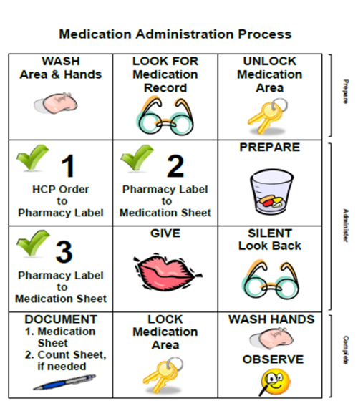
Medication Administration
Notes:
Page 138
Review parts of process and how they correspond to rows on grid.
-Prepare is the first row (When demonstrating for test purposes may do in any order)
-Administer is the two middle rows (May NOT change the sequence)
-Complete is the last row (When demonstrating for test purposes may do in any order)
You are just learning. When comparing information, read it like a book. Don’t jump back and forth. Once you’ve learned the process, then as you compare you will really need to think about what you are saying in regard to what you just compared to figure out if the information “agrees”.
Show mandatory med pass demonstration video.

Slide 67
Med Pass Scenario
Tanisha Johnson
4pm medication
March 3rd, yr
Notes:
Review med sheet documentation.
Review additional countable med documentation.
Use index to locate correct count sheet.
Spell out “number used” instead of numeral.
Stress to use pretend info (date/time).
Review how to remove meds from a blister pack. (Start with highest #.)
Optional-Demonstrate having another student read aloud the process as you demonstrate.
Pair staff.
Good way to learn:
-Read steps out loud and point as you practice

Slide 68
Med Pass Scenario
David Cook
4pm medication
March 3rd, yr
Notes:
Pair off and practice.
AFTER PRACTICING…
If there is time remaining, consider having staff complete any exercises not completed in the units covered or assign for homework.
Handout to use for med administration practice outside of training:
-Practice Med Book
-Count Book
-corresponding copies of (or actual) blister packs
HOMEWORK…next 3 slides

Slide 69
Homework
Review
  Units 1 and 2
    Pages 15-31
  Unit 7
    Pages 116-139
    Complete exercises
Notes:
Read what we have covered and complete any exercises we did not do. Check your answers and I’ll answer any questions tomorrow.
Also…

Slide 70
ma.tmuniverse.com
Log in to TMU to access your computer based pre-test
To end CBT click ‘end test’
Check results- ‘Details’
  Percent answered correctly
  Missed questions
    Topics to be reviewed are listed
Notes:
Access the practice Computer Based Pretest. If you want, try to answer a few questions or actually take the test if you have time.
End of day 1

Slide 71
Med Sheet Documentation
Initials in box that directly correspond to date/time given
Initials and signature at bottom
  If first time giving during month
PRN Medication
  Time/initials in same box
  Medication progress note
Notes:
Beginning Day 2
Remember med sheets are tracking forms used to ensure meds are given as prescribed.
The standard when giving meds is whole tabs with water.
Who has seen other certified staff crush meds and mix in applesauce, pudding, yogurt, etc. or put a whole tablet in applesauce before giving?

Slide 72
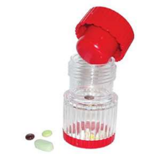
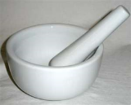
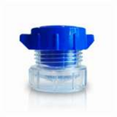
Oral Medication
HCP order required to
  Crush and mix a med with
    Food or liquid
Notes:
If you have seen meds crushed or placed whole in applesauce, etc. you should see an order to do so on a person’s HCP orders and it must specify, may crush and mix in applesauce or may put whole tab in applesauce to give.
VOLUNTEER to read ‘A HCP Order is Required to’ on Page 132

Slide 73

Oral Medication
May give half tabs only if
  Split by the pharmacy
Notes:
Not allowed to break, cut, etc.
What would you do if pharmacy supplied a 50mg strength tab and the dose in the order was to give 25mg?
-Return to pharmacy to have them split
EXERCISE Page 133

Slide 74

Cautionary Guidelines
Stop administering meds if
  You cannot read the HCP order
  There is no HCP order
  Label is missing
  Med was prepared by someone else
  Med seems to be tampered with
Notes:
Page 140
Never use another person’s med
Ask staff what “tampered with” means, then show the example on the next slide…

Slide 75
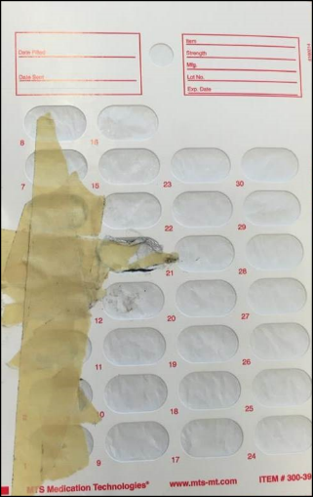
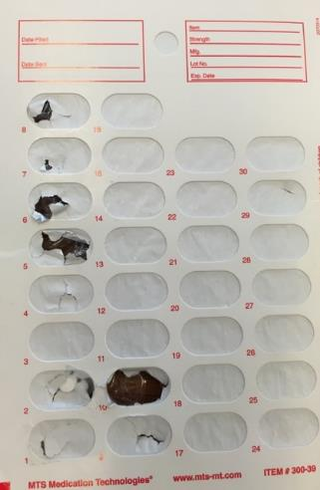
Tampered Packaging
Notes:
Blister pack with masking tape, although you cannot see the tablets on the other side, in the first example, Percocet tabs were replaced with Extra Strength Tylenol tabs.
The second example, although it is hard to see there is scotch tape over ‘bubbles 1 and 2’. Ativan tabs were replaced with Sudafed.

Slide 76
Cautionary Guidelines
Stop administering meds if
  You are uncertain if the 5 rights agree
  The person
    Has a serious change
    Has difficulty swallowing
    Refuses
  The med was pre-poured

Slide 77
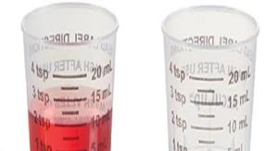
Liquid Med Administration
Place med cup
  Flat surface
  Eye level
Locate correct measurement
Shake bottle
  If needed
Pour slowly
  To avoid pouring too much
Notes:
Liquid Medication Pages 141-150
Look at med cup. What is smallest measurement ? Largest?
Equivalent of 1mL=1cc, etc.
Review phenytoin label page 141 then complete exercises pages 142-144
Page 145
Review slide info re: using medication cup
Optional-Demonstrate pouring a liquid med and or have class practice with you
Ask what would you do if pour too much.

Slide 78
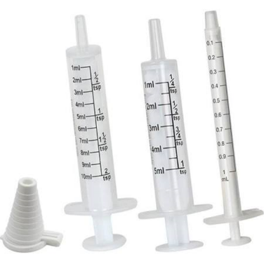
Liquid Med Administration
Oral syringe
Notes:
Page 146
Using an oral syringe is the most accurate measurement.
Demonstrate how one is used.
How is it cleaned?
Have a back up because the “markings” will eventually fade.
Pass around examples

Slide 79
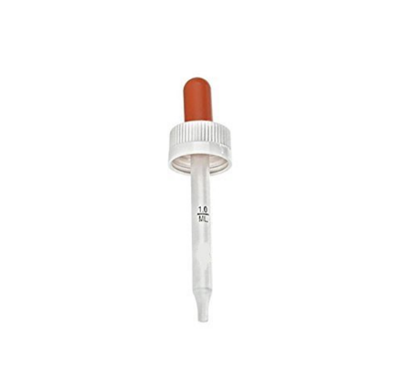
Liquid Med Administration
Dropper
Notes:
Page 147
Another common marked measuring device for liquid meds.
Demonstrate how one is used.
Pass around examples

Slide 80
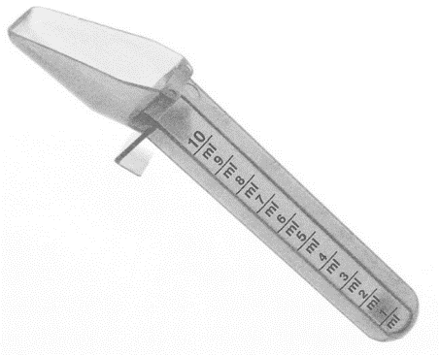
Liquid Med Administration
Dosing Spoon
Notes:
Page 148
Household teaspoons hold from 2 to 10 mL of liquid. But a measuring teaspoon holds 5 mL of liquid. So if you measure your liquid medications with a regular teaspoon, chances are you either giving too much or too little medicine. (www.healthlink.mcw.edu)

Slide 81
Liquid Med Exercise
Dose Strength Amount
150mg 75mg/10mL ____
100mg 50mg/6mL ____
100mg 50mg/2mL ____
150mg 75mg/4mL ____
200mg 100mg/5mL ____
150mg 50mg/3mL ____
100mg 25mg/2mL ____
500mg 250mg/10mL ____
100mg 100mg/15mL ____
500mg 500mg/30mL ____
500mg 125mg/5mL ____
Notes:
EXERCISE p. 149 Out loud and together. You can write the answers on page 149
Answers:
1. 20mL
2. 12mL
3. 4mL
4. 8mL
5. 10mL
6. 9mL
8mL
20mL
15mL
30mL
20mL
EXERCISES page 150

Slide 82
Medication Refusal
Definition(s)
  Says ‘no’
  Never takes med from you or spits out
  Spits out later
    Found on floor, bed, etc.
  Intentional vomiting
    Within ½ hour of taking med
Notes:
Pages 151-155
Definition of Refusals page 151
Suggestions if occurs:
Ask person why they do not want to take
Tell the person you will call HCP
HCP may adjust meds

Slide 83
Dealing with Refusals
Offer 3 times
  Wait 15-20 min
Notify
  Prescribing HCP
  Supervisor
Document
Notes:
In practice, any MAP Consultant may be contacted; however specific to a refusal, the prescribing HCP must be made aware.
Ask how to document a refusal on med sheet.

Slide 84
Document a Refusal
Circle initials
Med progress note
  Refusal description
  Who was notified
    HCP
    Supervisor
Notes:
Review example of documentation refusal 153
EXERCISES page 153-154 (David Cook exercises)
Class discussion and exercise page 155
Volunteer to read ‘Let’s Review’ page 161

Slide 85

Medications
Used to treat
  Illness
  Disease
  Pain
  Behavior
Taken to
  Eliminate or lessen symptoms
  Improve quality of life
Notes:
Unit 3 Pages 32-47
What’s your definition of a med?
Re-state example staff gave previous day and apply here

Slide 86
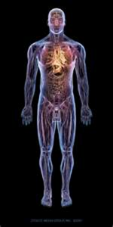
Medication
Substances that enter the body
  Changes one or more ways the body works
Notes:
Meds can affect different parts of the body at the same time so…it’s important to observe for both desired and side effects.
Examples – Motrin if taken on an empty stomach could cause upset.
Cold medicine taken for a runny nose can help but also cause sleepiness.
All meds have the potential to cause side effects so must watch for.
Most medications have a brand and generic name.

Slide 87
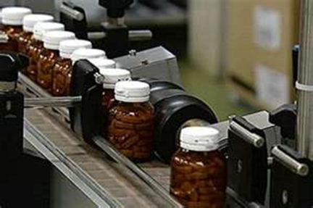
Brand Name Medication
Made by a specific pharmaceutical company
Notes:
Page 32
Only way to receive brand name from pharmacist is for HCP to write ‘no substitution’ at bottom of prescription form.

Slide 88
Generic Name Medication
Similar to brand name meds
Made by different companies
Usually less expensive
May be differences in
  Color
  Size
  Shape
  Markings
Notes:
Page 32
When the HCP writes a prescription for a brand name medication and the generic name is substituted, you will see the generic name on the label and the letters ‘IC’-interchange near the brand name of medication printed on the pharmacy label.
LABEL EXERCISE page 33

Slide 89
Medication Schedules
All prescription meds are controlled substances
  Controlled substances are placed into schedules
    Schedule placed into
      Based on abuse potential
Notes:
Page 34

Slide 90
Prescription Medication
Prescription required
  Set of instructions from HCP to pharmacist
    What med to prepare and how to administer
  Pharmacist uses to print a label
  Can be electronic or paper
    If paper, may not be copied and used as an HCP order
Notes:
A prescription is the HCPs directions to the pharmacist.
Pharmacist uses the prescription to prepare and label medication.

Slide 91
Medication Categories
Controlled
  Schedule VI
Countable Controlled
  Schedules II-V
Over-the-Counter (OTC)
Notes:
Optional-divide class into 3 Groups
-Assign categories
-Decide key points
-Spokesperson to present
Controlled (Schedule VI) Pages 34-35
Countable Controlled (Schedule II-V) Pages 35-37
OTCs Page 38

Slide 92
Controlled Schedule VI
Requirements
  HCP order
  Pharmacy labeled
  Packaging options
    Bottled
    Tamper resistant
  Secured
    Key locked
  Tracked
    Med ordering/receiving log
    Med sheet
Notes:
Page 34-35 Controlled (Schedule VI)
May mention exception of high alert meds here

Slide 93
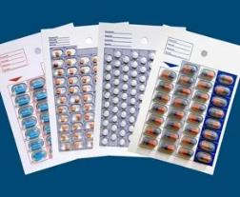
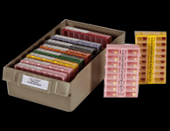

Countable Controlled
Requirements
  HCP order
  Pharmacy labeled
  Only packaging option
    Tamper resistant
      Blister packed
      Opti-Pak
      Opus cassette etc.
  Identifier
Notes:
Page 35-37 Countable Controlled
Depending on the company you work for the packaging will vary. Blister packs are most common.
There is also Opti-Pak unit dose and OPUS color coded cassette, tamper resistant packaging options.
Liquid countables must be packaged sealed in a labeled coffee creamer type container OR…

Slide 94
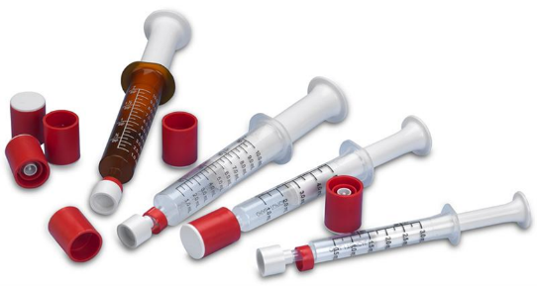
Countable Substance Packaging
Schedule II-V meds must be
  Received directly from the pharmacy
  In tamper resistant packaging
Notes:
…an oral dosing syringe that is tamper resistant.
These are tamper resistant syringes; when the cap is unscrewed it leaves the red ring. If you can just pull the cap off without unscrewing it, tampering may have occurred.
If you have this type of syringe in your program, the total number of prefilled syringes received from the pharmacy are added into the count. Each syringe is subtracted from count as it’s used rather than subtracting the total number of milliliters in each syringe.
Empty syringes are required to be secured on site but they do not have to be added to the count.

Slide 95
Countable Controlled
Requirements continued
  Secured
    Double key locked
  Tracked
    Med ordering/receiving log
    Countable Controlled Substance Book
    Med sheet
  Counted
    Every time the med storage keys change hands
Notes:
If not mentioned ask:
-Reason for tamper resistant packaging
-Reason for double lock
-Reason for counting frequently
ANSWER: High risk of being stolen and abused.

Slide 96
OTC Medication
Requirements
  HCP order
  Pharmacy label
  Packaging options
    Bottle or
    Tamper resistant
  Secured
    Key locked
  Tracked
    Med ordering/receiving log
    Med sheet
Notes:
Page 38
Can buy without a prescription but must have HCP order in a program setting to give.
In addition to the 3 categories of medications there are dietary supplements.

Slide 97
Dietary Supplements
Requirements
  HCP order
  Pharmacy label
  Packaging options
    Bottle or
    Tamper resistant
  Secured
    Key locked
  Tracked
    Med ordering/receiving log
    Med sheet
Notes:
Page 39
For a pharmacy to ‘label’ the bottle, even though it can be purchased without a prescription, they will require a prescription from the HCP.
Page 39 (Bottom) mentions Nutritional supplements (conventional food items) which are not medications.
Review labels page 40
EXERCISE page 41

Slide 98
Medication Outcomes
Desired Effect
No Effect Noted
Side Effects
Notes:
Page 42
Ask the class, What does the desired effect of a medication mean?
Ask for Examples?

Slide 99
Desired Effect
Examples
  Acetaminophen
    Administered for a headache
      Headache goes away
  Phenytoin
    Administered due to seizures
      Person is seizure free
Notes:
Page 42
Desired
Med is working
Must know a meds desired effect, reason for use.

Slide 100
No Effect Noted
Reasons
  Med has not had enough time to work
  Even after enough time for the med to work
    It does not
Notes:
Page 42
No Effect Noted-a medication is taken for a specific reason and the symptoms continue.
READ EXAMPLES 1. and 2. page 42

Slide 101
Side Effects
Results not wanted or intended
Range from mild to severe
  Mild
    May be uncomfortable
  Adverse Response (severe side effect)
    Allergic
    Anaphylactic
    Paradoxical
    Toxicity
Notes:
Page 42
Side effects are results from medication that are not wanted.
They range from mild to severe.
Severe side effects (adverse responses) definitions page 43:
Allergic reaction-high sensitivity
Anaphylactic reaction (severe allergic reaction) is potentially life threatening and requires immediate medical help.
Paradoxical-opposite.
Toxicity-body stores up more med than it can handle.
Do people where you work receive more than 1 med?
If so, there is always the potential for med interactions.

Slide 102

Medication Interactions
Medications, dietary supplements mix in the body
  May increase or decrease
    Effect and/or side effects of one or more of the meds and/or dietary supplements
Notes:
Page 43
Ask for VOLUNTEER to read through the 3 examples of interactions on bottom of page

Slide 103
Medication Interactions
The more meds/dietary supplements taken at one time
  Increases the possibility
Changes observed
  May be due to a med interaction
Notes:
Why is it important for a HCP to be aware of all meds a person is taking?
Answer: Can prescribe a new med that has a lower chance of interacting with current meds

Slide 104



Other Substances
Alcohol
Nicotine
Caffeine
Notes:
Page 44
Why is it important for the HCP to know if a person uses alcohol, smokes, drinks coffee/tea/soda/Red Bull/Monster drinks?
These substances have the ability to interfere or interact with the absorption of medication and/or dietary supplements.
TRAMADOL MED INFO SHEET EXERCISE page 44

Slide 105
Sensitivity to Medication
Influencing factors
  Age
  Weight
  Gender
  General health
  Medical history
  Level of physical activity
  Use of other meds and/or dietary supplements
Notes:
Page 45
How a person responds to medication depends on several factors.

Slide 106
Medication Information
Resources
  Prescribing HCP
  Pharmacist
  Package inserts
  Reputable online source
  Medication reference book
Notes:
Page 45
You are responsible to learn about the medication you administer.
You need to know where to look or who to ask if you have questions regarding medications in general.
Who and/or what are your medication resources?
Page 46 exercise
Page 47 Lets Review

Slide 107

Giving Multiple Meds
Complete checks for each med
#1
#2
#3
  Before moving to the next med
    All meds due at the same time, for the same person may be given together
Notes:
What is the next date and time Ellen is due to get meds? How many meds will you be giving?

Slide 108
Med Pass Scenario
Ellen Tracey
8pm medication
March 3rd, yr
Notes:
Practice

Slide 109
Med Pass Scenario
David Cook
8pm medication
March 3rd, yr
Notes:
Practice

Slide 110
Med Pass Scenario
Juanita Gomez
8pm medication
March 3rd, yr
Notes:
Practice
Review homework slides

Slide 111
Homework
Read Unit 6
Complete transcription exercise
  Pages 79-110
Review
  Remainder of Unit 7
    Pages 140-161
Notes:
If your time is limited, before tomorrow at least read Unit 6 and complete the transcription exercise.
Remember to check your answer.
Also remember to continue to access the CBT and answer questions, seeing if you can get a 80% or higher score in less that 35 minutes.
Tomorrow you will practice transcribing over and over.
End of Day 2

Slide 112
Responsibilities
Transcription
  Info copied from
      HCP order and pharmacy label
        Onto the med sheet
Notes:
Beginning of Day 3
Ask if anyone completed the practice homework transcription
Unit 6 Pages 79-110
Part of skills test with D&S. Have 15 minutes using a HCP order to DC one med and transcribe another.
Transcription packets as group.
Page 80 visual of 3 documents required for transcription

Slide 113
Keep in Mind
What counts?
  Spelling
  Handwriting
  Spacing of med times
Notes:
When transcribing, keep these in mind…

Slide 114




Spelling Counts
‘Thee’ tablets
‘Thee’ times a day
‘Tree’ times a day
‘My’ mouth
3 ‘tats’
Notes:
Spelling counts!
On the slide are some examples of words that were misspelled on Certification testing when transcribing.
The word ‘three’ was spelled as ‘t-h-e-e’
‘by’ mouth was written as ‘my’ mouth and
3 ‘tabs’ was spelled as 3 ‘t-a-t-s’
Another example is writing ‘tables’ instead of ‘tablets’
When transcribing, copy the information exactly as written

Slide 115
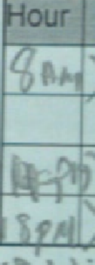
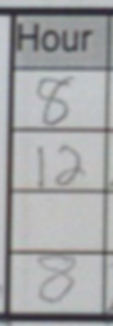
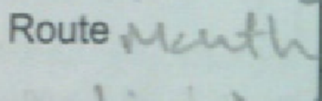
Handwriting Counts
Notes:
The person who scores the test cannot guess at what he/she thinks something says; if your handwriting is illegible it will be scored as incorrect.
The left and middle pictures are examples of illegible handwriting and
the picture on the right of the screen does not include an ‘am’ or ‘pm’ with the times chosen.

Slide 116
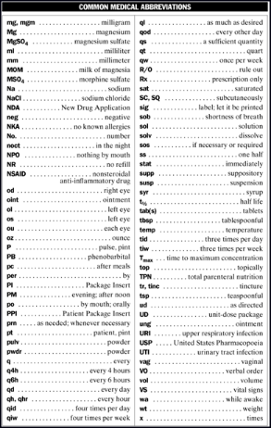
Abbreviations
Safer not to use
Notes:
It is common to still see abbreviations on a HCP order and script.
Should be a reference list in med area.
Will be using a few abbreviations.

Slide 117
Abbreviations
DC Discontinue
am- morning
pm- afternoon or evening
cap- capsule
tab- tablet
gm- gram
mg- milligram
mcg- microgram
IU- international unit
mL- milliliter
PRN- as needed
IM- intramuscular
ODT- orally dissolving tablet
Subcut- subcutaneous
Notes:
Page 81
Will be using these when transcribing
EXERCISE page 81

Slide 118
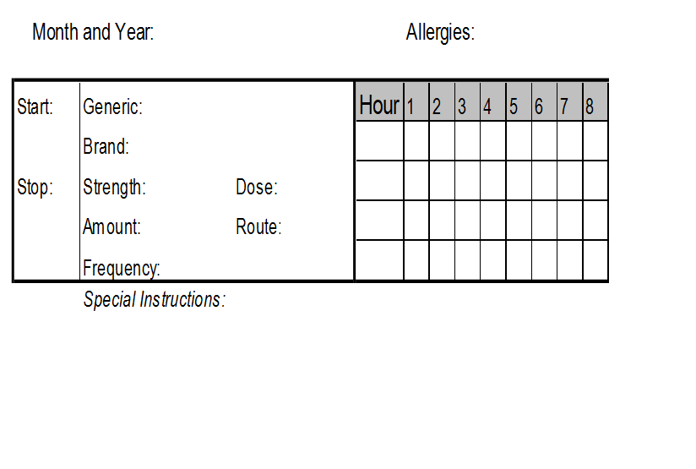
Medication Sheet
Notes:
Pages 82-87
A medication sheet tracks administration of medication.
Other words used are med sheet, MAR (medication administration record); medication log.
Go through components
Exercise Page 89
Optional re: SPECIAL INSTRUCTIONS -pass around pharmacy label stickers and/or if had ‘shake well’ sticker on Juanita Gomez’ Colace liquid from practice yesterday, ask staff what the special instruction was.

Slide 119

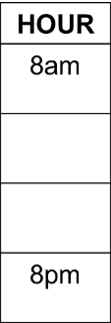
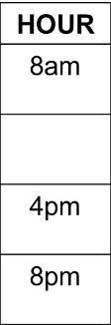
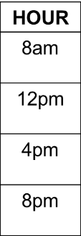

Frequency
Number of times per day to be given
Specific hour chosen
Notes:
Pages 90-92 (frequency when written on a med sheet is the same as time)
Samples of how to choose med times.
Consider:
Persons daily schedule, agency policy
12 am same as midnight
12 am is usually considered the first dose of the day.
12 pm same as noon
The every 6 hours and every 8 hours transcriptions are considered more difficult and are not covered in the basic training-for reference only
General guideline - times chosen must be at least 4 hrs. apart, unless HCP specifies otherwise.
Best practice : write ‘am’ times in top two boxes and ‘pm’ times in bottom two boxes.
Exercises pages 93-94

Slide 120
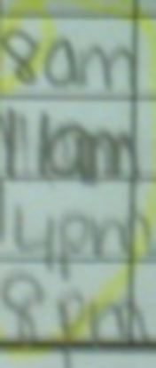
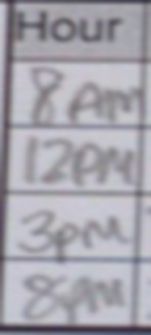
Spacing Times Counts
Notes:
Remember that times chosen must be at least four hours apart; these are two examples of a time spaced only 3 hours apart.

Slide 121
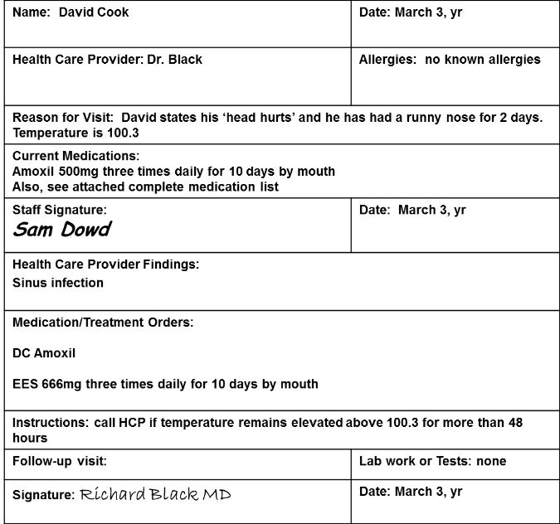
Health Care Provider Order
Notes:
Page 95
Review the entire order form
The first written HCP order states, DC Amoxil

Slide 122
Discontinued Order
On the med sheet
  Mark through all boxes where the med was scheduled to be given
  Diagonal lines through
    Left side of med sheet
      DC, date, your initials
    Right side of med sheet
      DC, date, your initials
Notes:
These next slides show marking a medication as DC’d on a med sheet.
Page 96- three step example of discontinuing a medication

Slide 123
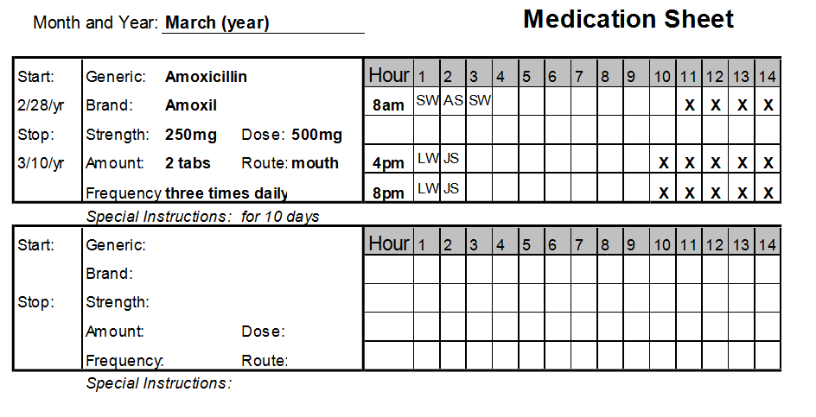
Discontinue Process
Notes:
To mark the medication as DC’d on a med sheet, the first step is to mark through all the empty spaces next to where the med was scheduled to be given.
Once completed…,

Slide 124
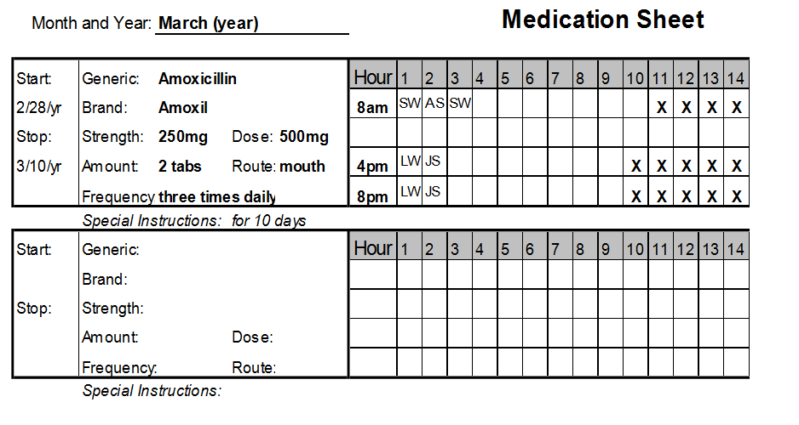
Step 1
Notes:
it will look like this. You can use straight lines or ‘X’s or a combination as long as empty boxes are completely marked through.
Then draw through left section of med sheet…

Slide 125
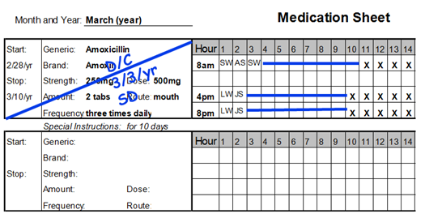
Step 2
Notes:
……and write:
DC
Date
Initials

Slide 126
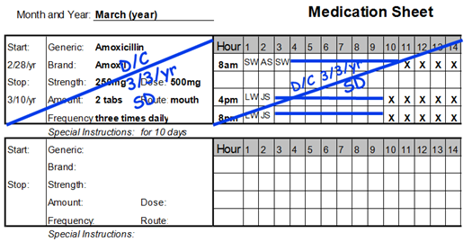
Step 3
Notes:
Then draw a diagonal line through the right section of med sheet and write:
DC
Date
Initials
Review example of discontinuing a medication page 95
Then go back to the HCP order…

Slide 127
Health Care Provider Order
Notes:
Now you are ready to transcribe the next order.
What is the name of the new medication?

Slide 128
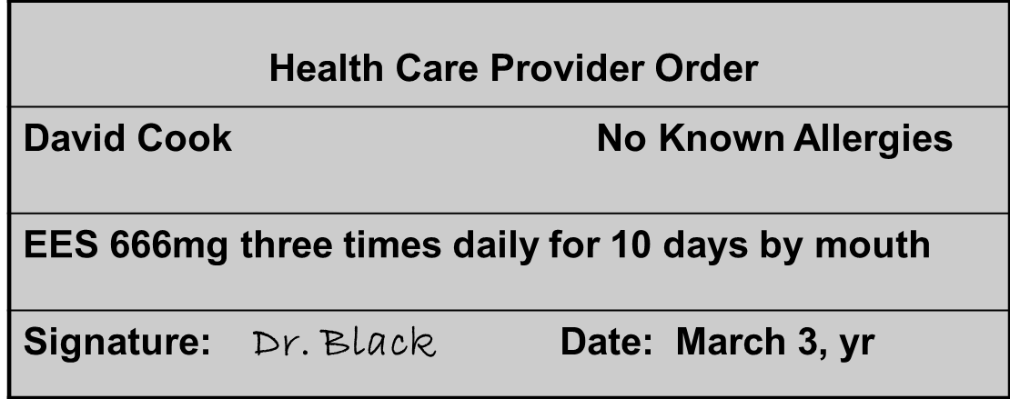
Dose
Found in HCP order, usually in mgs
Notes:
If transcribing this HCP order, would copy 666mg next to the word “dose” on the med sheet……

Slide 129
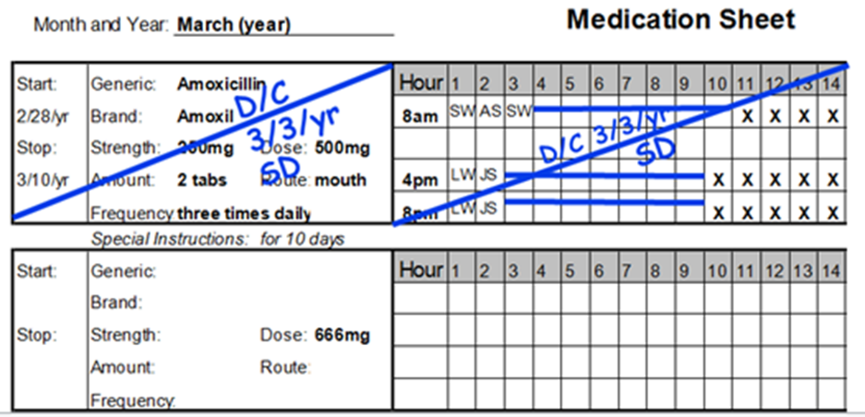
Transcribing Dose
Notes:
…..like this
Then look at the corresponding pharmacy label…

Slide 130

Strength and Amount
Found on pharmacy label
Notes:
….. for the strength of the tablet and the number of tablets to administer
If transcribing, would copy “333mg” next to the word strength on the med sheet
If transcribing, would copy “2 tabs” next to the word amount on the med sheet

Slide 131

Transcribing Strength and Amount

Slide 132

Completed Transcription
Notes:
Now that the transcription is completed, you are ready to Post the order.

Slide 133
‘Post’ HCP Order
Completed for new HCP orders
After transcribing
Written on HCP order
  Under HCP signature
  Write:
    Posted
    Your signature
    Date
    Time
Notes:
After transcribing all orders, the HCP order is “posted”. Your signature means you are the certified staff who took care of the new HCP order. (Remember not all new orders are for medications. You may be asked to monitor someone’s weight or how much they drink, etc.)

Slide 134

Health Care Provider Order
Posted Sam Dowd 3/3/yr 1pm
Notes:
Underneath the HCP signature you write posted, your signature, the date and time.
It doesn’t have to be in any particular order.

Slide 135
Transcription Workbook One
Notes:
Close up training manual and get the Transcription Workbook.

Slide 136

Worksheet
Notes:
Open to the worksheet on page 3

Slide 137

Dose
Found on HCP order usually in ‘mg’s’
The dose is: mg
Notes:
If transcribing this HCP order, would copy ____ mg next to the word “dose” on the med sheet

Slide 138

Strength and Amount
Found on Pharmacy label
The strength per tablet to give is: mg
The amount of tablets to give is: tabs
Notes:
If transcribing, would copy “___ mg” next to the word strength on the med sheet
If transcribing, would copy “___ tabs” next to the word amount on the med sheet

Slide 139
Transcription Practice
INSTRUCTIONS
You have taken Tina Lewis to the doctor and have received medication from the pharmacy. Pretend that the date is June 11, year. It is 1 pm.
Use the health care provider’s order, pharmacy label and generic equivalents to discontinue the order and transcribe the new order on to the Medication Sheet.
Please Note: Do not place your initials in the medication box. You are not administering a medication at this time. This is transcription only.
Notes:
It is important to know how to use the pretend date and time. This is NOT the time of the HCP visit (because the appt. has already happened.) The time is when you are in the program sitting at a table with the HCP order and the pharmacy labeled bottle in front of you ready to transcribe the information on the med sheet.
Remember you are not giving meds now. You are getting the med sheet set up and ready for someone else to use to administer meds later after you’ve left for the day.

Slide 140
HEALTH CARE PROVIDER ORDER
Name: Tina Lewis | Date: 6/11/yr
Health Care Provider: Dr. Jones | Allergies: no known allergies
Reason for Visit: Tina states she has a burning feeling in her throat during the day.
Current Medications: Pantoprazole 40mg by mouth once daily in the evening
Staff Signature: John Smith, Program Manager | Date: 6/11/yr
Health Care Provider Findings: GERD
Medication/Treatment Orders: D/C Pantoprazole Pepcid 20mg twice daily by mouth dose frequency route
Instructions:
Follow-up visit: | Lab work or Tests:
Signature: Dr. Jones | Date: 6/11/yr
S
T
A
F
F
HCP
Notes:
What is the name of the staff who has written the top half of the form?
What is the reason for the visit?
Is Tina on any current meds?
What does the HCP want to do with the current med?
Are any new meds ordered?
Notice the “pretend” date in the instructions is on this form in 3 different places.

Slide 141


Slide 142



Slide 143

Medication Administration Sheet
Notes:
Turn back to the HCP order on page 5 and have the med sheet next to it.
Now let’s DC the current med.

Slide 144

Medication Administration Sheet

Slide 145

Medication Administration Sheet

Slide 146
HEALTH CARE PROVIDER ORDER
Name: Tina Lewis | Date: 6/11/yr
Health Care Provider: Dr. Jones | Allergies: no known allergies
Reason for Visit: Tina states she has a burning feeling in her throat during the day.
Current Medications: Pantoprazole 40mg by mouth once daily in the evening
Staff Signature: John Smith, Program Manager | Date: 6/11/yr
Health Care Provider Findings: GERD
Medication/Treatment Orders: D/C Pantoprazole Pepcid 20mg twice daily by mouth
Instructions:
Follow-up visit: | Lab work or Tests:
Signature: Dr. Jones | Date: 6/11/yr
Posted John Smith 6/11/yr 1pm
Notes:
Turn back to the HCP order on page 5. Under the HCP signature write the word “posted”, your signature, the date and time.

Slide 147
Transcription Practice
INSTRUCTIONS
You have taken Tina Lewis to the doctor and have received medication from the pharmacy. Pretend that the date is June 20, year. It is 1 pm.
Use the health care provider’s order, pharmacy label and generic equivalents to discontinue the order and transcribe the new order on to the Medication Sheet.
Please Note: Do not place your initials in the medication box. You are not administering a medication at this time. This is transcription only.

Slide 148
HEALTH CARE PROVIDER ORDER
Name: Tina Lewis | Date: 6/20/yr
Health Care Provider: Dr. Smith | Allergies: None
Reason for Visit: complaint of pressure on forehead, mild fever, dizziness, increase in head slapping behavior
Current Medications: Synthroid 0.125mg by mouth once a day in the morning
Staff Signature: Paula Jones, Program Manager | Date: 6/20/yr
Health Care Provider Findings: hypothyroid, elevated blood pressure, sinus infection
Medication/Treatment Orders: D/C Synthroid Armour Thyroid 30mg by mouth once daily before breakfast. Brand name only medication. Inderal 20mg by mouth once daily in the morning Amoxil 500mg by mouth three times daily for 10 days
Instructions:
Follow-up visit: 2 weeks | Lab work or Tests:
Signature: Dr. Susan Smith | Date: 6/20/yr
dose
Notes:
How many new meds are there? What is the dose of Armour Thyroid? Circle it. The dose of Inderal? Circle it. The dose of Amoxil? Circle it. Write the word dose (once) so you remember these are the doses of each new med.

Slide 149
Rx#139 Greenleaf Pharmacy 111-222-3434 20 Main Street Treetop, MA 00000 6/20/yr Tina Lewis Armour Thyroid 30mg I.C. Qty. 30 Take 1 tablet once daily before breakfast by mouth Dr. Smith Lot# 659 ED: 6/20/yr Refills: 3
Rx#285-97226 Greenleaf Pharmacy 111-222-3434 20 Main Street Treetop, MA 00000 6/20/yr Tina Lewis Propranolol 10mg I.C. Inderal Qty. 60 Take 2 tablets once daily in the morning by mouth Dr. Smith Lot# 323-334 ED: 6/20/yr Refills: 3
strength
Rx#285-97227 Greenleaf Pharmacy 111-222-3434 20 Main Street Treetop, MA 00000 6/20/yr Tina Lewis Amoxicillin 500mg I.C. Amoxil Qty. 30 Take 1 tablet three times daily for ten days by mouth Dr. Smith Lot# 323-335 ED: 6/20/yr Refills: 0
Notes:
What is the strength in mgs per tablet of Armour Thyroid supplied by the pharmacy? Circle it. The Inderal? Circle it. The Amoxil? Circle it. Then write the word strength once out to the side of the labels.

Slide 150

Answer

Slide 151

Answer

Slide 152

Answer

Slide 153

Answer

Slide 154

Answer

Slide 155

Answer

Slide 156

Answer

Slide 157
Transcribing HCP Orders
Dose- mg the HCP orders to be given each time med is administered
Strength- supplied by pharmacy
Amount- tabs, caps, mLs etc.
Dose = Strength x Amount
Notes:
Additional math required if half tab or liquid med

Slide 158
New Orders
If the med is the same but the
  Dose
  Frequency
  Route or
  Symptoms if PRN
      Change
        Then it is a new order
          DC the old order
          Transcribe the new order
Notes:
Page 103
This we have practiced…if any part of a HCP order changes-start over.

Slide 159
Post HCP Order
Completed for new orders
After transcribing
On HCP order
  Under HCP signature
    Write
      Posted
      Your signature
      Date
      Time
Notes:
Pages 103-105
Posting we have covered and practiced.

Slide 160
Verify HCP Order
Second Certified staff double-checks
On HCP order
  Under HCP signature
    Write
      ‘Verify’
      Your signature
      Date
      Time
May meds be given if not yet verified?
Notes:
…the answer is ‘YES!’
Page 104
The goal is to administer medication as soon as ordered. If there is no staff to verify the transcription but you are there and the medication is there, etc. You can give the medication.
Page 105 Example of order that is posted and verified.
EXERCISE page 107
VOLUNTEER to read ‘Let’s Review’ page 110

Slide 161
Responsibilities in Action
Interacting with a HCP includes but is not limited to:
  HCP visit
  Emergency Room (ER) visit
  Hospital
    Admission
    Discharge
  Fax orders
  Telephone orders
Notes:
Unit 4 Interacting with a Health Care Provider
Pages 48-63

Slide 162
HCP Visit
Before appointment
  Prepare the person
    When, where, what will happen
Day of appointment
  Insurance card
  Current med list (copy of med sheets)
  Allergies
  HCP Consult/Encounter/Order form
Notes:
Page 48
Optional-Show “Making the Connection” DVD [17 minutes]. The video demonstrates how your responsibilities apply during a routine work day.

Slide 163
HCP Visit
During appointment
  Assist if needed
  Advocate
    Redirect HCP to individual to speak
  Obtain written results and recommendations
      HCP order
      Diagnosis
      What to expect from new med
Notes:
Page 50

Slide 164
Communicating with Pharmacist
Prescription
  HCP may
    Send electronically
    Call prescription into pharmacy
    Give prescription to
      Staff or
      Person
        To bring to pharmacy
Notes:
Page 52

Slide 165
HCP Visit
After appointment
  Ensure pharmacy received prescription
  Pick up new medication
    Or check on when it will be delivered
  Bring back all forms, orders, etc.
    Transcribe
  Secure meds
  Document the visit
  Communicate changes
Notes:
Page 52

Slide 166

Emergency Room Visit
Bring
  Current med list
  Insurance card
  HCP order form
Discuss
  Any scheduled med the person may miss due to the visit
Notes:
Page 55

Slide 167
Hospital
Admission/Discharge
  Medication Reconciliation
    Ensures when individual returns home
      New meds ordered during the hospital stay are not omitted
      Meds DC’d during hospital stay are not administered
Notes:
Page 55
Be prepared to tell hospital staff why you are bringing the person to the hospital.
If you have any concerns about taking the person home, tell the hospital staff and contact your supervisor before leaving the hospital.
Medication Reconciliation Process Checklist page 56

Slide 168
Fax Orders
Legal
Signed by HCP
Preferred
  Over a telephone order
Notes:
Sometimes orders are received in a program in the form of a faxed order.
Page 57

Slide 169
Telephone Orders
Check your agency policy
Read back info
  Ask another staff to listen, if needed
Remind HCP to call pharmacy
Posted/Verified twice
  First after transcribing
  Again after signed by HCP
Must be signed by HCP
  Within 72 hours
Notes:
Page 57
If there is no fax machine you may receive an order in the form of a telephone order.
-Check with your agency to see if allowed to take a T.O. If so,
-Ask supervisor where T.O. form is kept.
-Read back to the HCP what you have written
-Ask if do not know how to spell a word
How do you get the new med?

Slide 170

Sample Telephone Order Form
Notes:
Sample form page 58
Telephone orders are unique in that they must be posted and verified twice:
once as soon as the med is received into the home and transcribed; and
again after it’s been signed by the HCP.
The purpose of posting and verifying a second time is to check whether the HCP made changes to the order when signing it.
EXERCISE page 59

Slide 171

Exhausting Current Medication
Responsibilities
  Must verify with pharmacist if OK
Requirements
  New HCP order reflecting change
  New order transcribed onto med sheet
  Strength on hand allows for easy preparation
  Med container is flagged with
    A ‘Directions Change’ or
    Brightly colored sticker
Notes:
Page 60
If there is a new order to change the dose or frequency of a medication the person is currently on, it is acceptable to use the current supply.
If you see a directions change sticker you will know there is a new HCP order and you cannot rely on the information printed on the pharmacy label.
Example of ‘Directions change’ sticker page 61
Exercise page 62
VOLUNTEER to read ‘Let’s Review’ page 63

Slide 172

Pharmacy Label
Notes:
Unit 5 Pages 64-78
Corresponding label EXERCISE Page 70 or ask questions:
What is the name of the pharmacy
What is the Rx#
What is the Rx# used for
Do you see the phone number
Who is the doctor that prescribed the medication
What is the strength of the tab
What is the expiration date
What does an expiration date mean
What is a refill

Slide 173
Responsibilities
Ensure pharmacy provides correct med
  Compare HCP order with label
If familiar with med
  Open and look
    If different in color, shape, size, marking etc.
      Call MAP Consultant
If not familiar
  Look up or ask
Notes:
Page 72
Look in drug reference book, package insert, online
Ask pharmacist
What if it doesn’t look right?
EXERCISE page 72
What would you do on the med sheet if you notice the strength and directions changed of a medication while logging in receipt of a refill however the new strength works with the dose ordered?
See Example page 73
When to Request a Medication Refill page 73
Class discussion page 74

Slide 174
Responsibilities
After obtaining medication
  Tracking
  Storage
  Security
Notes:
When meds come in to a program they must be documented as received.

Slide 175
Responsibilities
Tracking
  Ordering/Receiving Log
  Pharmacy Receipts
  Count Book
  Med Book
  Med Release Documents
    LOA
    Transfer
  Disposal Record
Notes:
Page 75
Medication is documented and tracked using this list of items.
We will cover these forms of tracking in detail tomorrow.

Slide 176

Responsibilities
Medication Storage
  Requirements
    All meds key locked
    Countable meds double key locked
  Labeled med container per person
    Separate oral meds from other routes
  Refrigerated meds
    Must be key locked
Notes:
Page 76
Only items needed for med administration should be stored in med area.
Meds must remain in original packaging
Keep in a cool, dry place away from excessive heat, light and moisture
Mention med info sheet lists storage requirements

Slide 177

Responsibilities
Medication
  Security Requirements
    Keys must be carried by you if you are assigned medication administration duties
Notes:
Page 77
Back up keys are accessed through administrative staff.
Sometimes there are 2 combination lock boxes.
MAP Certified staff in the home know only one combination to one of the boxes.
If keys are lost, administrative staff are contacted to determine the code to the second combination lock box to access the keys
VOLUNTEER to read ‘Let’s Review’ page 78
Review homework on next slide

Slide 178
Homework
Review
  Units 4-5-6
    Pages 48-110
Complete exercises
Notes:
Tomorrow we will
-cover Units 8 and 9
-take the transcription pretest
End of Day 3

Slide 179
Chain of Custody
An unbroken documentation trail
  of accountability
Ensures physical security
  of medication
Notes:
Beginning of Day 4
Ask if questions about homework
Unit 8 162-213
Every tablet that comes in to or leaves a program must be accounted for.

Slide 180
Chain of Custody
Documents and Methods
  Used to track medication
    Medication Ordering/Receiving Log
    Pharmacy Receipts
    Count Book
    Medication Book
    Medication Release Documents
      LOA/Transfer
    Disposal Record
    Blister pack monitoring (not MAP required)
Notes:
These documents and methods are used to track medication.
We will go through each item listed.

Slide 181
Chain of Custody
Medication Ordering/Receiving Log
  Used to track when medication is
    Requested and
    Received
Notes:
Page 164
Sample Medication Ordering/Receiving Log Page 164
Exercise Bottom of Page 164
If a refill was requested and did not arrive with a pharmacy delivery, what should you do?
Always double check the strength of medication received against the strength ordered.

Slide 182
Chain of Custody
Pharmacy Receipts
  Provided by pharmacy
    When medication is dispensed
Notes:
Page 165
When medication is received from the pharmacy you must compare the medication to the pharmacy receipt (making sure the pharmacy provided what is listed on the receipt) and against what was requested in the medication ordering and receiving log.
Receipts must be kept in a program for at least 90 days.

Slide 183

Chain of Custody
Count Book
  Index
  Count Sheets
  Count Signature Sheets
Notes:
Page 166
To the Trainer: consider showing staff a commercially available count book
A count book tracks countable medication. The book must be bound with no loose pages and have preprinted page numbers.
Each count book is “numbered” somewhere in the front.
If the pages become loose staff should notify a Supervisor so that another book can be obtained as quickly as possible.

Slide 184
Chain of Custody
When entering a new countable med or transferring an existing countable to a new count sheet
  Add to or update Index
  Complete heading section of next available Count Sheet
    Do not skip pages
Notes:
The assigned staff giving meds who uses the last line on a count sheet is the one who transfers the information to the next available count sheet and updates the index.
The next slides cover the basics of a count book.

Slide 185

Index
Notes:
Index Section Page 167
Page 167 and 168 Sample Index
Every count book has an index page at the beginning of the book that identifies the pages that are currently in use. It must be kept accurate and up to date.
Looking at this index, you know Sarah Brown’s Phenobarbital is no longer in the doubled locked area to count because Linda White (Supervisor) signed as removing it from the count. If the med was discontinued, it would have stayed on count and double locked until disposed of. Only after its disposal (following the guidelines) would a supervisor sign as ”Responsible for Removing Medication from Count”.
Mike Stone has Ativan 1mg tabs to be counted on p. 5 (because p. 2 became full.)
The index must be updated when transferring information from an old count page to a new count page.
When the 4 boxes next to Joseph Smith’s Ativan were full, a Supervisor wrote “see below” with their initials to indicate his Ativan had started on a new row in the index. Joseph Smith’s Ativan 0.5mg is currently found on page 11.
William Mitchell has Percocet to be counted on page 8.
According to this index, there are 3 count sheets currently in use.

Slide 186


Count Sheet
Page Transfer
Notes:
Page 169-171
Each prescription is entered onto a separate numbered count sheet.
These pages tell us the current number of pills remaining (amount left) on each prescription
Two MAP Certified staff signatures are required when:
-transferring from a previous count sheet
-adding medication into count
Look at the first 12-19-yr entry – what happened there? When a count sheet page is full, the prescription gets transferred to a new page
At the bottom of the ”full” page (page 10) Linda and Lisa’s signature would be there also
Look at 12/20/yr 11:00 am entry – what happened there? Meds had been re-ordered and the refill blister package is added to the existing supply

Slide 187

Count Signature Sheet
Notes:
Page 172
Countable meds must be counted every time the staff keys change hands; ideally with a staff coming on and another staff who is leaving.
If that is not possible, count with another MAP Certified staff working on the same shift as you. Have them document next to their name “witness”. See 3/4/yr entry
Document the exact time you count.
Optional-Show video of ‘Shoulder to Shoulder’ count procedure.

Slide 188
Count Procedure
Count must be done
  Shoulder to shoulder with
    Off-going Certified staff
    On-coming Certified staff
Notes:
Page 173

Slide 189
Count Procedure
On-coming Certified staff
  Manages the blister packs
Off-going Certified staff
  Holds the Count Book and
    Leads the count using the index as their guide
Notes:
Counting should be done using the index.

Slide 190

Count Procedure
During the count
  Both staff look at
    Blister pack and
    Count Sheet
Full signatures
  On Count Signature Sheet
Notes:
After reviewing the count process, pair staff and have them complete a double person count.
EXERCISES Page 174-177

Slide 191
Two Signatures Required
Adding a
  Newly prescribed med into the count
  Medication refill from pharmacy
Disposing medication
Count sheet page transfer
  Bottom of old
  Top of new
Each time med storage keys change hands
Notes:
Page 178
These are when 2 signatures are required in the Count Book.

Slide 192
Chain of Custody
Medication Sheet
  Used to document when med is administered at the program or
  Codes used when individual is at a different location
Notes:
Page 180
List of acceptable codes
Exercise Page 181

Slide 193
Chain of Custody
Medication Release Documents
  Transfer form
    Day program
  Leave of Absence (LOA) form
    Visit with family
Notes:
Page 183
A transfer form is used form various reasons, i.e., when meds are transported by MAP Certified staff from a residential to a day program.
Page 184 Sample transfer form
The transfer form goes back to residential program.
Day program staff may keep a copy of the transfer form as their ‘receipt’ of meds.

Slide 194
Day Program Medication
Residential staff’s responsibility to
  Provide day program staff with
    Copies of HCP orders
    Pharmacy labeled meds
      Transfer form required
  Notify DP staff if med is DC’d
    Fax DC’d HCP order
Notes:
Pages 185-188
Find out communication system between the two programs.
Exercise pages 187-189

Slide 195
Off-Site Medication Administration (OSA)
OSA Medication
  Medication administered at on off-site location
    By MAP Certified or licensed staff
      During the hours the person would typically receive medication in their
          Home or
          Day program
Notes:
Page 190

Slide 196
Off-Site Medication Administration (OSA)
Pharmacy must prepare OSA meds
  If staff will be administering for more than 24 hours
Staff may prepare OSA meds
  If the pharmacy cannot and
  Staff will be administering for less than 24 hours
Notes:
How is a OSA documented on med sheet, count book?
Med Sheet:
‘OSA’ code is written in place of staff initials
Corresponding med progress note or narrative note that includes the location where OSA medication will be administered.
Count Book:
The total number of tablets removed are noted along with ‘OSA’ in the ‘amount used’ column on a count sheet.
See count sheet page 192 for documentation example

Slide 197
Leave of Absence (LOA)
LOA medication
    Medication that is released from a person’s home
      To be administered by
        Family member
        Responsible friend
          Not a MAP Certified or licensed staff
Notes:
Page 195-199

Slide 198
Leave of Absence (LOA)
Pharmacy must prepare meds if
  LOA is planned or scheduled
  Person will be away from their home for more than 72 hours
Notes:
Regardless of the length of time, if the LOA is planned, it must be prepared by the pharmacy.

Slide 199

Leave of Absence (LOA)
Certified staff may package the LOA meds only if the
  Pharmacy is unable to
  LOA is unplanned
  LOA is less than 72 hours
Notes:
How is a LOA med documented on med sheet, count book?
Med Sheet:
‘LOA’ code is written in place of staff initials
One med progress note needed that includes the LOA destination; unless the LOA form used includes the destination, then no medication progress note is required.
Count Book:
The total number of tablets removed are noted along with ‘LOA’ in the ‘amount used’ column on a count sheet.
See count sheet page 200 for documentation example
Sample LOA form page 197
LOA form with double signatures needed.
Meds returned from an LOA may not be used and must be destroyed or consider having family keep the meds to use at the time of the next LOA. If this is done, there must be a system to keep track of how many meds the family has.

Slide 200
Medication Disposal
Purpose
  To make meds useless
Notes:
Pages 200-205
Meds must be destroyed on site or at Provider main office.
If disposal is done at a main office, a transfer form is needed when transporting to the office and both the transfer form and disposal records are maintained on site.
Medication is never returned to a pharmacy for disposal.

Slide 201
Chain of Custody
DPH Controlled Substance Disposal Record Form used
  For all prescription medication schedules II-VI
  May also use for
    Over the counter meds and
    Dietary supplements
Notes:
The DPH form is required to be used for countable meds and other prescription meds that are not countable, such as Tegretol and Dilantin.
To the Trainer: Let staff know if your company also uses the DPH disposal form for over the counter meds and dietary supplements.

Slide 202

DPH Disposal Form
Notes:
Review the sections/information to be completed on the form
Documentation of any controlled and controlled countable (prescription) med disposal is required on a DPH disposal form.
If the med is countable there must be a corresponding progress note in the count book indicating the med was disposed of.

Slide 203
Medication Disposal
When
  Dropped
  Refused
  Expired
  Discontinued
  Person leaves
Notes:
Page 201
These are examples of when meds are disposed.

Slide 204
Disposal Process
Expired or discontinued meds
  Disposal must be completed with
    Two Certified staff present
    One must be a supervisor
Notes:
Page 202

Slide 205
Disposal Process
If a med is refused or accidently dropped
  Disposal must be completed with two Certified staff present
    If unavailable, your supervisor is not required to be present
      Unless your agency requires it
Notes:
Page 202
To the Trainer: If your company has a policy that all disposal is to be completed in the presence of a Supervisor make sure your staff know that.

Slide 206
Disposal Methods
Unless prohibited by local community
  Read the med information first
    See if there are specific disposal instructions, if not
      Take med out of original container
      Crush and/or dissolve in water in a sealable bag
      Mix with dish soap, hand sanitizer or moistened kitty litter ,etc.
      Place bag in non descript container
      Place in trash
  Following disposal
    Remove any personal identifying info from label
  Flush only if the med info sheet
    Provides as a disposal option
Notes:
Page 202
Scenario of disposal pages 203-204 OR…
Optional Scenario-As you prepare (pick a person and med), you accidently drop the medication on the floor. You are working with another MAP Certified staff and must dispose of the tablet dropped. (Pop out highest numbered tic tac.) Document what happened:
-Disposal form page 204
-Count book that corresponds with blister pack ‘popped from’.
EXERCISE page 205

Slide 207

Blister Pack Monitoring
Notes:
Page 206 example
Although not a MAP requirement, your agency may require that you do blister pack monitoring. If so, you will document your initials, date and time on the back of the blister pack for each tablet removed.

Slide 208
Medication Supply Discrepancy
Suspicious
  Medication is missing
Non Suspicious
  Medication is not missing
Notes:
Page 207
The next 2 slides cover medication supply discrepancies.

Slide 209
Medication Loss
Count is off
  Suspicion of
    Tampering
    Theft
    Unauthorized use of medication
  Report to DPH
    Within 24 hours after discovery
      DPH Drug Incident Report Form
Notes:
Page 207
Medication is missing
Call supervisor

Slide 210


Missing Med Documentation
Notes:
This is an example of how to document on a Count sheet an incorrect count due to a missing medication.
Tell a story on both the Count Sheet and Count Signature Sheet.

Slide 211

Missing Med Documentation
Notes:
This is an example of the Count Signature Sheet. It reflects that the Count is incorrect, “no” is documented with a story including the corresponding Count Page number.
An example of the Drug Incident Report that would be filed is on Page 210

Slide 212
Non Suspicious
Count is off
  Can easily be resolved by checking
    Addition
    Subtraction
    Blister pack monitoring
      If used
Report
Document in Count Book
Notes:
Page 211
A non suspicious count discrepancy typically involves inaccurate documentation; meds are not missing.
Example page 212 and/or cover a different example on the next slide.

Slide 213

Non Suspicious
Page Transfer
12/20/yr 7:45p Morning dose not subtracted when removed. Linda White notified. Lisa Lane
12/21/yr 6a Late entry On 12/20/yr 8a med was given and not documented at that time. Reggie Newton
Notes:
Take a look at this slide.
This scenario is an example of the count being correct but the staff forgot to document the med when it was removed from the package.
A “late entry” should be documented by the staff who gave the med but forgot to document.
No spaces should be skipped for the staff to “go back” and subtract.
VOLUNTEER to Read ‘Let’s Review’ page 213

Slide 214

Medication Occurrence (Error)
One of the 5 rights goes wrong
Notes:
Unit 9
Page 214-226
Most medication occurrences can be traced to not following the medication administration process.

Slide 215
Medication Occurrence
Wrong
  Person
  Medication
  Dose
  Time
    Omission (subcategory of time)
  Route
Notes:
Need to look back at HCP order to figure out which right went wrong

Slide 216

What To Do
Check to see if person is ok
  If no, call 911
Call MAP Consultant
  Explain what happened or what you discovered
Follow MAP Consultant recommendations
Notify your supervisor
Document
  Complete MOR form
Notes:
Page 215
Notifying someone when a med occurrence happens or is discovered is one of your responsibilities. This is a self-reporting system, designed to keep the person safe.
The responsibilities listed are the same whether you make an error or discover one.
Most med occurrences are not emergencies but know your agency’s emergency procedures and who to call in addition to calling 911, if needed.
When calling the MAP Consultant make sure you have the orders, med sheet, medication and any other pertinent materials at your finger tips.
Sometimes, even though the person looks okay to you, when you contact the MAP Consultant…

Slide 217
Medical Intervention
Lab work
Medical test
HCP visit
Clinic visit
Emergency Room visit
Urgent Care visit
Hospitalization
Etc.
Notes:
…The MAP Consultant may recommend what is known as medical intervention, which includes, but is not limited to the list on the slide.

Slide 218
Hotline Medication Occurrence
Notify DPH with 24 hours if
  These follow an occurrence
    Illness
    Injury
    Death
Notes:
When medical intervention, illness, injury and or death follow an occurrence, this meets the criteria of a ‘hotline’ medication occurrence.
Page 216 DPH MAP Medication Occurrence Report Form
The DPH medication occurrence report form is used for all MORs in DMH-DCF programs and in DDS programs for hotlines only.
All DDS MORs require electronic entry into the HCSIS system.

Slide 219
Reporting Guidelines
Hotline MORs
  Notify
    DPH and
    MAP Coordinator
      Within 24 hours of discovery
All other MORs
  Notify
    MAP Coordinator
      Within 7 days of discovery
Notes:
When medical intervention, illness, injury and or death follow an occurrence, this meets the criteria of a ‘hotline’ medication occurrence.
Page 216 DPH MAP Medication Occurrence Report Form
The DPH medication occurrence report form is used for all MORs in DMH-DCF programs and in DDS programs for hotlines only.
All DDS MORs require electronic entry into the HCSIS system.

Slide 220
Medication Occurrence
Wrong
  Person
    Misidentification
    Distraction
    Medication was left unattended/not secured
Notes:
Page 220
A wrong person means medication was administered to the wrong person for the reasons as listed.
To decrease the chances:
-Remain mindful
-bring person to med area, if possible
-if unsure of right person, ASK or look at EFS
-do not try to do more than 1 task at a time
-stay off your cell phone
-secure med if you have to leave
EXERCISE page 222

Slide 221
Medication Occurrence
Wrong
  Medication
    Administered
      Without a HCP order
      Using an expired HCP order
      Using a discontinued HCP order
      Past the stop date of a time limited med
      One med instead of another med
Notes:
Page 221
A wrong medication means medication was administered for the reasons as listed.
To decrease the chances:
-Look at HCP order (Check # 1) to ensure
-it is valid
-signed
-dated by HCP
-has not been changed or discontinued
EXERCISE page 221

Slide 222
Medication Occurrence
Wrong
  Dose
    Too much or
    Too little
      Medication administered
Notes:
Page 222
A wrong dose of medication means medication was administered for the reasons as listed.
To decrease the chances:
-Look at:
-HCP order for dose
-pharmacy label for strength supplied and amount to give
-medication once prepared in the cup to ensure you are giving correct number
EXERCISE page 222

Slide 223
Medication Occurrence
Wrong
  Time
    Too early
    Too late
    Parameters or instructions were not followed
      Omission
        Forgotten
        Not available
Notes:
Page 223
A wrong time means medication was administered for the reasons as listed.
Omission means the med was not given at all.
To decrease the chances:
-use top boxes for am meds/bottom boxes for pm meds
-remember 1 hour time frame (hour before/after)
-document after administering so that another staff does not give again
-follow parameters before giving-ensure med is obtained from pharmacy
EXERCISE page 224

Slide 224
Medication Occurrence
Wrong
  Route
Notes:
Page 225
A wrong route means medication was administered by a way (route) not ordered by the HCP.
To decrease the chances:
-look at the route ordered and make sure the label and med sheet are the same
-store oral meds separate from other routes
-remain mindful
EXERCISE page 225

Slide 225
Following an Occurrence
Teachable moment
  Learn from what happened
Opportunity to improve
  Medication administration procedures
Focus on cause
  Rather than who made the mistake
Notes:
Exercise page 226
Expect that your Supervisor will speak to you to try and determine what happened so that they may set up procedures to minimize the chance that another staff will make the same error.
Many supervisors will review what happened at a staff meeting to ensure others do not make the same occurrence.
Most med occurrences are followed by retraining, such as a mock med pass or unannounced med pass, etc.
Volunteer to Read ‘Let’s Review’ page 226

Slide 226
Med Pass Scenario
Tanisha Johnson
8pm medication
March 3rd, yr
Notes:
Different pairs and practice

Slide 227
Med Pass Scenario
David Cook
8am medication
March 4th, yr
Notes:
Different pairs and practice

Slide 228
Med Pass Scenario
Tanisha Johnson
8am medication
March 4th, yr
Notes:
Different pairs and practice

Slide 229

Support Plan
Notes:
Review support plan, unless reviewed earlier.
Pair off and practice

Slide 230
Med Pass Scenario
Ellen Tracey
PRN med for anxiety
March 4th yr
3pm
Notes:
Practice

Slide 231
Med Pass Scenario
Tanisha Johnson
4pm medication
March 4th, yr
Notes:
Practice

Slide 232

Questions
Notes:
Pages 276-277 Remember to use this list, ‘Ask Your Supervisor Questions Specific to Your Work Location’ and get all your questions answered prior to administering medication in your work location.
Q&A

