Slide 1
Medication Administration Program
Spring 2018
DDS MAP Trainer Webinar
Notes:
Welcome to the semi annual DDS MAP Trainer Webinar. I’m Carolyn Whittemore, a Department of Developmental Services MAP Coordinator and I’m your webinar presenter.
By viewing webinars marked as ‘required’ within the specified time period, you’ll meet the MAP Trainer meeting ‘attendance’ requirement.
After the webinar, you’re encouraged to contact your Regional MAP Coordinator if you have a question or need further clarification on a topic presented.
Handouts
Organizational chart
Advisories
On-line References
Transportation of Medication (to and from) MAP Site
Drug Tampering
MAP Certification Process-Testing
New Site Checklist
Medication Occurrence Reporting
Revised MOR form
Hospice
Attestation of Medication Administration Program Document
Notices
DCP Disposition of Controlled Substance MAP Sites MCSR Termination
DCP MAP Notice-Rescission of MAP Hospice Policies 16-2 and 16-3
Revision of G/J Tube Management Form
BoRN Advisory Ruling 9401
BoRN Advisory Ruling 9324
Transcription Work Book 3-Advanced Learning
DDS Technical Assistance Tool
Coumadin Protocol
Clozaril Protocol

Slide 2
Agenda
New information
  Advisories
  Notices
Updates
Reminders
Notes:
The agenda for today is to cover new information including some recent advisories and notices from the Department of Public Health (DPH), updates and lastly review items.

Slide 3
New Information
Notes:
So first, new information….

Slide 4
New MAP Coordinator!
Welcome
  Heather Lake RN
  Southeast Region
    DDS MAP Coordinator
Notes:
We have a new MAP Coordinator in the Southeast region, Heather Lake and we are very happy to have her on board with us! As one of your handouts, you have the organizational chart, there you will see Heather listed in the DDS Southeast Region along with her contact information.

Slide 5
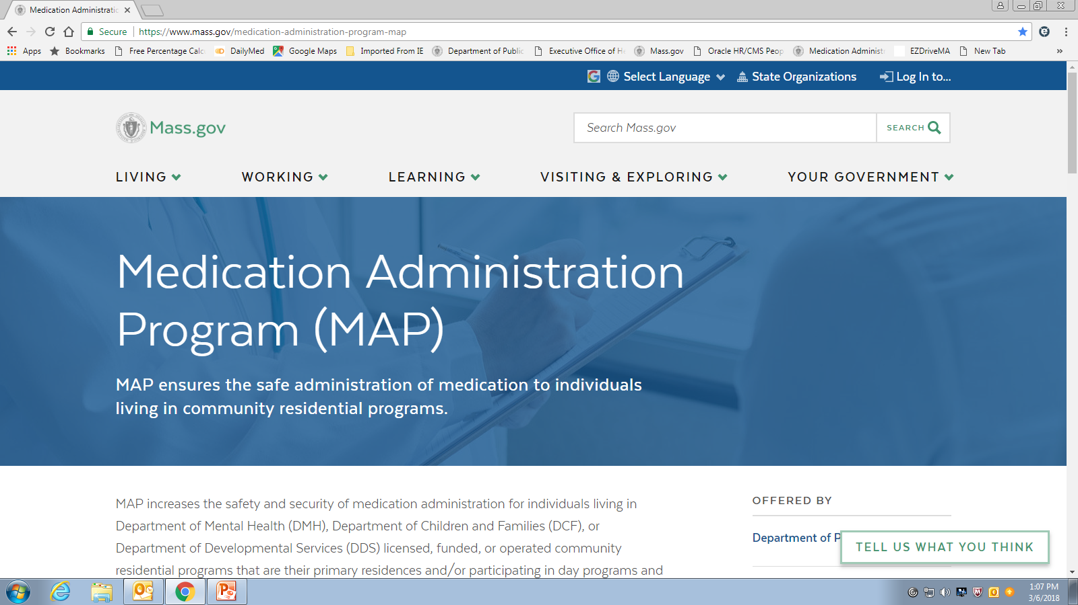
Mass.gov; New Look!
Notes:
….if you haven’t looked lately, Mass.gov has a new look! To get to the MAP information, from the mass.gov homepage type in ‘Medication Administration Program’ in the search bar and then click on the first link and you will see this screen; the MAP homepage or ……..

Slide 6
www.mass.gov/dph/map
Notes:
…. use the MAP friendly URL, listed at the top of your screen, to get directly to the MAP page.

Slide 7
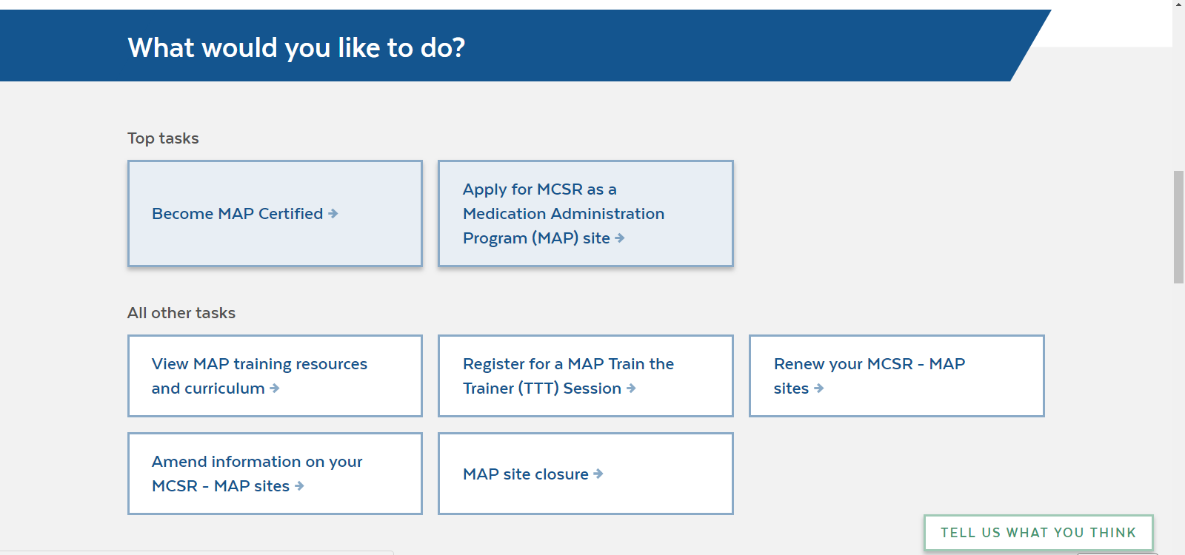
www.mass.gov/dph/map
Notes:
The format of the new site is meant to be ‘user friendly’ and is set up by asking ‘What would you like to do?’ with a series of options listed…..and if you scroll down you will see the next section titled…

Slide 8
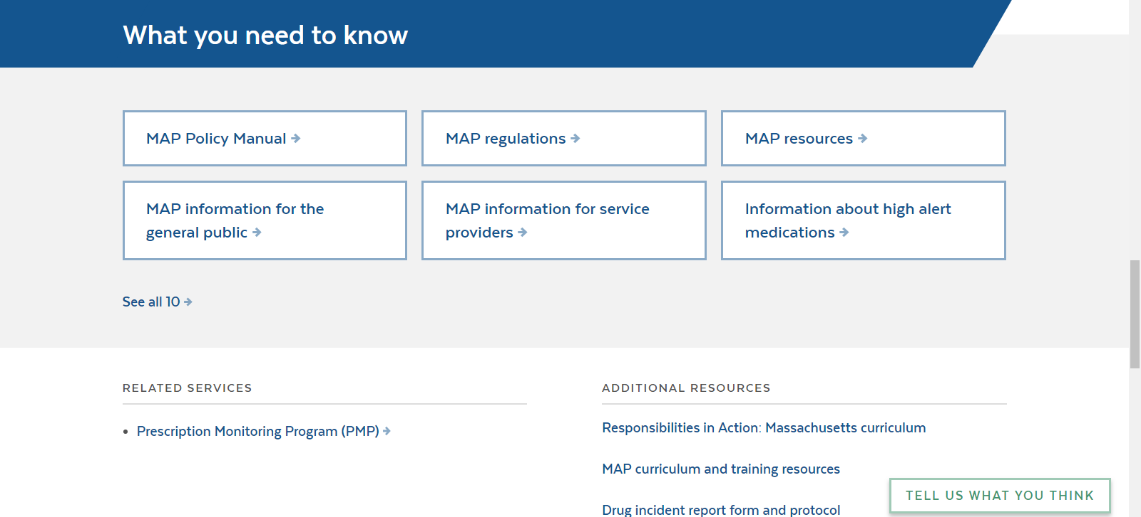
www.mass.gov/dph/map
Notes:
….What you need to know…it is in this section that you will find the new Advisories…

Slide 9
Advisories
On-line References
Transportation of Medication
Suspected Drug Tampering
MAP Certification Process
New Site Checklist
Medication Occurrence Reporting
Hospice
Notes:
…..I will review each…..to access the Advisories……..

Slide 10
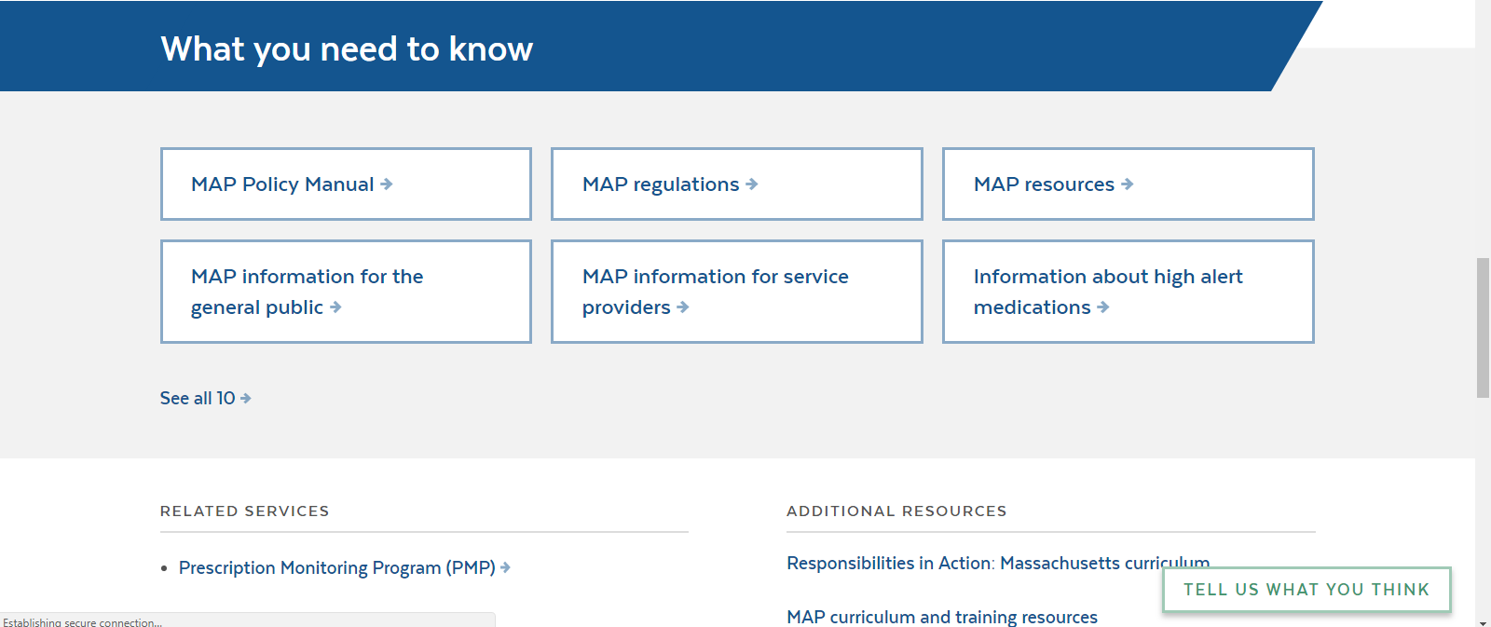
www.mass.gov/dph/map
Notes:
Look in the ‘What you need to know’ section… and click on ‘MAP Resources’, there you will see…..

Slide 11
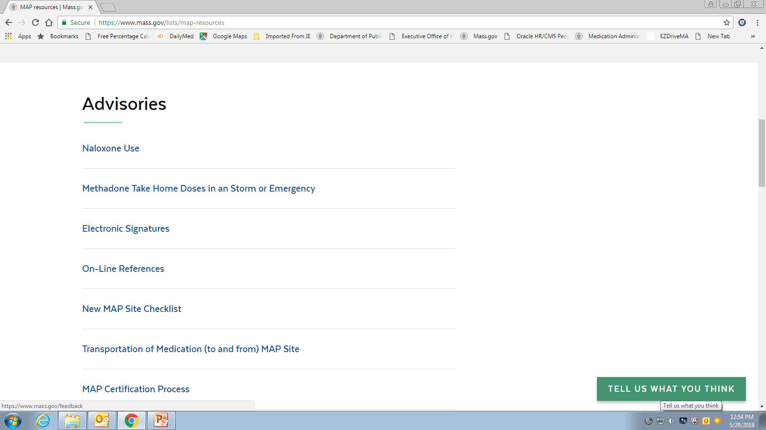
www.mass.gov/dph/map
Notes:
this screen…all advisories are posted here
The new advisories have been included as attached handouts with today’s presentation.
The first new advisory is…

Slide 12
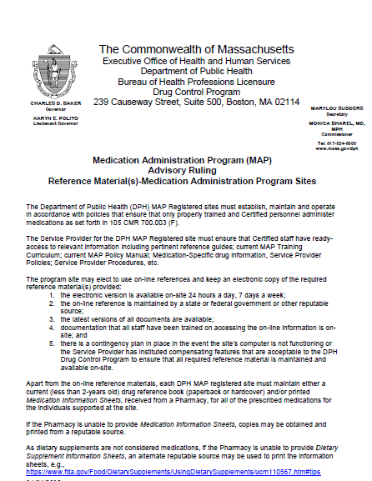
On-line References
Notes:
….On-line References.
This advisory provides clarification regarding if/when required documentation/reference materials/trainings etc are stored electronically at a MAP registered site. One of the stipulations cited in the advisory for storing required information electronically is that there is an additional training for all staff regarding how to access the information, the information is accessible 24/7, the information is ‘readily accessible’ (such as filed in a folder on the desk top) and there is a back up system in the event the computer is not working.
For Drug Reference material there must still be a hard copy of either a Drug Reference Book or printed Medication Information Sheets for each med ordered, on site.

Slide 13
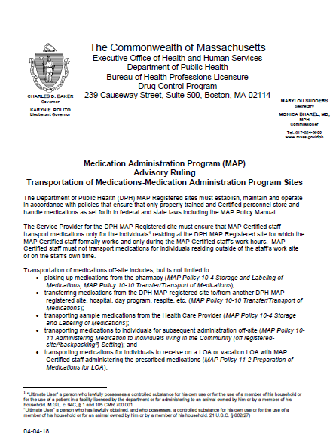
Transportation of Medication
Notes:
The Transfer of Medication (to and from) MAP Sites advisory details who may transfer medication to/from
the pharmacy
An HCP visit
From one MAP site to another MAP site
For an offsite administration such as backpacking and
A LOA and/or vacation LOA
In general, this advisory states that the staff must be Certified and that the staff may only transport medications for individuals residing at the site that the staff formally works. The transport must also take place during the staff’s work hours (meaning not during off-work hours).

Slide 14
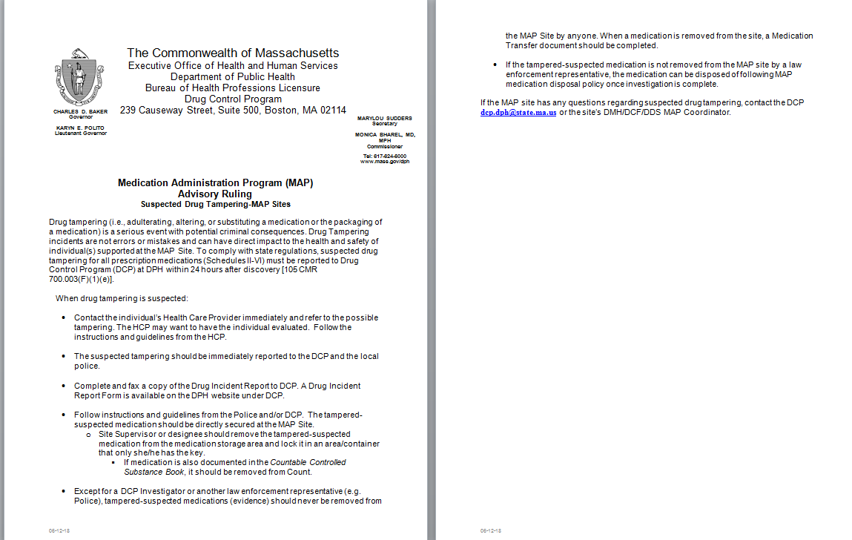
Suspected Drug Tampering
Notes:
Suspected Drug Tampering
Drug tampering is considered adulterating, altering or substituting a medication or the packaging of a medication, which is a serious event and can result in potential criminal consequences.
Drug tampering can have a direct impact to the health and safety of the people supported at MAP sites.
To comply with state regulations, suspected drug tampering must be reported to the Drug Control Program at DPH, using the Drug Incident Report form, within 24 hours of discovery.
If drug tampering is suspected you need to
Call the persons HCP
Call the local police
Complete a Drug Incident Report form and
Follow any instructions given to you by the HCP, police or DCP
In addition, the suspected tampered with drug must be removed from the medication storage area, including if it’s a countable medication, and should be secured in an area/container that only the supervisor has access to.
If the medication is transferred to the police or an investigator be sure to complete a Transfer Form
If the tamper-suspected medication is not removed from the MAP site by an enforcement representative, the medication may be disposed of following MAP policy once the investigation is complete.

Slide 15
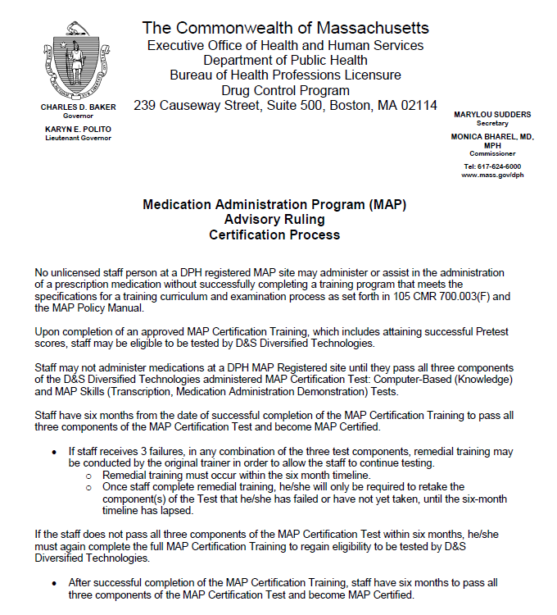
MAP Certification Process
Notes:
MAP Certification Process
The MAP Certification Process advisory states that certification training is now only good for 6 months meaning that all testing must be completed within 6 months after training is completed….this includes…

Slide 16
MAP Certification Process
Remedial training
  Once completed
    Staff will only complete the portion(s) of the certification test which was failed
Notes:
….if/when remedial training is conducted. If conducted, the remedial training and corresponding testing must be completed in the same 6 month time frame; remedial training does not extend the 6 month period of time.
A difference in the testing after completion of the remedial training is that staff will only need to re-take the portions of the test which were initially failed.

Slide 17
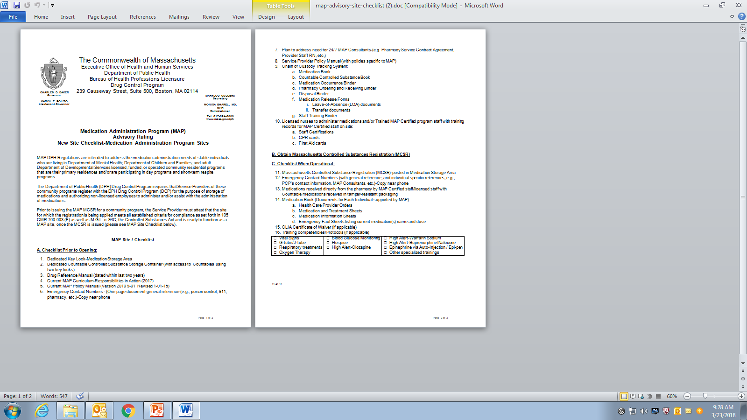
New Site Checklist
Notes:
New Site Checklist Advisory
DPH has created a checklist to use as a guide when opening a new MAP site to streamline the process. The checklist provides details of what must be done prior to opening the new site, followed by obtaining the Massachusetts Controlled Substance Registration or MCSR, followed by what must be done once the site is operational.

Slide 18
New MAP Sites
Attestation of Medication Administration Program Controlled Substance Registration
  For New Potential MAP Sites
Notes:
In addition to the new site checklist…..when preparing to open a new site, before the MCSR application has been submitted, the Service Provider must attest that the site for which the registration is being applied, meets all established criteria for compliance and will be ready to function as a MAP site once the MCSR is issued.
Prior to issuing the MAP MCSR for a community program, Service Providers must complete the Attestation of Medication Administration Program document and submit it within 30 days of the date listed on the notice with their site application for a MAP MCSR. If you are not able to attest to the items in this list, your MCSR application will be rejected without prejudice. Your program may apply when you are able to provide the required attestation.
To locate the Attestation of Medication Administration Program Controlled Substance Registration form, go to the MAP website….

Slide 19

www.mass.gov/dph/map
Notes:
Look under ‘What would you like to do?’……Click on the ‘Apply for a MCSR as a new Medication Administration site’….

Slide 20
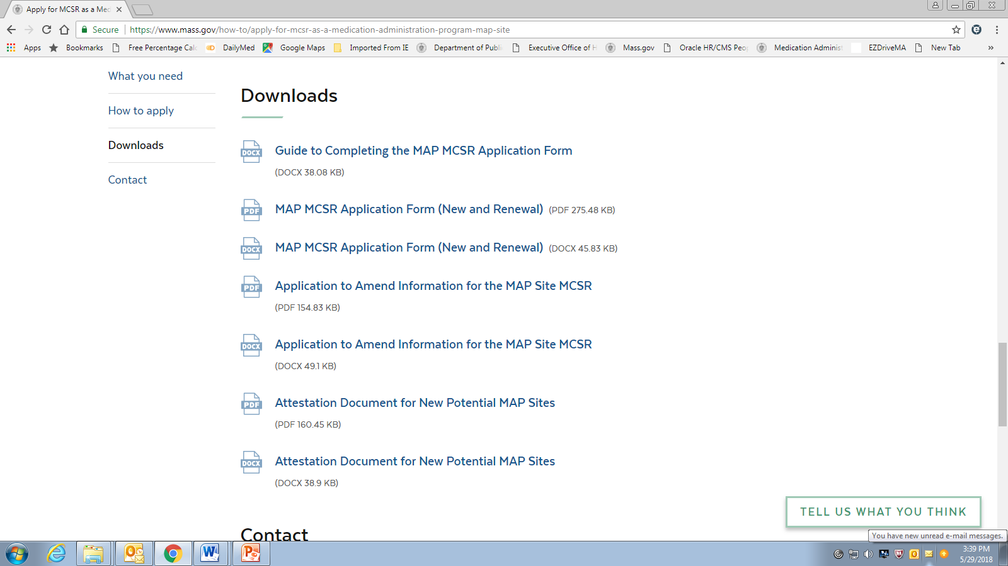
Attestation Document
Notes:
Then scroll down until you see the ‘Downloads’ section, the Attestation document is located here (as seen on your screen), below the MCSR registration application form…..

Slide 21
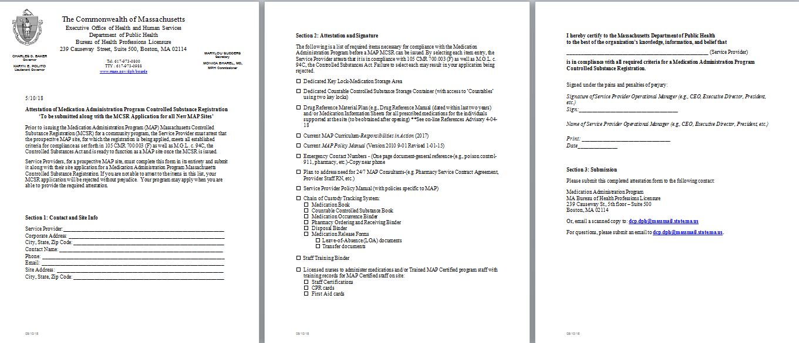
Attestation Document
Notes:
…the Attestation document is 3 pages as seen on your screen and is included as one of your handouts.

Slide 22
Notices
DCP Disposition of Controlled Substance MAP Sites MCSR Termination
DCP MAP Notice-Rescission of MAP Hospice Policies 16-2 and 16-3
    Follow up Advisory Ruling MAP Policy 16-2 Hospice
Notice of Revised G/J Tube Management Form
Notes:
There are 3 recent notices released by the Drug Control Program…
The first one is the DCP statement Regarding Disposition of Controlled Substances at MAP Sites Upon Termination /Closure /Expiration or Voiding of the MCSR….
….the Notice of Rescission of Policies 16-2 and 16-3
And the Notice of Revision of the G/J Tube Management Form
I will review each…

Slide 23

www.mass.gov/dph/map
Notes:
The first one is the DCP Statement Regarding Disposition of Controlled Substances at MAP Sites Upon Termination/Closure/Expiration or Voiding of the MCSR…..
Disposition means the act of disposing; transferring to the care of or possession of another. The parting with, alienation of or giving up of property.
To locate this form, go to the MAP website and look in the ‘What would you like to do?’ section…
click on ‘MAP Site Closure’…

Slide 24
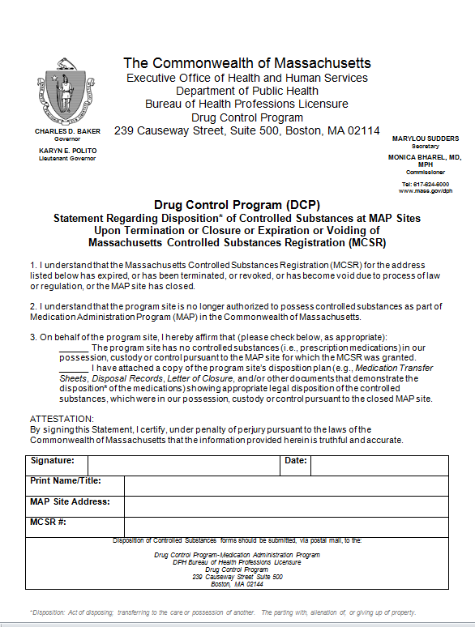
Notes:
….once there, you will find the this form, as seen on your screen. This form is used to affirm that when an MCSR is expired, terminated, revoked or is no longer valid, that the program is no longer in possession of controlled substances for which the MCSR was issued.
This form is to be used when a site closes or when there is a change in provider; MCSR’s are not transferrable so if one site closes and a new site opens or the site remains open however there is a change in provider, old MCSR must be terminated and a new MCSR applied for.

Slide 25
Board of Registration in Nursing
Advisory Ruling
  Accepting, Verifying, Transcribing and Implementing Prescriber Orders
Notes:
The second DCP notice is subsequent to the Board of Registration in Nursing Advisory Ruling number 9324 ‘Accepting, Verifying, Transcribing and Implementing Prescriber Orders’, which has been included as one of your handouts. The nursing advisory ruling states that HCP ‘range orders’ require specific objective measures that must be collected and assessed by the nurse prior to administering the correct dosing. Based on this information the hospice policies 16-2 and 16-3 were rescinded and policy 16-2 has been revised to reflect current standards of practice and has been released as an advisory.

Slide 26
www.mass.gov/dph/map
Notes:
To locate the notice of rescission, look under ‘What you need to know’ and click on ‘MAP Policy Manual’.

Slide 27
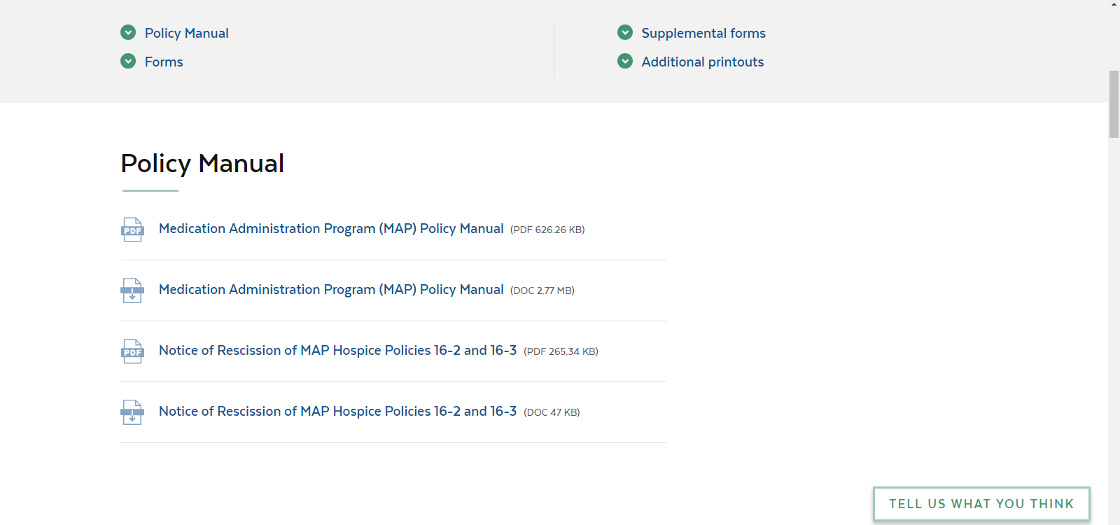
Rescission of Hospice Policies 16-2 and 16-3
Notes:
….there you will see the Notice of Rescission of MAP Hospice Policies 16-2 and 16-3….remember, as I stated policy 16-2 has been revised and is released as an advisory in the advisory section on-line.

Slide 28
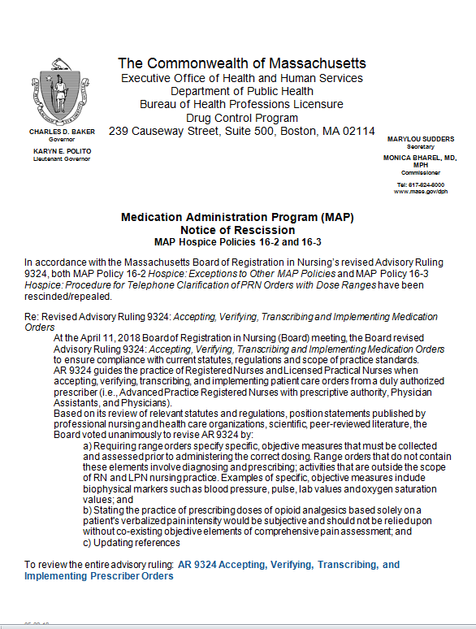
Rescission of Hospice Policies 16-2 and 16-3
Notes:
….the Notice of Rescission of Hospice Policies 16-2 and 16-3 has been included as one of your handouts…..

Slide 29
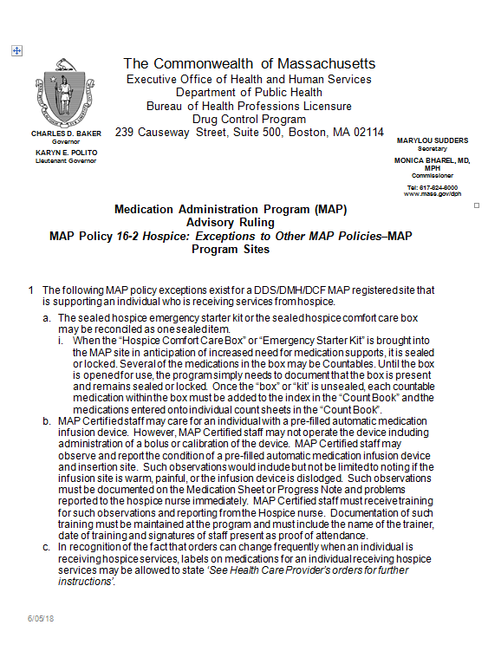
Advisory-MAP Policy 16-2 Hospice
Notes:
….in addition, the Advisory Ruling MAP Policy 16-2 Hospice: Exceptions to Other MAP Policies-MAP Program Sites has been included as a handout.
This advisory ruling provides direction when a person is receiving hospice services including..
Reconciling the hospice care kit
MAP staff monitoring a person with a pre-filled infusion device and
In recognition that orders can change frequently when a person is receiving hospice services, pharmacy labels may state ‘See Health Care Provider orders for further instructions’

Slide 30
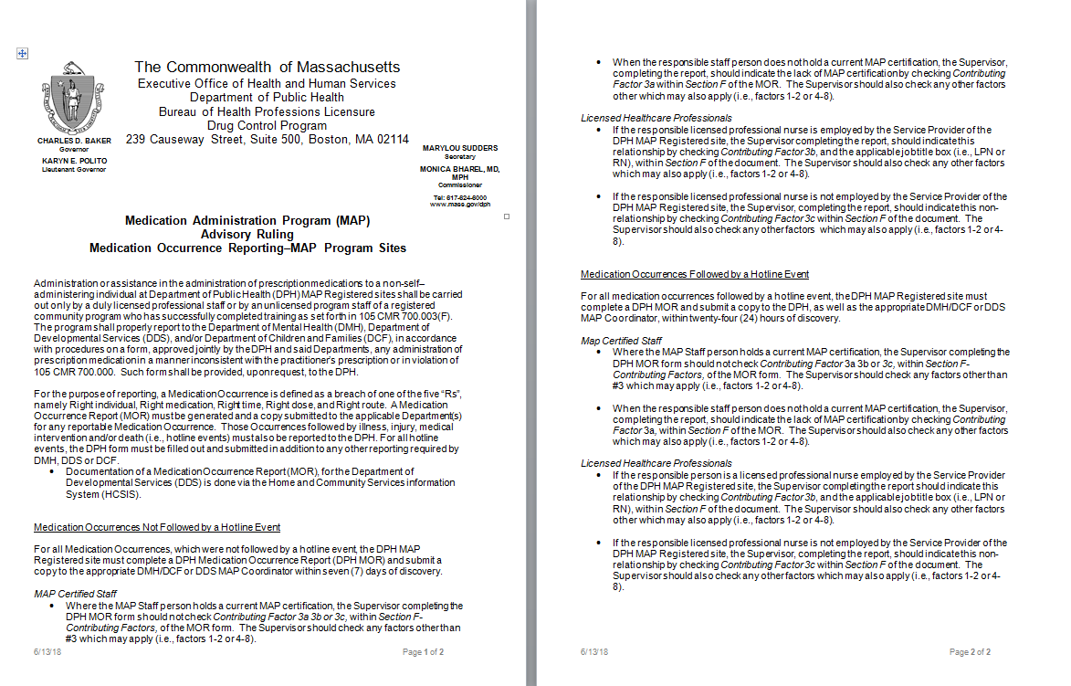
Medication Occurrence Reporting
Notes:
Advisory Ruling Medication Occurrence Reporting
As has always been the case, if a MAP Certified staff makes a medication occurrence, the occurrence is reported by entering it into HCSIS or if a hotline, entering it into HCSIS and faxing it to DPH.
The Department of Public Health regulations state that medication occurrences happening at a MAP registered site must be reported; there is no differentiation regarding who makes the error .
So as many of you in DDS programs know, we have asked that as of January 1st 2018 that all errors made by licensed staff are reported in addition to occurrences made by Certified staff. So if this is new to you, moving forward, all medication occurrences, including those made by a licensed professional at a MAP registered site, must be reported.
The DPH MOR form has been revised to reflect this expectation and the advisory, as seen on your screen, provides direction when completing the revised form; both are included as handouts.

Slide 31
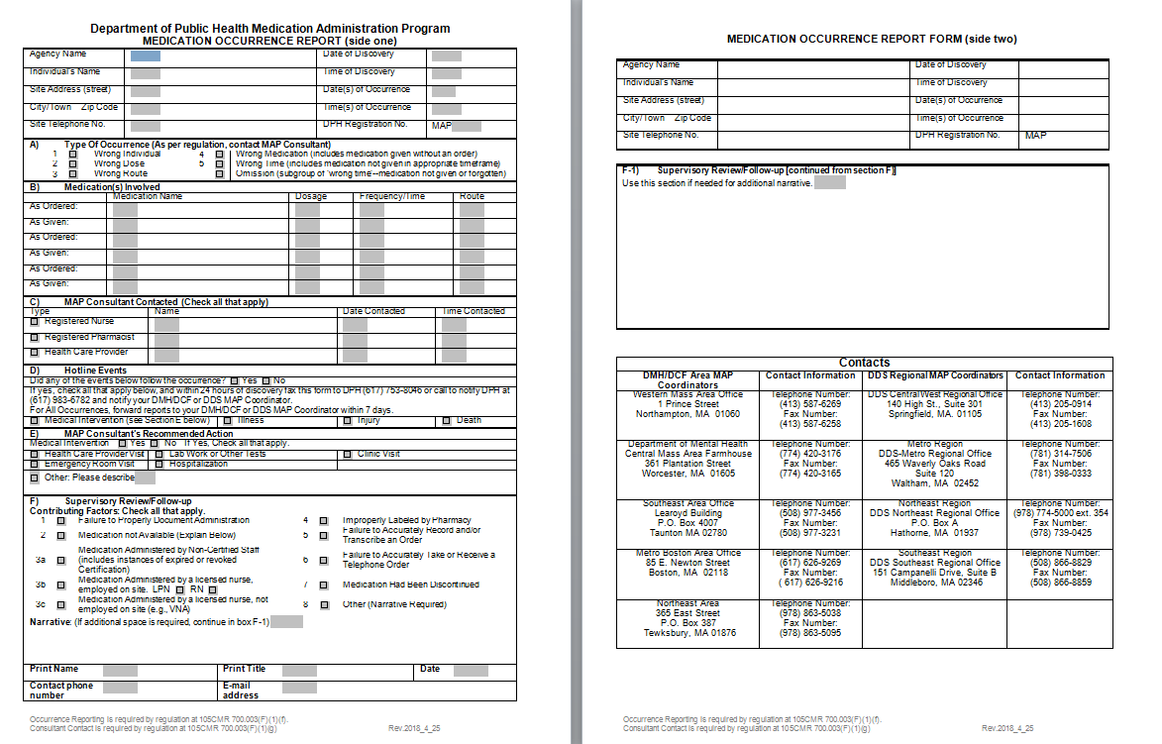
Medication Occurrence Report
Notes:
The changes to the Medication Occurrence Report form are in section F……

Slide 32
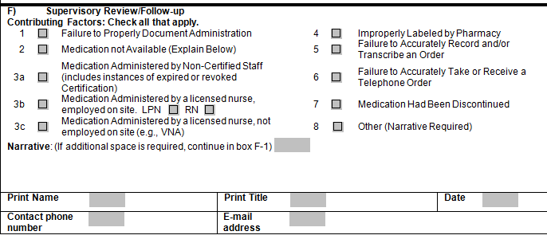
MOR form Section F
Notes:
Section F 3a, b and c are new additions to the form
3a states Medication Administered by Non-Certified Staff; this box is only checked if the staff’s Certification is expired or revoked. If the staff holds a current MAP Certification, 3a, b and c should not be checked, instead the supervisor should check any contributing factors which apply in 1-2 and/or 4-8
3b states Medication Administered by a licensed nurse employed on site: LPN or RN; so if the nurse who made the error is an employee of your agency then 3b is completed, in addition any contributing factors in 1-2 and 4-8 may be chosen
3c states Medication Administered by a licensed nurse, not employed on site: LPN or RN; so if the nurse who made the error is not an employee of your agency, such as a VNA nurse, 3c is completed, in addition any contributing factors in 1-2 and 4-8 may be chosen

Slide 33
DDS Reporting Guidelines
Summer 2018
  All medication occurrences will be entered into HCSIS
    Including medication errors made by licensed staff
Notes:
The DDS HCSIS reporting system is in process of being updated to include the option of RN or LPN as a response to the question “Staff Position of Person Giving Medication”. Updates to the system should be completed by Summer 2018. In the mean time, until the HCSIS updates are completed, the medication occurrences made by licensed staff must be completed on the DPH MOR form and faxed to your regional MAP Coordinator; the organizational chart is included as a handout. Find the MAP Coordinator for your region and fax the completed report to the fax number listed. When the HCSIS updates are complete, all MORs made by nurses, including all of the previously faxed MORs, must be entered into HCSIS.

Slide 34
Hotline Nursing Errors
Entered into HCSIS and
Faxed to DPH
  Follow up
    Determined by DPH
Notes:
The reporting timeline requirement for nursing errors is the same as the reporting timeline requirement for MAP Certified staff; if it is a hotline it is faxed to DPH and the MAP Coordinator within 24 hours of discovery and for non-hotlines notification to the MAP Coordinator within 7 days of discovery. The only difference will be in the follow up. Currently, for all hotlines made by MAP Certified staff, there is a scheduled MAP technical assistance visit by the Regional MAP Coordinator; for the nursing hotlines, there will not be a follow up review (site visit) by a Regional MAP Coordinator; if follow up is necessary it will be initiated and conducted by DPH.

Slide 35
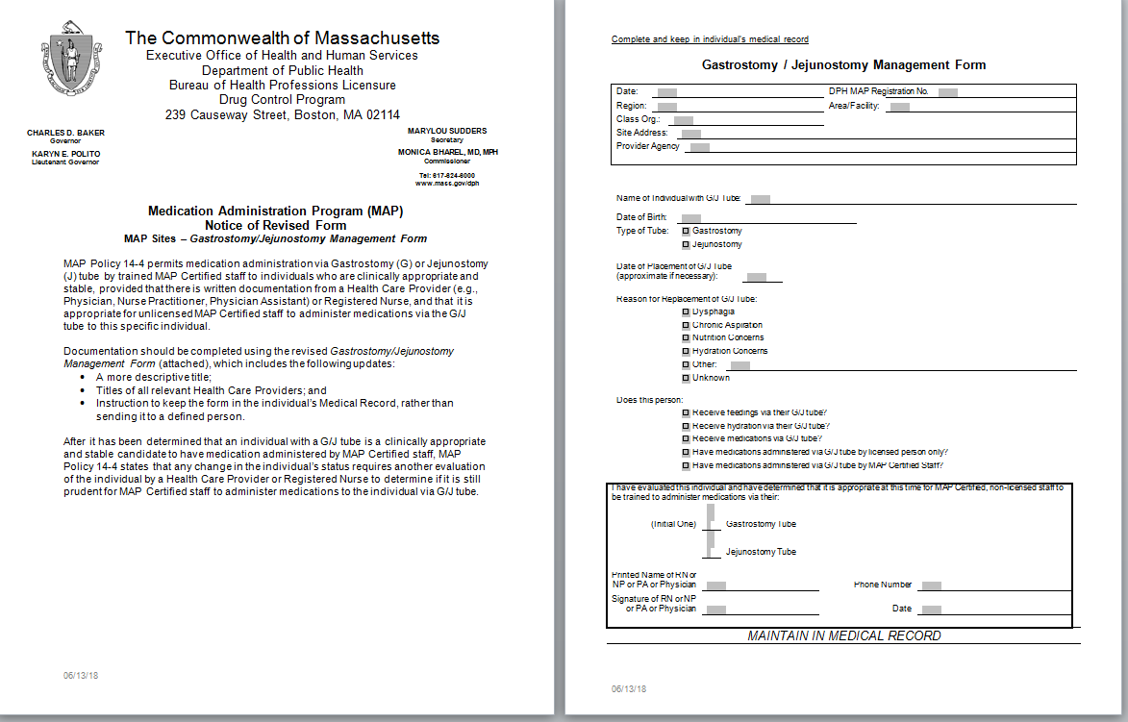
Revised G/J Tube Management Form
Notes:
The G/J Tube Management form was also revised.
The revised form includes
A more descriptive title
Titles of all relevant Health Care Providers; and
Instruction to keep the form in the person’s Medical Record rather than sending it to a defined person

Slide 36
MOR Trigger Reports
8 or more MORs/quarter
  Triggers a report
    MAP self-review will be requested
Notes:
Medication Occurrence Trigger Reports
Some of you out there may already know that we have been monitoring quarterly medication occurrence report numbers. If a site reaches the threshold of 8 or more medication occurrences in a quarter a report is triggered; this number is based on 4 people living at the site. Each site on the trigger report, will be requested to conduct a ‘self-review’ using the MAP technical assistance tool, follow up due in 30 days after request, to the MAP Coordinator. As I said, we do keep in mind the number of people living at each site, so for example, if the site had 8 medication occurrences for the quarter and 5 people lived at the site, the threshold is not met and a self-review is not required.

Slide 37
MOR Trigger Reports
2 consecutive appearances on the trigger report
  MAP review by the MAP Coordinator
Notes:
If a site appears on the trigger report for 2 consecutive quarters, a site visit will be scheduled by the Regional MAP Coordinator.

Slide 38
Transcription Workbook Three
Advanced Learning Transcriptions
  Cross over from one month to the next
  Taper up and taper down
  Data collection required for med administration
  And More!
Notes:
Training Materials
A third transcription workbook has been created for ongoing education. This TWB is considered ‘advanced learning’ as it covers transcriptions that transfer from one month to the next, there are taper up and down medication orders and more.
This transcription workbook can be used as follow up retraining after a medication occurrence involving one of the scenarios in the work book or even as a reference material. Typically, it would not be used for initial certification training.
TWB 3 will be posted on line with TWBs 1 and 2 with the MAP trainer Tools and is also included as one of your handouts.

Slide 39
Updates
Notes:
The next few slides will cover some updates…

Slide 40
Train the Trainer
Updated
  Nursing practice
Notes:
Train the Trainer
The DPH MAP Policy session of the Train the Trainer program has been recently updated to reflect current standards of nursing practice in accordance with the Board of Nursing. So if you have attended TTT prior to March 2018 you should review this information regarding nursing practice as it is different than what has been said in the past.

Slide 41
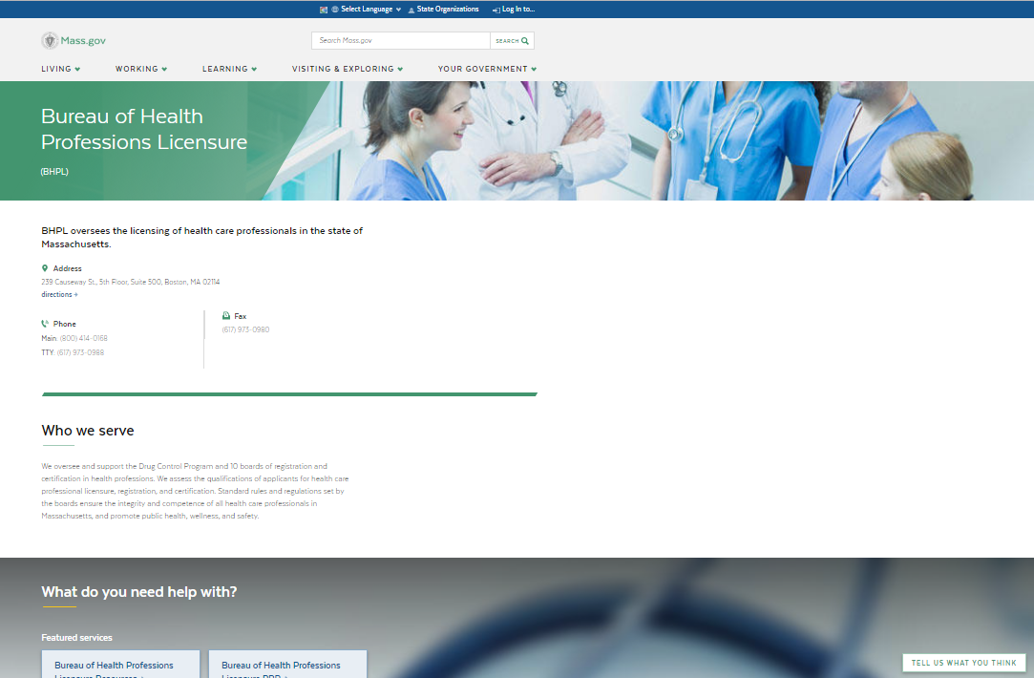
WWW.MASS.GOV/DPH/BOARDS
Notes:
To locate the standards of practice according to the board of nursing… the URL at the top of the screen is the Bureau of Health Professions Licensure website resource for information specific to nursing. Once in this website, you can select ‘nursing’…

Slide 42
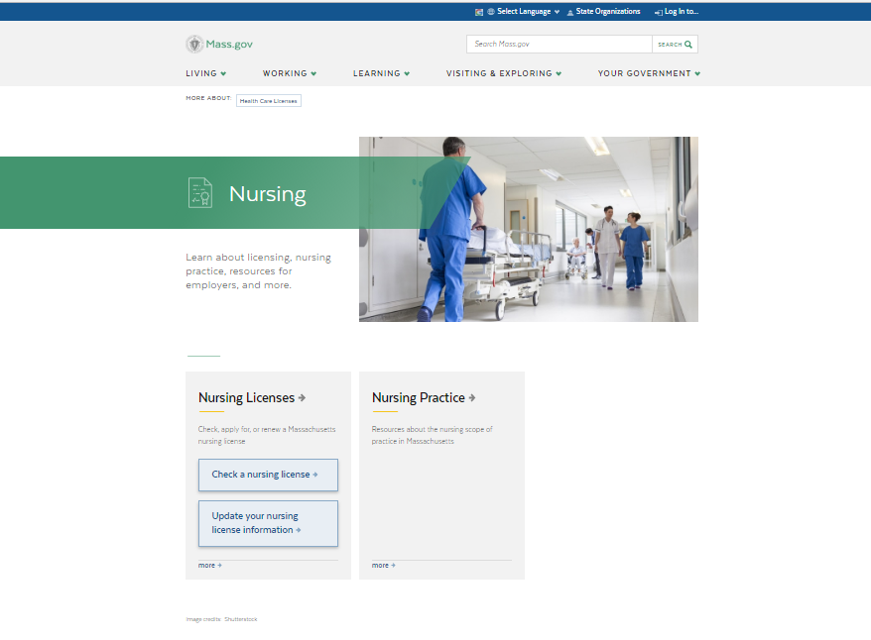
WWW.MASS.GOV/TOPICS/NURSING
Notes:
to get to this screen…
Then nursing practice…

Slide 43
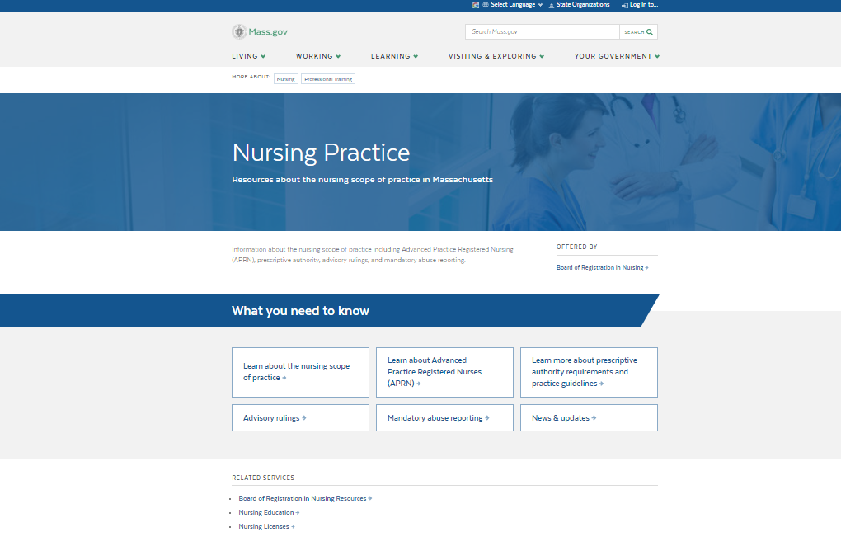
WWW.MASS.GOV/NURSING-PRACTICE
Notes:
to get to this screen…

Slide 44
Nursing Practice
The Board of Nursing does not regulate practice in accordance to setting- or episodes of care
Throughout the course of care, a nurse may perform nursing activities that he/she has the adequate training (competency) and it is within his/her scope of practice.
Notes:
The information on your screen is the expectation of nursing practice according to the board of nursing including at MAP registered sites; in general it states, if an individual requires care by the nurse and the nurse has adequate training and it is within his or her scope of practice, the nurse should perform the nursing activity.
For more information on the topic, visit the nursing practice section on the mass.gov website listed in the previous slides.

Slide 45
DDS Technical Assistance Tool
Expanded
  To include more details
    On the same topics previously listed
Notes:
The DDS MAP technical assistance tool has recently been updated and is included as one of your handouts. You’ll notice, the tool has expanded in length however content remains basically the same… greater detail was added to each topic.

Slide 46
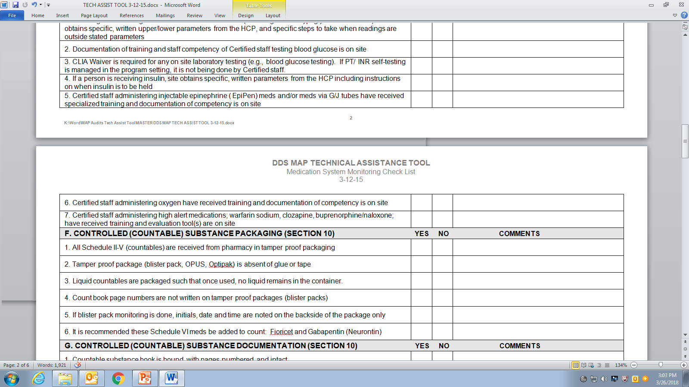
DDS Technical Assistance Tool
Notes:
So for example, on the prior tool (on your screen), Section E number 7, addresses all high alert medications, including the training and evaluation tools for each, all in a single box.
Now….

Slide 47
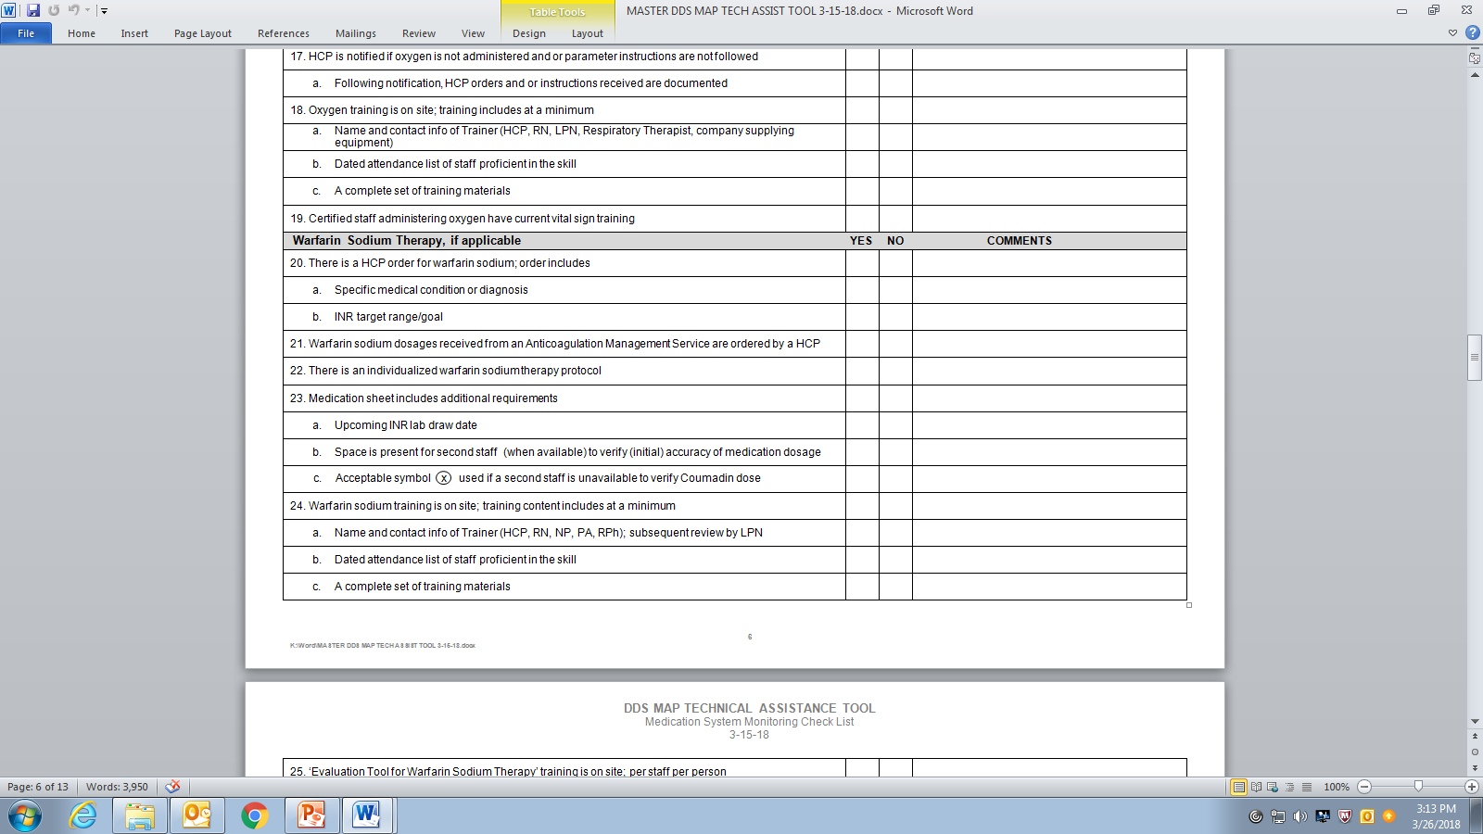
DDS Technical Assistance Tool
Notes:
….each of the high alert meds has its own section on the tech tool with the corresponding requirements listed for each. Above, the requirements for warfarin sodium are listed.
This detail makes the tech tool an excellent resource for you to monitor the medication system at your work location.

Slide 48
DDS Technical Assistance Tool
Available online at
  www.mass.gov/dph/map
    and
  www.hdmaster.com
Notes:
The technical assistance tool is available online at either of the web addresses listed on your screen.
To access the tool using the MAP URL, go to the home page, then….

Slide 49
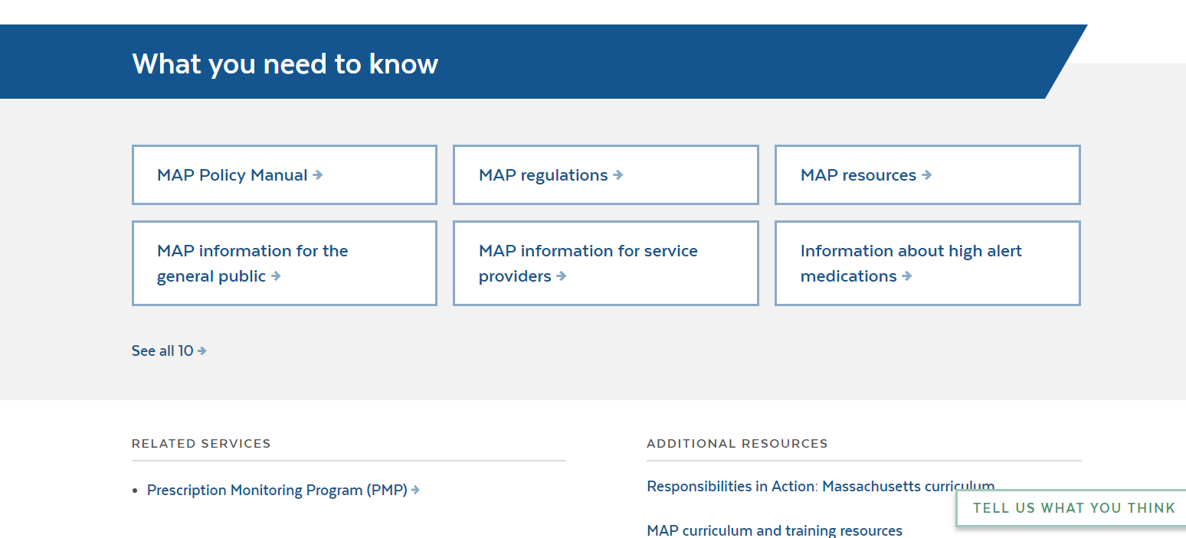
www.mass.gov/dph/map
Notes:
……under ‘What you need to know’, scroll, then click on “see all 10”

Slide 50
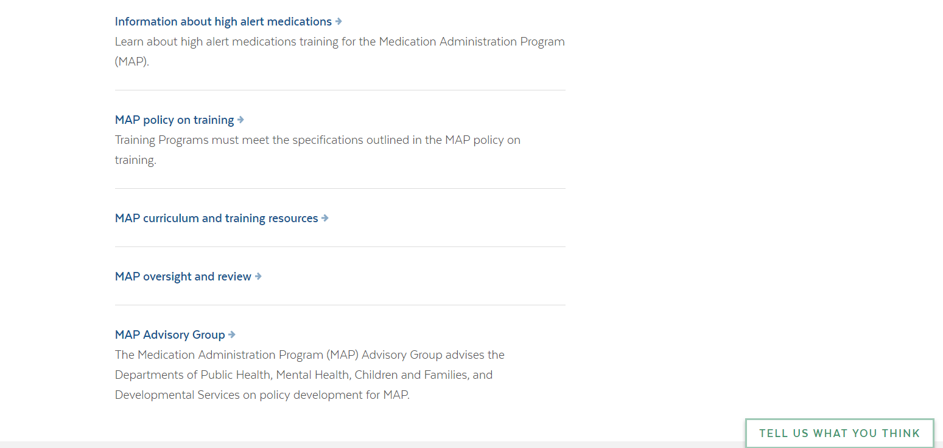
www.mass.gov/dph/map
Notes:
From this expanded list click on MAP oversight and review…

Slide 51
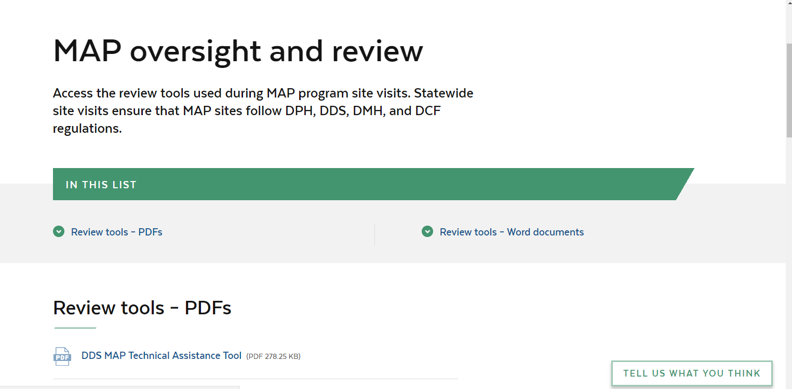
www.mass.gov/dph/map
Notes:
There you will find the DDS MAP technical assistance tool.

Slide 52
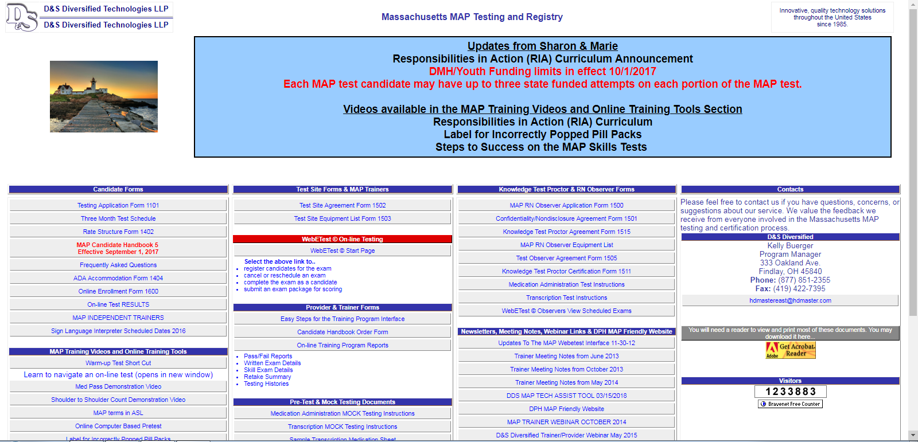
www.hdmaster.com
Notes:
The tech tool can also be located on the hdmaster.com site as seen on your screen.

Slide 53

Responsibilities in Action
One year since released!
  Feedback welcome
Notes:
It has been almost one full year since Responsibilities in Action was released!
At this time, the expectation is that you have already transitioned over to RIA or if you are still using Administering Meds the Right Way, that you have a clear plan with end date of when the transition to RIA will be completed.
We do have an ‘active’ version of the curriculum already in process so if you are using RIA and you have some feedback for us please email your MAP Coordinator; all feedback is welcome.
If you are not yet using the RIA curriculum, access is easy and free…. using the MAP friendly URL….

Slide 54
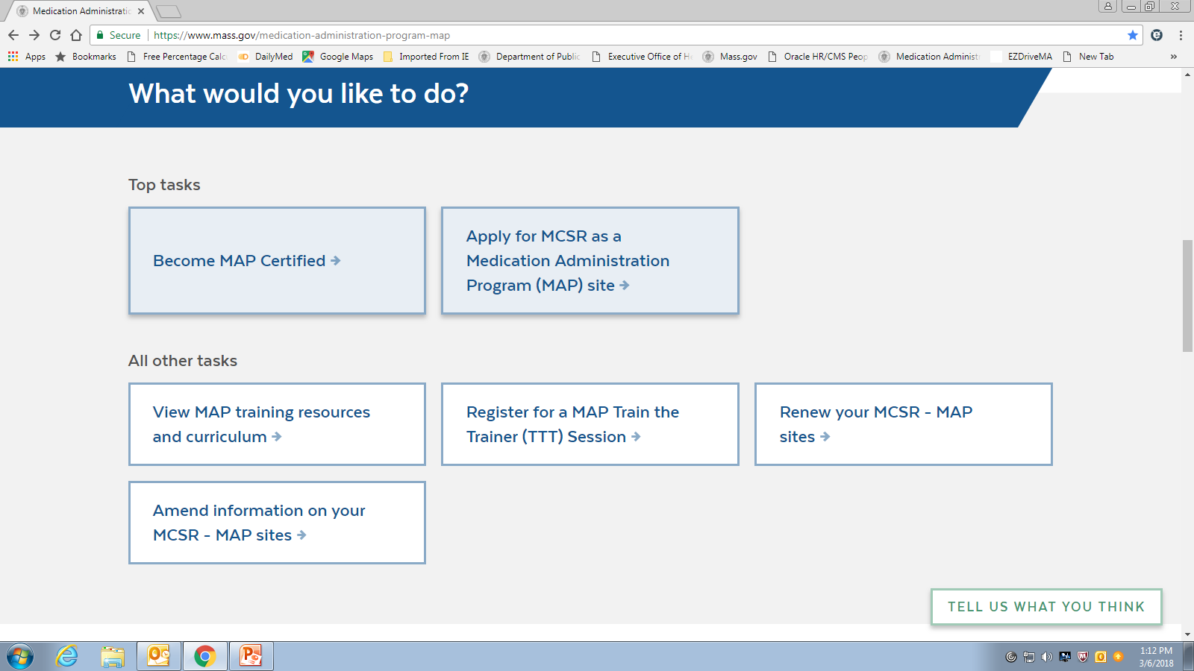
mass.gov/dph/map
Notes:
scroll down…. under ‘What would you like to do?’ and you will see several boxes with different topics. To find the Responsibilities in Action curriculum, click on the box that states ‘View MAP training resources and curriculum’…..

Slide 55
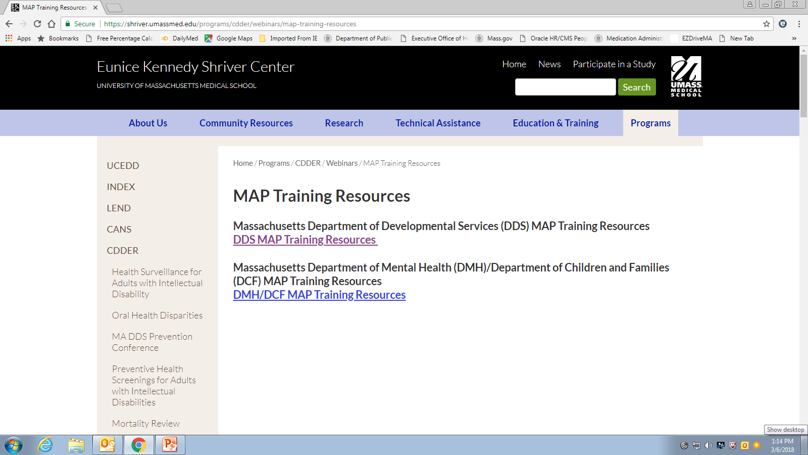
mass.gov/dph/map
Notes:
then…click on DDS MAP Training Resources….

Slide 56
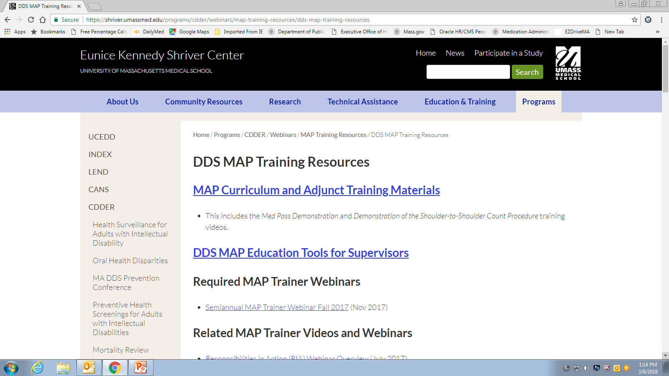
mass.gov/dph/map
Notes:
….and you will come to this page…..click on MAP Curriculum and Adjunct Training Materials, it brings you to….

Slide 57
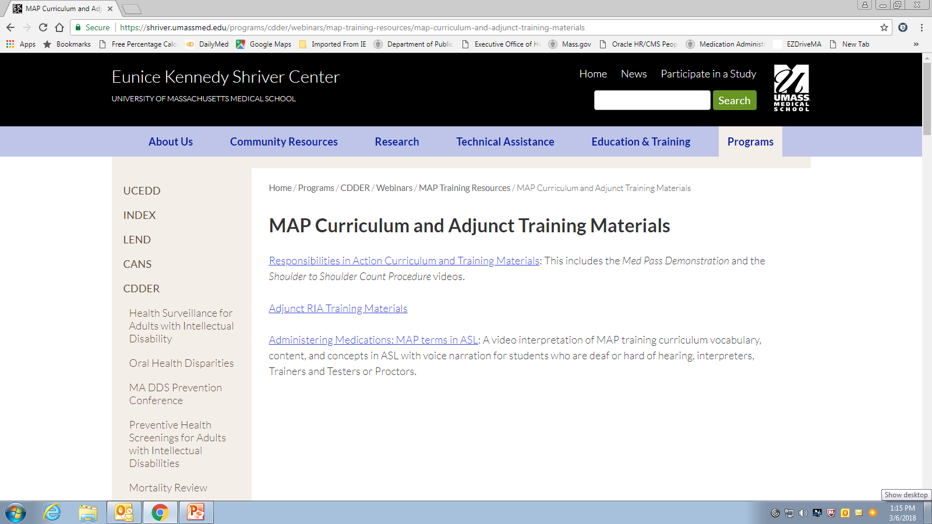
Mass.gov/dph/map
Notes:
This page…..click on ‘Responsibilities in Action Training materials’ and it will bring you to….

Slide 58
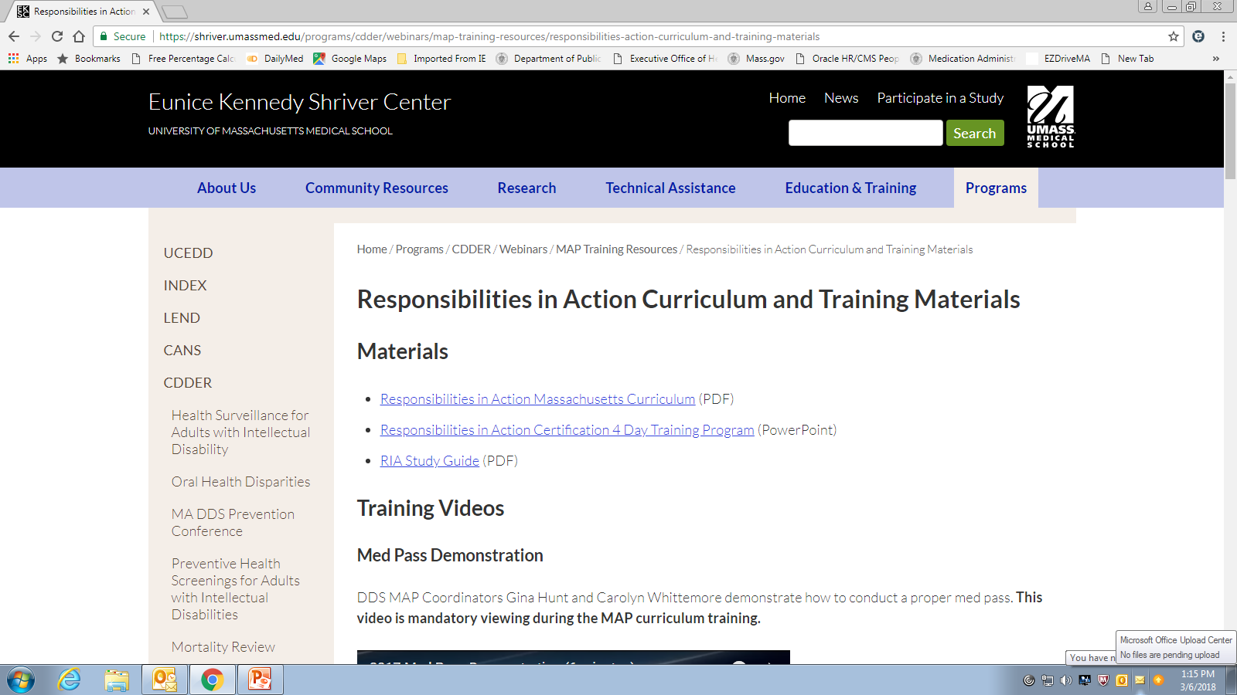
Mass.gov/dph/map
Notes:
This page.. .here you see the curriculum. Scroll down a little and you will see ……

Slide 59
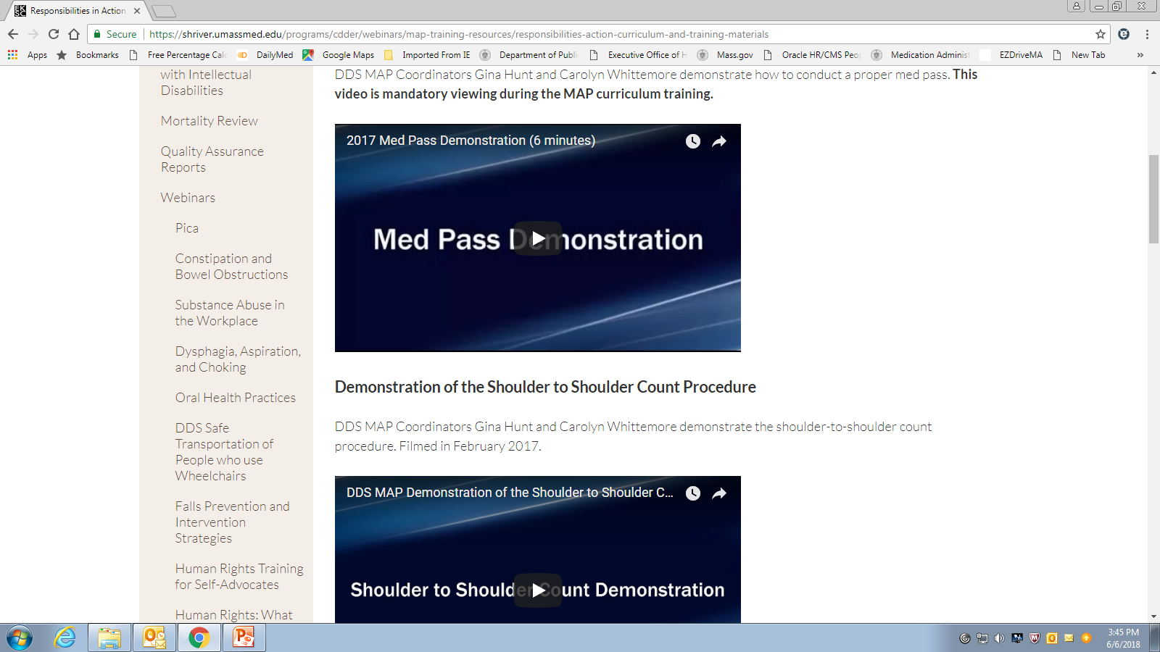
Videos
(Mandatory)
(Optional)
Notes:
The required medication administration demonstration and the optional ‘Shoulder to Shoulder Count’ videos.

Slide 60

D&S Diversified Technologies
Medication administration skill test
  Now gives a ‘3 minute’ warning for time remaining
Notes:
Updates from D&S include that there is now a 3 minute warning given to staff when taking the medication administration portion of the skills test; in the past it was a 5 minute warning.

Slide 61
Reminders
Notes:
The next few slides will cover some topics for reminders.

Slide 62
Insulin
Administered only by licensed staff
  Unless the person is self-administering
    Defined in MAP Policy Section 7
    ‘Self-injecting’ does not automatically mean ‘self-administering’
Notes:
Insulin
…as has always been the case in MAP, insulin may only be administered by licensed staff such as a nursing service (VNA) or Provider nursing staff.
Licensed staff need an HCP order to administer insulin. The insulin order must include specific parameters regarding if/when the insulin is to be held and when to notify the HCP. Notification of the HCP must be documented with recommendations, if any.
A nursing service typically has its own documentation requirements, usually consisting of a file maintained in the home. The nursing service may communicate directly with the HCP and obtain new insulin orders if needed.
It is recommended that you ask for and keep a copy of the nursing service policy in regard to obtaining a HCP signature on a TO.
Also, any time the nurse obtains a new insulin order ask for a copy so you can put it in the med book.

Slide 63
Sample Medication Sheet
Notes:
The insulin order should be transcribed onto the medication sheet with clear instructions written across the grid that the insulin is to be administered by nursing only.
Certified staff should never initial the med sheet next to the insulin.
If at any point the insulin order changes, DC the previous order on the med sheet and transcribe the new one just like any other med.

Slide 64
Insulin
Self-administering
or
Not self-administering
  All MAP policies/regulations apply
  If learning to self-administer
    Training program must be carried out by licensed staff
Notes:
If an individual is in the process of learning to self administer insulin, they are considered non self administering during the transition. All MAP rules apply. Which means the training program must be conducted by licensed staff only.

Slide 65
Insulin
MAP Certified staff may NOT
  Administer insulin
  Dial a dose on a insulin pen
  Verify
    a dose dialed by a person
    the amount of insulin drawn up by the person
Notes:
Remember, while the individual is in process of learning to self-administer, the MAP Certified staff may not
administer or help to administer the insulin
dial a dose on the insulin pen
verify a dose dialed by the individual on a insulin pen or
verify the amount drawn up in a syringe by the individual
any of this if required, must be completed by a licensed person.

Slide 66
Insulin
If the insulin is managed by a nursing service
  Such as the VNA
    The nursing service may not have a key or know the combination to the medication storage area
Notes:
If the insulin is managed by a nursing service, the nurse should not have a key or know the code to access keys to the med storage area. If needed, access to the insulin and/or supplies would be through contact with a MAP Certified staff.

Slide 67
Protocols
Considered to be a HCP order
  Subset of a ‘standing order’
    DPH MAP Policy 13-6
Notes:
Protocols
Many times an HCP order is so lengthy with details regarding information needed for the administration of a medication that a Protocol may be required. Protocols are considered to be an extension of the HCP order.
In policy, they are considered a ‘subset’ of a standing order. Another term for a Protocol is a Support Plan; both give needed details for safe medication administration.

Slide 68
Protocols
HCP order:
  Ellen Tracey Ativan 1mg by mouth every 6 hours PRN, for anxiety see protocol
Pharmacy label:
  Ellen Tracey
  Lorazepam 1mg
  IC Ativan
  Take 1 tab by mouth every 6 hours PRN for anxiety, see protocol
Med Sheet:
  Ellen Tracey
  Generic Lorazepam 1mg
  Brand Ativan
  Strength 1mg Dose 1mg
  Amount 1 tab Route by mouth
  Frequency every 6 hours PRN for anxiety, see protocol
Notes:
When there is a Protocol that corresponds with a HCP order, the HCP order, pharmacy label and the med sheet may all refer staff to the protocol for the required additional information, as seen on your screen.

Slide 69
Protocols
Ellen Tracey Support Plan for use of PRN Medication for Anxiety
Specific behaviors that show us Ellen is anxious:
Biting hands for more than 4 minutes
Head slapping for longer than 30 seconds or more than 5 times in 4 minutes
  Staff will attempt to engage Ellen in one on one conversation regarding current feelings and difficulties
  Staff will attempt to direct and involve Ellen in a familiar activity such as laundry, meal preparation, etc.
If unsuccessful with A or B staff may suggest/offer Ellen:
Ativan 1mg by mouth every 6 hours PRN, not to exceed 2 doses in 24 hours. If anxiety continues after the second dose, notify HCP.
HCP signature: Shirley Glass MD 6/23/yr
Posted: Wanda Smith 6-23-yr 2pm
Verified: Sam Dowd 6-23-yr 2:30pm
Notes:
The protocol format allows the space for additional information, such as objective criteria for use, parameters and what to do if the medication is given and is not effective.

Slide 70
Protocols
Must be signed and dated by the HCP
  Valid for one year
    Posted/Verified by staff
Notes:
When the protocol gives details regarding medication administration is considered an extension of the HCP order, it must be signed and dated by the HCP, posted and verified by staff, filed in the medication book with all of the other HCP orders and is valid for 1 year.

Slide 71
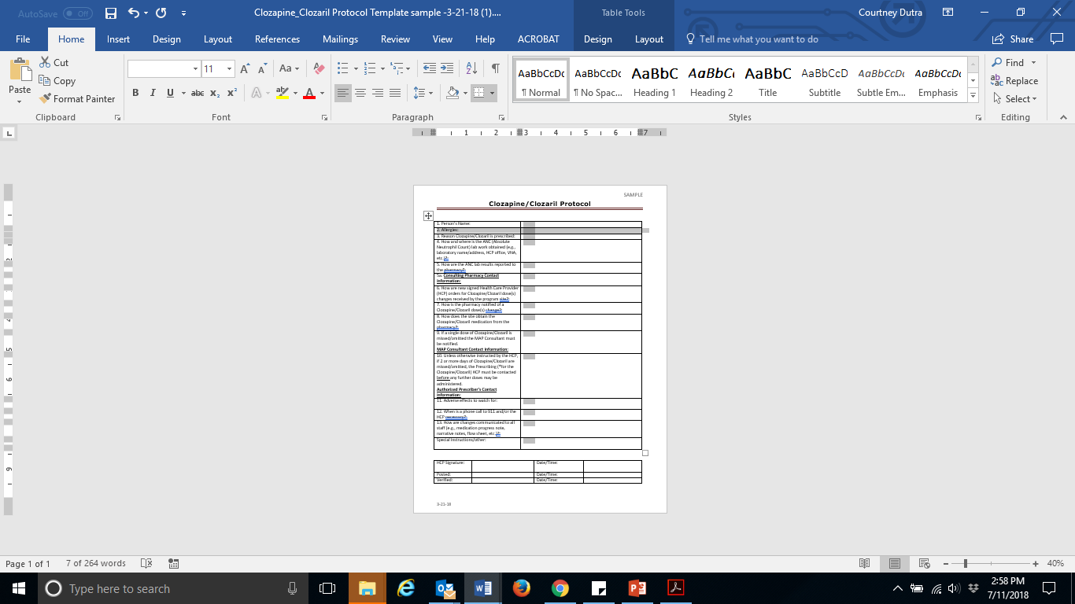
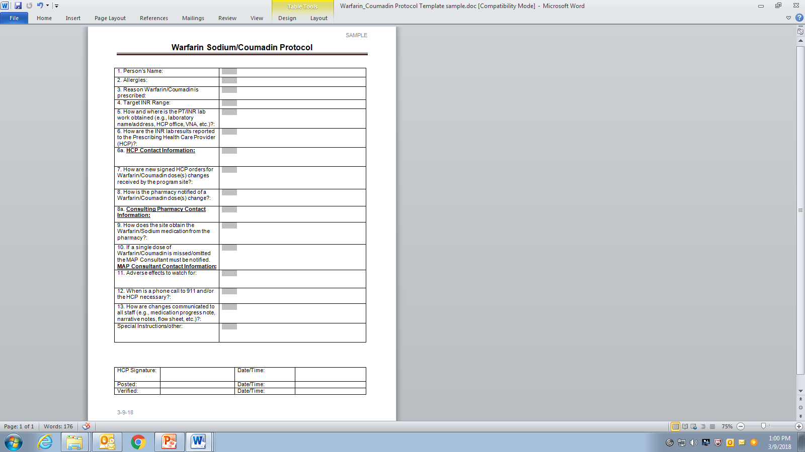
Sample Protocol Templates
Clozaril
Coumadin
Notes:
Two of the high alert medications, Clozaril and Coumadin, have specific criteria listed in policy which must be included in these particular protocols. For that reason we made sample protocol templates which may be used to meet the protocol requirement for these 2 meds. The protocol templates were recently updated and reformatted by DPH and are included as handouts today.

Slide 72
Responsibilities in Action
Medication Administration Process
  Page 127
    “Never set the medication cup down”
      Meaning: never leave medication unattended
Notes:
Based on feedback from the field, we would like to point out that in the MAP curriculum, part of the medication administration process states that staff should ‘never set the medication cup down’; what is meant by that is staff should never leave medication unattended.

Slide 73
PRN Parameters
Required to help prevent over use of PRN meds when there may be an underlying issue
  When to notify the HCP if symptoms continue
Notes:
This slide is a clarification regarding PRN parameters.
All PRN orders require additional parameters for use to avoid a PRN medication from being given for a prolonged period of time without the HCP’s knowledge as there may be an underlying health issue to be addressed. That being said, a ‘not to exceed’ parameter could be included however this only makes sense if the NTE parameter is less than what the person could conceivably receive based on the frequency ordered. So for example, if the order read ‘every 6 hrs PRN’, it does not make sense to include a ‘do not exceed 4 doses in 24 hours’ since 4 doses is already the max number of doses that could be administered according to the order. In addition, if the PRN order has only a ‘not to exceed’ parameter, there is still no direction for staff regarding what to do next if the medication is given and the symptoms continue.
In summary, keep the ‘not to exceed’ parameters, if/when it makes sense however the most important parameter to include in all PRN orders is directions for staff regarding what to do if the medication is given and is not effective, for example calling the HCP.

Slide 74
D&S Diversified Technologies
Certification Testing
  Reasons for failing the transcription
    Incorrect grid
      First dose/last dose
Notes:
At a recent meeting with D&S Diversified Technologies feedback was received regarding some of the more common reasons staff continue to fail the skills portion of the certification test.
For transcriptions, staff continue to set up the grid incorrectly meaning that either the first dose, the last dose or both, are not correct.

Slide 75
D&S Diversified Technologies
Certification Testing
  Reasons for failing the transcription
    “am” or “pm” is not listed with the time in the hour column
Notes:
Other reasons for failure is that ‘am’ and/or ‘pm’ is not listed with the time in the hour column or is listed incorrectly…such as..

Slide 76
D&S Diversified Technologies
Certification Testing
  12 am and 12 pm are used incorrectly
  Remind staff:
    12 am is midnight
    12 pm is afternoon
Notes:
12am and 12pm are reversed. Remind staff that 12am is the same as midnight and 12pm is noontime

Slide 77
D&S Diversified Technologies
Certification Testing
  Reasons for failing medication administration
    Forget or document incorrectly in the Count Book
Notes:
The most common reason for failure of the medication administration portion of the skills test is either forgetting to document in the count book at all or doing it incorrectly.

Slide 78
D&S Diversified Technologies
  No Shows
    If staff leaves employment during the testing process
      Be sure to cancel any previously scheduled portions of the certification test
Notes:
No shows
If staff do not show for a test a ‘no show’ fee is incurred. After 7 years, an unpaid fee will go to collections. This is important information especially if the staff is in the midst of the testing process and breaks service with the agency; be sure to cancel the certification test. The staff may not even be aware that the no show fee was incurred until it goes to collections and is subsequently reflected in their credit score.

Slide 79
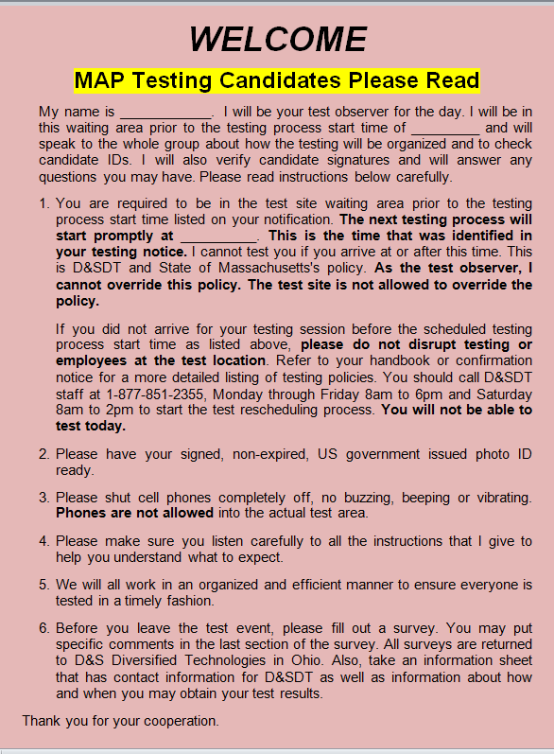
D&S Diversified Technologies
Notes:
When going for their certification test , instruct staff to locate the ‘Pink Sign’ at the test site which identifies the waiting area.
After locating the Pink Sign, staff should read it for details and policies regarding the test procedure, such as having their ID ready and cell phones off.

Slide 80
Next Webinar Date
Fall 2018
Notes:
This concludes today’s webinar, the next trainer webinar will be in the fall 2018, date to be determined.
Thank you for listening.

