Slide 1
Medication Administration Program
Winter 2019
DDS MAP Trainer Webinar
Notes:
Welcome to the semi annual DDS MAP Trainer Webinar. I’m Mary Despres, a Department of Developmental Services MAP Coordinator and I’m your webinar presenter.
By viewing webinars marked as ‘required’ within the specified time period, you’ll meet the MAP Trainer meeting ‘attendance’ requirement.
You’re encouraged to contact your Regional MAP Coordinator if you have a question or need further clarification on a topic presented.
Handout
Advisory–Epinephrine/Competency Evaluation Tool for Epinephrine Administration via Auto Injector Device

Slide 2
Agenda
New Information
Updates
Issues in the Field
Reminders
Notes:
The agenda for this webinar includes new information, some recent updates, issues in the field and lastly reminders.

Slide 3
New Information
MAP
Notes:
So first, new information…

Slide 4
Naloxone
Management is outside of the Medication Administration Program
Storage is not with MAP medications
DDS guidelines in process
Notes:
Naloxone can be administered at MAP sites but it is not covered under MAP Policy and must not be stored in the MAP registered site’s medication area. Currently DDS is compiling guidelines for Naloxone Administration and the training requirements which would allow all direct care staff to safely administer Naloxone.

Slide 5
Naloxone
Staff must be trained. Suggested links:
https://delvalle.bphc.org/enrol/index.php?id=660
https://endmassoverdose.teachable.com/
HCP order
Store separate from MAP medications
Do not transcribe on medication sheet
Tracking system if administered
List on emergency fact sheet and/or ‘medication list’
Notes:
In the interim, if Naloxone is available in a MAP program please take note of the items listed on this screen. If you have any questions regarding Naloxone, please contact your Regional MAP Coordinator.

Slide 6
Epidiolex
June 2018-FDA Approval
Sept. 2018-DEA reclassification Schedule V Controlled Substance
MAP staff can administer
Notes:
In June of 2018, the Food and Drug Administration (FDA) approved Epidiolex as the first and only Cannabidiol Oil (CBD Oil) for the treatment of specific seizures. Cannabidiol Oil is extracted from marijuana plants and it does not contain the psychoactive ingredient that produces the high typically associated with marijuana. Epidiolex has recently been reclassified by the Drug Enforcement Agency (DEA) from a Schedule I to a Schedule 5 and due to this reclassification MAP staff can now administer at MAP registered sites.

Slide 7
Epidiolex
Currently only available in liquid form
Unable to be repackaged per MAP Policy 10-8
Requires waiver form to allow use of multi dose bottle
Notify Regional MAP Coordinator if ordered
Notes:
Epidiolex manufacturer advises the medication is not chemically stable when removed from original container and stored in individual dose pre-filled tamper resistant syringes. Since the packaging requirements cannot be met in regards to MAP Policy 10-8 that requires tamper resistant unit dose packaging, a waiver request will be required from DPH Drug Control Program. The waiver is not a request to allow staff to administer Epidiolex but rather to administer a liquid countable medication without meeting the packaging requirements stated in MAP Policy 10-8. Currently DDS is applying for this waiver and once formalized will send out notification to all DDS providers. Please notify your Regional MAP Coordinator if Epidiolex is to be administered in a program so that a copy of the waiver can be provided.

Slide 8
Epidiolex
Waiver form
Agency Policy/Procedure
Must be stored in original container
Dispensed by a pharmacy
Any remaining medication must be disposed within 12 weeks of opening the sealed bottle
Any discrepancies must be reported to the Drug Control Program using the Drug Incident Report per MAP Policy
Specific staff training requirements
Notes:
These are some of the requirements and a few more may be added as the process moves forward. Once DDS receives approval of the waiver, formalized notification will be sent out.

Slide 9
Epidiolex
Training must include
  Preparation of bottle for use/documentation of baseline data
  Non removal of bottle adapter
  Air bubble occurrences
  Liquid measuring using the appropriate dosing syringe
  Count book documentation
  Use of second staff(if available) to verify
  Verification of supply
Notes:
These are some of the areas that need to be addressed when training staff to administer Epidiolex.

Slide 10
MAP Policy Manual
Revisions ongoing
Advisories/Notices posted until new Policy Manual released
Important to check website for updates
Notes:
The MAP Policy is currently under revision but advisories and notices are posted during the interim. There are two ways to check for any advisories and notices using …

Slide 11
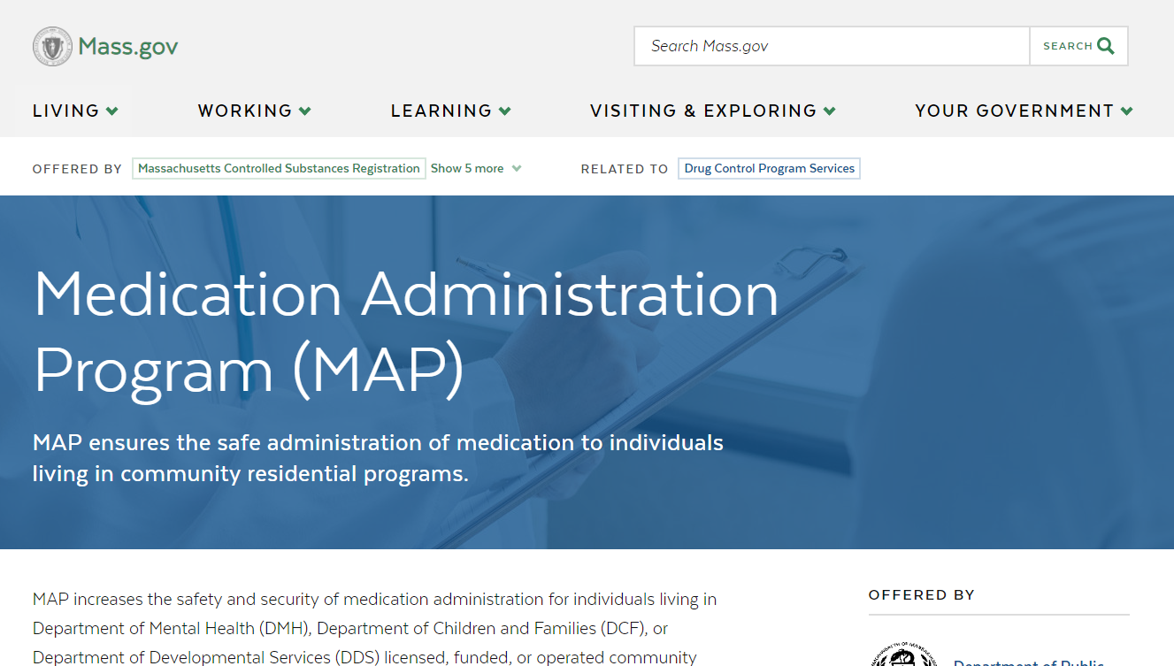
www.mass.gov/dph/map
Notes:
….the MAP friendly URL, listed at the top of your screen. You can access all current MAP Information by scrolling down….

Slide 12
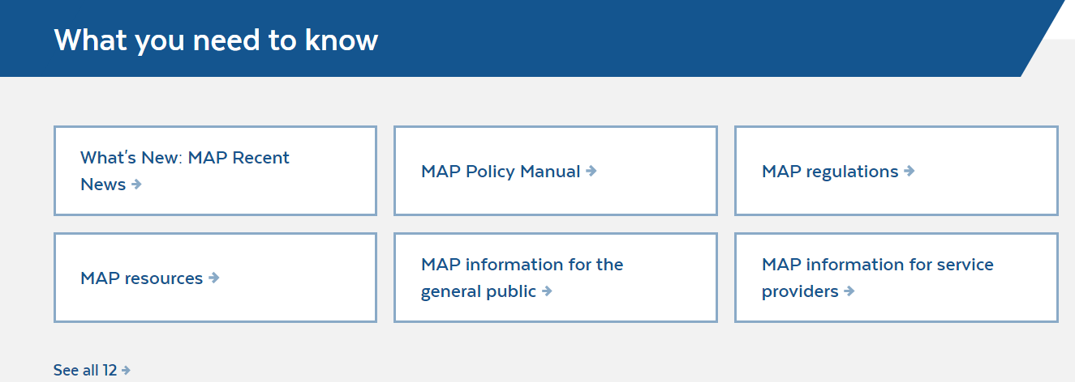
www.mass.gov/dph/map
Notes:
to the section titled “what you need to know”. Here you may access any of the advisories by clicking on MAP Resources…

Slide 13

www.mass.gov/dph/map
Notes:
and once there select Advisories…

Slide 14
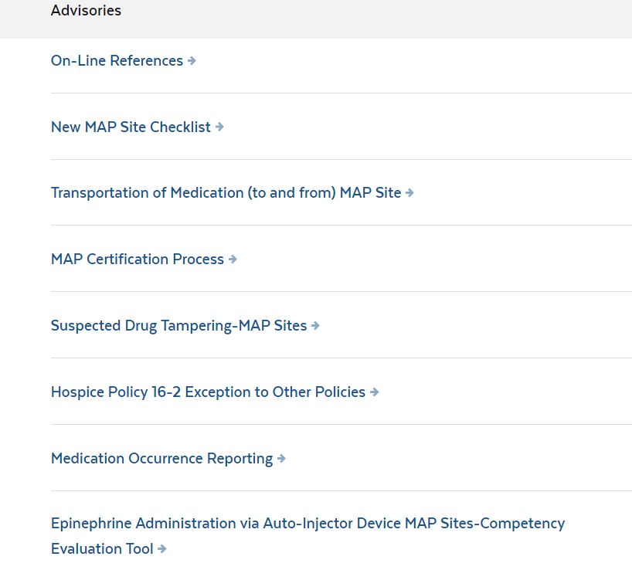
www.mass.gov/dph/map
Notes:
All advisories are posted here.
The majority of advisories were discussed during the Spring webinar
One recent advisory since the Spring webinar is the Epinephrine Administration via Auto –Injector Device MAP sites-Competency Evaluation Tool.

Slide 15
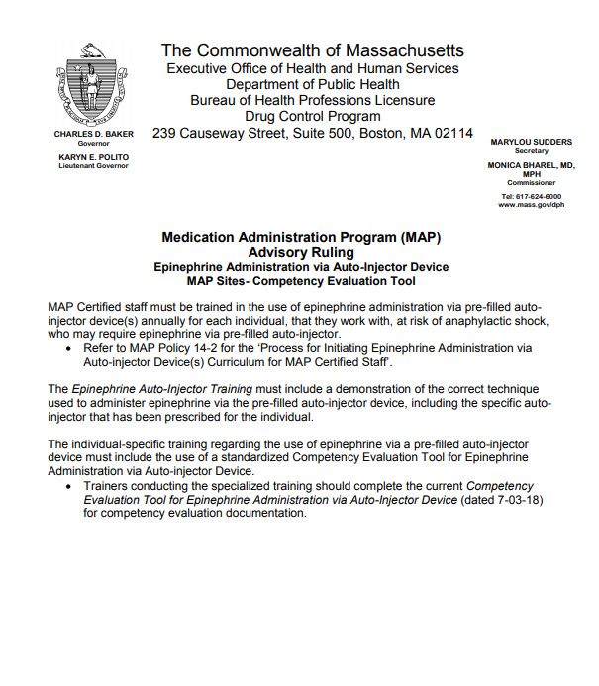
Epinephrine Administration
Notes:
This advisory addresses the new Competency Tool and is included in you handout along with…

Slide 16
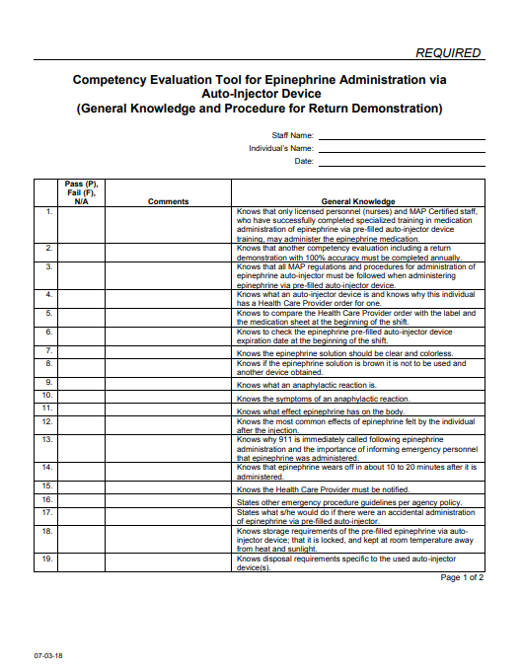
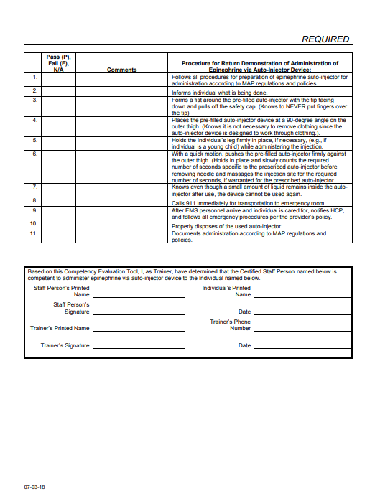
Competency Evaluation Tool for Epinephrine Administration via Auto-Injector Device
Notes:
a copy of the required tool. Note that it is dated 7-3-18. There were a few minor revisions to the competency tool mostly to encompass the different auto injector devices.

Slide 17
MAP Recent News
New section on MAP website
Lists all recent updates by date
Direct link: https://www.mass.gov/info-details/medication-administration-program-map-recent-news
Notes:
Another way to access any advisories or updates to the MAP Website is to access a new section titled MAP Recent News.
This section will help assist you to determine what has recently been updated within the DCP-MAP website. You may either use the direct link listed on this screen or….

Slide 18
www.mass.gov/dph/map
Notes:
access the MAP friendly URL and scroll down to “what you need to know” and then click on “What’s New: MAP Recent News”….

Slide 19
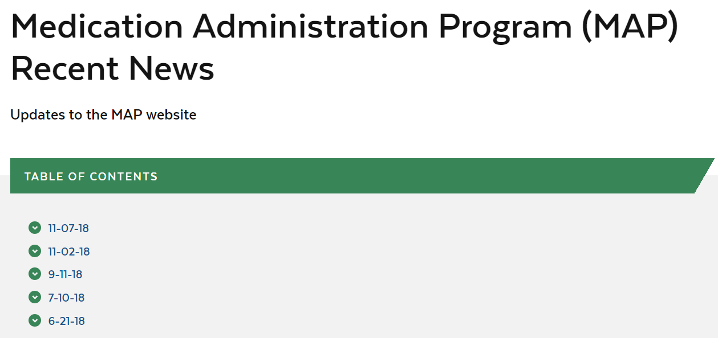
www.mass.gov/dph/map
Notes:
You will see a table of contents that lists dates where updates have been made to the website, for example clicking on 7/10/18…

Slide 20
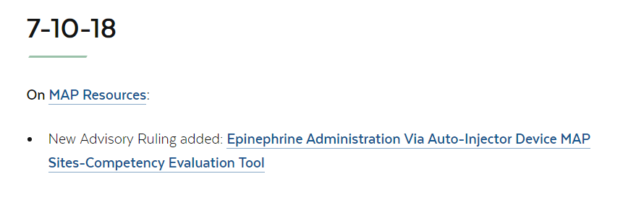
www.mass.gov/dph/map
Notes:
brings you to the Epinephrine Advisory ruling that we reviewed earlier.

Slide 21
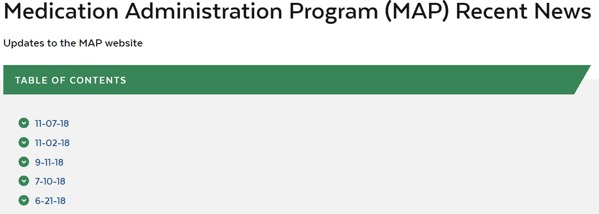

www.mass.gov/dph/map
Notes:
Also, to assist you in determining if there has been any updates since you last visited the site, the MAP Recent News webpage has a ‘last updated’ date listed on the bottom below the Table of Contents.

Slide 22
Updates
MAP
Notes:
Now we will review some recent updates…

Slide 23
Regulations
The updated Department of Public Health 105 CMR 700.000: Implementation of M.G.L. c. 94C regulations have been posted to the Mass.Gov website:
https://www.mass.gov/regulations/105-CMR-70000-implementation-of-mgl-c94c
https://www.mass.gov/files/documents/2018/11/07/jud-105cmr700.pdf
105 CMR 700.003 (F) is specific to the MAP.
Notes:
These regulations have just recently been updated and if you would like to review them they can be found at either of these websites. The 105 CMR 700.003 is specific to the Medication Administration Program.

Slide 24
Supervisor Modules
6 PowerPoint Presentations
Specifically formatted for staff trainings
Updated to reflect RIA Curriculum References
Notes:
If any of you as Trainers have encouraged Supervisors to use the Supervisor Education Modules, they have been recently updated to reference the new Responsibilities in Action Curriculum. They can be found at….

Slide 25
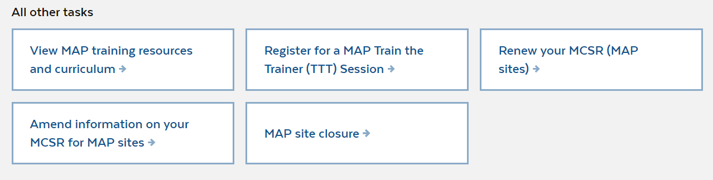
www.mass.gov/dph/map
Notes:
the MAP Friendly URL. Scroll down to “View MAP Training resources and curriculum”…

Slide 26

www.mass.gov/dph/map
Notes:
from there, select DDS MAP Training Resources,…

Slide 27
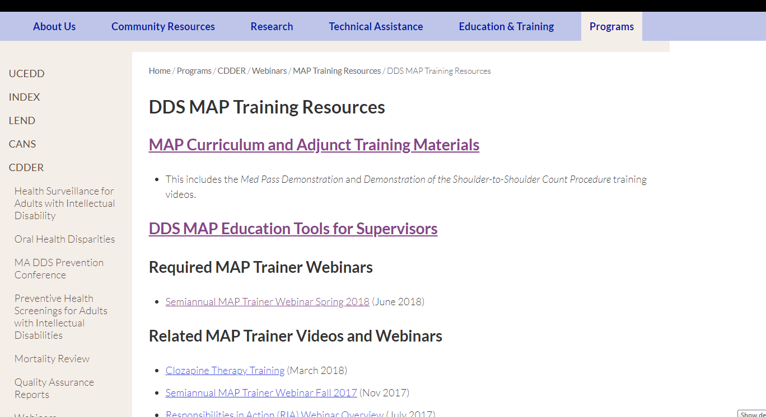
www.mass.gov/dph/map
Notes:
Click on DDS MAP Education Tools for Supervisors…….

Slide 28
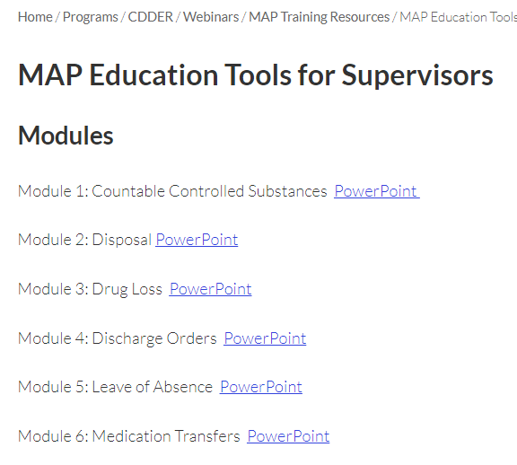
www.mass.gov/dph/map
Notes:
and here you will see the 6 Modules that have recently been updated.

Slide 29
HCSIS-Nursing Medication Occurrences
Staff position choice available in HCSIS
If a hotline
  DPH must be notified
    Date and time of DPH notification must be listed on the HCSIS form
Notes:
The DDS HCSIS reporting system has been updated to include the option of Licensed Staff-RN or Licensed Staff-LPN as a response to the question “Staff Position of Person Giving Medication”.
For a hotline involving a nurse, DPH must be notified and the MOR filed in HCSIS must list this information. As a reminder, the reporting time frame for reporting nursing errors is the same as the reporting time frame for MAP Certified Staff. If it is a hotline, it must be faxed to DPH and the MAP Coordinator within 24 hours of discovery and for non-hotlines notification to the MAP Coordinator via HCSIS within 7 days of discovery.

Slide 30
Issues in the Field
MAP
Notes:
Now a review of issues that we encounter on some of our site visits…

Slide 31
LOA Documentation
LOA Documentation should be filed with the Medication Administration Records
Notes:
Frequently we are asked where Leave of Absence (LOA) documentation should be kept as some sites file separately with other documents. These forms should be filed with the Medication Administration records and if the person moves to a different site within the agency they would go with their records to the new site.

Slide 32
Routes Training
Oral Route/MAP Curriculum
Must receive training for any other routes
Trainings by Licensed staff
Notes:
We are often asked about routes training for Certified staff. The only route covered in the MAP Curriculum Responsibilities in Action is the oral route. Staff must receive additional training in all other routes. This training must be by a licensed staff and we typically see it occur during a staff meeting. There is no specific training and no required competency tools for other routes except for Gtube/Jtube and Epinephrine Administration via auto-injector device.

Slide 33
Items LIST
“Items Not Requiring a Doctor’s order or Label by MAP”
No longer valid
Should be removed from MAP site
Some items on list require HCP order/labeling and would require a MOR if administered without HCP order
Notes:
On many of our site visits, we see this list posted in the medication area. It is no longer valid and after review of some of the items on the list, some must be considered medications/supplements that require a HCP order and labeling per MAP Policy. The list should be removed to prevent some of the items on the list from being administered without a HCP order. If administration occurs, it would be considered a Medication Occurrence requiring submission of a MOR.

Slide 34
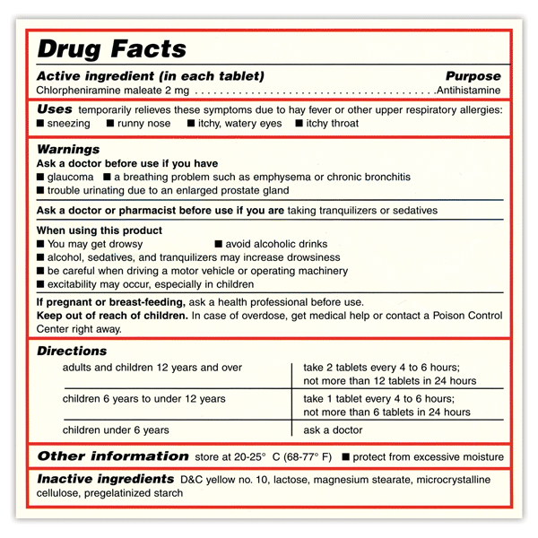
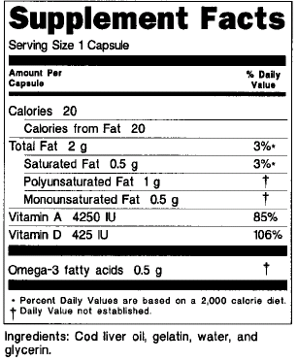
Labels
Dietary Supplement
OTC Medication
OTC Medication
Notes:
To evaluate if an item requires a HCP order, look for either Drug Facts or Supplement Facts listed on the packaging. If the packaging contains either of this information the item must have a HCP order and be labeled, administered and stored per MAP Policy.
An OTC medication will have a “Drug Facts” label.
A dietary supplement will have a “Supplement Facts” label.

Slide 35
Exceptions
    Sunscreen
    Insect repellant
    Personal hygiene products
      Solely intended for cleansing or beautifying the body
Notes:
These are exceptions to the HCP order and pharmacy label requirement. Please note that personal hygiene products that can affect the structure and/or function of the body such as: dandruff shampoo, acne medication, incontinence skin care creams or dermatitis creams will require a HCP order and pharmacy label but if it is solely intended for cleansing or beautifying the body it does not require a HCP order and pharmacy label.

Slide 36
Injectable medications
Increase in use
Requires administration by licensed staff
  Unless the person is self-administering
  Defined in MAP policy Section 7
“Self-injecting” does not automatically mean self-administering
Exception auto injectable epinephrine administered by staff after receiving specialized training
Notes:
With the increase in prescribed injectable medications for various health issues such as Type II Diabetes, Crohn’s Disease, Eczema, etc. this is a reminder that any injectable medication must be administered by licensed staff unless the individual is self administering his/her medications per MAP Policy 07-1. The ability to self inject does not deem the person as self administering if they do not meet the other requirements listed in MAP Policy Section 7. If an individual would like to learn to self administer an injectable medication the training must be done by a licensed staff. The only exception is auto injectable epinephrine administered by staff after specialized training.

Slide 37
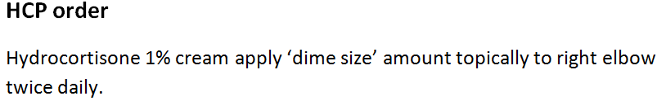
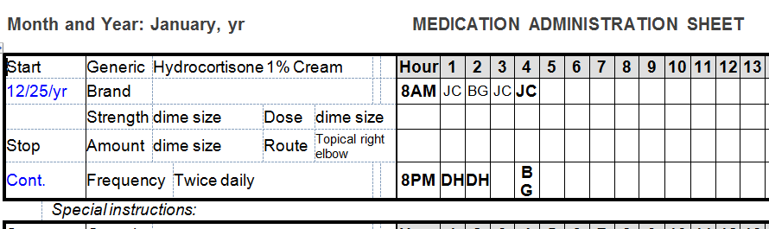
Transcription Example
Notes:
Frequently we see issues with transcriptions involving medication that are available in varying strengths, such as many of the medicated creams. When the medication is available in varying strengths the % of the medication is part of the medication name. In this example, the 1% needs to be included in the HCP order and also listed in the transcription under the name of the medication. The strength, dose and amount transcribed in this case would be dime size.

Slide 38
Count Book Index
Notes:
While reviewing Count Book Documentation, we are frequently asked how to correctly highlight the index. A highlighter(pale yellow) can be used to designate that a medication has been removed from ”Count” or that the row is inactive due to a page transfer and a new count row has been started. In this case, the row where, Karen Mason, the Supervisor has signed indicating the the medication was removed from count and is no longer availabe to count has been highlighted and also the row for Joseph Smith that is now inactive with the new information entered below.
Also in regards to the Count Book Index, the Page Numbers should not be marked thru with a line or “X”.

Slide 39
Count Page Transfer
Notes:
Continuing on with Count Book documentation, we frequenly see when information needs to be transferred onto a new count page the amount on hand column is filled in with the amount transferred. The acceptable way to document is to indicate ”transferred from and the page number” and then indicate the amount transferred under the amount left column.

Slide 40
Count signature Page
Notes:
Finally a reminder to have staff enter the time of count in real time rather than shift end time. For example, entering time for 7am, 3pm, 11pm continuously leads a reviewer to question the validity of documentation.

Slide 41
D+S Diversified Technologies
New Contact
Anne P. Shields
Massachusetts Program Manager
877-851-2355 (toll free)
419-420-1605 (local)
419-422-7395 (fax)
hdmaster.com
Notes:
There is a new Massachusetts contact at D + S and her information is listed on this screen.

Slide 42
D+S Diversified Technologies
Expected Behavior at Test Sites
Professional
Respectful
Courteous
Patient
Procedure Prior to Testing
Arrive in testing waiting area prior to time listed on testing confirmation
Locate pink sign identifying the waiting area
Review pink sign for details and policies
Have ID ready
Turn Cell phones off
Notes:
When asked about any issues with testing, D + S reports that there are still incidents of unprofessional behavior occurring at the test sites. Here is a list of expected behavior and the procedure to follow prior to testing.

Slide 43

D + S Handbook
Notes:
As MAP trainers it is important that we remind staff to act in a professional manner and are courtesy to staff at the test sites. There is a section in the D + S Handbook that reviews inappropriate behavior and it is recommended that you give a copy of the handbook to each of your students. They can be accessed by ordering them directly from the company…

Slide 44
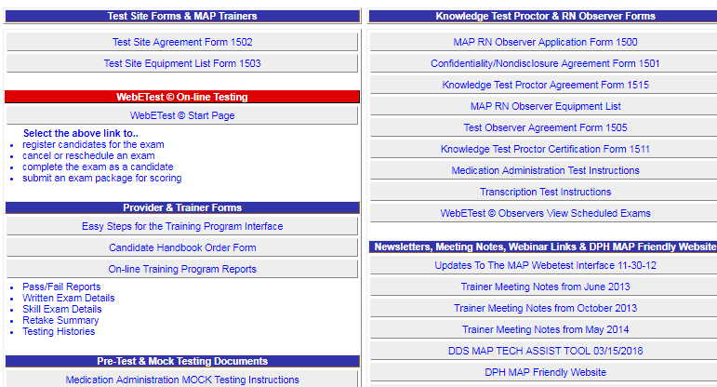
hdmASTER.cOM
Notes:
using the order form located on the Massachusetts home page at hdmaster.com.

Slide 45
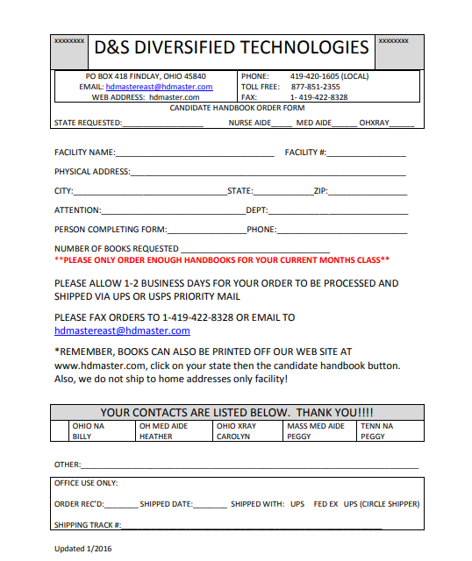
ORDER FORM
Notes:
There is no charge for the handbooks and you should only order what you will need for a few of your upcoming classes as the handbook is often updated with new information. The most recent Handbook is Version 5 effective 09/01/17.

Slide 46
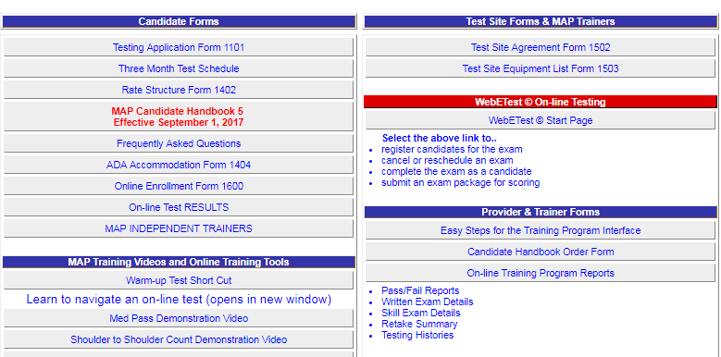
Hdmaster.com
Notes:
Handbooks can also be printed directly from the D + S website and distributed to students.

Slide 47
Reminders
MAP
Notes:
Now for some reminders…

Slide 48

RIA Curriculum
6/30/19
Notes:
Many of you have already transitioned over to the Responsibilities in Action Curriculum. As a reminder, you must be using it in your Certification classes by June 30, 2019 and a hard copy or electronic version must be in each MAP registered site by June 30, 2019.
Use of the Administering Medication the Right Way curriculum after June 30, 2019 could result in a violation of copyright law by the trainer as DDS, DMH and DCF no longer have permission to use it after 6/30/19.
To access your free copy of the RIA Curriculum, please go to the MAP friendly URL…

Slide 49
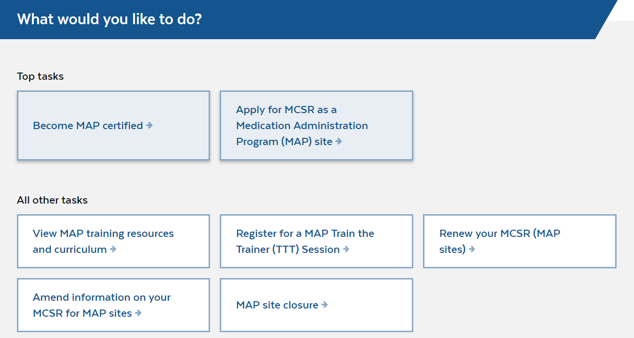
www.mass.gov/dph/map
Notes:
Once there scroll down and under “what would you like to do” select View MAP training resources and curriculum….

Slide 50
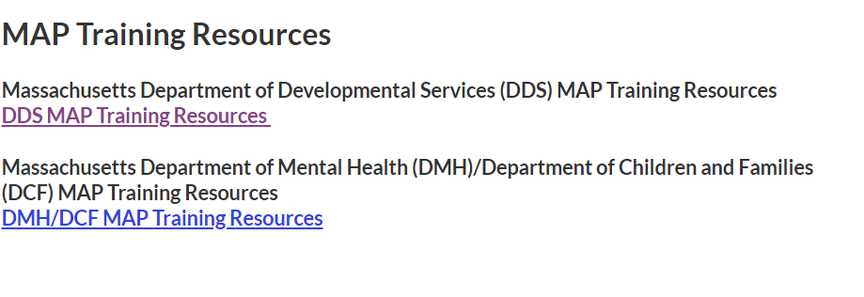
www.mass.gov/dph/map
Notes:
then select DDS MAP training resources…

Slide 51
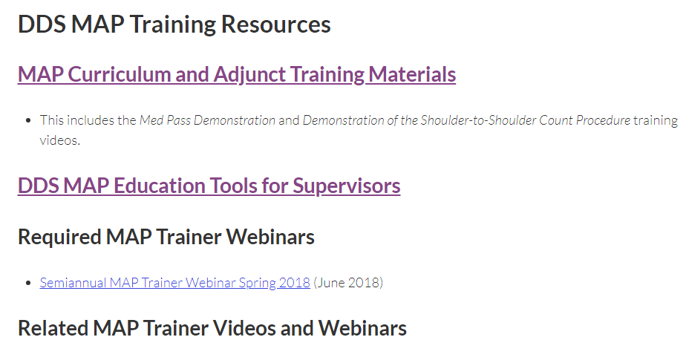
www.mass.gov/dph/map
Notes:
and then select MAP Curriculum and Adjunct Training Materials…

Slide 52

www.mass.gov/dph/map
Notes:
Here you select Responsibilities in Action Curriculum and Training Materials and…

Slide 53
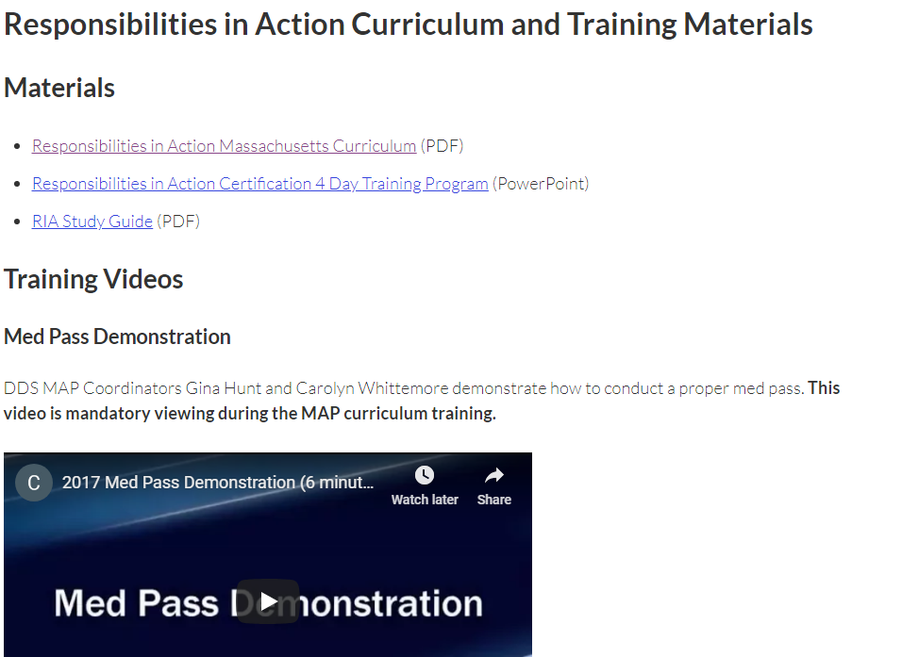
www.mass.gov/dph/map
Notes:
There is a downloadable PDF version of the RIA Curriculum. Also here is where you can access the Med Pass Demonstration Video that is required to be viewed during MAP Certification Training.

Slide 54
www.mass.gov/dph/map
Notes:
To obtain all the corresponding RIA training materials that you will need, simply click back to this screen and select Adjunct RIA Training Materials and…

Slide 55
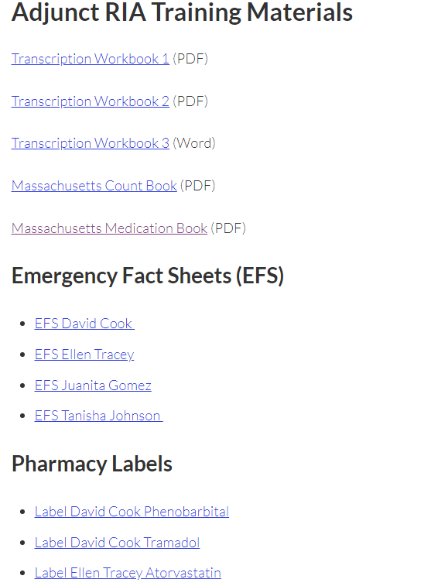
www.mass.gov/dph/map
Notes:
then you can access the corresponding transcription workbooks, medication book, count book, emergency fact sheets and pharmacy labels. If you have any questions about accessing this information or questions about presenting the new curriculum please contact your Regional MAP Coordinator.

Slide 56
Next Webinar Date
Spring 2019
Notes:
This concludes today’s webinar, the next trainer webinar will be in the Spring of 2019, date to be determined.
Thank you for listening.

