Slide 1

Medication Administration Program
FALL 2019
MAP Trainer webinar
Notes:
Welcome to the semi annual MAP Trainer webinar. I’m Heather Lake, a Department of Developmental Services MAP Coordinator and I’m your webinar presenter.
By viewing webinars marked as ‘required’ within the specific time period, you’ll meet the MAP Trainer meeting ‘attendance’ requirement.
After the webinar, you’re encouraged to contact your Regional MAP Coordinator if you have a question or need further clarification on a topic presented.
Handouts included are the MAP Organizational chart, Notice of rescission of the MAP Policy 08-7 High Alert Medication-Combination drug product buprenorphine hydrochloride and naloxone (also known as Suboxone), the Advisory for the Valid Health Care Provider Orders-MAP Sites and the D&SDT TMU Memorandum.

Slide 2
agenda
New information
Issues in the field
MAP Trainer status
D&S Diversified Technologies updates
Notes:
The agenda for today is to cover new information, issues in the field, MAP Trainer status followed by D&S Diversified Technologies updates.

Slide 3
New information
MAP
Notes:
Let’s start with ‘New Information’…

Slide 4
New MAP Coordinators!
Welcome
  Matthew Meredith, RN
    Statewide MAP Coordinator
    DDS ABI/MFP Waiver programs
  Lorraine Murphy, NP
    Northeast
    DDS MAP Coordinator
  Daniel Silva, RN
    Northeast
    DMH-DCF MAP Coordinator
Notes:
We have 3 new MAP Coordinators to introduce. Matthew Meredith, is the new statewide DDS MAP Coordinator who works in the ABI/MFP waiver programs; Lorraine Murphy is the new DDS MAP Coordinator in the Northeast region and Daniel Silva is the new DMH-DCF MAP Coordinator in the Northeast region. We are happy to welcome them aboard!
You have a handout with their contact information on the MAP Organizational Chart.

Slide 5

www.mass.gov/dph/map
Notes:
The MAP Policy Manual is currently under revision but advisories and notices are posted during the interim. You can check for any advisories and notices using the MAP friendly URL, listed at the top of your screen. You can access all current MAP information by scrolling down…

Slide 6
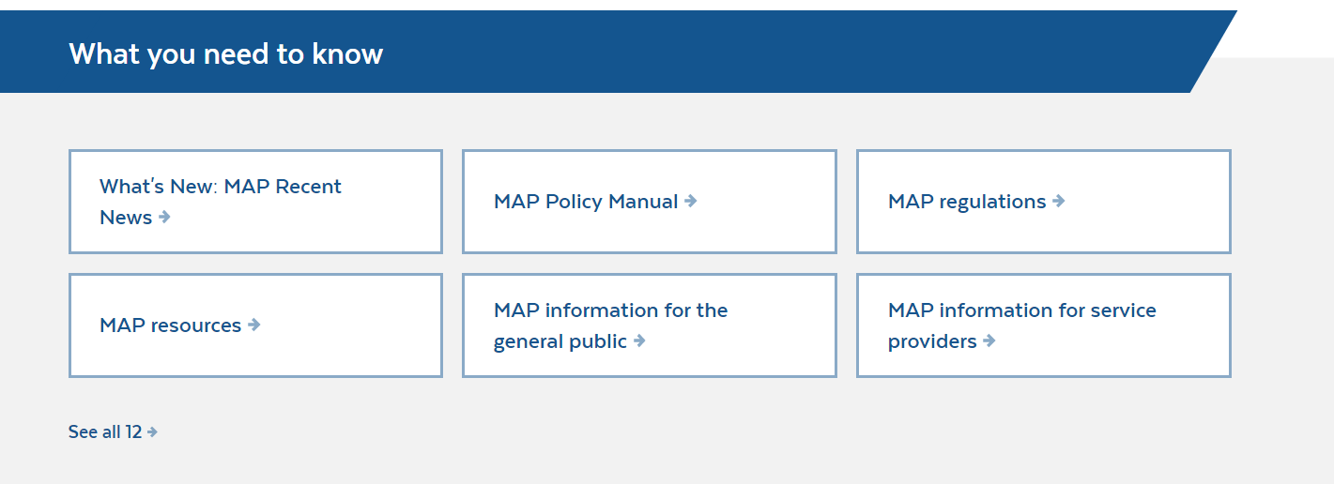
www.mass.gov/dph/map
Notes:
to the section titled, “what you need to know”. Here you can access any of the advisories by clicking on ‘MAP Resources’…

Slide 7
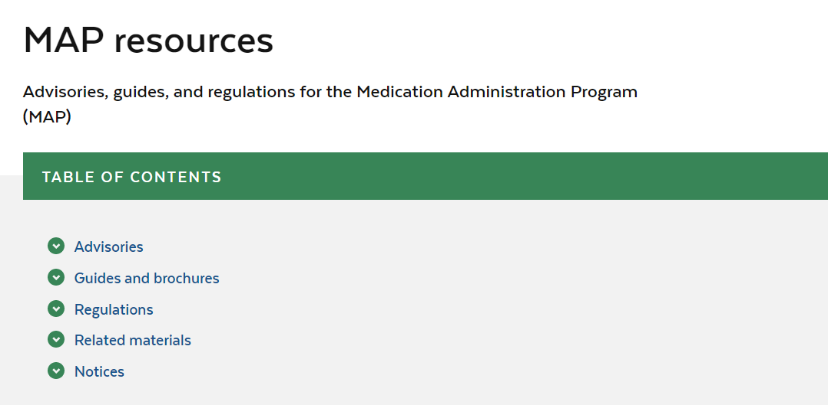
www.mass.gov/dph/map
Notes:
and once there, select ‘Advisories’…

Slide 8
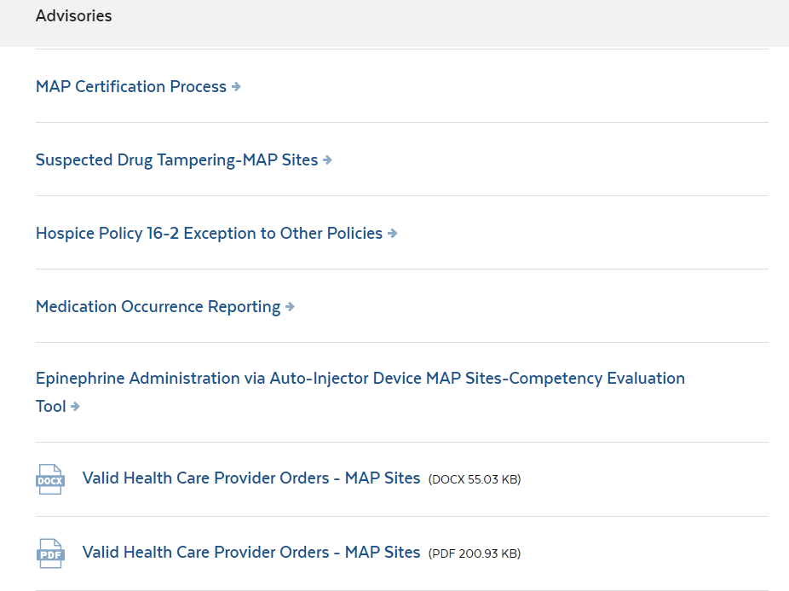
www.mass.gov/dph/map
Notes:
All Advisories are posted here.
One recent advisory since the Winter webinar is ‘Valid Health Care Provider Orders-MAP Sites’.

Slide 9
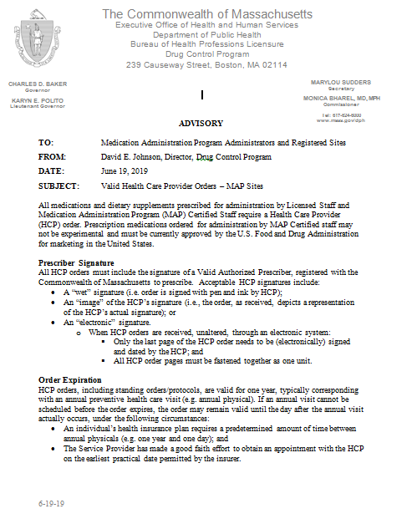
Advisory
Notes:
‘Valid Health Care Provider Orders – MAP sites’, dated June 19, 2019. A copy is included in your handouts.
HCP orders, including standing orders and protocols, are valid for one year, typically corresponding with the annual preventative health care visit (e.g. annual physical). If an annual physical cannot be scheduled before the order expires, the order may remain valid until the day after the annual visit actually occurs, under the following circumstances:
An individual’s health insurance plan requires a predetermined amount of time between annual physicals (e.g. one year and one day); and
The Service Provider has made a good faith effort to obtain an appointment with the HCP on the earliest practical date permitted by the insurer.
The advisory also includes what is an acceptable signature from the HCP. Please be sure to review the advisory in detail.

Slide 10
www.mass.gov/dph/map
Notes:
Another way to access any advisories or updates to the MAP website is to click on the new section titled ‘MAP Recent News’. First, start with the MAP friendly URL, listed at the top of your screen... and scroll down…

Slide 11
www.mass.gov/dph/map
Notes:
to ‘what you need to know’ and click on ‘What’s New: MAP Recent News’… This section lists what has recently been updated within the DPH-MAP website.

Slide 12
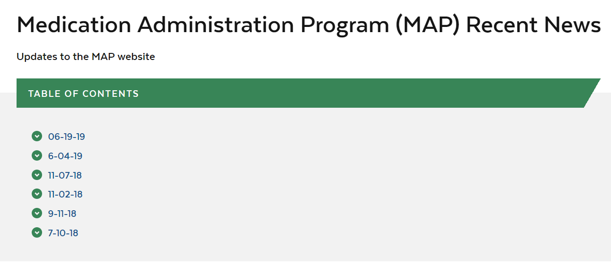
www.mass.gov/dph/map
Notes:
Here you will see a table of contents that lists the dates when updates have been made to the website, for example clicking on 06-19-19…

Slide 13

www.mass.gov/dph/map
Notes:
Brings you to the ‘Valid Health Care Provider Orders-MAP Sites’ that we reviewed earlier.

Slide 14
www.mass.gov/dph/map
Notes:
To access any notices you would start with the MAP friendly URL, listed at the top of your screen and scroll down…

Slide 15
www.mass.gov/dph/map
Notes:
to the section titled, “what you need to know”. Here you can access any of the notices by clicking on ‘MAP Resources’…

Slide 16
www.mass.gov/dph/map
Notes:
and once there, select Notices…

Slide 17
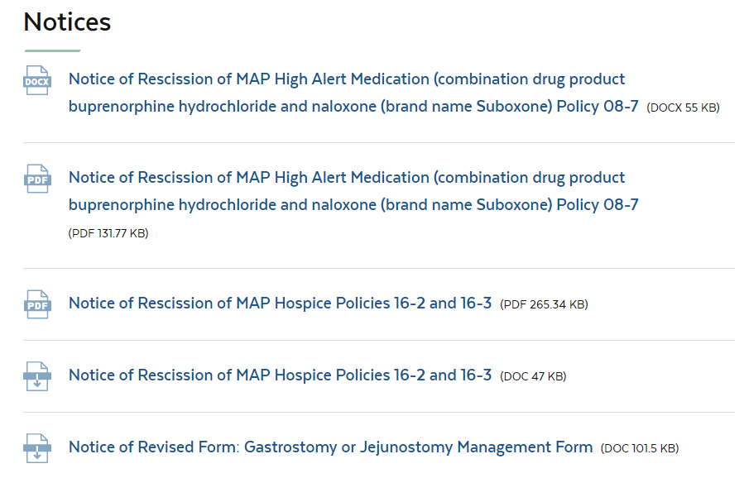
www.mass.gov/dph/map
Notes:
All Notices are posted here.
The ‘Notice of Rescission of MAP High Alert Medication combination drug product buprenorphine hydrochloride and naloxone (brand name Suboxone) Policy 08-7’ is identified on your screen above.
When you click on the Notice…

Slide 18
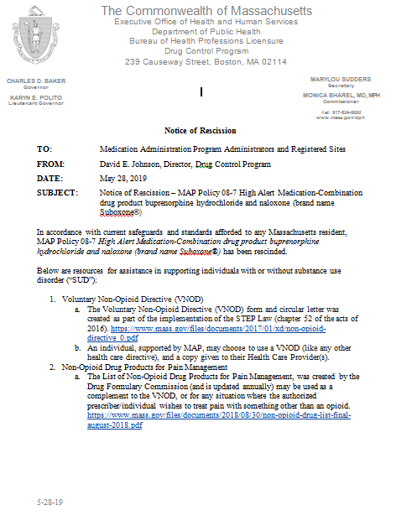
Notice of rescission
Notes:
…you can view the Notice in it’s entirety. A copy is also included in your handouts.
As of May 28, 2019 Suboxone is no longer considered a ‘high-alert’ medication and can be managed as any other scheduled VI medication. The notice of rescission provides agencies with 2 resources for assistance for supporting individuals with or without substance use disorder.

Slide 19
Issues in the field
MAP
Notes:
This section will discuss some ‘issues in the field’…

Slide 20
Blank spaces on the mar
‘Empty’ boxes on front of MAR where staff put their initials
Need to review if med was administered or not
If administered but not documented, staff need to document a late entry in progress note
If not administered, it is a Medication Occurrence and must be reported
Notes:
The issue of how to manage ‘blank’ spaces on the front of the MAR comes up often. If you have ‘empty’ boxes on the MAR where there should be initials indicating the med was administered and after a review of blister pack monitoring or routine pill counts, it is determined that the medication was administered but staff ‘forgot’ to document it as given, they cannot go back and put their initials…

Slide 21
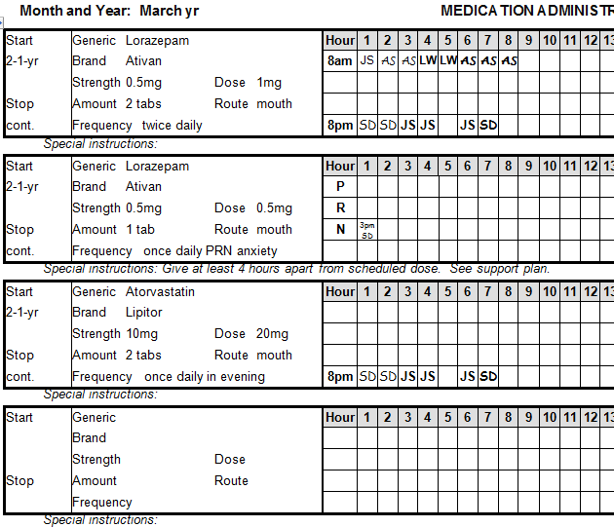
Blank spaces on the mar
Notes:
As you can see on the screen above the 8pm med boxes on March 5th are blank; the boxes must remain ‘empty’ and the staff who forgot to put their initials must document a ‘late entry’ MAR progress note…

Slide 22
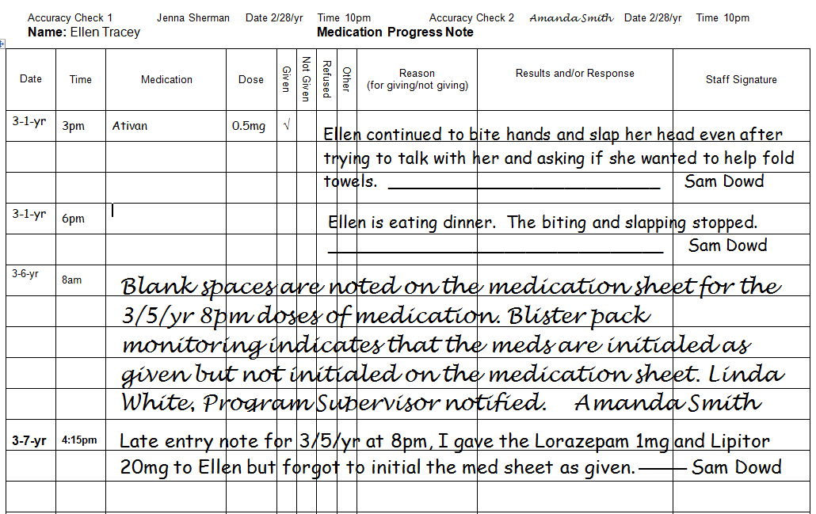
Blank spaces on the MAR
Notes:
The screen above is an example of a ‘late entry’ progress note when staff administered medication but forgot to initial the box.
The staff who discovered the ‘blank’ spaces on the MAR documented a progress note describing what they found and who they contacted. The staff who failed to document the med as given in real time wrote a progress note as well. They put the date and time (of entry) and documented that the med was administered on ‘x’ date at ‘x’ time but they forgot to put their initials in the box.
If after review it is determined the med was not administered, it is a medication occurrence for omission and must be reported. The documentation for an omission would include the name of the MAP Consultant contacted and recommendations given.

Slide 23
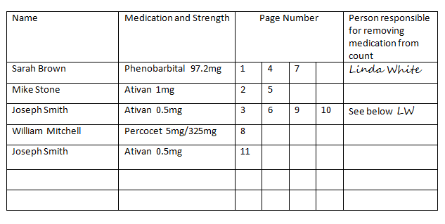
Last column of index in countable controlled substance book
Notes:
The last column of the index titled, “Person responsible for removing medication from count”, is for supervisors to sign. Only a supervisor may remove a medication from count, for reasons including but not limited to:
The medication was discontinued and disposed
The medication was disposed after a person passed away
The person moved and medication was transferred to a new home
The ‘amount left column’ of the corresponding count sheet page in any of the above examples will be marked ‘0’, since that medication is physically no longer in the program to count
On the current slide the supervisor, Linda White, removed from count Sara Brown’s Phenobarbital.
This example can be found on Page 161 in the RIA curriculum.

Slide 24
Use of highlighter in map
Light-yellow
Visual aid for HCP signature
Index of Countable Controlled Substance Book
Notes:
The use of a highlighter can have different meanings. It can alert the eyes to ‘pay attention’ to the highlighted information or it can alert the eyes to ‘ignore’ the highlighted information. In addition, if documents need to be photocopied, the highlighted area on the photocopy is no longer legible. For these reasons, we recommend limiting the use of a highlighter.
A ‘light-yellow’ highlighter is recommended:
as a visual aid for the HCP to document their signature
in the index of the Countable Controlled Substance Book only to identify the rows that are ‘no longer active’ because:
the medication has been removed from count, or
the medication has been transferred to a new row because all the boxes indicating a page transfer have been used

Slide 25
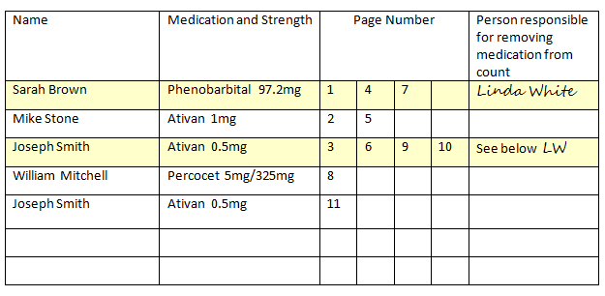
Use of highlighter in map
Notes:
On the current slide, the first row for Sarah Brown has been highlighted because the Phenobarbital has been discontinued and removed from count.
The 3rd row, for Joseph Smith, has been highlighted to indicate the medication (Ativan 0.5mg) has been transferred to a new row because all the boxes for a page transfer have been used. Staff will need to turn to page 11 to count Joseph Smith’s Ativan 0.5mg.

Slide 26
Med disposal when person is self-administering
Medication is under complete control of the person, including disposal
Medication(s) is discontinued and/or expired
  Need to include how to manage disposals in teaching plan/phase
Notes:
When a person is considered self-administering, that is, the medication is under the complete control of the person, and the medication is discontinued or expired the person must dispose of the medication themselves. The teaching plan or teaching phase of ‘learning to self-administer’ needs to include how the individual will manage medication disposal.

Slide 27
VNA and insulin
Obtaining
Transfer form
Notes:
VNA and Insulin
It is recommended that the party responsible for insulin administration accept the insulin delivery from the pharmacy. If the VNA or nursing service is responsible for insulin administration and is not present when the pharmacy delivers the insulin, then MAP Certified staff can sign for and accept the insulin delivery.
The MAP Certified staff would then need to use a Medication Transfer form when transferring the insulin to the VNA staff; once the insulin has been transferred to the VNA or nursing service, MAP Certified staff may no longer have access to the insulin.

Slide 28
VNA and insulin
Storage
  Access
Documentation
Notes:
If the insulin has been transferred to the VNA or nursing service but will still be stored at the MAP registered site it is recommended that the insulin be kept in a separate locked box or bank bag and stored per the manufacturer’s recommendation.
MAP staff should not have access to the contents of the locked box or bank bag. If the locked box or bank bag is kept in the refrigerator in the locked med room, MAP staff can go and retrieve the locked box or bank bag and hand to the licensed staff.
The VNA or nursing service typically has its own documentation requirements, usually consisting of a file maintained in the home. The VNA or nursing service may communicate directly with the HCP and obtain new insulin orders, if needed. Any time the nurse obtains a new insulin order a copy needs to be put in the med book.
If staff are taking the person to medical appointments and receiving changes in insulin orders, staff are expected to communicate those changes with the VNA or nursing service and give a copy of the HCP order to them to keep in their file. Licensed staff need an HCP order to administer insulin.
There should be a procedure or protocol in place, including the preferred method of communication (with the VNA or nursing service input) at the MAP site, that staff could follow (and be trained on) to help ensure that the agreed upon procedure is followed.

Slide 29
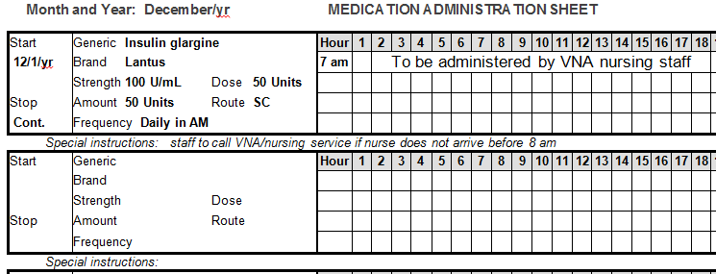
Sample insulin med sheet
Notes:
Here is a sample insulin med sheet…
The insulin order should be transcribed onto the med sheet with clear instructions written across the grid that the insulin is to be administered by VNA nursing staff.
Certified staff should never initial the MAR next to the insulin, however the certified staff does have a responsibility to notify someone if the VNA nursing staff does not arrive in the specified time period.
If at any point the insulin order changes, the previous order would be discontinued on the MAR and the new order transcribed.

Slide 30
Documenting Control of medication keys
Date | Time | Incoming Staff | Outgoing Staff
3/1/yr | 3:10pm | Amanda Smith | Sam Dowd
3/1/yr | 11:06pm | Jenna Sherman | Amanda Smith
3/2/yr | 8:56am | Keys put in lockbox | Jenna Sherman
3/2/yr | 2:04pm | Sam Dowd | Keys removed from lockbox
3/2/yr | 11:10pm | Jenna Sherman | Sam Dowd
Notes:
The question has been asked; how do staff document control of the medication storage keys when there are no countable controlled substances on site. In the event that a site does not have Countable Controlled Substances and MAP staff are not completing the ‘Count Signature Sheet’, the MAP registered site can keep track of which MAP staff has possession of the med keys in a couple of ways.
One option is to use a composition notebook and create a heading for each page. You could then draw 3 vertical lines down each page creating four columns, as in the current slide. Label the columns starting from the left, ‘Date’, ‘Time’, ‘Incoming Staff’ and ‘Outgoing Staff’. As you can see in the slide on your screen, staff can document when there isn’t another staff person coming on (e.g., when all individuals are at program) and the keys are secured in the lockbox and also when staff are coming on shift and the keys have been retrieved from the lockbox.
Another option would be to keep on file the shift assignment form indicating the staff assigned medication administration duties and the medication security for each shift.

Slide 31
Disposal of fentanyl patches
Manufacturer recommends ‘flushing’
Town/City may prohibit
Optional method of disposal
  Disposal pouches
    For more information: Deterrasystem.com
Notes:
On occasion, the question of how to dispose of Fentanyl transdermal patches comes up. According to the manufacturers instruction, Fentanyl patches are to be disposed by folding the patch with sticky sides together and then flushing down the toilet.
However, due to environmental concerns many towns and cities prohibit the practice of flushing any medications, including transdermal patches, down the toilet. In the event your site is located in such a town or city, there is an alternative method of disposal that is available.
If you would like more information on the Deterra Drug Deactivation System the website address is listed on this screen.

Slide 32
Liquid medications
Increase in MOR’s
Practice liquid med pass
  Juanita Gomez
    Liquid Colace
Review different measuring devices
Notes:
Recently, there has been an increase in MOR’s related to administering the wrong dose of a liquid medication, especially related to using inappropriate measuring devices. It is a recommendation that MAP trainers focus on liquid medications as part of MAP certification training; this includes practicing the liquid med pass scenario (Colace) for Juanita Gomez and reviewing different measuring devices.
Examples can be found on pages 133-143 in the RIA curriculum.

Slide 33
‘Directions change’ sticker
Used only when ‘exhausting the current supply’
  Label must be corrected within 30-days or when next supply is delivered.
Notes:
According to MAP Policy 13-4, Exhausting Current Supply of Medication, the ‘directions change’ sticker is only to be used as a flag to alert the staff administering the medication to a new, changed HCP order. The sticker indicates that there is a new Health Care Provider order and that the individual’s record should be checked.
A ‘directions change’ sticker should be adhered to the medication packaging as to not destroy or obstruct the original pharmacy label. Staff are never to write or mark directly on the medication package. The pharmacy needs to be contacted so that the label is corrected within 30-days or when the next supply of medication is delivered.

Slide 34
NO ‘Directions change’ sticker
A ‘directions change’ sticker cannot be used:
  as a ‘flag’ to a discrepancy between HCP order and pharmacy label
  In absence of a new HCP order
    The discrepancy must be corrected immediately
Notes:
A ‘directions change’ sticker cannot be used as a ‘flag’ to alert staff of a discrepancy between the pharmacy label and HCP order such as the medication name on the HCP order not agreeing with the medication name on the pharmacy label. Any discrepancy must be reported to your MAP Consultant for a recommendation and the label must be corrected by the pharmacy immediately.

Slide 35
MAP trainer status
MAP
Notes:
This next section will discuss what is required in order to maintain ‘MAP Trainer status’ and review the ‘In-House MAP Recertification’ process…

Slide 36
Map trainer status
Certification Trainer
  Teach a minimum of 1 MAP Certification training yearly
Recertification Trainer
  Teach/Test a minimum of 1 MAP Recertification Training/Test every 6 months
Participate in webinars created by MAP Coordinators and as determined by DPH regarding all DPH approved
  Training and test materials
  Advisories and policies
  Any other changes
Notes:
In order to maintain ‘MAP Trainer’ status, trainers must teach a minimum of (1) MAP certification training yearly and view the mandatory webinars within the designated time frame. There are some nurses who only provide recertification ‘refresher’ training followed by recertification testing. These trainers must teach and test every 6 months to stay current.
If you co-train, make sure you divide the staff being entered into WebETest so that both Trainers will receive credit for the training.
MAP updates are provided in the form of webinars. Notification of webinars is via email from Sharon Oxx through the CCDER UMASS Medical. Trainers will receive notification once they have requested to be added to the list server. Trainers not complying with these requirements may be notified that their approval status has been revoked.

Slide 37
In-house map recertification process
Refresher training
  Adjunct RIA training materials
  www.mass.gov/dph/map
MAP Recertification Competency Evaluation form
Enter results in D&SDT MAP Registry for each attempt
Notes:
An email was sent to all MAP trainers on July 29th as a reminder of the recertification process when conducting in-house MAP recertifications.
For providers who conduct their own ‘In-house’ MAP recerts, a refresher training can be accomplished by reviewing Units 6 & 7 in the Responsibilities in Action (RIA) curriculum, having the candidates practice transcription using the transcription workbooks and viewing the med pass video. You can access all adjunct RIA training materials using the MAP friendly URL.
The MAP Recertification Competency Evaluation form is completed after the candidate successfully demonstrates medication administration and completes a transcription test.
Enter results of all in-house recertification test attempts in the D&SDT MAP Registry. You must enter each test event at the time of the testing. You may enter a total of 3 test attempts per candidate as this is the number of attempts allowed for a candidate before a full MAP training and testing by D&SDT is required.
If a candidate fails an attempt, they are no longer eligible to administer medications until they pass the Recertification test or successfully complete full training and testing again.
This “ineligible” status applies to all MAP settings where the candidate works. This rule is in place as, according to the testing process, the candidate has not demonstrated competence to administer medications.
Once a candidate begins the recertification process they must continue with that track. For example, if the candidate decides to recertify using the ‘In house’ process and they fail on first attempt, they cannot decide to switch and go through D&SDT to take a second test.

Slide 38
D&s diversified technologies updates
map
Notes:
The last item on the agenda for today’s webinar is D&S Diversified Technologies updates…

Slide 39
D&SDT updates
TestMaster Universe© (TMU)
January 2020
Training
  Webinar format
Notes:
Coming attractions…
We are very excited to announce that plans are underway to convert to a new MAP testing platform called TestMaster Universe© or (TMU) during the first part of January 2020. D&S Diversified Technologies plans to provide an introductory training before the January rollout date, most likely in webinar format.

Slide 40
Tmu© highlights
  Streamline testing process
  Single login
  Accessibility
    Smart phone
Notes:
Some highlights of TMU© include:
Testing, training and certification info will exist in one platform; eliminating the need to move from one database to another
Providers and trainers will be able to manage all students and candidates from a single location and login
Enhanced reporting and notification of testing status and testing results and
Designed to run in newer web browsers and current operating systems; allowing for some tasks to be completed with smart phones

Slide 41
Tmu© timeline
Down time 1/1/20 through 1/12/20
  No data entry
  No scheduling
  No testing
Test dates visible through 12/31/19
TMU© live 1/13/20
Notes:
The timeline for the transition is as follows: No data entry, scheduling or testing from January 1st through January 12th. Test dates will only be visible through December 31, 2019. No test dates will be visible for 2020 until TMU© goes live on January 13th.

Slide 42
For more information
  Contact:
  Anne Shields
  Massachusetts Program Manager
    877-851-2355
Notes:
In addition and very important to note, once TMU© goes live on January 13th, the ID and pin numbers that trainers and employers currently have will not allow access into TMU©. You will need to contact D&SDT for access information. As you can see on your screen, Anne Shields is the Program Manager for Massachusetts and her contact number is listed. D&SDT are prepared to have increased staff available to assist in the volume of phone calls anticipated.

Slide 43
Next webinar date…
Spring 2020
Notes:
This concludes today’s webinar, the next MAP trainer webinar will be Spring 2020, date to be determined.
Thank you for listening.

