Slide 1
MAP Trainer Webinar
Winter 2026
Notes:
Hello, and welcome to the Winter 2026 MAP Trainer Webinar. I am Dan Silva DMH Northeast Area MAP Coordinator, and I am your webinar presenter. By viewing all required webinars within the specified 8-week time period, you will meet the MAP Trainer meeting attendance requirement. After the webinar, you’re encouraged to contact your MAP Coordinator if you have any questions or need further clarification on a topic presented.

Slide 2
MAP Webinar Contact Hour Disclosure
This educational activity meets the requirements of the Massachusetts Board of Registration in Nursing at 244 CMR 5.00 for 0.5 contact hours.
In order to receive a Certificate of Attendance, you must:
  Watch the full webinar during the 'locked' viewing period
  Answer knowledge questions with 80% accuracy
  Sign the attestation statement at the end
  Complete the training evaluation
Notes:
We are happy to announce that MAP Trainers who watch the required MAP Webinars during the 'locked' viewing period are now eligible to receive Contact Hours. You can view the full disclosure on your screen.

Slide 3
Agenda
What’s New
MAP Updates
Reminders
D&S
Notes:
The agenda for this webinar includes What’s New, MAP Updates, D&S, and Reminders.

Slide 4

What’s New
Notes:
Let’s begin with What’s New.

Slide 5
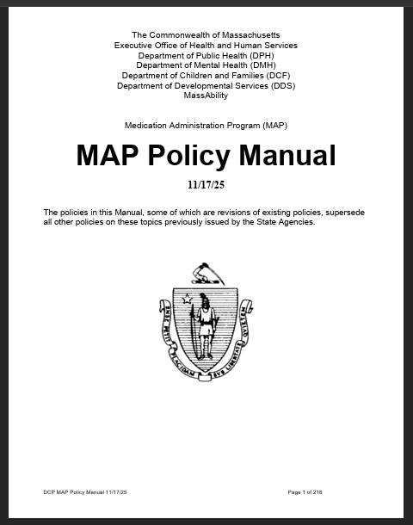
Updated MAP Policy Manual
Notes:
DPH released an updated MAP Policy Manual on November 17, 2025. Changes in the updated manual include the addition of “MNA” (Medication Not Administered) as a new acceptable code, the expansion of the use of the acceptable code “P” (for Packed) and a requirement for Refresher Training prior to MAP Recertification Testing.

Slide 6
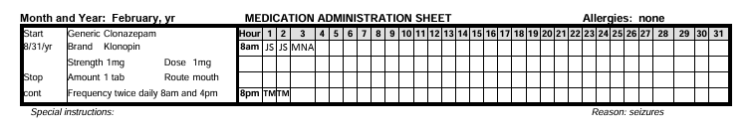
MNA – Medication Not Administered
Used when medication is not administered at the scheduled time
Replaces circling of initials on a medication sheet
Notes:
The code “MNA” has been added to the list of Acceptable Codes. It is used when medication is not administered at the scheduled time. “MNA” replaces the circling of initials on a medication sheet.

Slide 7
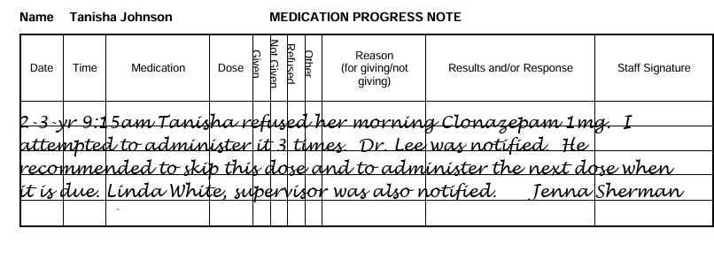
Medication progress note required
Notes:
A corresponding medication progress note is required when using “MNA” on the medication sheet.

Slide 8
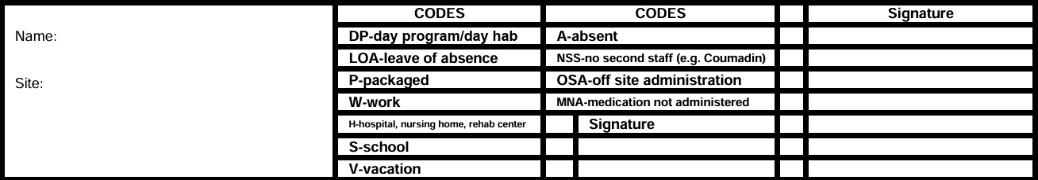
Notes:
“MNA” and its definition must be added to the list of acceptable codes at the bottom of the medication sheets.

Slide 9

P - Packaged
Used when a person packages or administers their medication as part of learning to self-administer
Notes:
The other change in acceptable codes is the expansion of the use of “P” for packaged. Staff will document this code on the medication sheet when an individual administers their own medication under Certified/licensed staff supervision as part of the process of learning to self-administer. This is in addition to using the code when the individual packages their own medication under Certified/licensed staff supervision.

Slide 10
Updated Recertification Process
Refresher Training
Compliance by 5/1/2026
Notes:
The updated MAP Policy Manual also includes an expanded MAP Recertification Process. There is now a requirement for Refresher Training to be completed by a MAP Trainer prior to Recertification Testing. Service Providers must come into compliance with this updated policy by May 1, 2026.

Slide 11

Refresher Training
MAP Trainer
Prior to Recertification Skill Test
Notes:
The Recertification Process can be conducted up to 90 days prior to the expiration date of current Certification. The process begins with Refresher Training. This training must be conducted by an approved MAP Trainer, and it must be completed prior to Recertification Skill Testing.

Slide 12

On-site Documentation
Trainer name and contact info
Dated attendance list
Complete set of training materials
Notes:
Refresher Training must be documented and maintained at the MAP Registered site. The documentation must include at a minimum the name and contact information of the Trainer(s), the date of the training and name(s) of staff trained (e.g., attendance list), and a complete set of training materials used to train staff.

Slide 13

Refresher Training Documentation in TMU
Notes:
Refresher Training must also be documented in the staff’s record in TMU. The process is similar to entering an initial Certification Training. Log in to TMU and go to Students, then select the staff member who is being recertified. From the menu on the left, select Trainings. On the right side, above the list of the staff member’s trainings, click “Add New Training” to enter the refresher training information.

Slide 14
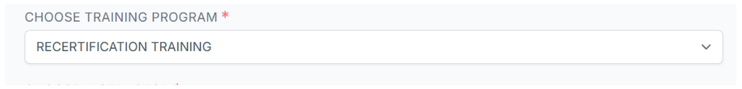
Refresher Training Documentation
Notes:
From the Choose Training Program dropdown menu, select “Recertification Training.” Then enter the start and end date(s) of the Refresher Training. These dates can be the same if the Refresher Training was conducted on a single date. After entering the dates, click Create Refresher Training.

Slide 15
Employment Verification
Notes:
Once the Refresher Training information has been entered, MAP Trainers who are recertifying a staff who is employed by a Service Provider must request Employment Verification. Again, this is similar to the initial Certification process.

Slide 16
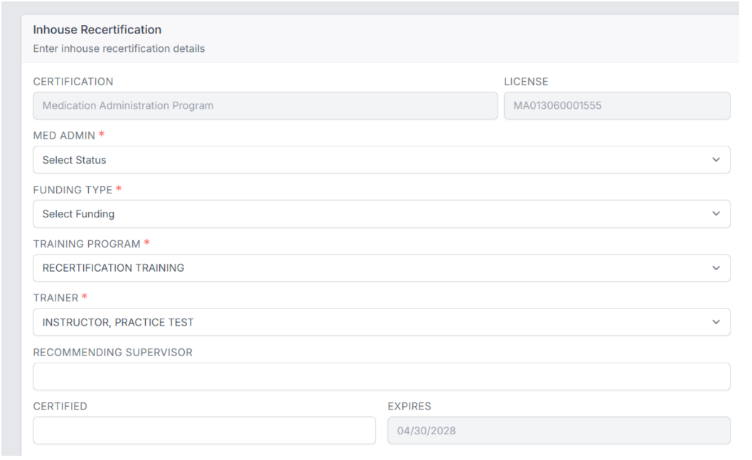
In-house Recertification Testing
Notes:
After the Service Provider verifies the staff’s employment, the MAP Trainer will have the option to Recertify inhouse. From this point forward, the MAP Trainer completes the Recertification Process following the existing in-house recertification steps. The MAP Trainer affiliated with the Service Provider that employs the staff observes a medication administration demonstration. The MAP Trainer uses the MAP Recertification Competency Evaluation Form to evaluate the staff.

Slide 17
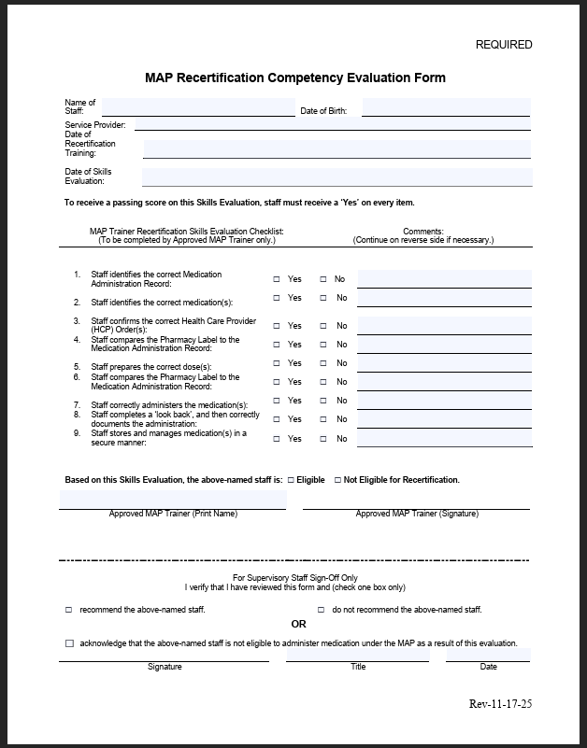
Recertification Competency Evaluation Form
Enter date of Refresher Training
Notes:
The MAP Recertification Competency Evaluation Form now requires documentation of the date that Refresher Training was completed.

Slide 18

D&S Recertification Testing
Notes:
If the candidate does not have current verifiable employment, for example they are employed through a staffing agency, recertification must be completed through D&S. The MAP Trainer must contact D&S to secure a Recertification test date. Before calling D&S, the MAP Trainer and the staff must identify a mutually convenient test date, time, and location for virtual testing.

Slide 19


Resource Packets
Shipping and Handling Costs
Notes:
Trainers are now responsible for the Shipping and Handling costs associated with obtaining Resource Packets from CDDER. Participants in the Train-the-Trainer Program must also cover the cost of Shipping and Handling for their Resource Packets.

Slide 20
Resource Packet
Effective September 11, 2025, CDDER will need to begin collecting revenue to cover the shipping and handling fees associated with distributing MAP Resource Packets. CDDER will continue to produce the packets at no cost to service providers, with material and labor expenses still covered by MAP state agencies. However, due to an increase in costs for shipping, we will have to transition to shipping costs being paid by the Service Provider and Independent Trainer.
Resource Packet Shipping and Handling costs: (as of March 2026)
Single resource packet: $11.00
Set of 6 resource packets: $14
Set of 12 resource packets: $16.50
Blister Pack ONLY Option:
6 Blister Packs: $12.50
12 Blister Packs: $13.50
Orders are placed through the Map Mass website. You will be invoiced for the cost of the packet. Orders will be shipped after payment is received. Payments will be accepted by Debit or Credit Card using PayPal.
Reminders about the Resource Packets:
Unused packets can be transferred to a new student if the original student does not start the course.
Providers may prefer to hold packets until the student officially begins the course, to account for those who enroll but ultimately do not start.
Notes:
As a reminder, CDDER is collecting revenue to cover the shipping and handling fees associated with distributing MAP Resource Packets. CDDER will continue to produce the packets at no cost to service providers, with material and labor expenses still covered by MAP state agencies. However, due to an increase in costs for shipping, we will have to transition to shipping costs being paid by the Service Provider. Independent Trainers will pay the full cost of the Resource Packet, plus the shipping fees.
Resource Packet Shipping and Handling costs: (as of March 2026)
Single resource packet: $11.00
Set of 6 resource packets: $14
Set of 12 resource packets: $16.50
Blister Pack ONLY Option:
6 Blister Packs: $12.50
12 Blister Packs: $13.50
Orders will be shipped only after payment is received. Payments will be accepted by Debit Card, Credit Card, or using PayPal.
Reminders about the Resource Packets:
Unused packets can be transferred to a new student if the original student does not start the course.
Providers may prefer to hold packets until the student officially begins the course, to account for those who enroll but ultimately do not start.

Slide 21
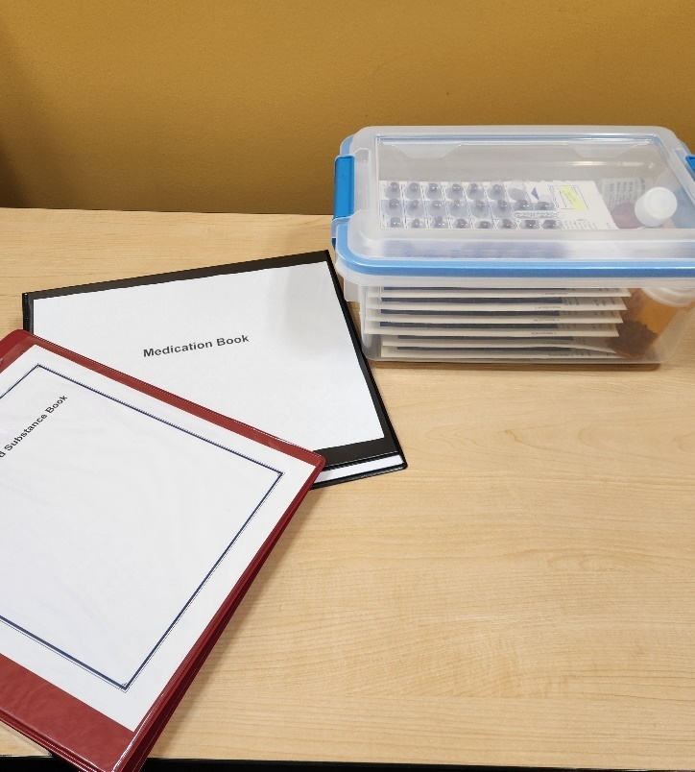
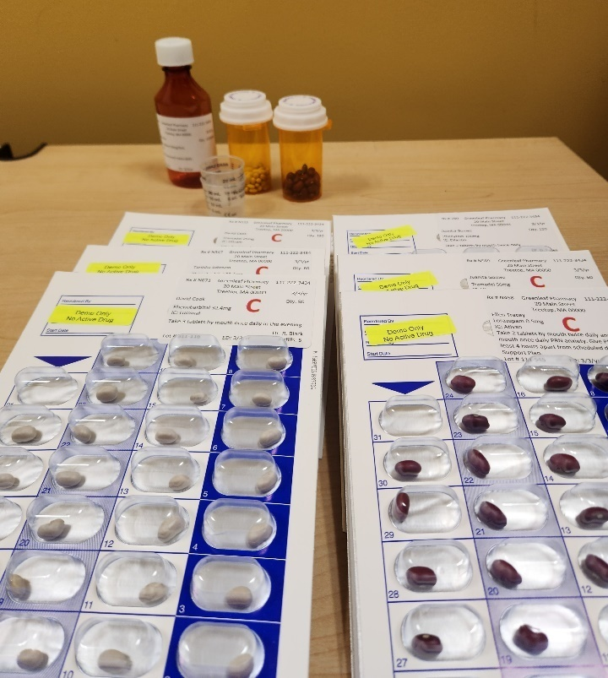
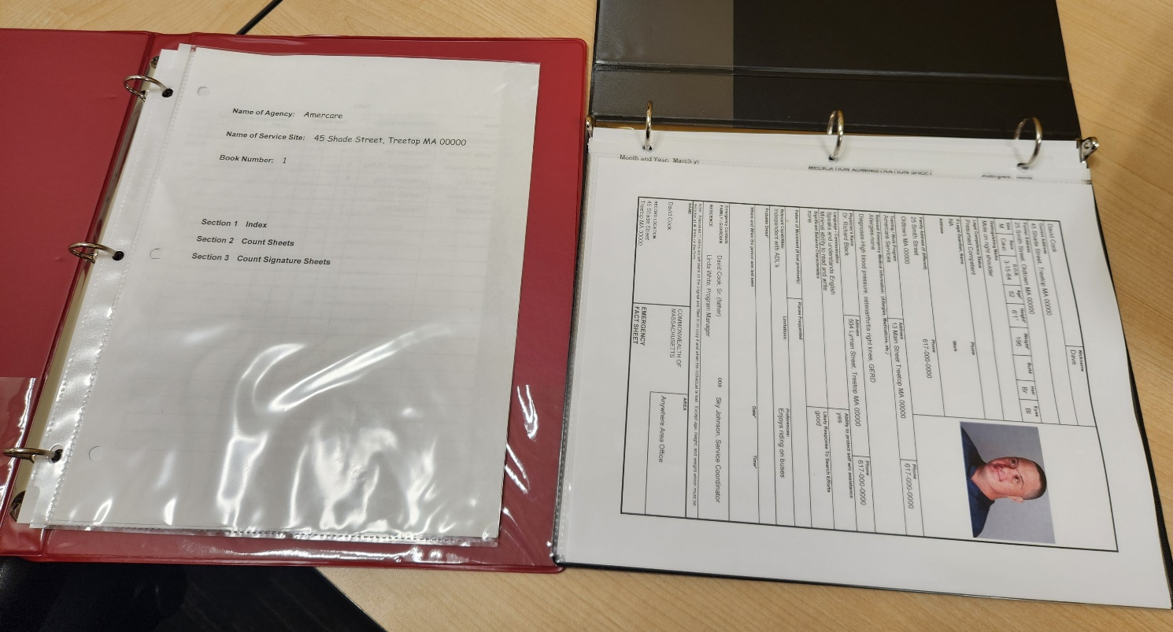
Optional Assembled Trainer Kit
https://shriver.umassmed.edu/map-trainer-kits/
Notes:
MAP Trainers now have the option to order at cost reusable, pre-assembled sets of supplies for medication administration practice session(s). The sets may be ordered at the URL listed on this slide.
One Trainer Kit contains the following supplies:
Medication Book binder with sleeve-protected pages
Count Book binder with sleeve-protected pages
Mock medications: pill bottle, labeled and filled with mock medication; labeled liquid bottles; labeled countable controlled blister packs for each character
Medication storage container
Medication cups

Slide 22

MAP Updates
Notes:
Now let’s review some MAP Updates.

Slide 23
Train-the- Trainer
Updated program as of September 9th, 2025
Existing Trainers moved to new program
Changes include:
Contact Hours offered for new Trainers
Webinars 3 & 4 removed
RIA Course for MAP Trainer Candidates
Notes:
The MAP Train-the-Trainer program has been revised. The updated program was opened on September 9th, 2025. All existing, current MAP Trainers were moved to the new TTT program, and we encourage them to take some time to explore it. New MAP Trainers will now be granted Contact Hours for completing TTT. Other changes include the removal of the Step 3 & 4 webinars. The information in the webinars has been converted into course content to make it easier to reference after completing the program. In addition, Step 2, the RIA Course for MAP Trainer Candidates, now includes a requirement that the Transcription Assignment in Unit 6 be completed.

Slide 24

D&S
Notes:
Now let’s discuss some feedback from the testing vendor, D&S.

Slide 25

D&S Test Events
On-Site Proctors
Notes:
As a reminder from D&S, on-site proctors should not remain in the room during the test event unless they need to assist with or hold the camera. Having the on-site proctor in the room is often a distraction and their presence is not necessary.

Slide 26

Remedial Training
Notes:
Remedial training can only be offered by the MAP Trainer of Record, for example, the MAP Trainer who conducted the training program. Independent MAP trainers cannot adopt a student and provide remedial MAP training for any person for whom they are not the trainer of record.

Slide 27
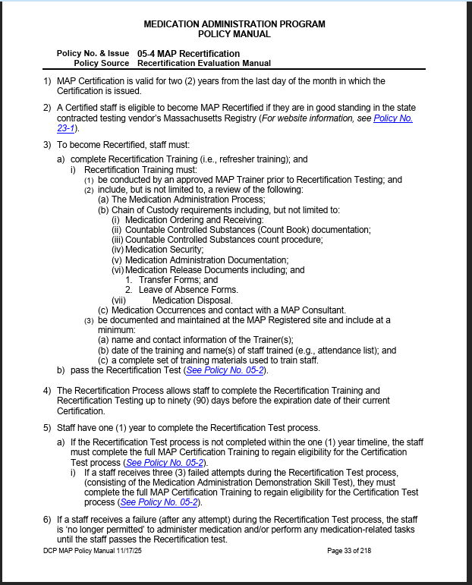
Recertification Training Topics
Notes:
MAP Policy 05-4 states that recertification trainings must include, but are not limited to, a review of the Medication Administration Process; Chain of Custody requirements, including medication ordering and receiving procedures; Countable Controlled Substances (Count Book) documentation; the count procedure for Countable Controlled Substances; and medication security practices. Recertification training must also review proper medication administration documentation, including accurate and timely completion of MARs; medication release documents such as Transfer Forms and Leave of Absence (LOA) Forms; medication disposal procedures and required documentation; identification and reporting of medication occurrences; and the requirements for contacting a MAP Consultant when necessary to ensure compliance, safety, and adherence to MAP Policy.

Slide 28

In-house Recertifications
Notes:
The next few slides will talk about In-house Recertifications....

Slide 29
In-house Recertifications
Each attempt must be documented in TMU
Notes:
According to MAP Policy 05-5.2, MAP Recertification Process Through the Service Provider, the Approved MAP Trainer must enter each Recertification Evaluation attempt in TMU immediately following each evaluation. If the staff fails an attempt, staff may not administer medication and may not perform any medication-related tasks, even if their current MAP Certification document has not expired.

Slide 30
In-house Recertifications
MAP Recertification Competency Evaluation Form
Requires MAP Site Supervisor approval
Notes:
The completed and signed MAP Recertification Competency Evaluation Form is forwarded by the Approved MAP Trainer to the Service Provider designated supervisory staff. For those staff deemed "eligible" by the Approved MAP Trainer, the designated MAP Site Supervisor must determine whether the staff is "Recommended" or "Not Recommended" for Recertification. The MAP Site Supervisor has knowledge of the staff's medication administration history, including medication occurrences, if any. They use that information to determine if the staff should be recommended for recertification and will indicate on the form, sign and return to the MAP Trainer. The Approved MAP Trainer must include the full name of the designated MAP Site Supervisor in the candidate’s record in TMU. The MAP trainer is not the MAP Site Supervisor and must not be documented as one in TMU. If the designated MAP Site Supervisor determines that the staff is “Not Recommended” for recertification, MAP Policy requires that a copy of the MAP Recertification Competency Evaluation Form must be forwarded to the applicable MAP Coordinator for review.

Slide 31
Recertifications through D&S
Agency staff
No designated Site Supervisor
Recertification through D&S
Notes:
As previously mentioned, if MAP Certified staff are employed by a staffing agency, they must recertify through the testing vendor, D&S. The MAP Certified staff will be required to contact an Approved Independent MAP Trainer to provide the MAP Refresher Training, provide the testing materials, and to act as the onsite proctor for the skill portion of Recertification Testing through D&S.

Slide 32

Reminders
Notes:
Hello, I am Danielle Parvez, DCF MAP Coordinator. Finally, let’s review some important reminders.

Slide 33

Required Trainings
Complete documentation
  Trainer name and contact info
  Date of Training
  List of staff trained
  Competency if required
  Complete set of Training Materials
Notes:
Service Providers and Trainers must ensure that documentation of required trainings, including general, individual and equipment specific required competencies, are complete and accessible on site for review.
Complete documentation must include the name and contact information of the Trainer, the date of the training, the names of the staff who were trained, and a complete set of training materials used to train staff.

Slide 34

Responsibilities in Action
Notes:
The updated version of Responsibilities in Action is available for download on mapmass.com, and is available for purchase through Amazon. A hard copy is not required to complete the course, although a hard copy may be preferred by some students for practicing the exercises and making notes.

Slide 35
Electronic Reference Materials
Programs may elect to maintain electronic versions of required reference materials.
  The MAP Policy manual
  The MAP RIA curriculum
Provider programs must train all MAP Certified/licensed staff on electronic versions, which includes:
  How to access these electronic materials
  A contingency plan to follow in the event of a system failure
  Training documentation must be maintained at the MCSR site.
Notes:
The MAP Registered site may elect to maintain an ‘electronic version’ of the required reference materials such as the MAP Policy Manual and MAP training curriculum. If programs use electronic versions of their reference materials, they must ensure the following:
a) The electronic versions are readily available to all Certified/licensed staff at the MAP Registered site, twenty-four hours a day, seven days a week
b) Electronically filed required reference materials must be readily accessible and available for oversight by State Agencies
c) All electronically filed reference materials are the most current and latest versions
d) All Certified and licensed staff have been trained to access the electronic or online reference materials and documentation of this training is maintained at the MAP Registered site
e) There is a contingency plan in place in the event that the MAP Registered site’s computer or internet service is not functioning
Please refer to MAP Policy 14-4 for additional information.

Slide 36

Service Provider TMM System
Service Provider Policy
Notes:
MAP Policy 11-3 addresses the Service Provider Transcription of Medication Management (TMM) System. One of the requirements of the Policy is that the Service Providers must have a Provider Specific TMM System Policy.
.

Slide 37
Required Components of a Transcription Management System Policy
HCP Order Management
  Transcription
  Posting and verifying HCP Orders
  Monthly Accuracy Check of HCP Orders
Medication Changes
  Documenting discontinued medications
  Communicating changes in HCP Orders
Support Contacts
  IT support (if applicable)
Notes:
The Service Provider TMM Policy must include:
A procedure for ensuring all Certified staff responsible for the Transcription of HCP Orders. Posting and Verifying, and completing Accuracy Checks are appropriately trained.
The procedure that Certified staff should follow when HCP Orders are obtained, when posting and verifying orders or when completing accuracy checks.
The Process for documenting and communicating changes in HCP orders and
Information on who to contact if questions arise during the transcription process, if there are order changes or if IT support is needed.

Slide 38
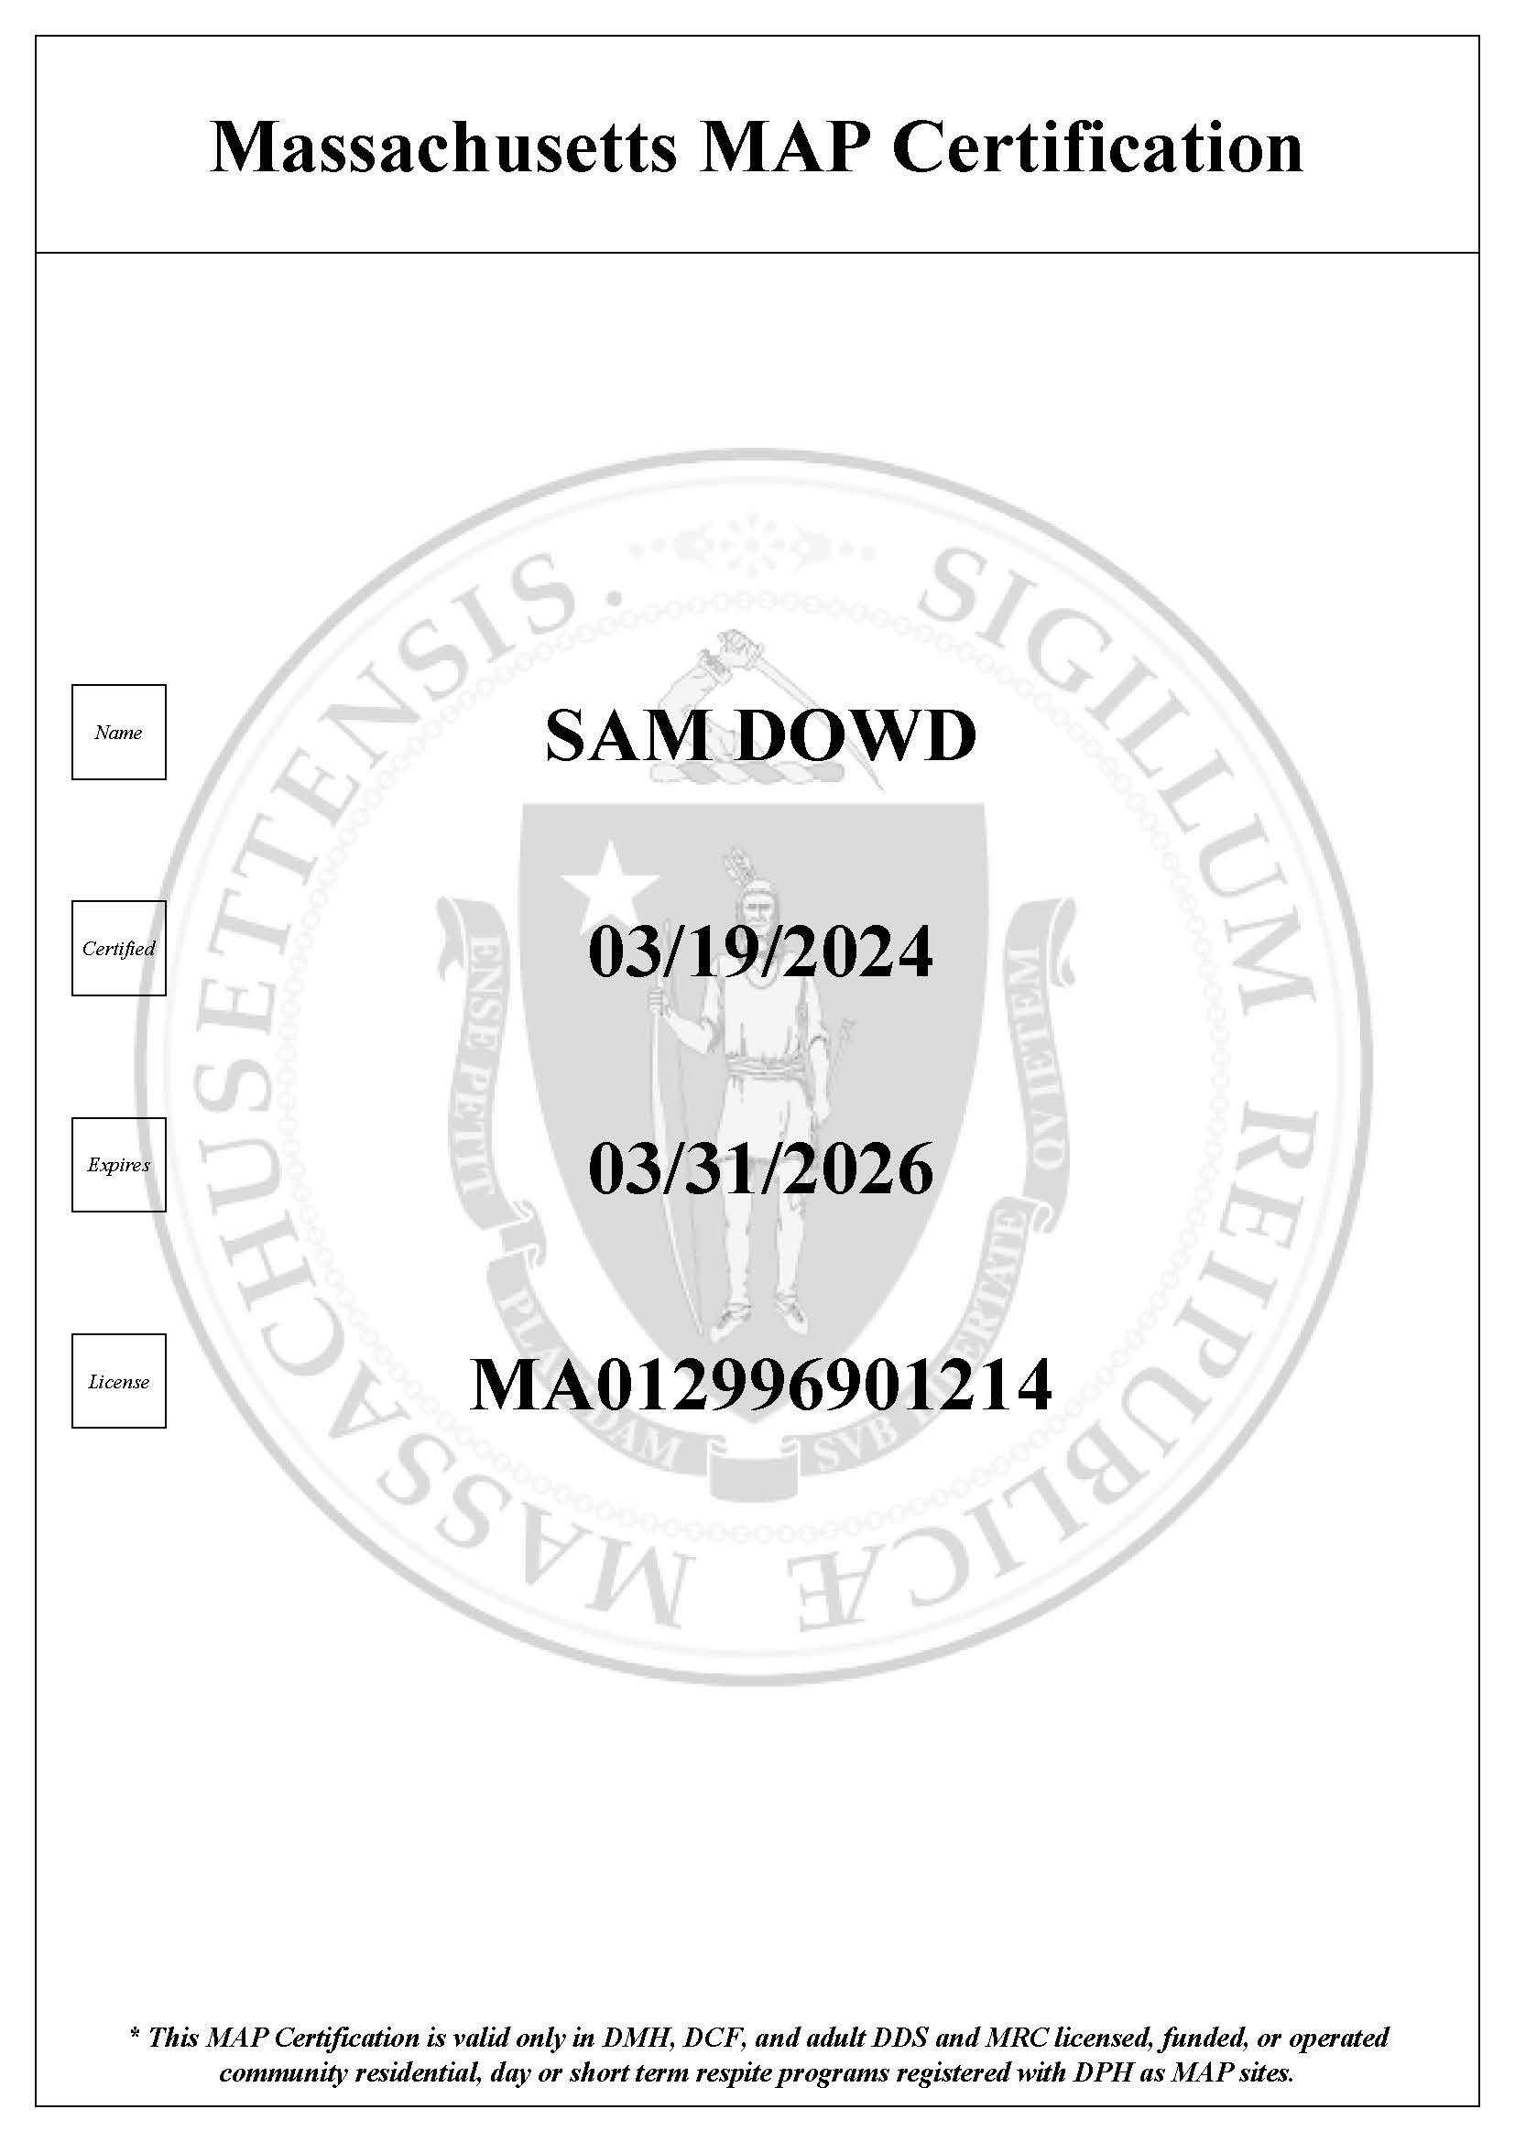
TMM System Training
Prerequisite: Current MAP Certification
Notes:
MAP Certified staff, including Relief staff, who will be responsible for the Transcription of Health Care Provider Orders at MAP Registered sites, must be trained by the Service Provider that employs them specific to the Transcription of Medication Management System utilized by the Service Provider.
A valid and current MAP Certification is a prerequisite of TMM System training. This means that TMM System training cannot be part of MAP Certification Training. Only after a staff has successfully completed MAP Certification Training and Testing, and has received their MAP Certification, can the staff be trained in the Service Provider’s TMM System. TMM System training is completed after initial certification and then on a biennial basis.

Slide 39

Competency Evaluation Tool
Customized to Provider’s TMM System
Documentation on site
Notes:
Each Service Provider must also develop a customized TMM System Competency Evaluation Tool specific to the TMM System utilized by the program. This Competency Evaluation Tool must also be completed as part of TMM System Training, and the documentation must be maintained at the MAP Registered site.

Slide 40
Required Components of a Transcription Management System Training
TMM Training requirements:
An Overview of TMM System in use
Components of TMM utilized by the provider including:
  how a new HCP Order is generated and received by the MAP Registered site
  how to transcribe a medication order using information obtained from the HCP Order and the Pharmacy Label
  How to document discontinued medication onto a medication sheet
  How to document posting/verifying and accuracy checks
How changes in HCP Orders are communicated and who to contact if there is an IT issue.
Notes:
The following topics must be included in staff TMM training using a customized TMM System Competency Evaluation Tool must include, but is not limited to:
an overview of the ‘TMM System’ utilized including if the Service Provider uses paper documents, Electronically or pharmacy generated documents or Electronic HCP Orders and Medication Administration Record
components of the ‘TMM System’ utilized, including:
how a new HCP Order is generated and received by the MAP Registered site;
how to transcribe a medication order using information obtained from the HCP Order and the Pharmacy Label
how to contact the MAP Consultant if the HCP Order and Pharmacy Label do not agree
how to document a discontinued medication on the Medication Sheet
how to Post and Verify an HCP Order and
how to complete a Monthly Accuracy Check
The training should also include:
how changes in HCP Orders are communicated; and
who to contact if there is an ‘IT’ issue

Slide 41

Internal MAP Monitoring System
Completed Tools, Checklists, etc. maintained on site
Notes:
Service Providers are required to have an Internal MAP Monitoring System in place. The documentation of the completed tools used for monitoring, or to complete a review or audit, must be maintained at the MAP Registered site.

Slide 42
Medication Occurrence Reporting Timelines
Hotline Medication Occurrences: 24 hours
Non-hotline Medication Occurrences: 7 days
MAP Consultant: immediately
Notes:
As a reminder, Hotline medication occurrences must be reported to DPH and the applicable State Agency MAP Coordinator within 24 hours of discovery. Non-hotline medication occurrences must be reported to the applicable State Agency MAP Coordinator within 7 days of discovery.
For DDS programs, reporting is done in HCSIS.
DCF programs report MORs in iFamilyNet through the Virtual Gateway.
For MassAbility programs, MORS are entered into Qualtrics.
For DMH programs, please forward MOR reports to the DMH-MOR@mass.gov email.
For all medication occurrences, a MAP Consultant must be contacted as soon as the medication occurrence is discovered.

Slide 43
Directions Change Stickers
Only used when Exhausting a Current Supply of Medication
Valid for 30 days
Do not obstruct pharmacy label
Notes:
“Directions change” stickers are used only when exhausting a current supply of medication. They alert staff that there is a new HCP order, and the pharmacy label directions are no longer accurate.
A “directions change” sticker, or brightly colored sticker, is adhered to the medication packaging so that it does not obstruct the original pharmacy label.
Staff are never to write or mark directly on the pharmacy label.
A “directions change” sticker is only valid for up to thirty (30) days. A ‘‘directions change” sticker cannot be used as a flag to alert staff of a discrepancy between the HCP order and the pharmacy label, such as when the medication name on the HCP order does not agree with the medication name on the pharmacy label.

Slide 44



Allergies
Listed on all health-related documents
If no allergies, this must be listed
Allergy List may be formatted for easy identification
Notes:
Allergies that the individual has must be listed on all health-related documents, including, but not limited to, Health Care Provider Orders, Consult or Encounter Forms, Protocols, Medication Administration Records, and Emergency Fact Sheets.
If the individual does not have any known allergies (i.e., No Known Allergies), then this information must be listed.
In MAP, highlighting and using different font colors for bringing attention to allergies is prohibited.
The Allergy List may be formatted to assist in readily identifying allergies by doing things like circling the Allergy List with a red pen or creating an electronically generated Allergy Alert ‘text box’.

Slide 45
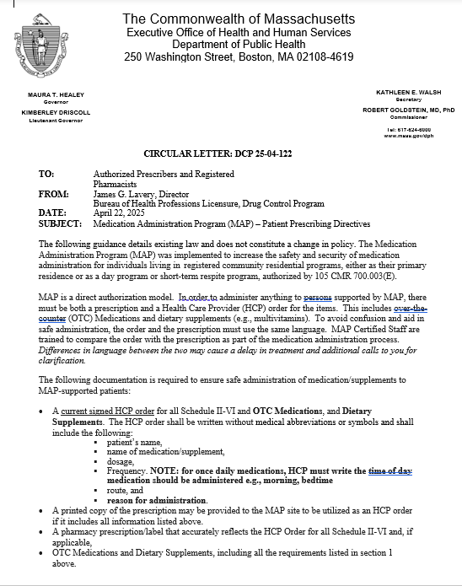
MAP Prescriber Guidance Circular Letter: DCP 25-04-122 Patient Prescribing Directives
This guidance reflects existing law and does not change MAP policy.
Notes:
This slide provides a quick overview of the Medication Administration Program Prescriber Guidance Circular Letter 25-04-112 released April 25, 2025.
A key requirement that the guidance reviews is that the prescription and the HCP order must use the same language. It explains that since MAP Certified Staff are trained to compare these two documents before administering medication, minor differences in wording can lead to delays in treatment and require follow up calls for clarification. Consistent language will therefore help to ensure safe and timely medication administration.
It is important to note this guidance does not reflect a change in policy and is existing law. MAP was implemented to improve the safety and security of medication administration for individuals living in registered community residential programs as well as those receiving services in day programs, outreach programs and short-term respite programs. MAP operates on a direct authorization model, which means that before any medication can be administered there must be a valid prescription and healthcare provider order, or HCP prescription order that may be used in the place of an HCP order.
Circular #DCP 25-04-122: Medication Administration Program (MAP) - Patient Prescribing Directives | Mass.gov

Slide 46
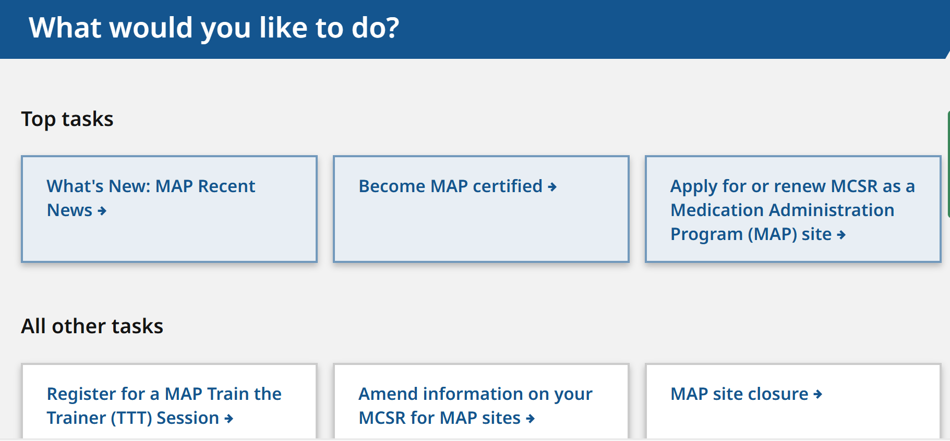
CLOSING A MAP REGISTERED SITE
Notes:
When a MAP Registered site closes, there is a formalized process that must be followed. To report a MAP site closure, begin with the MAP friendly URL www.mass.gov/dph/map, and then select the tab "MAP site closure.”

Slide 47
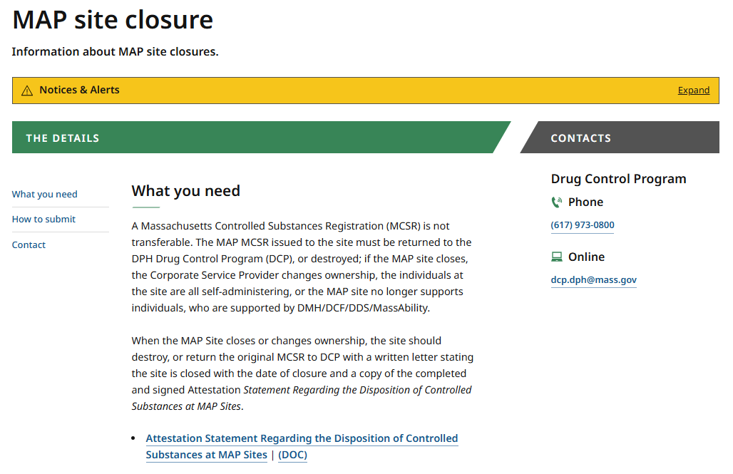
Notes:
Then click on the "Attestation Statement Regarding the Disposition of Controlled Substances at MAP Sites.”

Slide 48
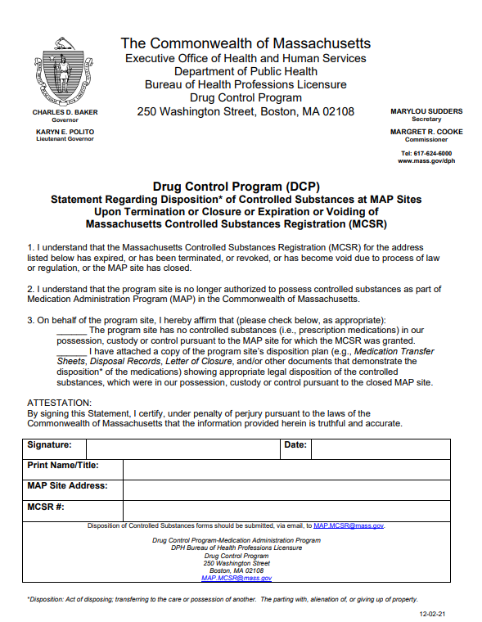
Notes:
The Attestation must be completed and submitted via email using the email address at the bottom of the form.

Slide 49

eMars and Relief Staff
Relief staff must have
Access to the eMAR
Ability to generate their initials on MAR for medications administered
Code for “relief staff” is not permitted
Notes:
If a MAP Registered site utilizing an eMAR engages agency relief staff, the relief staff must have the required access in the eMAR system to allow their initials to be generated on the MAR for medications administered. It is not acceptable for relief staff to document medications administered using a code that identifies them simply as “relief staff.”

Slide 50
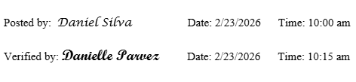
Posting and Verifying
Notes:
When posting and verifying HCP orders, the signatures must be legible and include the date and time the posting or verification was completed. All HCP orders must be posted and verified, including those that do not contain any new orders.

Slide 51
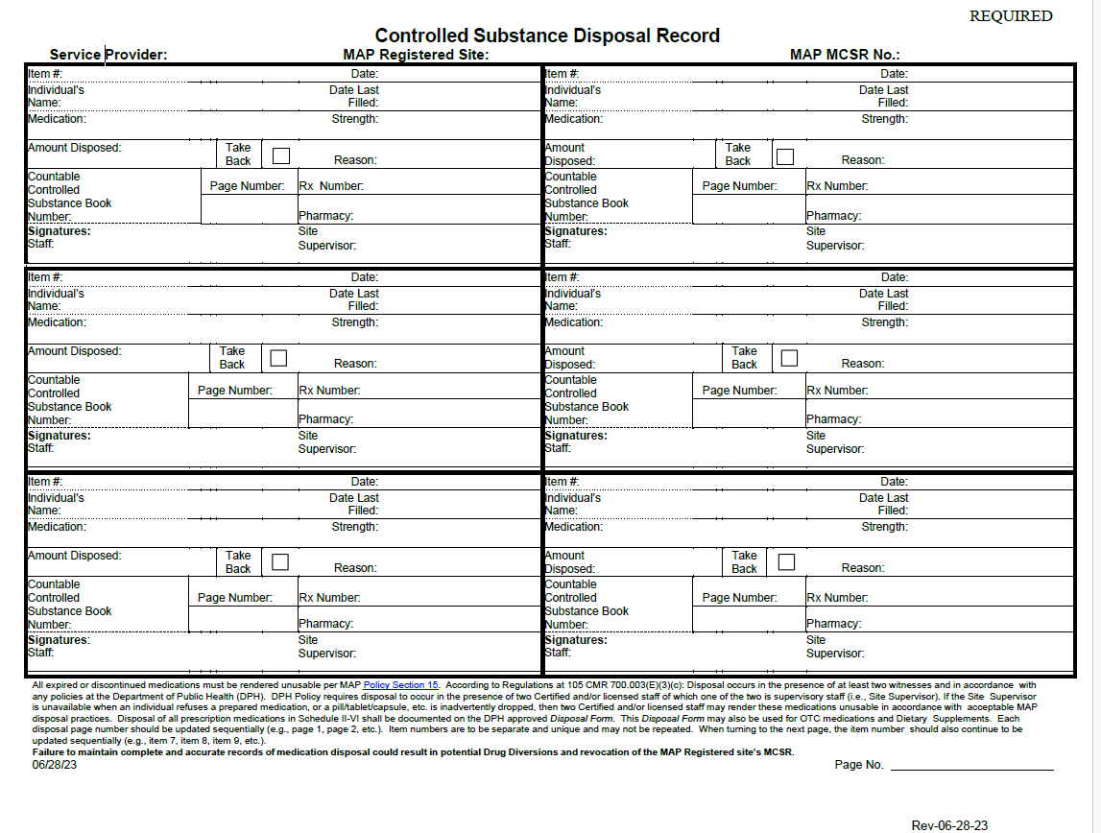
Disposal Documentation
Notes:
Whenever medications are rendered unusable and in need of disposal, regardless of the quantity, the current DPH approved Controlled Substance Disposal Record form must be used
The Disposal Form must be used for all Schedule II-V and VI medication disposals.
The Disposal Form may also be used for all Over-The-Counter (OTC) medication and Dietary Supplement disposals.
Disposal form heading must be completed with the Service Provider name, address and DPH MAP Registration number.
Page and item numbers must be completed sequentially.
Disposal blocks may not be skipped.
All spaces must be completed within a medication disposal block.
A Countable medication disposal block must include a Count Book number and Count Sheet page number.

Slide 52
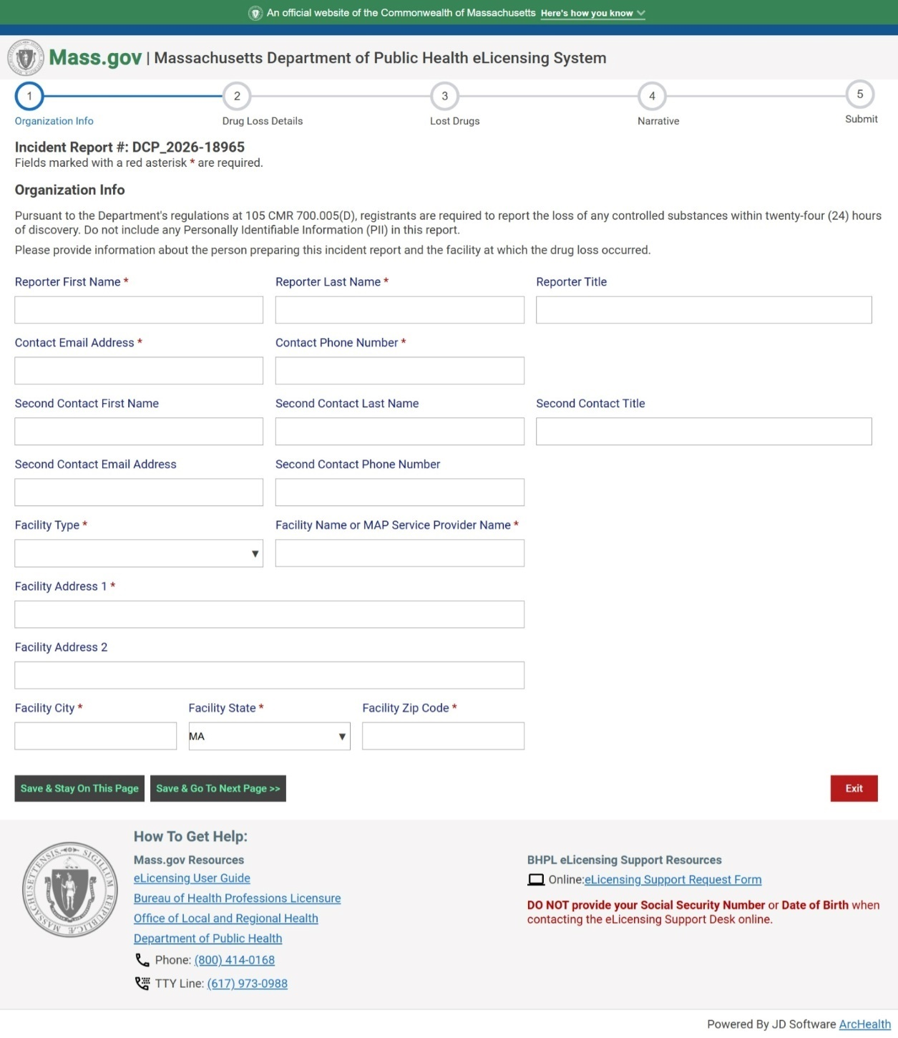
Drug Incident Reporting
Reminders
When completing a Drug Incident Report:
Ensure to add contact information for two staff
Under Facility Type indicate the state agency for which the site is licensed, funded, or operated (i.e. DDS, DMH, DCF, or MassAbility)
Notes:
As a reminder, when completing a Drug Incident Report (DIR) there are spaces to add two staff’s contact information. Two contacts are required to be documented. The reporter should not list the name staff person twice and should not leave the second space blank.
When completing information for “facility type”, indicate the state agency for which the site is licensed, funded, or operated (i.e. DDS, DMH, DCF, or MassAbility formerly known as MRC). Staff should ensure not to leave the space blank and do not list "other."
If you are unsure which state agency to choose, please reach out to your MAP Coordinator.

Slide 53
Maintaining MAP Trainer Status
Watch Required Webinars within viewing period
Complete at least one Certification Training every 365 days
Training completion date
Documented in TMU in Students’ Records
Notes:
Finally, to maintain status as an approved MAP Trainer, there are two requirements.
First, the MAP Trainer must watch all required webinars within the specified 8-week viewing period.
Second, the MAP Trainer must complete at least one Certification Training every 365 days. This is tracked by the Training Completion Dates entered in the Trainer’s student records in TMU. For example, if a Trainer enters a Training Completion date of November 5, 2025, they must enter at least one Training Completion date by November 5, 2026, to meet the training requirement. MAP Trainers may co-train a full MAP Certification Training provided that all Trainers Actively participate in the training. This means that both trainers names are documented on the roster to CDDER to oversee the students in online course AND the students are to be divided between the trainers in TMU. For example; some students will be under trainer number 1 and remaining students are under trainer number 2.

Slide 54

Thank you!
Notes:
This concludes the Winter 2026 MAP Trainer Webinar. Please contact your State, Regional or Area MAP Coordinator if you have any questions or need further clarification on a topic presented. Thank you for viewing!

