Slide 1
MAP Trainer Webinar One of 2024
Spring 2024
Notes:
Welcome to the Spring 2024 MAP Trainer Webinar. I’m Smita Chirayath, a Department of Developmental Services MAP Coordinator and I’m your webinar presenter. ​By viewing webinars marked as ‘required’ within the specified timeframe, you’ll meet the MAP Trainer meeting ‘attendance’ requirement.​ After the webinar, you’re encouraged to contact your MAP Coordinator if you have any questions or need further clarification on a topic presented.​

Slide 2
Agenda
What’s New
MAP Updates
Reminders
Notes:
The agenda for this webinar is as follows: What's New, MAP Updates, and Reminders.

Slide 3
What’s New
Notes:
Let's begin with 'What's New’.

Slide 4
MAP Policy Updates and Changes
11-15-23
Train-the-Trainer (TTT)
  Completion Timeline
  ‘Admission Review Process’
Copy of Prescription = HCP Order
Online DPH Hotline Reporting System
  Reporting Timelines Unchanged
  Reporting to Applicable State Agency Unchanged
Required and Sample Forms
  Replaced with Links
Notes:
Now that the MAP Policy Manual is a live document, it is updated as needed. When MAP Policy is updated, DPH notifies Service Providers via an email blast, using the emails on record that are associated with each site's MCSR. Highlights of the 11-15-2023 updates and changes include: The timeline to complete Train-the-Trainer is now 3 months. MAP Trainer Candidates with less than 2 years' experience are subject to an ‘Admission Review Process’ by the applicable state agency MAP Director. A copy of a prescription is now allowed to be used as an HCP order. The hotline reporting process to DPH is online only. Hotline medication occurrences are no longer called into DPH or faxed to DPH. All required and sample forms in the body of the manual were replaced with links.

Slide 5
MAP Policy Updates and Changes
3-1-24
Annual Observation of Medication Administration Form
MAP Recertification Evaluation Form
MAP Recertification Evaluation Guide
Multi-page HCP Orders
  Only Last Page Requires HCP Signature
    If Criteria Are Met
Biometric Medication Security
Notes:
Highlights of the 3-1-2024 updates and changes include: The Annual Medication Administration Observation Form, MAP Recertification Evaluation Form, and MAP Recertification Evaluation Guide were updated to reflect the revised Medication Administration Process. The revised process will be covered later. Only the last page of a multi-page set of orders require an HCP signature (wet or image) if established criteria are met. Maintaining medication security was expanded to include the use of a Biometric Medication Security System.

Slide 6
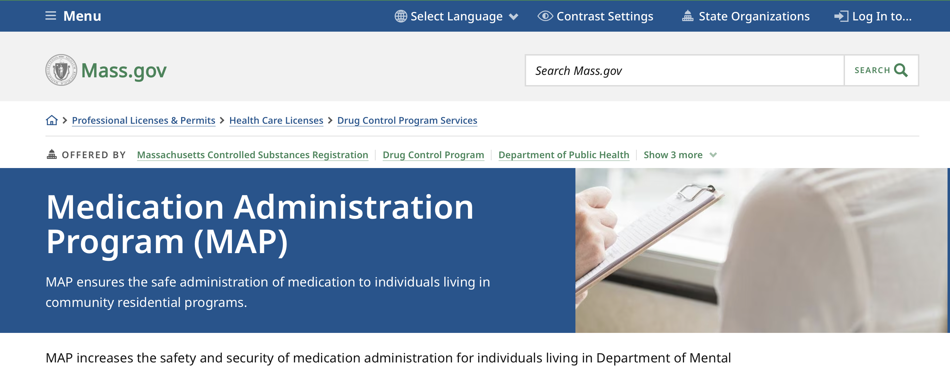
MASS.GOV/DPH/MAP
Notes:
To access the Hotline Medication Occurrence Reporting System, the MAP Policy Manual and corresponding guides, use the MAP friendly URL.
Once there, scroll down…

Slide 7
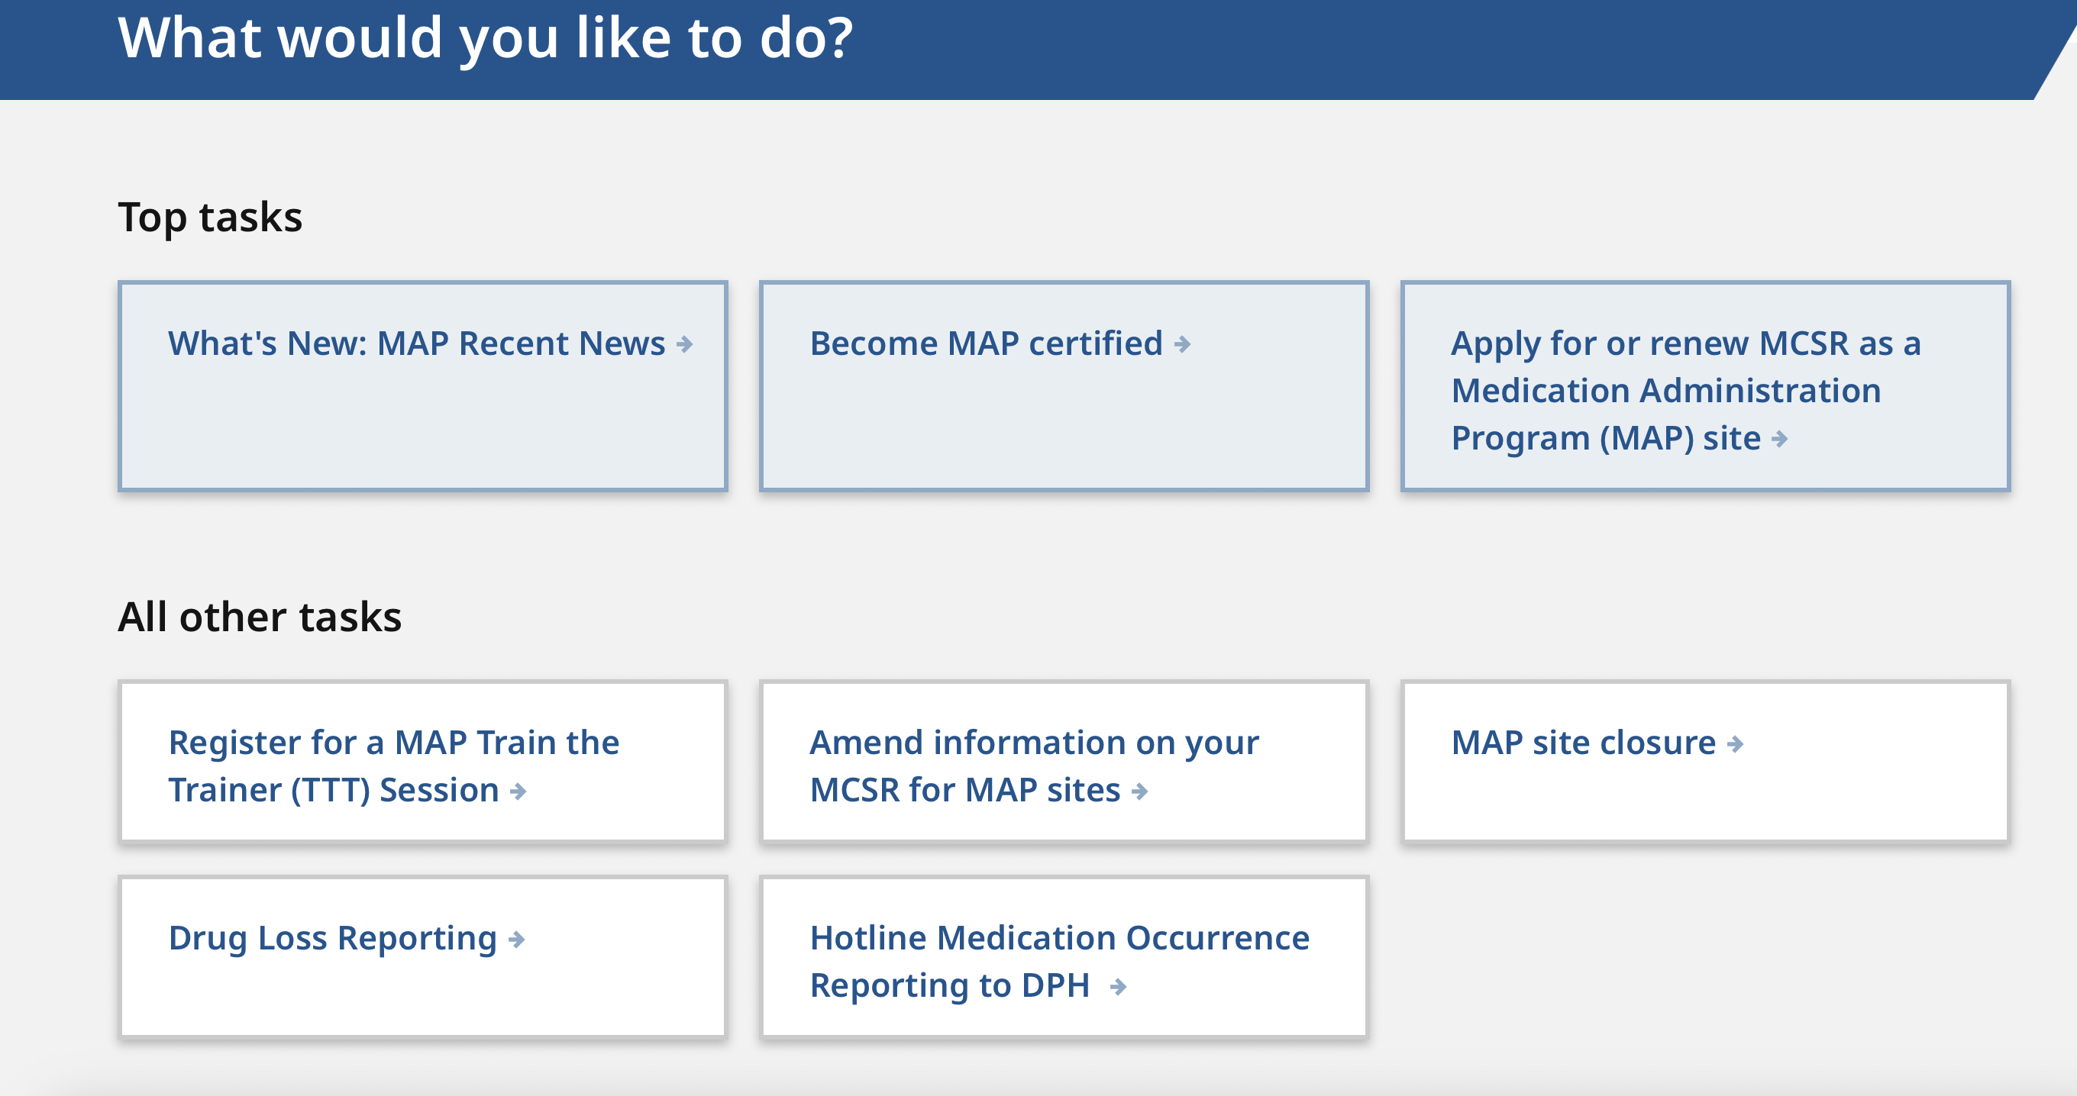
Notes:
Under the title, ‘What would you like to do?’, click the ‘Hotline Medication Occurrence Reporting to DPH’ tab to access the new online system and follow the prompts.

Slide 8
Medication Occurrence Report (MOR) Form
DDS
  All MORs Reported via HCSIS
    MOR forms for Hotlines No Longer Needed
DMH
  All MORs Reported using MOR forms via new email DMH-MOR@mass.gov
DCF
  All MORs Reported via iFamilyNet
    In addition, MOR forms Required for Hotlines
MRC
  All MORs Reported via Qualtrix
    In addition, MOR forms Required for Hotlines.
Notes:
With the implementation of the DPH online hotline reporting system, the use of the MOR form for reporting varies per state agency. State agency requirements for reporting medication occurrences are listed on the slide. Please contact your applicable MAP Coordinator if you need additional clarification on this topic.

Slide 9
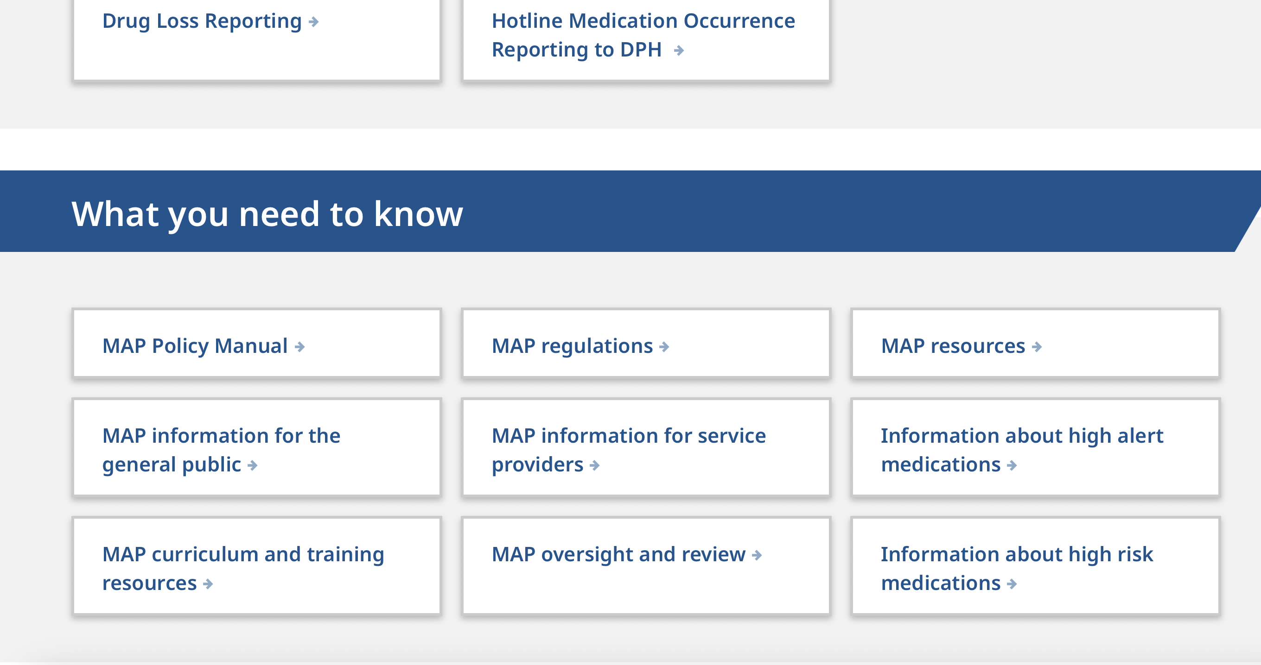
Notes:
If you continue scrolling down on the webpage of MAP friendly URL, you will find MAP Policy Manual tab. Click on it to access the manual and the corresponding guides to review the details of the updates mentioned.

Slide 10
Notes:
In addition, there are new tabs regarding high alert and high-risk medications.

Slide 11
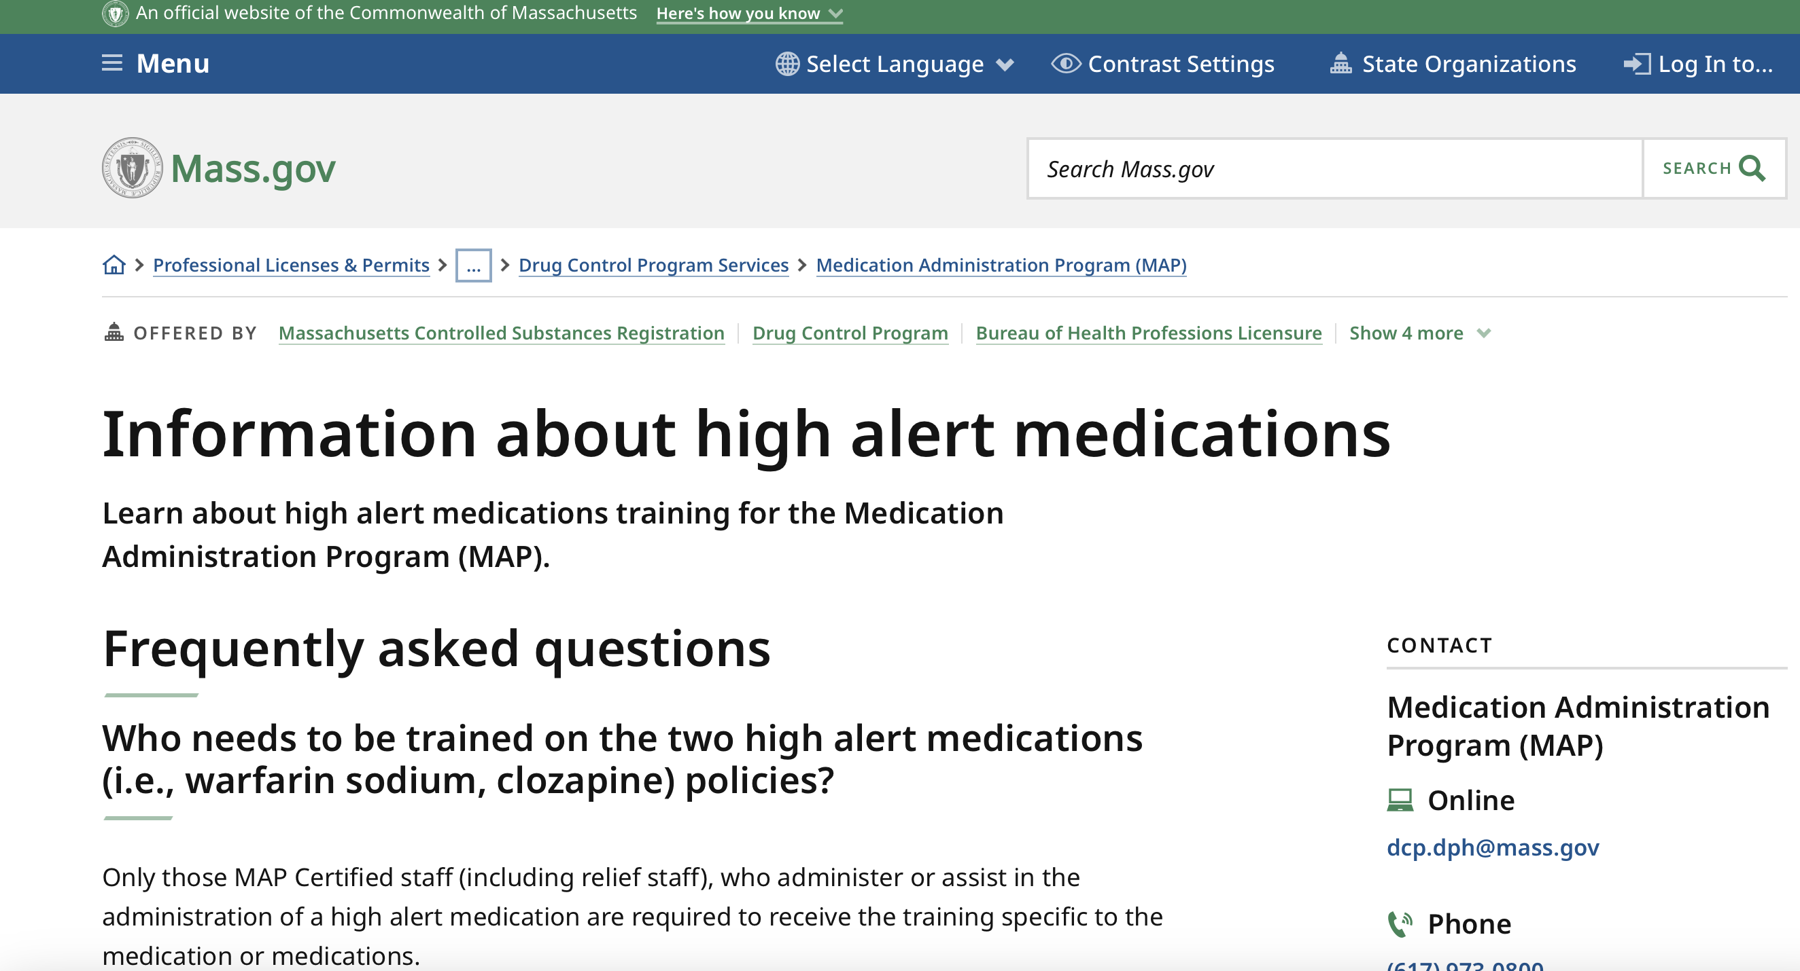
Notes:
When you click the high alert medications tab, you will see information specific to Warfarin Sodium and Clozapine. Please visit this tab for related information regarding documentation, training, etc., for these medications.

Slide 12
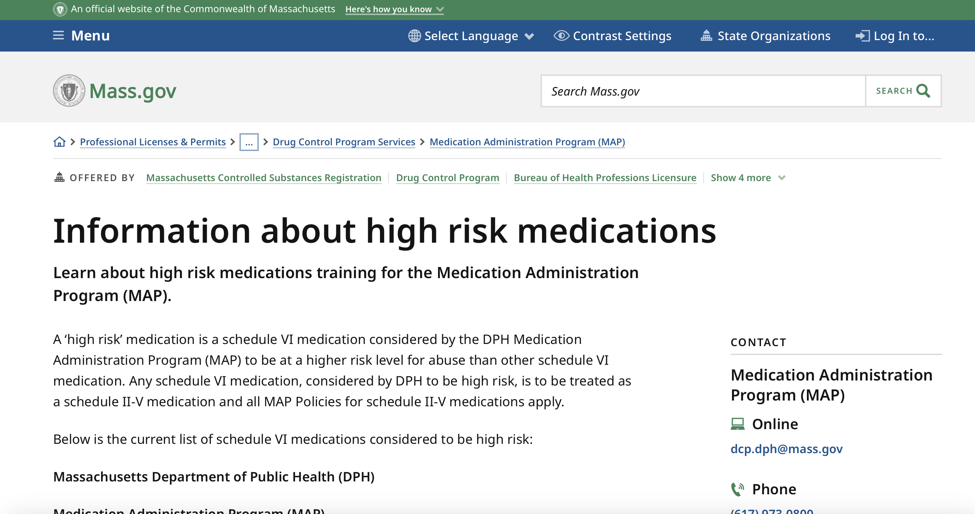
Notes:
When you click the high-risk medications tab, if there are schedule VI medications considered to be high risk they will be listed on this page.

Slide 13
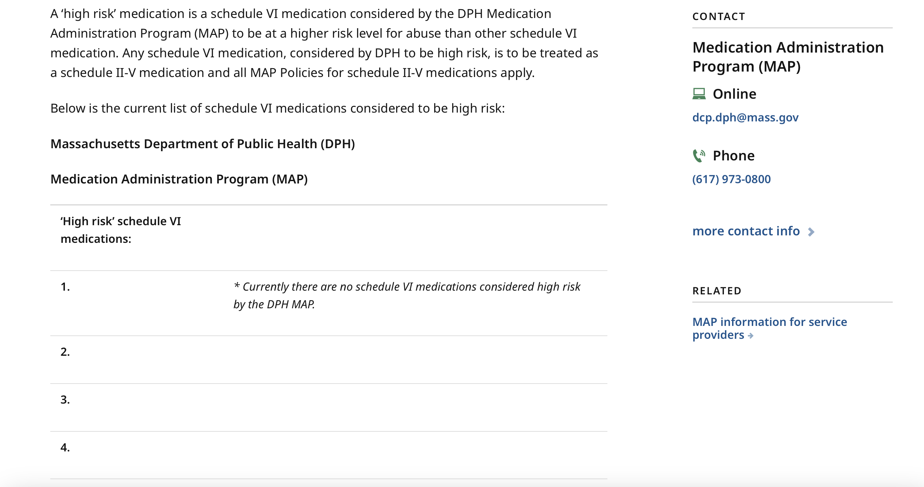
Notes:
If you scroll down this page, currently you will see there are no meds on this list. As a reminder, Fioricet and Gabapentin are no longer considered high risk medications. However, providers may choose to keep these medications on count. MAP Trainers are advised to periodically check these links for updates.

Slide 14
Notes:
When changes are made to MAP Policy, corresponding revisions are made to the MAP Technical Assistance Tool. To locate the updated tool, select the ‘MAP Oversight and Review’ tab.

Slide 15
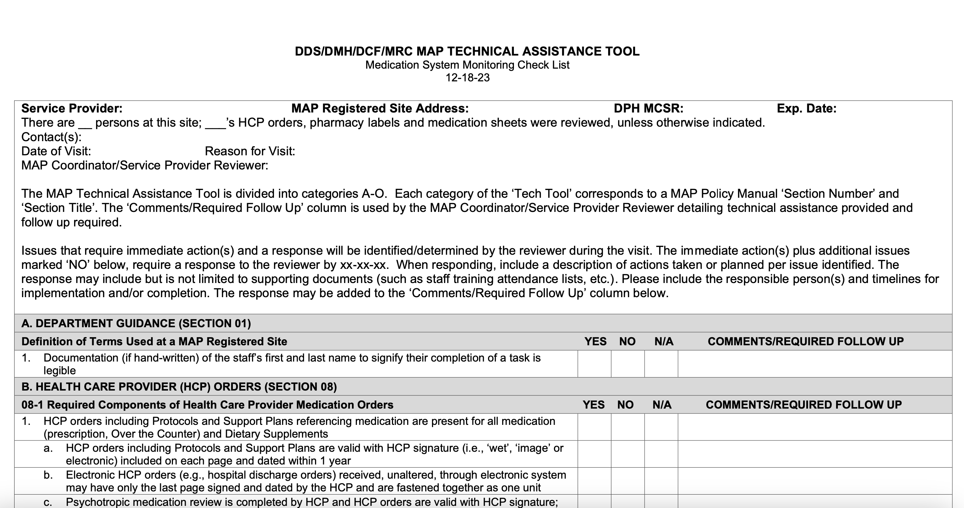
MAP Technical Assistance Tool
Notes:
The current tool is dated 12-18-23.

Slide 16

Coming Soon!
Curriculum Revision
Notes:
The MAP curriculum, ‘Responsibilities in Action’ has been under revision. The curriculum revision will align with the recent updates to the MAP policy manual.
With assistance from CDDER, the curriculum was revised to ensure that the reading level is at 8th grade level and that content is clear and concise with no duplication, to enhance students understanding of the material. A new version of the online Certification course will reflect the curriculum changes.

Slide 17
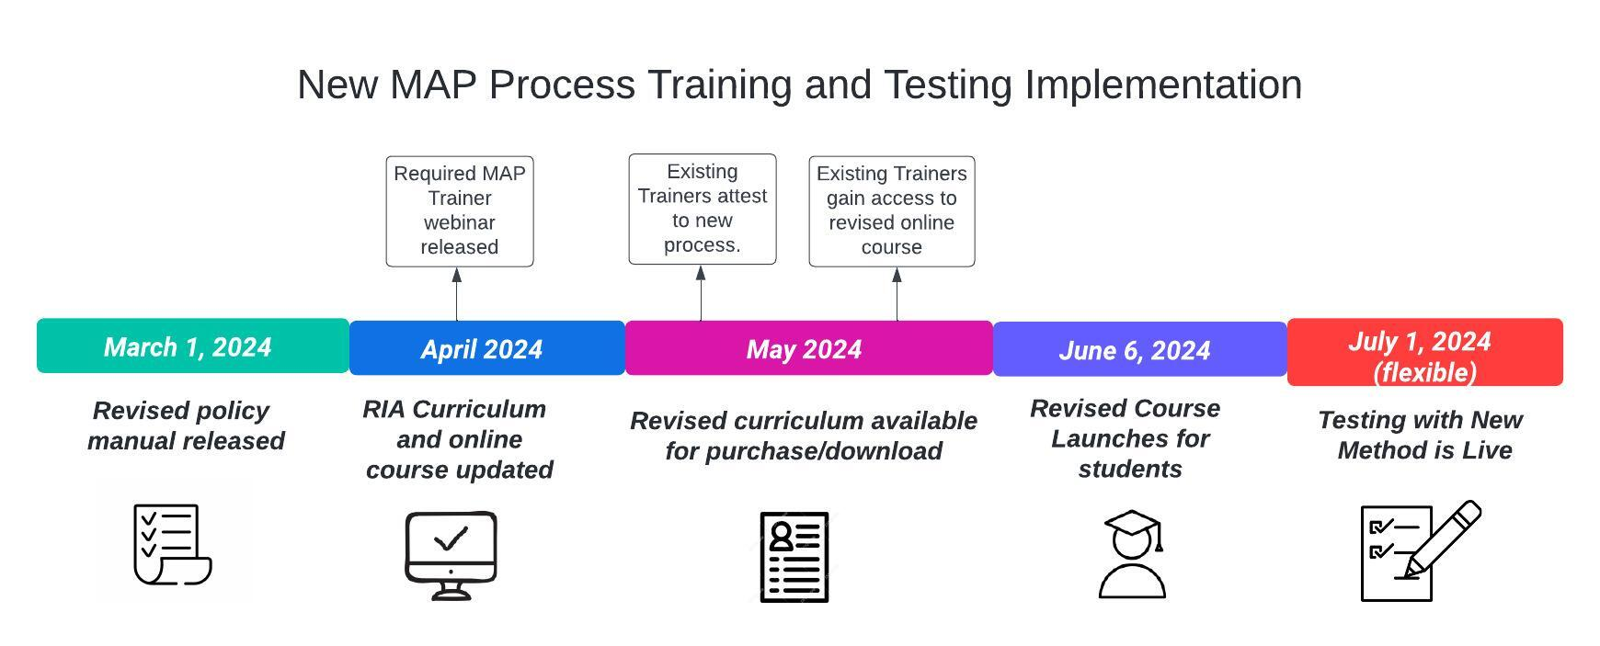
Notes:
This is the projected implementation process starting with the March 1st revised policy manual release. As of April, updates to the RIA curriculum and online course will be completed. In May, the revised curriculum will be available for purchase and download. In addition, existing MAP Trainers will have access to the online course. On June 6th, the revised course will open for students. Testing reflecting the revised medication administration process will go live approximately July 1st.

Slide 18

Medication Administration Process
Current Process
Revised Process
Prepare
Administer
  3 Checks of the 5 Rights
    HCP Order to Label
      Point and Read Aloud
    Label to Medication Sheet
      Point and Read Aloud
    Label to Medication Sheet
      Point and Read Aloud
Complete
Prepare
Administer
  Confirm HCP Order
    Point and Read Silently
  2 Checks of the 5 Rights
    Label to Medication Sheet
      Point and Read Aloud
    Label to Medication Sheet
      Point and Read Aloud
Complete
Notes:
The medication administration process was one of various issues identified and subsequently modified in response to the Eastern Research Group (ERG) report findings. The revised process was piloted by Service Providers who volunteered to participate. The comparison on your screen illustrates the similarities and the differences. When practicing and testing, staff will state, “I am confirming the HCP order” while pointing and reading the order silently. The steps to ‘Prepare’ and to ‘Complete’ remain the same. A new video demonstrating the revised medication administration process has been completed and will be available for review by MAP Trainers in the next Required MAP Trainer Webinar that will cover in detail all the curriculum and course changes.

Slide 19
Medication Administration Process
Current Process & Rationale
Revised Process & Rationale
Administer
  Check 1
    Ensure there is order for med
    What HCP ordered is what pharmacy supplied
    HCP order has not changed since last administered
  Check 2
    Ensure strength supplied & amount to administer on label agree with med sheet
    Focus on number of tabs needed
  Check 3
    Ensure correct number of tabs in med cup
Administer
  Confirm HCP Order
    Ensure there is order for med
    What HCP ordered is what pharmacy supplied
    HCP order has not changed since last administered
    HCP order was not discontinued
  Check 1
    Ensure strength supplied & amount to administer on label agree with med sheet
    Focus on number of tabs needed
  Check 2
    Ensure correct number of tabs in med cup
Notes:
This is a closer look at the current process and the revised process. Confirmation of the HCP order replaces Check 1. There is an additional rationale under Confirm HCP Order that states ‘HCP order was not discontinued.’

Slide 20
Medication-Related Tasks
Post and Verify HCP Order
Monthly Accuracy Checks of HCP Order
Ensuring Correct Medication Received from Pharmacy
Notes:
Prior to the revised Medication Administration Process, there are key medication-related tasks that must be completed accurately to ensure staff administer medications safely. These are listed on the slide. During each of these crucial and important processes listed, the 5 rights on the HCP order have been reviewed and ensured that they agree. The revised medication process takes this into account.

Slide 21
RIA Online Course Revision
New Revised RIA Online Course Opens June 6th
Students Enrolled in any RIA course before June 6th
  Complete course in the old, current version (Encourage to finish by May 31st)
  Will not be Rolled over into New Version
  Old Version will Remain Open for a Period of Time
Notes:
The June 6th RIA Online course will open in the new, revised version. Students who are enrolled in any RIA course before June 6th will complete their work in the old, current version. Students are encouraged to finish the course by May 31st. Students will not be rolled over into the new version. The old version will remain open for a period of time to allow MAP Trainers and Course Supporters to download student progress data.

Slide 22
MAP Updates
Notes:
Now we will discuss MAP updates.

Slide 23
OTC Medications and Dietary Supplements Without a Pharmacy Label
If needed, a Site Supervisor
May be the Service Provider Designee
To Complete Verification Process & Train Staff
Verification Required Each Time
New Container and/or
Premade Labels Not Permitted
Certified Staff are Trained in Administration
Each Differing OTC Medication & Dietary Supplement
Updated HCP Order is Obtained
Notes:
MAP policy now allows for a Site Supervisor to be identified as a Service Provider Designee to verify OTC medications and Dietary Supplements without a pharmacy label. The Service Provider Designee can also train staff regarding how to administer medications using this method. It is stated in the MAP policy manual that if a Site Supervisor acts as the Service Provider Designee, they need to confer with the pharmacist or MAP consultant before verifying the OTC medications without a pharmacy label. To indicate that the verification between the manufacturer’s label and the HCP Order is complete and correct, the Service Provider Designee must mark the following directly onto the container of OTC Medication or Dietary Supplement: Service Provider Designee initials, Date of Verification, Name of the individual. The completed verification should be noted on the HCP Order (i.e., initials and date of verification), in the margin next to the corresponding HCP Order. No premade labels written by the Service Provider Designee should be affixed to the container. Along with training for each individual OTC medications and dietary supplements using this method, the Service Provider must also have a policy for the administration of OTC medications and Dietary Supplements without a pharmacy label. For more details regarding this topic see MAP policy 10-6.

Slide 24

Notes:
In addition to the product specific training requirement regarding the management of Over the Counter (OTC) Medications and Dietary Supplements without a pharmacy label, there is a webinar presentation that you could use as an optional training tool for general knowledge training content. It is located on the mapmass site, and you can access it by clicking the “MAP Training Resources” section on the homepage.

Slide 25
Reminders
Notes:
Lastly, some friendly MAP reminders.

Slide 26
MAP Certification
  Only valid at
    DDS Adult MAP Registered Sites
    MRC Adult MAP Registered Sites
    DMH Youth and Adult MAP Registered Sites
    DCF Youth and Adult MAP Registered Sites
Notes:
MAP Coordinators continue to get questions regarding where MAP Certification is valid. MAP Certification is only valid at the sites listed on the slide. A MAP Registered site is defined as a site possessing a current and valid MAP Massachusetts Controlled Substances Registration (MCSR) from the Drug Control Program (DCP). The list of sites where MAP Certification is not valid is presented to students at the beginning of the MAP Certification Course, and it is recommended that Trainers review this with students at the completion of the course as well to ensure they know where their Certification is valid. This could be accomplished during the wrap-up meeting, either virtually or in person.

Slide 27
Multiple Consecutive Omission Reporting
Medication Not Received from Pharmacy
Out of Stock
Prescription Needed
Prior Authorization Needed
Contact HCP for Recommendation Until Available
If No HCP Recommendation Obtained
For Each Omission Staff Must
Contact a MAP Consultant
Document
Progress Note
MOR
Notes:
If a medication is not received from the pharmacy because: it is out of stock, a prescription is needed, prior authorization is needed, etc., staff must contact the HCP for a recommendation about what to do until it is available. If no HCP recommendation is obtained, MORs must be submitted for each omitted dose. A MAP Consultant must be contacted to obtain a recommendation for how to proceed following each omission of the medication. If you are a MAP Consultant and are notified of an omission due to medication not being available, instruct staff to call for each omission that may occur after the initial notification to you. Documentation of each notification, along with the recommendation, should be included in the progress note.

Slide 28
Electronic Health Record (EHR)
•Accuracy Checks
° Must be Documented
Notes:
Service Providers using an Electronic Health Record System must have documentation of how the accuracy checks are completed.

Slide 29
Resource Packet and Testing Material Options
Resource Packets for Students
  Print and assemble independently
  Order online through CDDER
    No cost to providers
    No stockpiling
Testing Materials
  Print and assemble independently
  Order through CDDER
    There is a fee
Notes:
MAP Trainers can choose to print and assemble the required Resource Packets and Testing Materials, or they can have them provided by CDDER. There is no cost to have CDDER provide the Resource Packets, however there is a small fee for CDDER to provide the Testing Materials. As a reminder, each student is required to be given a Resource Packet as part of MAP Certification Training. Trainers can get many uses from one Testing Materials Packet. To order Resource Packets or Testing Materials…

Slide 30
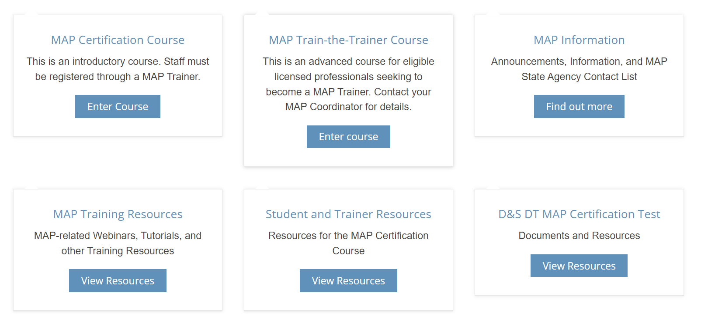
Ordering a Resource Packet and Testing Material
Notes:
…log into www.mapmass.com. From the home page, select the MAP Trainer Resources tab…

Slide 31
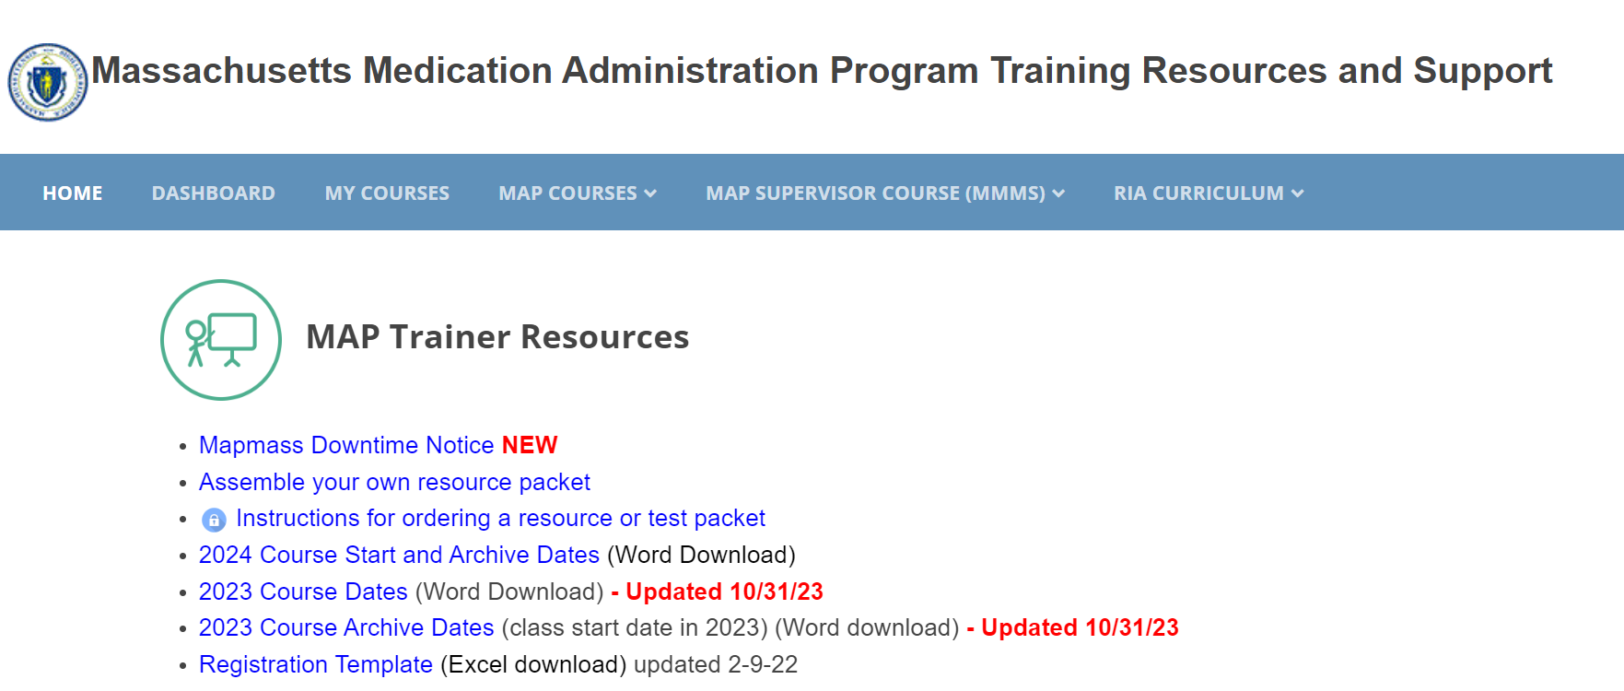
Ordering a Resource Packets and Testing Material
Notes:
…scroll down and select ‘Instructions for ordering a resource or test packet’, then follow the instructions.

Slide 32
Online Training Reminders
Required Training Format
Roster
Student Log in
Notes:
Online training reminders are covered on the next slides.

Slide 33


Blended Certification Training
Online, Self-Paced, 24/7 Access
In-Person Skills Session(s)
Notes:
The required training format to present the online MAP Certification course is a blended training. The blended training format consists of the 9 units and quizzes completed in the online course and a ‘face-to-face’ (either virtual or in-person) session or sessions with the MAP Trainer to present or review content and practice the transcription and medication administration skills.

Slide 34
Blended Certification Training
Roster to CDDER
Individual Student Login
Completion of Online Course
Self-Paced
In Classroom Setting with Trainer
Skills Training Face-to-Face
In Person
Virtually
Notes:
Trainers must submit a roster to CDDER, one week prior to the scheduled course start date, when conducting a MAP course. Each student must log in to the online course with their individual username and password and complete each unit to get credit. Students can work on the online portion of the course at their own pace or in class with the Trainer or a combination of both. The skills portions can be completed either in person or virtually, depending on Trainer preference. The face-to-face sessions will help support the students, especially those who have ESL or those who initially require hands-on technical support.

Slide 35
D&S Testing Reminders
New TestMaster Universe Access
Importance of Ensuring Candidate Name Matches
Candidate Handbook
Medication Administration Skill Testing Materials
Notes:
D&S Testing reminders are covered on the next few slides.

Slide 36
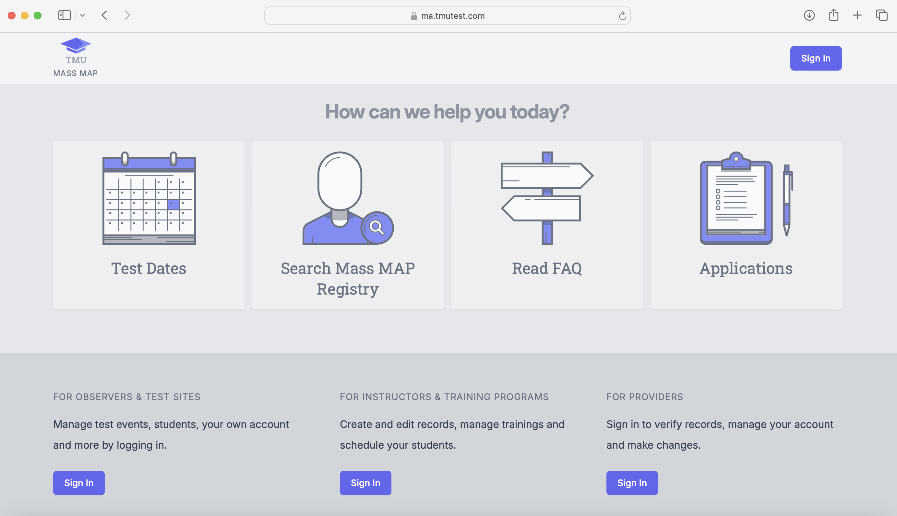
TestMaster Universe www.ma.tmutest.com
D&S Diversified Technology
Notes:
Please note there is a new link to access TestMaster Universe.

Slide 37
Name Discrepancy = ‘No Show’ Fee
Test Candidate Name Must Match!
Name Entered in TMU Record
Government Issued ID
Notes:
Test candidates are being turned away because there are discrepancies between the name entered in their TMU Record and the name on their government issued ID. If the name does not match, the candidate will be marked as 'no-show' for test event and incur a $45 no-show fee payable before they can reschedule another test attempt.​ Please remember, it is the Trainer’s responsibility to ensure staff are verifying that the name in their TMU record matches the government issued ID they will use for testing. The first and last name, including any suffix, on their ID must match their TMU record. Trainers can do this with their staff during the in-person training component or instruct staff to do this independently. The candidate or trainer can edit the name in TMU up until the employer verifies their employment. These details are in the Candidate Handbook. Trainers may need to 'assist' some students with this to ensure they are not turned away!
​

Slide 38
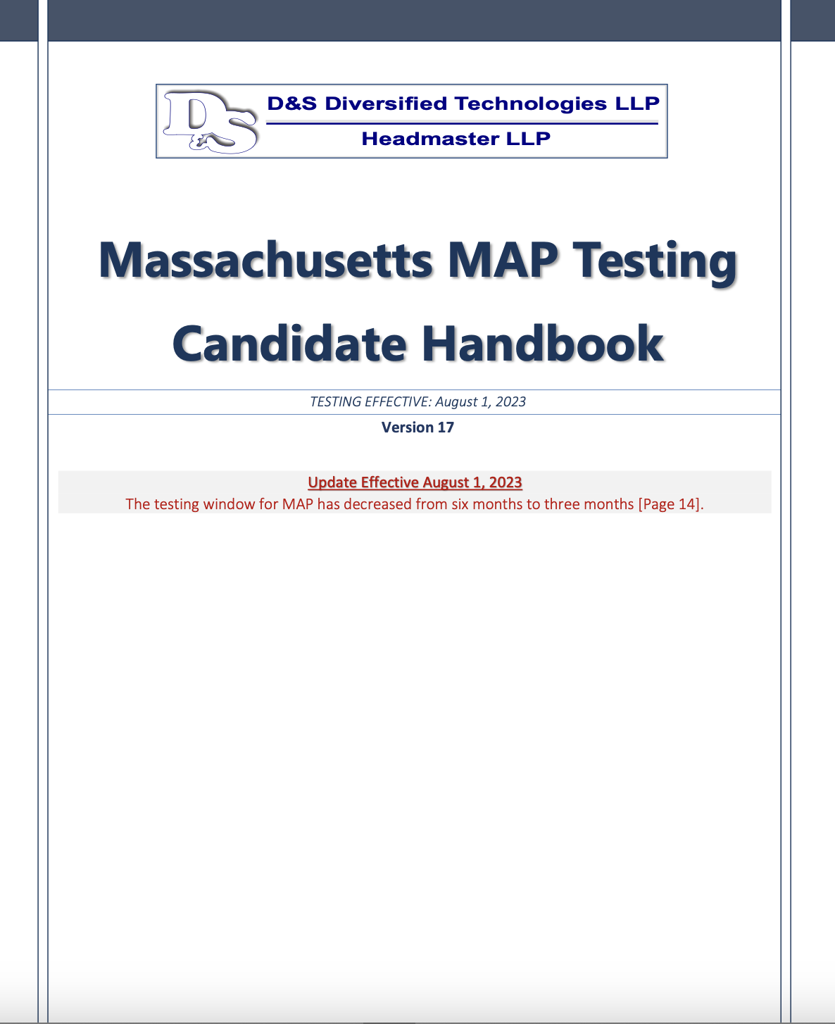
MAP Candidate Handbook (hdmaster.com)
Month xx, xxxx
xx
Candidate Responsibility
  Review Handbook
    Prior to Testing
Month xx, xxxx
Notes:
Candidates are responsible to review the D&S Candidate Handbook prior to testing. The Handbook contains information on testing attempts, pricing, no show policies along with all other pertinent information related to testing. You can find the handbook at the link listed on your screen. The handbook will be updated to align with the new medication administration process.

Slide 39

D&S Testing Materials
Prohibited
  Highlighting
  Marking
  Used for Practice!
Notes:
As a reminder, all testing materials must remain free of any highlighting, or additional markings, etc. The testing materials should be kept confidential. Candidates are not to use any of the testing materials for practice prior to their scheduled test event.

Slide 40
Maintaining MAP Trainer Status
View Required Webinars
  In Specified Timeframe
Conduct One Online MAP Certification Course
  Annually
Notes:
We would like to remind new trainers that your clock starts when your status is changed to 'trainer’ on mapmass.com. This means that you must view required webinars within the specified timeframe and conduct a minimum of one online MAP Certification Course within one year from the day you become a MAP Trainer. This applies to all MAP Trainers.

Slide 41

MAP Trainer Contact Information
Notify CDDER
Email Changes
CDDER@umassmed.edu
Notes:
Since the Required Webinars and email notifications are the primary means of communication to the trainers, it is very important to ensure that you’ve reported changes in your email address to CDDER. CDDER sends out regular email blasts to all trainers to give updates and new information related to MAP. CDDER uses your contact email to announce when required webinars are posted for viewing.

Slide 42

Required Webinar Viewing Improvements
Required Webinars in own Moodle Course
  ‘Required MAP Trainer Webinars’
All MAP Trainers are Enrolled in Course
Notes:
The mapmass website has recently been enhanced to streamline how to access 'Required MAP Trainer Webinars'. They are contained in their own Moodle Course and can be found after you log in and access 'My Courses' on the homepage. After that, scroll down and select 'Required MAP Trainer Webinars’. All MAP Trainers are enrolled in that course and have access.

Slide 43
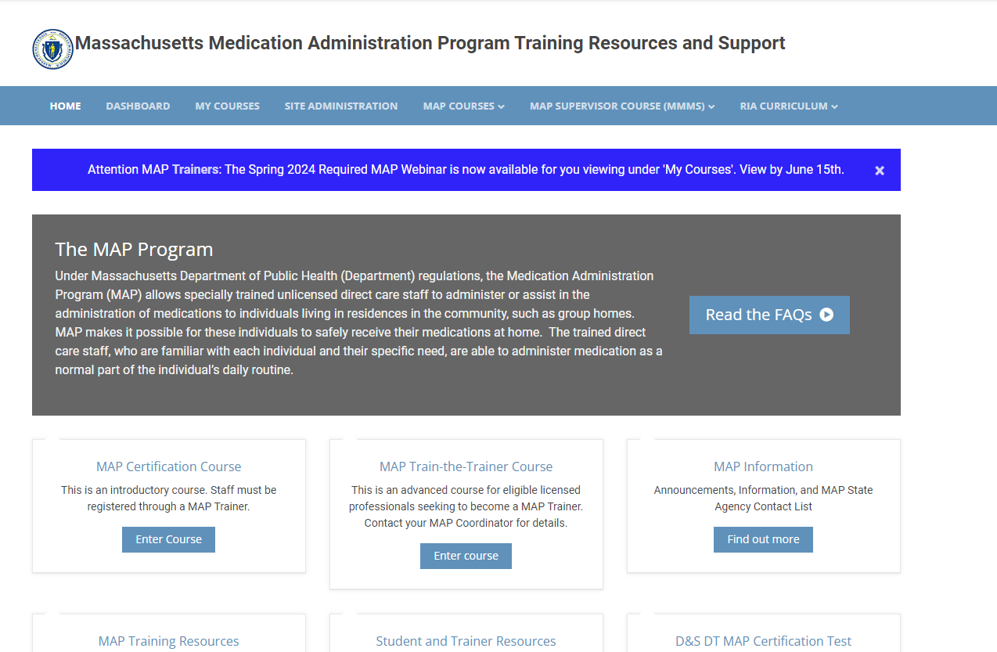
www.mapmass.com
xx-xx-xx
Notes:
In addition to the email announcement from CDDER notifying trainers of a new Required MAP Trainer Webinar to view, there will be an additional blue banner on the mapmass homepage alerting trainers. The banner will include the 'viewing period' for trainers to receive credit for watching. Trainers will be required to log in to access the webinar.

Slide 44
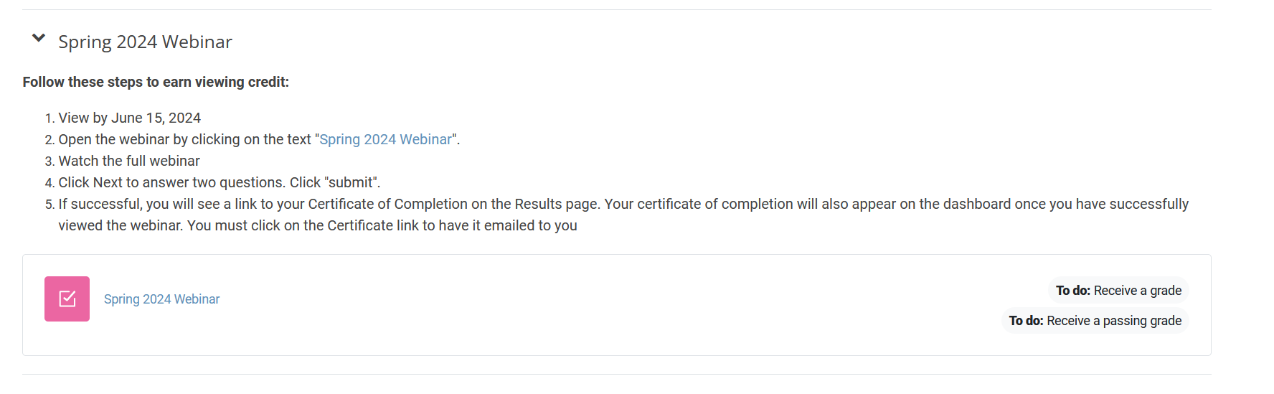
Dashboard Changes
Clear Instructions on Dashboard
Clear indication that you’ve completed it or not
  If not completed, you will see a ‘To do’ on the dashboard
View by xx-xx-xx
Notes:
On your dashboard, there are now steps to follow to ensure you receive viewing credit.

Slide 45
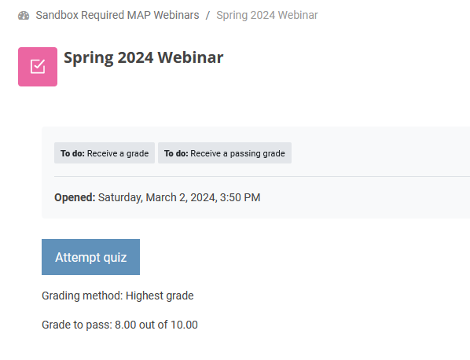

Click on Webinar Name Attempt Quiz
Saturday, Month xx, 2024, 3:50pm
Notes:
Follow the prompts you will see on your dashboard.

Slide 46
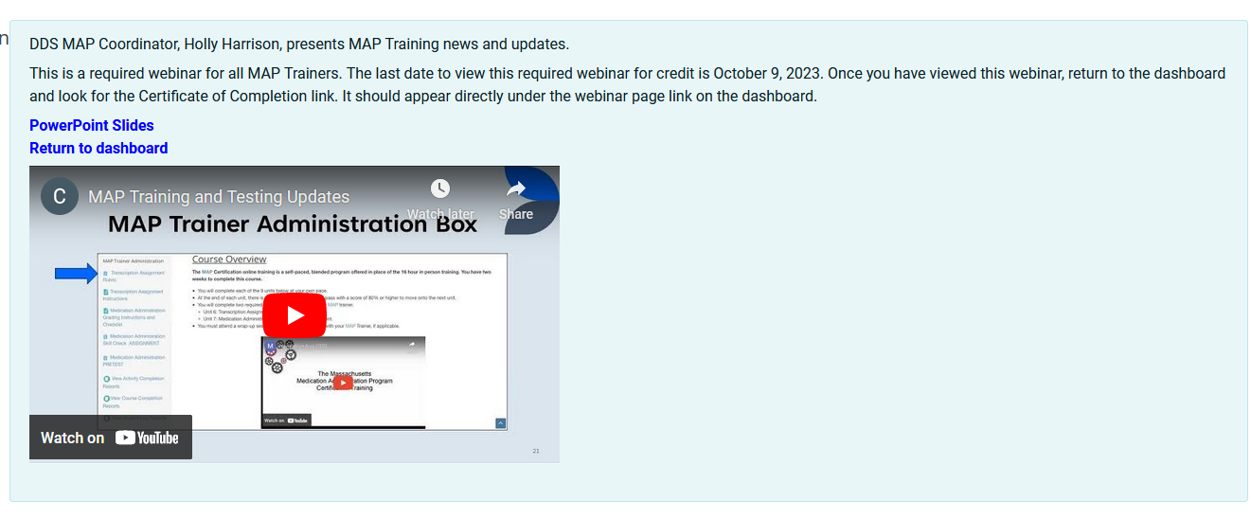
View Webinar
Month xx, xxxx
" Spring 2024 Webinar"
Notes:
After viewing the webinar, you will answer 2 Questions.

Slide 47
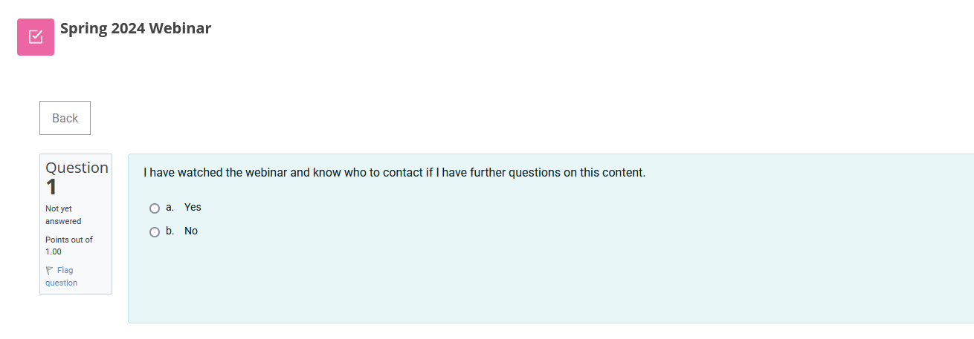
Answer Question 1
Notes:
Question 1 asks if you watched the webinar and know who to contact if you have further questions on the content presented.

Slide 48
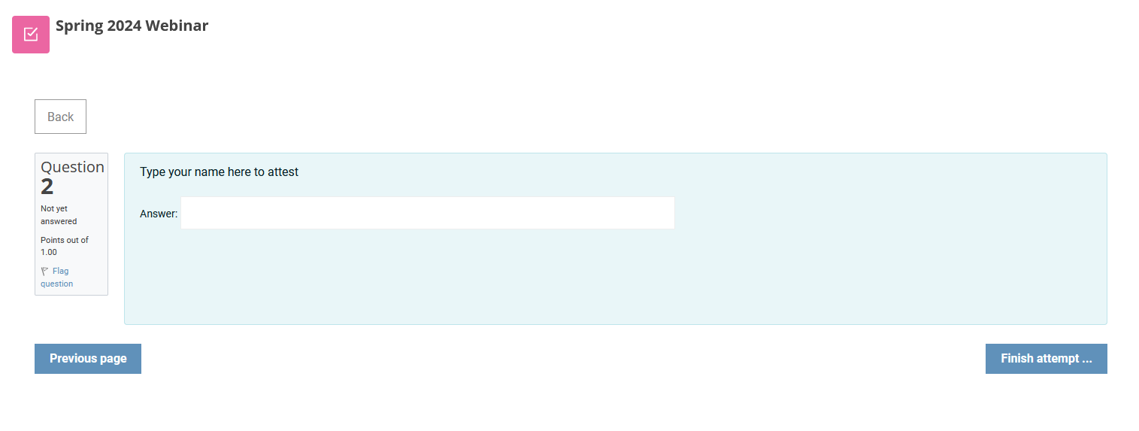
Answer Question 2 and Click Finish Attempt
Notes:
Question 2 asks that you type your name to attest.

Slide 49
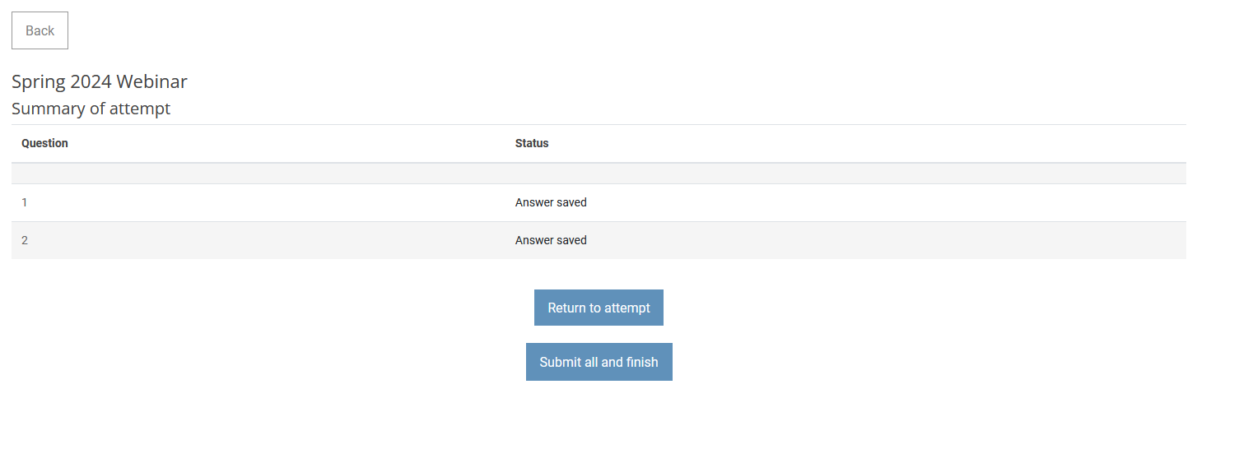
Submit All and Finish
Notes:
You will submit your answers.

Slide 50
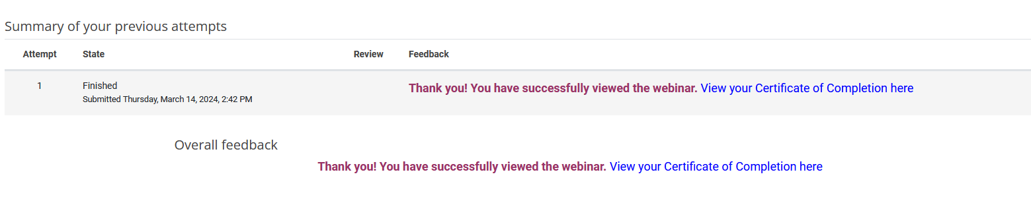
Confirmation Screen
Notes:
You will then see a confirmation screen with a link to click to view your Certificate of Completion.

Slide 51
Skipping a Question
Notes:
If either question is skipped, you will not receive credit. A ‘No’ on question 1 will also fail the quiz. You’ll see the message on the slide.

Slide 52
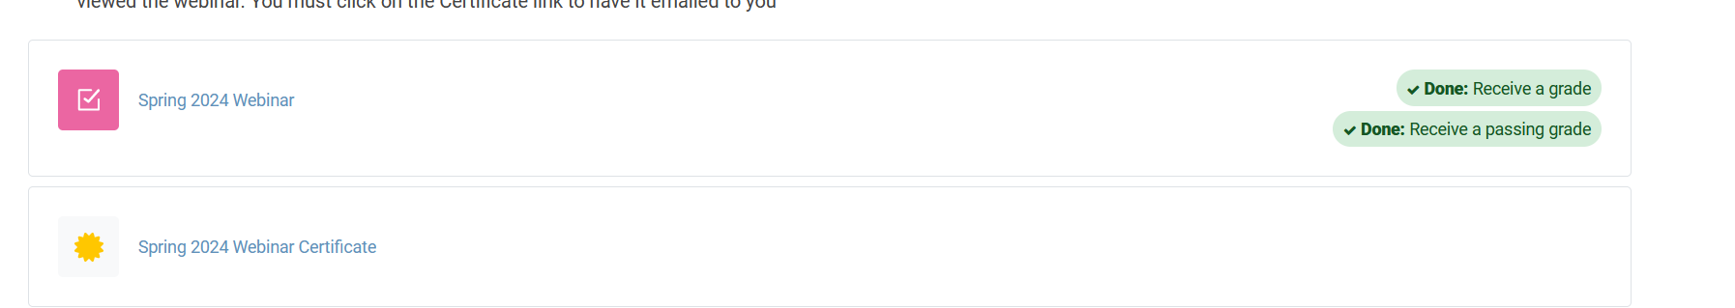
Back on the Dashboard…
Notes:
On your dashboard you see ‘Done’ and your Certificate of Completion. You must click and open the certificate of completion of the webinar for it to be emailed to you. These will remain on your dashboard after the viewing period has ended.

Slide 53
Archived Webinars
Removed from Required MAP Trainer Webinars Course
  After Viewing Period Ends
Posted on www.mapmass.com
  MAP Training Resources Section
  Not 'Locked'
    Anyone can Access
Notes:
Archived webinars were removed from the Required MAP Trainer Webinars course to reduce confusion. After the specified time frame has passed to receive ‘credit’, the Required MAP Trainer Webinar will be relocated to the 'MAP Training Resources’ section of the home page, where it will be unlocked and accessible to all. If a trainer were to look for a webinar under Required MAP Trainers Webinar, the last required webinar will be listed but have language that it can no longer be viewed for credit. To access the webinar, it will need to be viewed by going to the MAP Training Resources section. If a webinar is watched after the time frame, a Trainer will not get credit for it.

Slide 54
MAP Certification Course & Co-Training
Each Trainer Must
  Be listed on the Student Roster submitted to CDDER
  Create Separate Student Record(s) in TMU
Notes:
If you choose to co-train a MAP Certification class, each trainer must include their names on the roster submitted to CDDER. Each Co-Trainer should also assign students to themselves separately in TMU. If the Co-Trainer does not have any students listed as training in TMU, they will not receive credit for conducting the Certification Training.

Slide 55

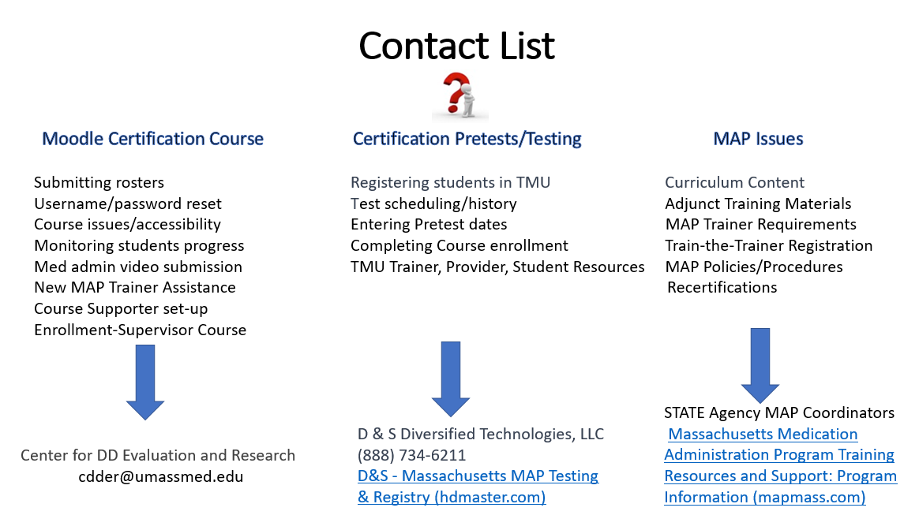
Who Do I Contact?
Notes:
To streamline questions that are often asked by trainers and/or providers, the chart on your screen was created to help guide you. For example, If you have questions regarding the online Certification Course, such as submitting a roster, monitoring students' progress, or issues with a username and/or password, you will contact CDDER, emailing them using the address on your screen. If your questions are relative to the Certification Test Process, including the essential information needed to create and complete a student TMU record, how to schedule candidates for a test, complete employment verification, run Trainer reports, etc., you will contact D&S. If you have MAP questions, for example, how to register nurses for Train the Trainer, MAP Trainer requirements, questions relative to MAP Policy and Procedure, where to locate MAP resources, etc., you can reach out to your State Agency Regional or Area MAP Coordinator.

Slide 56
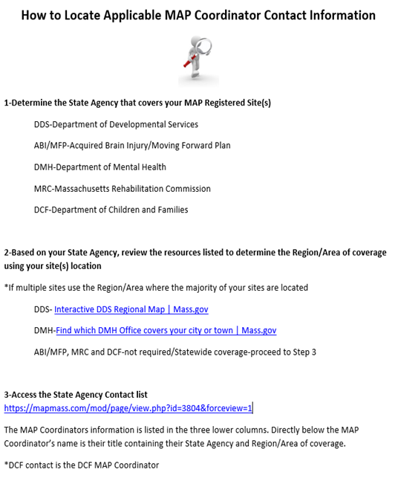
MAP Coordinator Contact Information
Notes:
It is also important to know who your MAP Coordinator is and how to contact them when you have questions. To determine the applicable MAP Coordinator contact information, first determine the State Agency that oversees the MAP registered site. Second, if either DDS or DMH, you can use the agency-specific online interactive state map to determine the region or area of coverage. If it is MRC, DCF or ABI, those MAP Coordinators cover statewide. Then, using the State Agency Contact List, you will be able to locate the applicable MAP Coordinator's contact information. The document on your screen contains direct links to the applicable DDS and DMH interactive state maps and State Agency Contact List.

Slide 57
Webinar Completion Confirmation
Look for Green Check Mark
Printout Certificate of Completion
Notes:
After viewing this webinar, please make sure that you see a green check mark next to the webinar on your screen. This confirms that you have received credit for viewing. It is advised to print a copy of the webinar completion certificate, or you can save the electronic copy that will be sent to your email. To do this, you must click and open the “Spring 2024 Webinar Certificate of Completion” link.

Slide 58

Next MAP Trainer Webinar Coming Soon!!!
Notes:
This concludes the Spring 2024 MAP Trainer Webinar. Please contact your State, Regional or Area MAP Coordinator if you have any questions or need further clarification on a topic presented. Thank you for viewing!

