Slide 1

Required MAP Trainer Webinar
#2 of 2024
RIA
Revision Overview
May 2024
Notes:
Welcome to the second Required MAP Trainer Webinar for 2024. I’m Holly Harrison, a Department of Developmental Services MAP Coordinator, and I’m your webinar presenter. By viewing webinars marked as required within the specified time period, you’ll meet the MAP Trainer meeting attendance requirement. After the webinar, you’re encouraged to contact your MAP Coordinator if you have any questions or need further clarification on a topic presented.
The topic of this webinar is “Responsibilities in Action Revision Overview.” Revisions were made to the RIA Curriculum based on feedback from MAP Trainers, Providers, the Departments of Public Health, Developmental Services, Mental Health, Children and Families, and the Massachusetts Rehabilitation Commission as well as MAP Policy Manual updates. The RIA online Certification course was also updated to align with the revised curriculum.

Slide 2
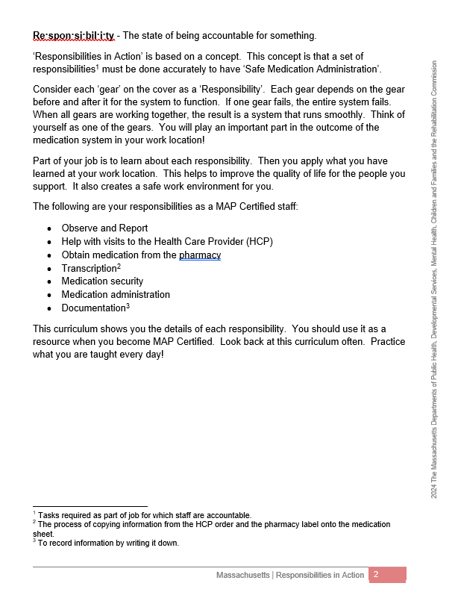
General Revisions
8th Grade Reading Level
Word Choice
Sentence Structure
Words Above 8th Grade Level
Glossary of Terms
Definitions
Footnotes
Appendix
Improve Understanding of Text
Notes:
General revisions to the RIA Curriculum include the following: Word choice has been simplified to bring the text to an 8th grade reading level. Sentence structure has also been simplified to improve comprehension.
Another change you will see throughout the text is the addition of footnotes for words above an 8th grade reading level. These words do not need to be memorized. Rather, the definitions are included to aid students’ understanding of the text. All of the footnoted words are compiled in a Glossary of Terms in the Appendix. This glossary is distinct from the Words You Should Know list, which includes the vocabulary words students must know for training and testing. Also, to further improve understanding of the text, some terms are directly followed by definitions in parentheses.

Slide 3
RIA Online Course
Curriculum Edits Incorporated
Updated Unit Activities and Images
Modified Medication Administration Demonstration Video
Notes:
Updates were made to the RIA online course to align with changes to the RIA Curriculum. Improvements to the RIA online course also include updated unit activities and images. Knowledge Checks were modified to improve comprehension. “Something to Think About” exercises were redesigned as “Stop and Think” exercises for clarity and ease of use. The modified Medication Administration Demonstration video has been incorporated into the course as well.

Slide 4
Introduction
Notes:
In the following slides, we will review both general and specific revisions to the RIA Curriculum, along with some notable changes to the RIA online course. Let’s begin with the Introduction.

Slide 5
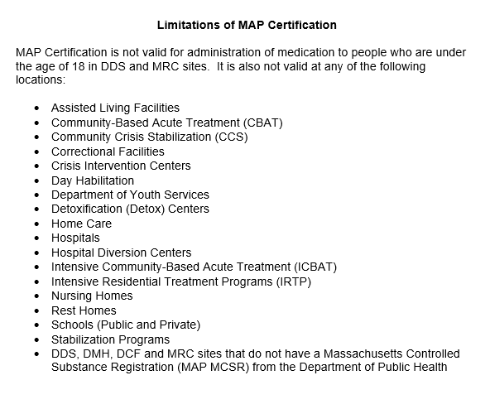
Limitations of MAP Certification
Notes:
The list of places where MAP Certification is not valid for the administration of medication has been updated.

Slide 6
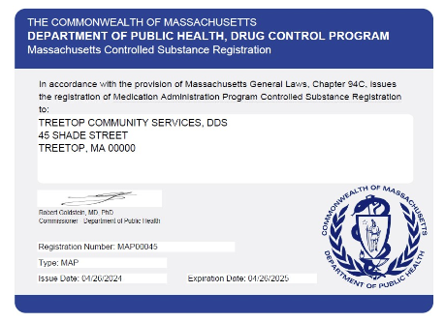
Massachusetts Controlled Substance Registration
Notes:
The curriculum also reflects that MCSR numbers may now begin with “COM” as well as “MAP.”

Slide 7






Case Studies
Notes:
In the RIA online course, the Introduction now has new character images included in the case studies section.

Slide 8
Unit 1
Working at a MAP Registered Site
Notes:
The title of Unit 1 has been changed using the word ‘site’ in place of ‘program’. Likewise, throughout the curriculum, ‘site’ has replaced ‘program,’ except when referring to ‘day program.’

Slide 9
Unit 2
Observing and Reporting
Notes:
In Unit 2…

Slide 10

Definition of Signature
Full First Name
Full Last Name
Written Legibly
Notes:
…the definition of a signature in MAP has been defined as your full first name and your full last name written legibly.

Slide 11
Unit 3
Medications
Notes:
In Unit 3…

Slide 12


OTC Medications and Dietary Supplements
Labeling Options
  With a Pharmacy Label
  Without a Pharmacy Label
Notes:
…both labeling options for OTC medications and Dietary Supplements are explained in detail. There is a policy reference explaining that the Service Provider designee may be a Licensed Nurse, Registered Pharmacist, Health Care Provider, or if need be, a MAP Certified Supervisor.

Slide 13
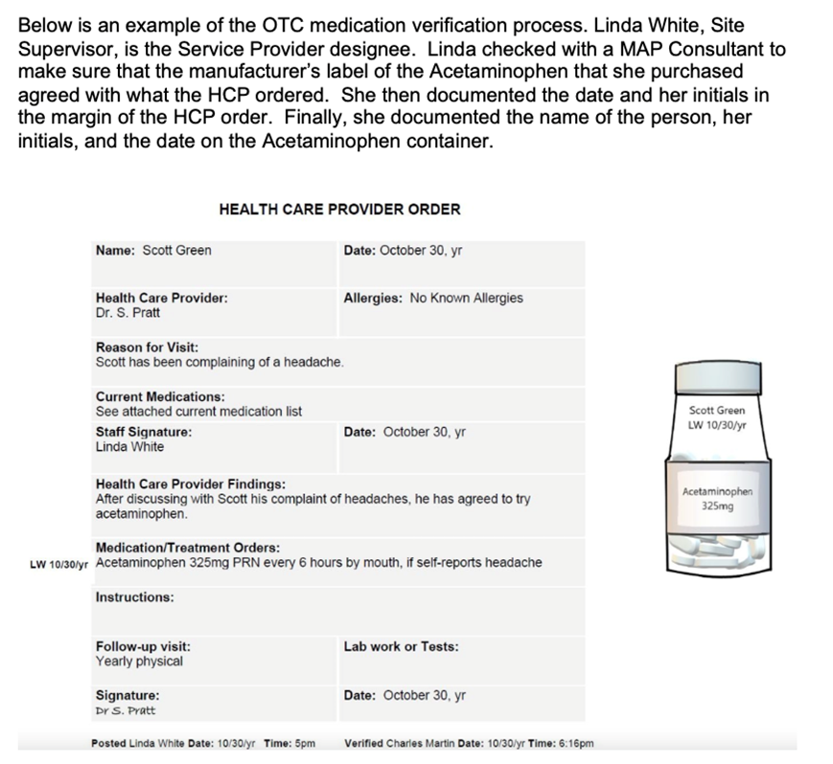
OTC Medications and Dietary Supplements Verification Process
Notes:
There is now a visual example of a completed verification process for an OTC medication without a pharmacy label by a Site Supervisor. A new True/False exercise replaced the existing manufacturer’s label exercise.

Slide 14

Multi-Dose Medication Packaging
Notes:
The option of multi-dose medication packaging is presented in the form of a policy icon and an Ask Your Supervisor question.

Slide 15
Unit 4
Interacting with a Health Care Provider
Notes:
In Unit 4…

Slide 16

Methods for Receiving HCP Orders
Electronic Systems
  Email
  Patient Portal Systems
Telehealth
Notes:
…methods for receiving HCP orders with corresponding HCP signatures have been expanded. Electronic systems for receiving signed orders now include via emails or patient portal systems. In addition, telehealth was added as an option for obtaining HCP orders and the sample form was updated to a Telehealth/Telephone HCP Order Form.

Slide 17
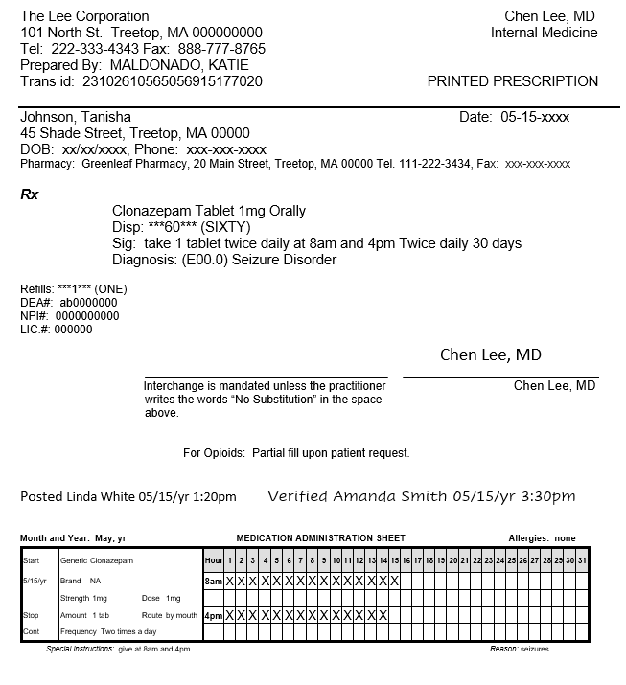
Prescription as HCP Order
Example in Appendix
Notes:
A policy reference has been added to reflect that a copy of the prescription for an HCP ordered medication may be used as an HCP order. There is no expectation that Trainers incorporate how to transcribe a prescription into the skills practice. However, as it is now allowed by MAP Policy, an example of a completed transcription using a copy of a prescription for the HCP order has been added to the Appendix.

Slide 18
Transcription of Medication Management System Training
Transcribe Orders
Post and Verify
Monthly Accuracy Checks
Notes:
There is also a policy reference regarding the requirement that only Certified staff, including relief staff, who have successfully completed the Service Provider’s Transcription of Medication Management System Training may transcribe HCP orders, post and/or verify HCP orders and complete monthly accuracy checks of HCP orders. This is mentioned again in Unit 6.

Slide 19

ER, Urgent Care and Hospital Visits
Notes:
Also in Unit 4, in the section addressing visits to the Emergency Room or hospital, Urgent Care has been added as an additional option. Staff responsibilities if medications are missed during an ER, Urgent Care, or hospital visit were expanded.

Slide 20

Medication Reconciliation
Notes:
Medication reconciliation information now reflects that HCP orders prior to a hospital admission will remain valid unless they are superseded by hospital discharge orders. The Medication Reconciliation/Discharge checklist has been updated to reflect the revised form dated 6/28/2023.

Slide 21
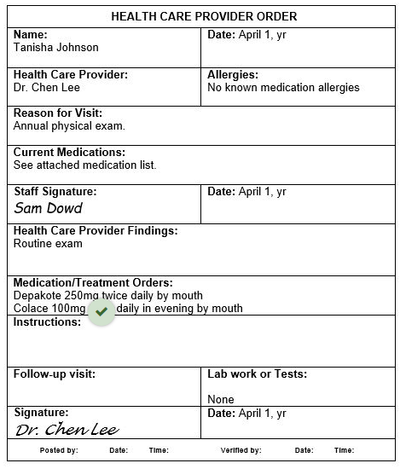
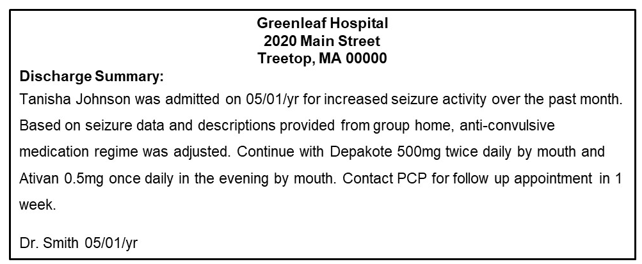
Medication Reconciliation
Perform a medication reconciliation by comparing the hospital discharge HCP orders to the HCP orders in the residential program prior to admission. Use your mouse to click on the discrepancies in either picture. A green check mark means you found one!
Correct! The Colace HCP Order that was in place at the residential site prior to the admission is continued. 1 of 4 Medication Order Differences.
Notes:
To emphasize the importance of Medication Reconciliation, in addition to the updates in the curriculum, the RIA online course now contains a “hotspot” exercise on medication reconciliation.

Slide 22

Exhausting a Current Supply of Medication
  Pharmacy Consultation
    Documented
  Must be Disposed When
    Current Supply Cannot be Exhausted
    New Supply is Received from Pharmacy
Notes:
Finally in Unit 4, Exhausting a Current Supply of Medication has been updated to include the requirement of documenting the discussion with the pharmacist that the current supply of medication can be used for the new HCP order. Additionally, a current supply of medication must be disposed when it cannot be exhausted and/or the new supply of medication ordered by the HCP is received from the pharmacy.

Slide 23
Unit 5
Obtaining, Storing and Securing Medication
Notes:
In Unit 5…

Slide 24

Ordering and Receiving Medications
  Comparison of the 5 Rights
    HCP order Pharmacy label
    Medication sheet
Notes:
…there were significant changes made to emphasize the critical medication-related task of ordering and receiving medications. The process involves the comparison of the 5 Rights between the HCP order, the pharmacy label, and the medication sheet. Key information from Unit 7 was moved to Unit 5 to underscore this critical task.

Slide 25
Unit 6
Recording Information
Notes:
In Unit 6…

Slide 26

Critical Medication Related Task
Monthly Accuracy Checks
Incorrect Information
Transcription Marked Through
Rewritten
Notes:
…the second critical medication-related task is the HCP order accuracy checks of the 5 rights between the HCP order, pharmacy label and medication sheet. During the accuracy check, if staff see incorrect information copied from the HCP order or the pharmacy label onto the medication sheet, the entire transcription must be marked through as an error and rewritten.

Slide 27
Medication Sheet Information Updates
Medication Progress Notes
Abbreviation mEq
Acceptable Codes on Medication Sheet Exercise
Notes:
Components of the Medication Record now include the Medication Progress Notes as part of the Medication Sheet. The abbreviation for milliequivalent (mEq) was added to the list of acceptable abbreviations. Also in Unit 6, an exercise about Acceptable Codes on a Medication Sheet was moved from Unit 8 to follow the list of Acceptable Codes information in this unit.

Slide 28
Unit 7
Administering Medication
Notes:
In Unit 7…

Slide 29

Regularly Scheduled or PRN Medications
Data Collection
  Electronically Tied
Notes:
…the call out symbol regarding data collection for medication administration now includes the option of the data being electronically tied to the medication.

Slide 30
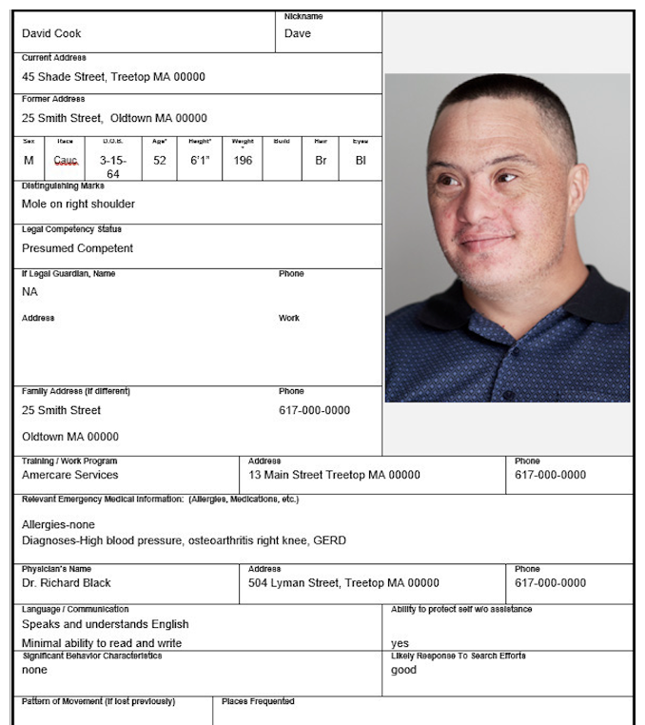
New Look
Notes:
In the 5 Rights section, the Emergency Fact Sheet for David Cook has an updated picture.

Slide 31

Safe Medication Administration
Critical Medication-Related Tasks
  New Exercise
Notes:
As previously noted, information regarding critical medication-related tasks and comparison of the 5 rights was moved to Unit 5. A new section titled Safe Medication Administration has been added to Unit 7. This new section outlines these critical medication-related tasks that are done prior to the medication administration process. A new exercise in this section emphasizes these tasks and their role in assuring that the 5 rights of medication administration on the HCP order agree with the pharmacy label and the medication sheet.

Slide 32

Safe Medication Administration
Confirm HCP Order
Check 2 – Compare 5 Rights Between Pharmacy Label and Med Sheet
Check 1 – Compare 5 Rights Between Pharmacy Label and Med Sheet
Notes:
Many of the updates within Unit 7 relate to the modified medication administration process. The video you are about to watch demonstrates the modified process in detail, including the confirmation of the HCP order followed by the 2 Checks of the 5 rights. This video will replace the current Med Pass Demonstration video located within the RIA online course, the Training Resources located on mapmass.com, and the D&S website. (Video)

Slide 33
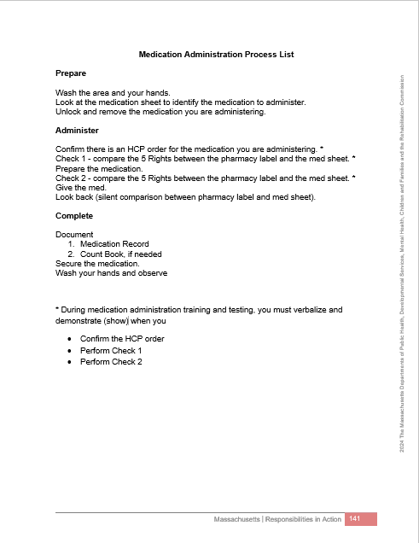
Modified Medication Administration Process List
Notes:
All Unit 7 content and exercises have been updated to reflect the modified medication administration process. The Medication Administration Process List was revised to identify that during medication administration training and testing, students must verbalize and demonstrate when confirming the HCP order, and when performing Checks 1 and 2.

Slide 34
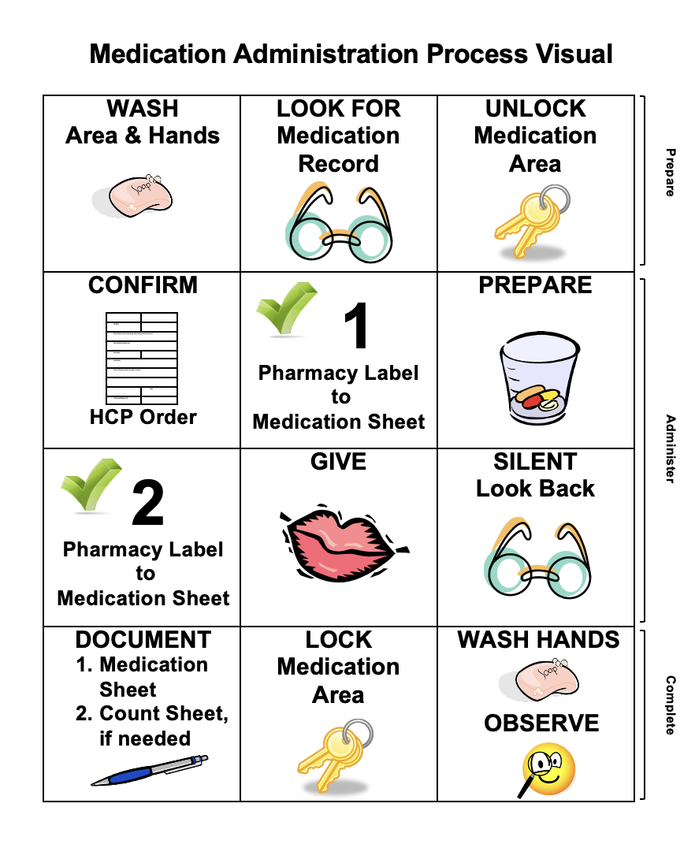
Modified Medication Administration Process Visual
Notes:
The Medication Administration Process Visual has been updated as well.

Slide 35
Unit 8
Chain of Custody
Notes:
In Unit 8…

Slide 36
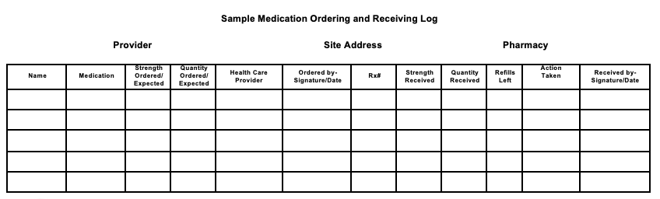
Sample Ordering and Receiving Log
Notes:
… the Sample Medication Ordering and Receiving Log has been revised. The columns for “strength ordered” and “quantity ordered” now include the term “expected” as well, for sites that have automatic cycle delivery of medications. A new column was also added for documenting “Action Taken.”

Slide 37
Medication Security
Medication Storage Key Responsibility
Security of the Medication Storage Area and Medication Administration Responsibilities
Notes:
A new call out symbol was added to clarify that if there are no countable medications, or ‘high-risk Schedule VI’ medications stored at a MAP registered site, there must be a documentation procedure to identify the Certified or licensed staff responsible for control of the Medication Storage Key. There is a new section titled Security of the Medication Storage Area and Medication Administration Responsibilities. This section reflects MAP Policy requirements for maintaining the security of the medication storage area. Guidance from MAP Policy for specific scenarios is included.

Slide 38

Biometrics Medication Security System
Notes:
Also in Unit 8, a new Ask your Supervisor question identifies the option of using a Biometrics medication security system.

Slide 39
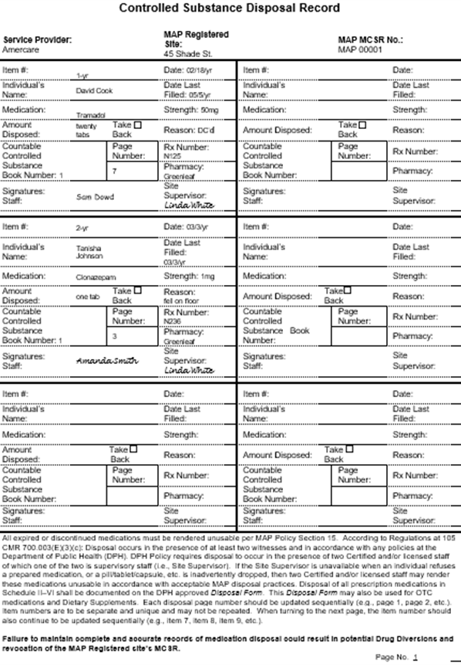
Medication Disposal
Disposal Process
  Do Not Crush per FDA Guidelines
Disposal Record
  Updated
Notes:
Disposal information was revised in accordance with FDA guidelines, and the Controlled Substance Disposal Record was updated to the most current version.

Slide 40

Drug Incident Reporting
Online
Documentation Inconsistencies
  Two Staff, Neither the Site Supervisor
Notes:
All references to a Drug Incident Report reflect that the process is now completed online, and the form was removed. The list of possible documentation inconsistencies requiring submission of a Drug Incident Report now includes a disposal record for expired or discontinued medication that contains two signatures but neither of them is that of the Site Supervisor.

Slide 41
Unit 9
Medication Occurrences
Notes:
In Unit 9…

Slide 42

MOR Reporting
Notification of DPH via Online Reporting System for Hotline MORs
Notes:
…the Procedure Following a Medication Occurrence was updated to reflect changes in the process of submitting a Medication Occurrence Report. This section now includes the notification of DPH via the online reporting system for hotline MORs.

Slide 43
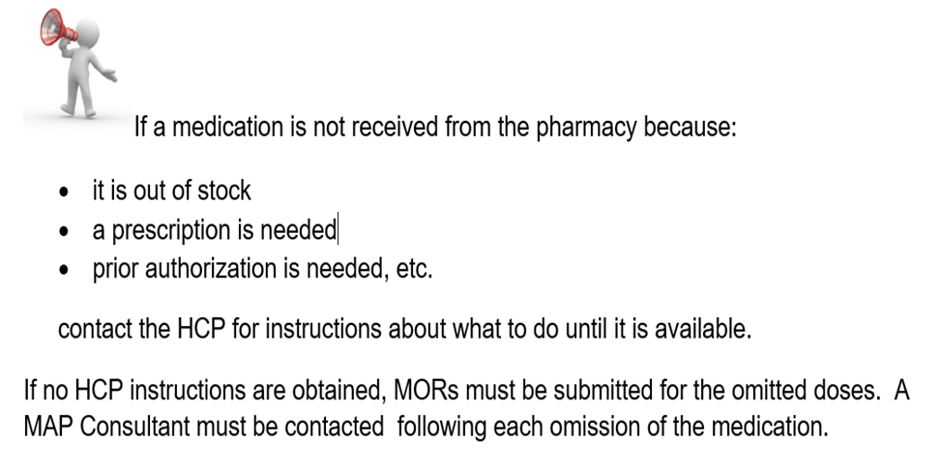
Medication Not Available
Notes:
A new call out symbol was added detailing the process to follow if a medication is not available from the pharmacy.

Slide 44
Appendix
Notes:
In the Appendix…

Slide 45
New Additions
Transfer of Count Sheet Page
Transcription Examples
PRN HCP Medication Orders
Notes:
…there are several new additions. These include the process for documenting the transfer of a count sheet page when there is only one MAP Certified staff present. New examples of transcriptions for inhaler and nebulizer medication have been added, as well as an example of a transcription of an HCP order using a copy of a prescription. There is also detailed guidance regarding PRN Health Care Provider Medication Orders.

Slide 46
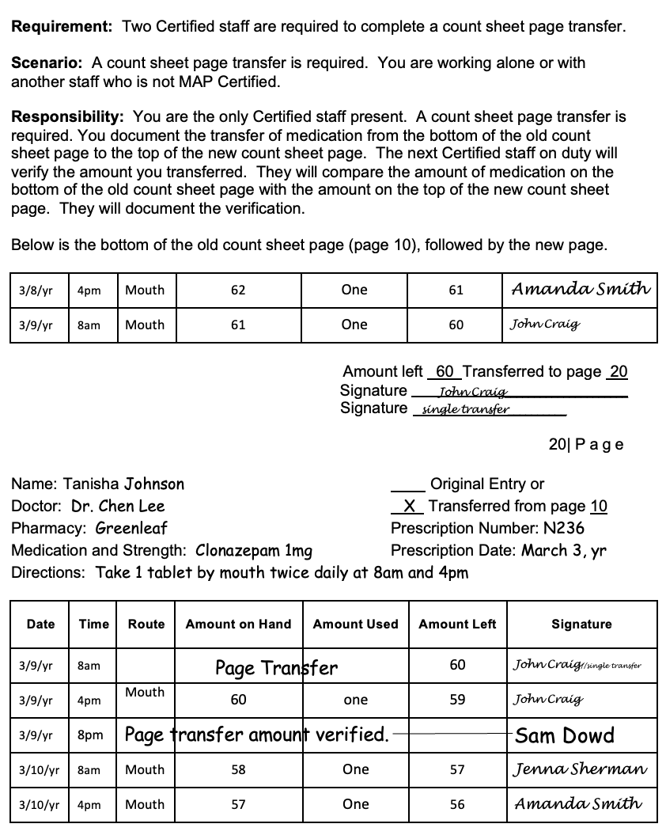
Count Sheet Page Transfer
Notes:
Here is the new example that illustrates how a count sheet page transfer is documented when there is only one MAP Certified staff present. Once a second MAP Certified staff is available, verification of the count sheet page transfer is completed.

Slide 47
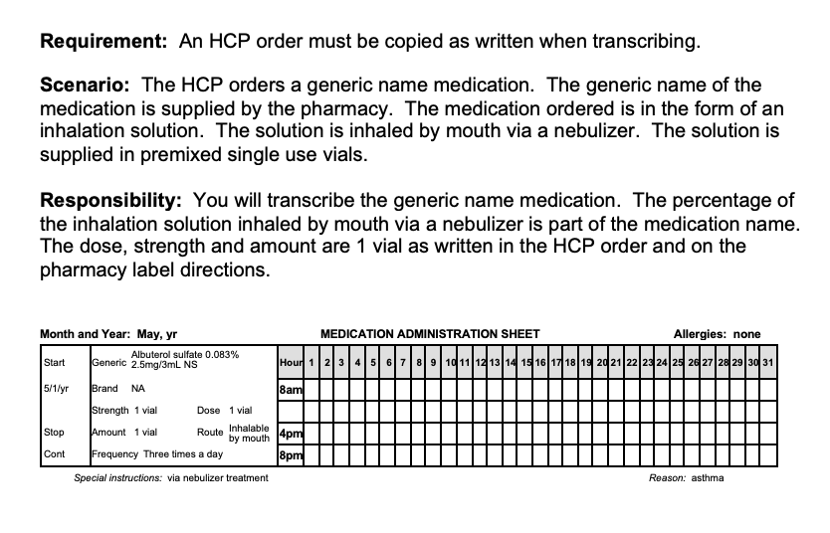
Nebulizer Transcription Example
Notes:
In addition to the nebulizer transcription example shown on the screen, there is also an inhaler transcription example, and as mentioned earlier, an example of a transcription using a prescription as an HCP order.

Slide 48
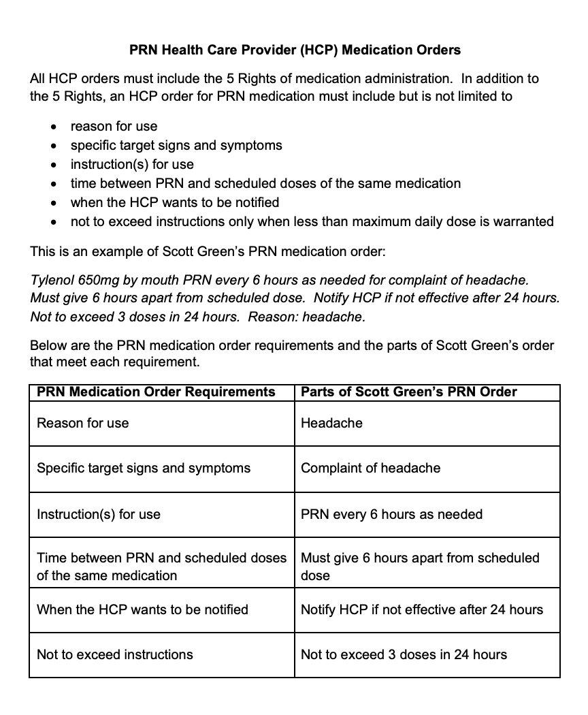
PRN HCP Medication Orders
Notes:
The detailed guidance for PRN HCP Medication order requirements contains an example of a PRN medication order, and a chart to clarify which components of the order fulfill the requirements.

Slide 49
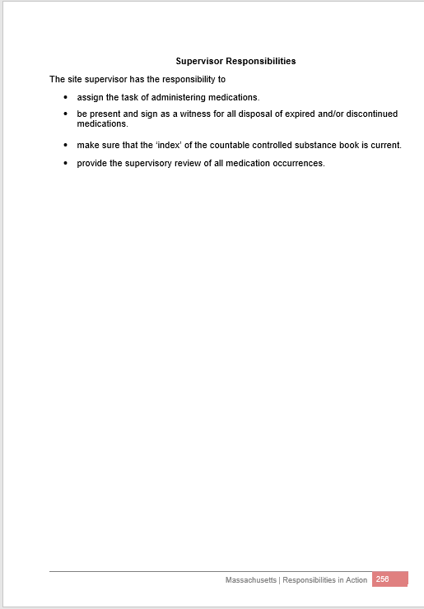
New!
  Supervisor Responsibilities
Notes:
Other additions to the Appendix are the Supervisor Responsibilities list…

Slide 50
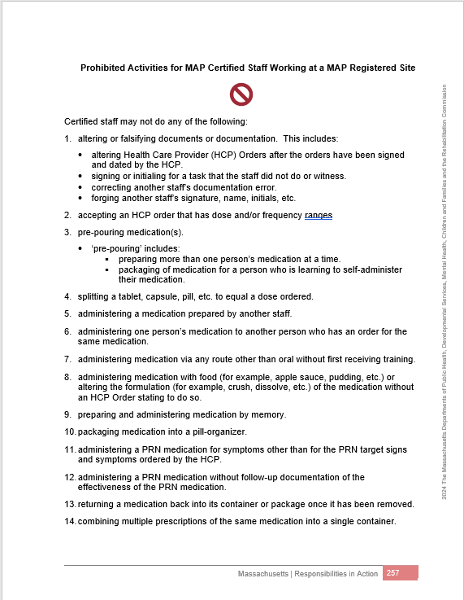
New!
  Prohibited Activities
Notes:
…a Prohibited Activities list…

Slide 51
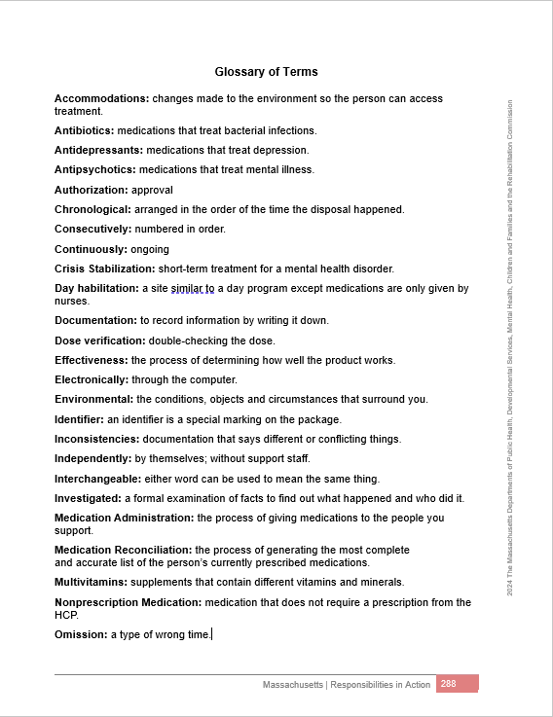
New!
  Glossary of Terms
Notes:
…and the Glossary of Terms, a list of the footnoted words throughout the text. As mentioned previously, this glossary is distinct from the Words You Should Know list, which includes the vocabulary words students must know for training and testing.

Slide 52
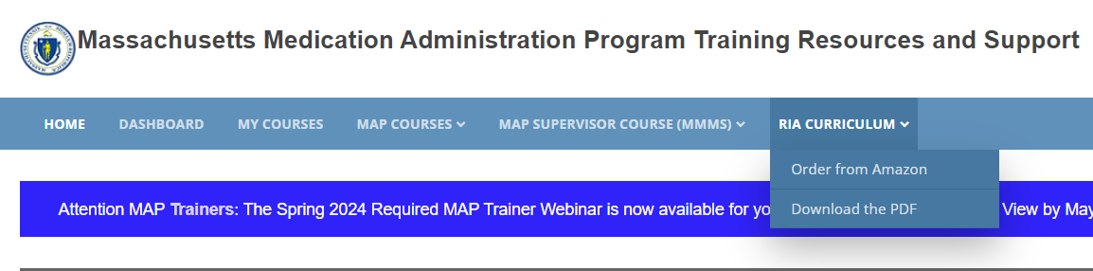
Accessing the Updated Curriculum
Notes:
All of these additions and changes are incorporated into the updated curriculum, which is available as of May 2024. On mapmass.com, click RIA Curriculum. A dropdown menu will give you the option of downloading the PDF to print or purchasing a hard copy from Amazon. All costs charged by Amazon are for printing and shipping only. No money is collected by the Commonwealth of Massachusetts for any purchases. A downloadable PDF version will also be available at hdmaster.com. For training purposes, the expectation is that Trainers will use the 2024 RIA Curriculum beginning June 6, 2024. Because the RIA Curriculum is available electronically, Service Providers who maintain hard copies for staff reference at DPH MAP Registered sites should transition to the revised version by January 1, 2025.

Slide 53
Implementation Timeline
May 2024
Revised Curriculum Available
Revised RIA Course Opens to Trainers
Revised Course Launches for Students
July 1, 2024*
D & S Begins Testing with Modified Medication Administration Process
June 6, 2024
Notes:
For Service Providers to come into compliance with the modified medication administration process, DPH and the state agencies have agreed to the timeline presented on the screen. The date of July 1st for implementation of testing with the modified medication administration process is flexible. Students who require testing using the modified medication administration process earlier than this date will be accommodated.

Slide 54
Students Enrolled in RIA Course Before June 6th
  Complete in Current Course
    Encouraged to Finish by May 31st
  Will not be Rolled into Revised Course
  Current Course Accessible for Period of Time
  Existing Medication Administration Process Testing
Notes:
Students enrolled in the RIA online course before June 6th will complete their work in the same course version in which they were enrolled. These students are encouraged to finish by May 31st. Students will not be rolled into the revised course. The current course will remain open for a period of time to allow access for students to finish the course and for MAP Trainers and Course Supporters to access and download student progress data. Testing with D&S using the existing medication administration process will be available for these students.

Slide 55
Thank You for Viewing!
Notes:
This concludes the RIA Revision Overview Webinar. Please remember to print or save your Certificate of Completion. During the required viewing timeframe, you can return to this webinar to review the content by logging in to mapmass.com, accessing “My Courses,” then clicking on “Required MAP Trainer Webinars.” Select this webinar, then click on the “Preview Quiz” tab. After the required viewing timeframe has closed, you will find the webinar posted on mapmass.com under “MAP Training Resources.” Please contact your State, Regional or Area MAP Coordinator if you have any questions about the content covered. Thank you for viewing!

