Slide 1

Responsibilities in Action
Understanding the Connections
Transcription Skill Session
Notes:
Blended Certification Training
Transcription Skill Session
‘Responsibilities in Action’ (RIA) Unit 6 p. 79-110
To the Trainer: This optional PowerPoint may be used (either in-person or virtual). It references Transcription Workbook One (TWB1).
The training ‘notes’ are set up in a manner where staff have read the online Unit 6 content prior to the transcription practice session.
If your preference is to use the PowerPoint in the reverse order, you may change the ‘notes’.
Training materials
-Resource Packet: Medication Administration sheet set
Optional
Hard copies:
-PowerPoint notes handout
-RIA curriculum-if staff have a hard copy; the RIA page numbers specific to the topic on some slides are included.
-Transcription Workbook 1 (TWB1)-if staff have a hard copy, the TWB1 page numbers specific to the transcription on some slides are included.
Trainer to staff: Lets review! What does transcribe mean? Specific to a new medication, who can tell me what is needed to transcribe?

Slide 2
Items Needed to Transcribe
HCP Order
Pharmacy Label
Medication (Med) Sheet
Notes:
RIA p. 80 visual of 3 items required for transcription.
Trainer to staff: correct!

Slide 3
Transcription
Info copied from
  HCP Order and
  Pharmacy Label
    onto Med Sheet
Notes:
Trainer to staff:
‘You will transcribe using the HCP Order and Pharmacy Label to copy all information onto the correct areas of the medication sheet.’

Slide 4
Think About
Spelling
Handwriting
Data Accuracy
Med Time Spacing
Notes:
Trainer to staff:
Remember to:
Copy/type the information from the HCP Order and Pharmacy Label exactly as seen onto the med sheet.
There are some medication names that differ only by a couple of letters. (Pentobarbital/Phenobarbital).
If the transcription is by hand, it must be written so that others can read it.
The med times you choose must be at least 4 hours apart from one another.
In addition, the times chosen must include whether they are ‘am’ or ‘pm’ med times.

Slide 5
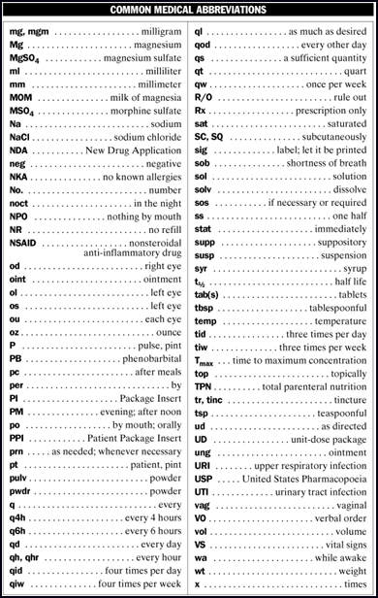
Abbreviations
DC - discontinue
cont. - continue
am - morning
pm - afternoon or evening
cap - capsule
tab - tablet
gm - gram
mg - milligram
mcg - microgram
IU - international unit
mL - milliliter
PRN - as needed
IM - intramuscular
ODT - orally dissolving tablet
Subcut - subcutaneous
Notes:
RIA p. 81 Abbreviation list
Trainer to Staff: It is common to sometimes see abbreviations on an HCP order that you are not familiar with; there should be a reference list in the med area so that you know what the abbreviation means.
In MAP, when transcribing, we will only be using a few abbreviations.
The list of abbreviations on the screen are acceptable for use when transcribing.
To the Trainer: After review of abbreviations-optional exercise RIA p. 81

Slide 6
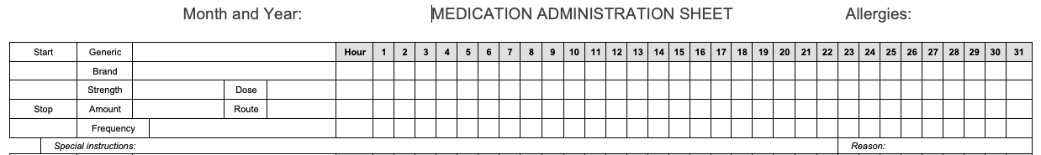
Medication Administration Sheet
Notes:
RIA p. 82-87
Trainer to Staff: A medication sheet tracks the administration of medication.
You are looking at the top portion of a med sheet.
To the Trainer: Review each component of the med sheet.
After review of med sheet components-optional exercise RIA p. 89

Slide 7





Frequency
Number of times per day to be given
Specific hour chosen
Notes:
RIA p. 90-91
Trainer to Staff: The words frequency and time are used interchangeably; there are two parts.
The number of times per day the HCP order specifies that the med be given.
The specific hours chosen for each med time
When choosing med times, consider: Persons daily schedule, Service Provider policy, etc.
12am same as midnight
12am is usually considered the first dose of the day
12pm same as noon
General guideline - times chosen must be at least 4 hrs. apart, unless HCP specifies otherwise.
Write ‘am’ times in top two boxes and ‘pm’ times in bottom two boxes.
To the Trainer: optional exercises RIA p. 93-94

Slide 8
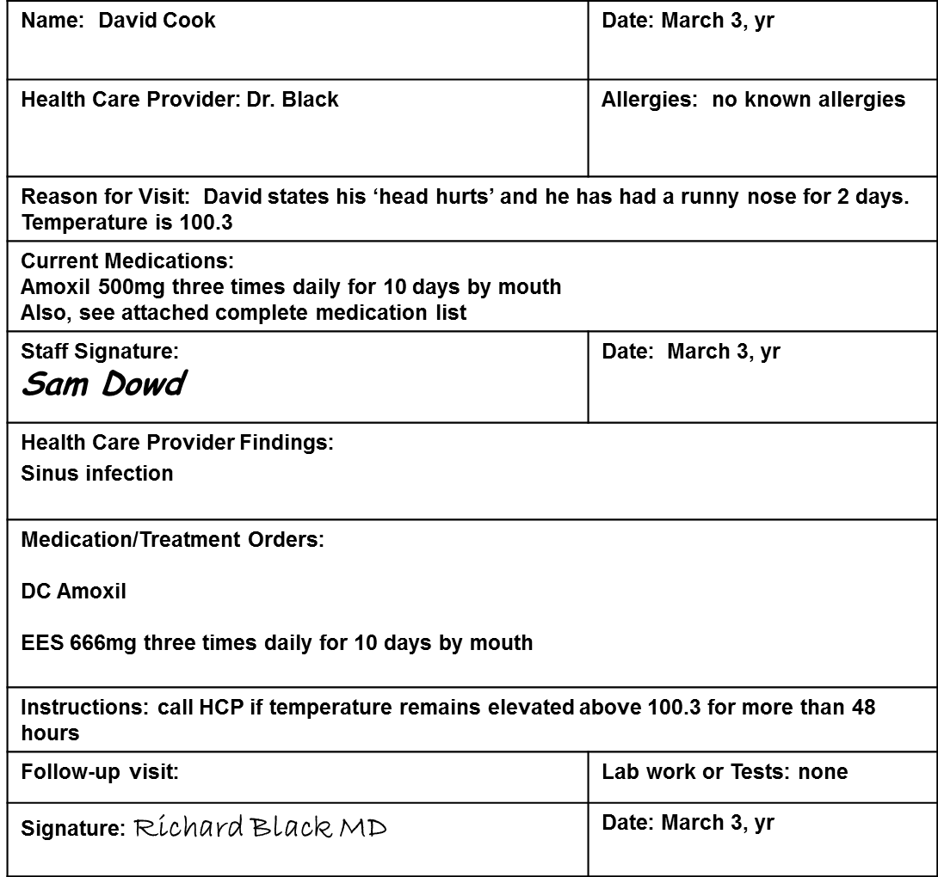
Health Care Provider Order
Notes:
RIA p. 95
To the Trainer: Review the entire HCP Order form.
Trainer to Staff:
Who is the HCP Order written for?
What is the name of the staff that filled out the top half of the form prior to the visit?
What is the date of the HCP visit?
What was the reason for the visit?
Is David on current meds? What are they?
After David was examined by the HCP, what were the HCP findings?
What are the medication/treatment orders? (Which med is being DCd?, What is the name of the new med?)
The first written HCP order states, DC Amoxil

Slide 9
Discontinued Medication Order
On med sheet
  Mark through all boxes where med was scheduled to be given
  Diagonal lines through
    Left side of med sheet
      DC, date, your initials
    Right side of med sheet
      DC, date, your initials
Notes:
Trainer to Staff: After receiving the HCP order to do so, these next slides show how a medication is documented as DC’d on a med sheet.
RIA p. 96-visual example of marking a medication discontinued on a med sheet.

Slide 10
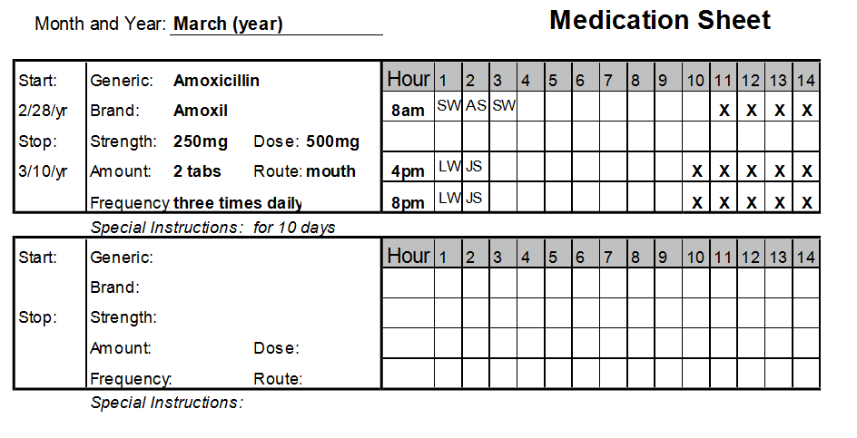
Discontinue Process
Notes:
Trainer to Staff: To mark the medication as DC’d on a med sheet, the first step is to mark through all the empty spaces next to where the med was scheduled to be given.

Slide 11
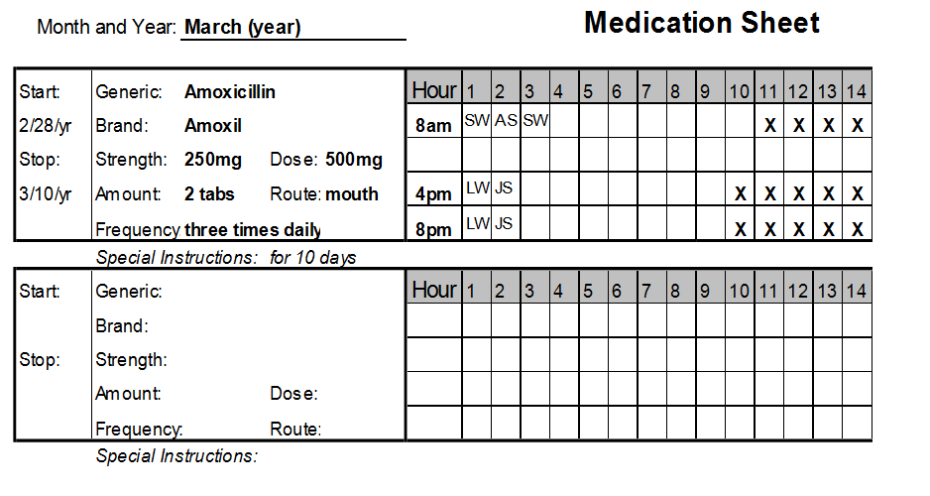
Step 1
Notes:
Step 1 will look like this. You can use straight lines or ‘X’s or a combination if the empty boxes are completely marked through.
Then draw a diagonal line through left section of med sheet…

Slide 12
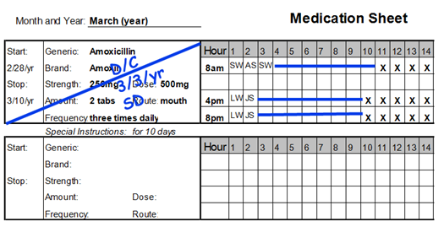
Step 2
Notes:
…and write:
DC
Date
Your Initials

Slide 13
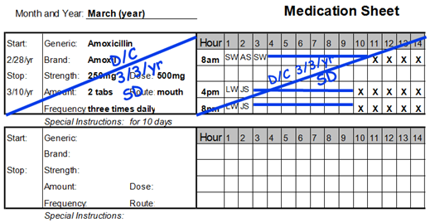
Step 3
Notes:
Trainer to staff: Next, draw a diagonal line through the right section of med sheet and write:
DC
Date
Your Initials
Trainer to staff:
Now we go back to the HCP order…

Slide 14
Health Care Provider Order
Notes:
Trainer to staff:
….and you are ready to transcribe the next order.
Trainer to Staff: What is the name of the new medication?

Slide 15
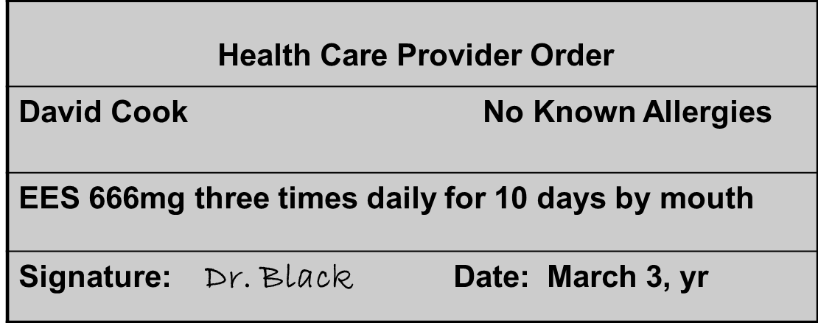
Dose
Found in HCP Order, usually in mgs
Notes:
If transcribing this HCP order, you would copy 666mg next to the word ‘dose’ on the med sheet.

Slide 16
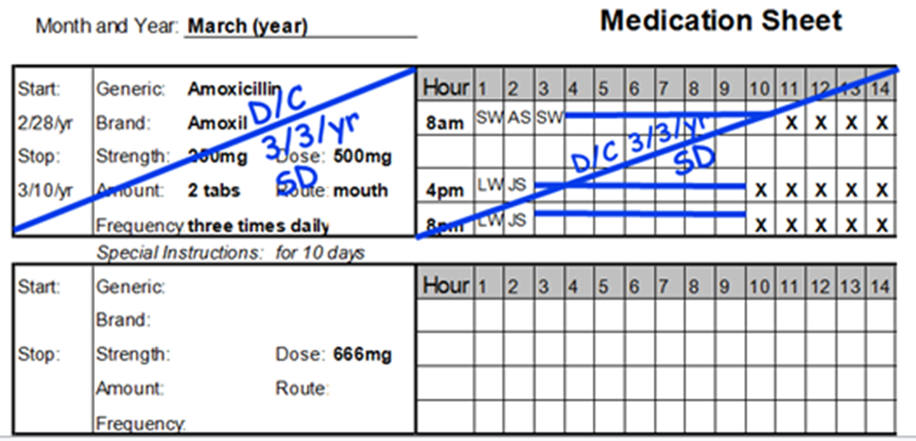
Transcribe Dose
Notes:
Trainer to staff:
Like this.
Then look at the corresponding pharmacy label.

Slide 17
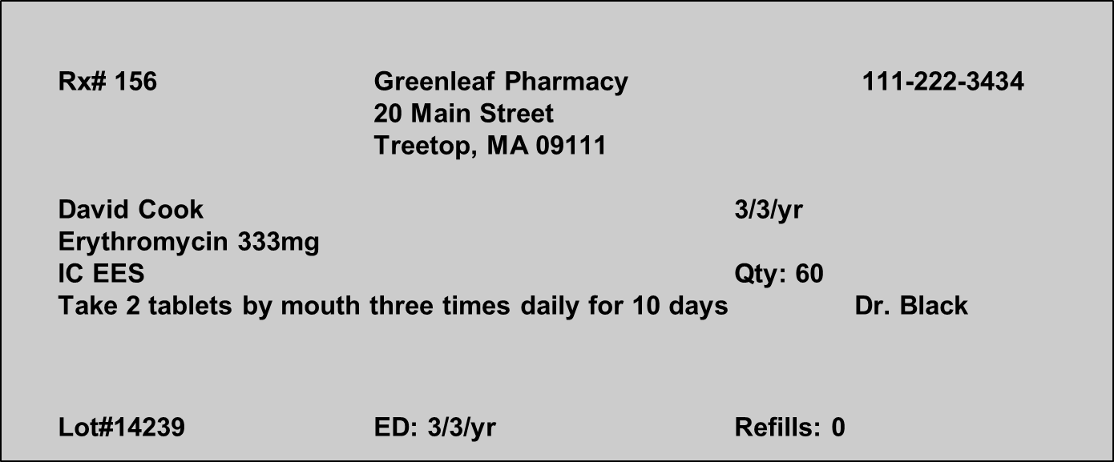
Strength and Amount
Found on Pharmacy Label
Notes:
Trainer to staff:
…to find the strength of the tablet supplied by the pharmacy and the number of tablets to administer (in the label directions).
If transcribing, you would copy ‘333mg’ next to the word ‘strength’ on the med sheet.
If transcribing, you would copy ‘2 tabs’ next to the word ‘amount’ on the med sheet.

Slide 18
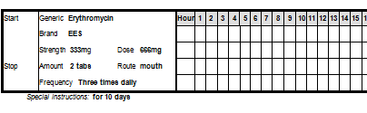
Transcribe Strength and Amount
Notes:
Trainer to staff:
Like this.
You can see the brand and generic medication names have also been copied.

Slide 19
Transcribe Route, Frequency, Special Instructions
Notes:
Trainer to staff:
The route, frequency, and any special instructions or parameters for use may be found on the HCP order and/or the pharmacy label and copied onto the left side of the medication sheet.

Slide 20
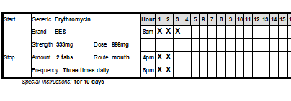
Complete the Grid
Notes:
Trainer to staff:
To complete the grid, first choose times (based on the frequency ordered) In this example, the frequency is three times daily, so we need to choose 3 med times.
Document the times you choose in the hour column; underneath the word ‘hour’ on the med sheet.
Think about the date and time you are transcribing to determine when the first dose can be administered.
If the medication is ordered to be administered for a certain number of days, the days/medication boxes in the grid must be counted.
You will mark through all medication boxes on the dates/times before the medication was ordered.

Slide 21
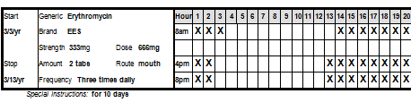
Complete the Grid
Notes:
Trainer to staff:
Notice there are 10 open/empty boxes next to each medication time and boxes on either side have an ‘X’ through them.
Based on how the grid is set up, now write the ‘start’ and ‘stop’ dates on the left side of the med sheet:
The start date is the date the first dose is scheduled to be administered.
The stop date is the date the last dose is scheduled to be administered.

Slide 22
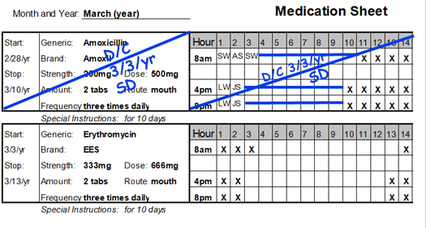
Completed Transcription
Notes:
Trainer to staff:
Now that the transcription is completed, you are ready to ‘post’ the order.

Slide 23
‘Post’ HCP Order
Completed for new HCP orders
After transcribing
Written on HCP order
    Under HCP signature write:
      Posted
      Your signature
      Date
      Time
Notes:
Trainer to staff:
After transcribing all the new HCP orders, the orders are ‘posted’.
Many times, Service Provider HCP Order forms include the word posted, with spaces for your signature, date and time at the bottom of the form underneath the HCP signature.
Your signature means that you are the Certified staff who transcribed the new HCP order.
Not all HCP appointments include new orders for medication. The new HCP order may be to monitor a person’s weight or how much they drink, etc. These types of HCP orders must have the information communicated to all staff and are also posted and verified.

Slide 24
Health Care Provider Order
Posted Sam Dowd 3/3/yr 1pm
Notes:
Trainer to staff:
Underneath the HCP signature you write the word ‘posted’, your signature, the date and time.
The information can be written in any order.

Slide 25
Transcription Practice
Transcription Workbook One
Notes:
To the Trainer: ask staff to take out med sheets from Resource Packet, or if you provided staff with a hard copy, take out TWB1.
You may want to mention the practice transcriptions are set up in a way the HCP orders the brand name of the medication, and the pharmacy supplies the generic name medication.

Slide 26
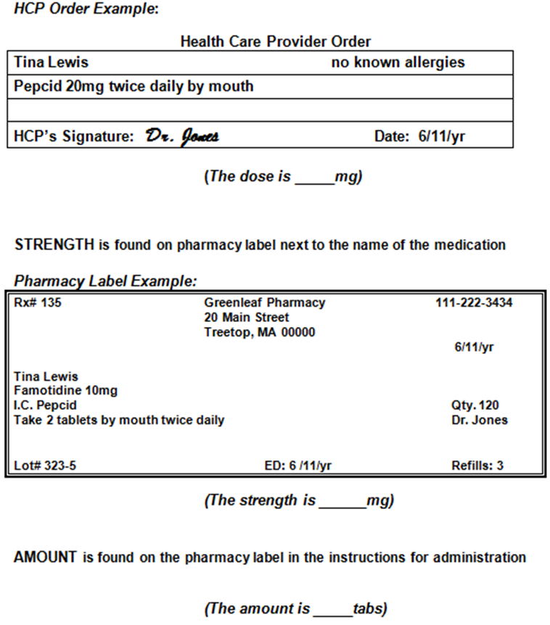
Worksheet
Notes:
To the Trainer: review the worksheet on the slide or ask staff to open TWB1 to the worksheet on page 3.

Slide 27
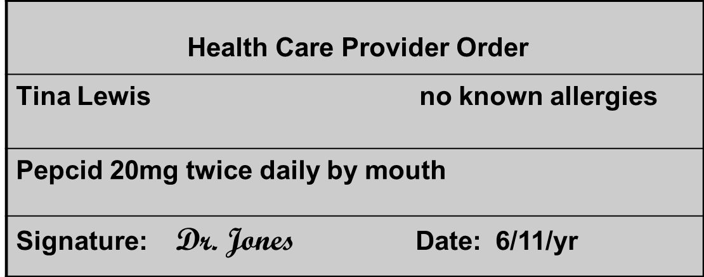
Dose
Found on HCP order usually in ‘mg’
The dose is mg
Notes:
To the Trainer: ask staff,
If transcribing this HCP order, you would copy what number of ‘___ mg’ next to the word ‘dose’ on the med sheet?

Slide 28
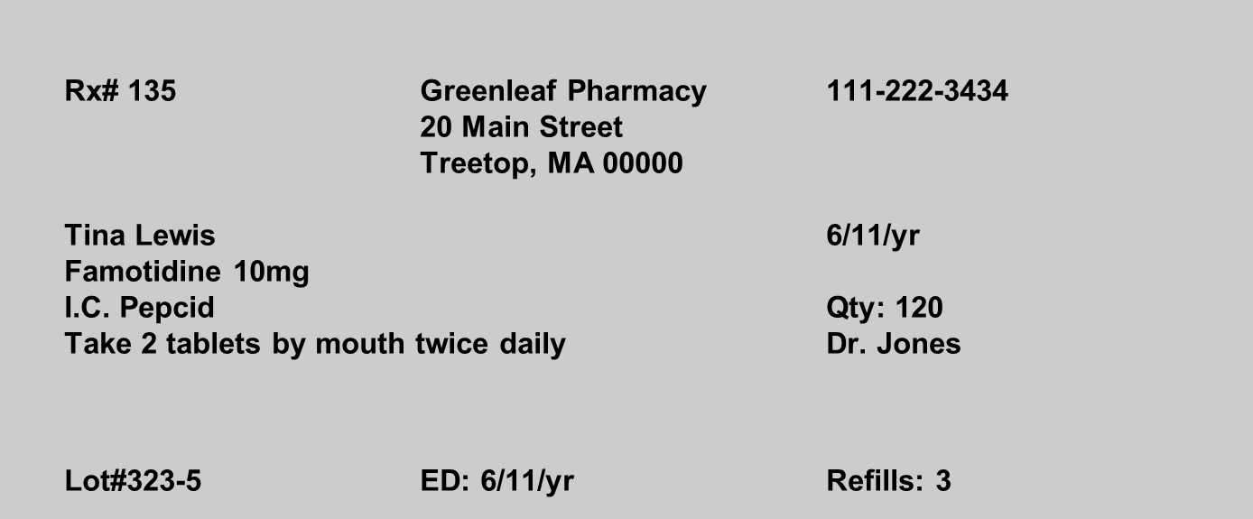
Strength and Amount
Found on Pharmacy label
The strength per tablet to give is mg
The amount of tablets to give is tabs
Notes:
Trainer to staff:
The strength is found on the pharmacy label next to the name of the medication.
The amount is also on the pharmacy label specifically in the pharmacy label directions.
To the Trainer: ask staff,
If transcribing, you would copy what number of ‘___ mg’ next to the word ‘strength’ on the med sheet?
If transcribing, you would copy what number of ‘___ tabs’ next to the word ‘amount’ on the med sheet?

Slide 29
Transcription Practice
INSTRUCTIONS
You have taken Tina Lewis to the doctor and have received medication from the pharmacy. Pretend that the date is June 11, year. It is 1 pm.
Use the health care provider’s order, pharmacy label and generic equivalents to discontinue the order and transcribe the new order on to the Medication Sheet.
Please Note: Do not place your initials in the medication box. You are not administering a medication at this time. This is transcription only.
Notes:
To the Trainer: if staff are using TWB1, before starting transcriptions, consider going through one transcription exercise, in its entirety, to familiarize staff with the documents they will be using.
Regardless if staff are using only the med sheet in their Resource Packet or TWB1, provide detail regarding how to use the scenario (date/time) information.
Each slide will include the corresponding TWB1 page number.
TWB1 p. 4
Trainer to staff:
It is important to know how to use the pretend date and time. This is NOT the time of the HCP visit (because the appointment has already happened), and the medication was obtained from the pharmacy.
The pretend time is when you are at your work location sitting at a table with the HCP order and the pharmacy labeled package of medication in front of you ready to transcribe the information onto the med sheet.
Remember you are not giving meds now. You are getting the med sheet set up and ready for someone else to use to administer meds, after you have gone home for the day.

Slide 30
HEALTH CARE PROVIDER ORDER
Name: Tina Lewis | Date: 6/11/yr
Health Care Provider: Dr. Jones | Allergies: no known allergies
Reason for Visit: Tina states she has a burning feeling in her throat during the day.
Current Medications: Pantoprazole 40mg by mouth once daily in the evening
Staff Signature: John Smith, Program Manager | Date: 6/11/yr
Health Care Provider Findings: GERD
Medication/Treatment Orders: D/C Pantoprazole Pepcid 20mg twice daily by mouth dose frequency route
Instructions:
Follow-up visit: | Lab work or Tests:
Signature: Dr. Jones | Date: 6/11/yr
S
T
A
F
F
HCP
Notes:
TWB1 p. 5
To the Trainer: Ask staff,
What is the name of the staff who has written the top half of the form in preparation for the HCP visit?
What is the reason for the visit?
Is Tina on any current meds? What is the name of it?
What does the HCP want to do with the current med?
Are any new meds ordered?
Point out to staff, notice the ‘pretend’ date in the instructions is on this form in 3 different places (top, middle and bottom sections).

Slide 31
Notes:
TWB1 p. 6
Trainer to staff:
You’ll use this med sheet for transcription.
You can see the med listed on the med sheet is the one the HCP has discontinued.
We’ll come back to this sheet.

Slide 32
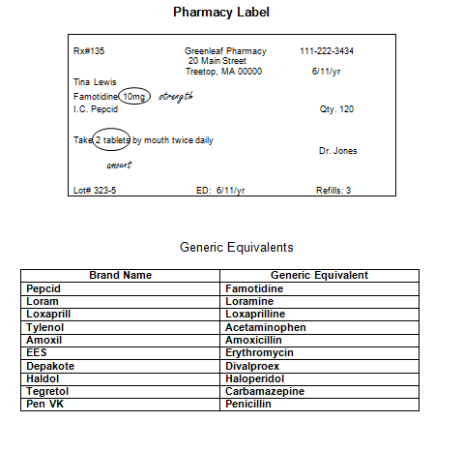

Notes:
TWB1 p. 7
Trainer to staff:
Next is the Pharmacy Label.
Remember you’ll locate the strength of the med and the amount to give on the label.
The Generic Equivalency chart is set up so that brand name medications are in the left column and the corresponding generic names are in the right column.
You are not expected to memorize brand and generic medications, however, you do need to copy the name of each med exactly as written.
Notice there is a mini medication information sheet. This is meant to mimic how a med info sheet is typically provided by the pharmacy when a new medication is obtained. Know that you will see it but do nothing with the information for practice purposes.

Slide 33
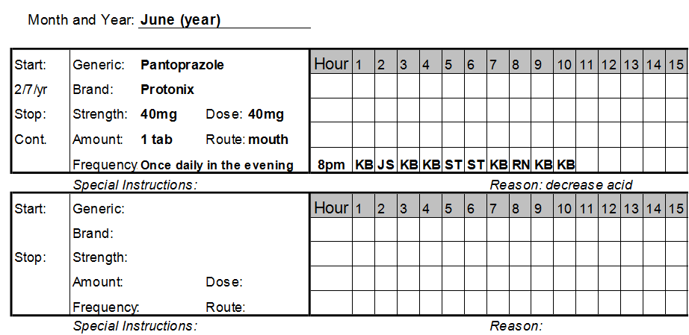
Medication Administration Sheet
Notes:
Trainer to staff:
Turn back to the HCP order on page 5 and place the corresponding med sheet (on page 6) next to it.
Now let’s DC what was the current med.

Slide 34
Discontinue (DC) Process Step 1
Notes:
Trainer to staff:
Remember, Step 1 is to cross out all open boxes where the med was scheduled to be given.
You can use an ‘X’ in each box or a straight line.
If using a straight line, it must be drawn completely through the boxes.

Slide 35
Discontinue (DC) Process Step 2
DC 6-11-yr JS
Notes:
Trainer to staff:
Step 2: on the left side of the med sheet draw a diagonal line and write DC/Date/initials.

Slide 36
Discontinue (DC) Process Step 3
DC 6-11-yr JS
DC 6-11-yr JS
Notes:
Trainer to staff:
Step 3- on the right side of the med sheet draw a diagonal line and on it write DC/Date/initials.
Now, complete the transcription for the newly ordered medication, starting by looking at the HCP order on page 5 and copying all parts of the order onto the med sheet.
Now, transcribe the new medication starting with the order, then the label, then the generic equivalency chart, then choose med times, and set up the grid using the pretend date and time.
Don’t forget the start and stop dates!

Slide 37
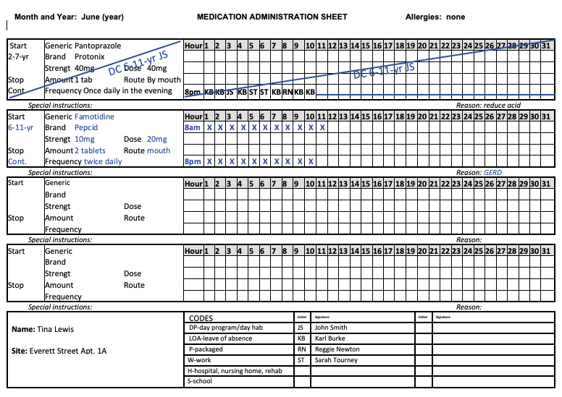
Answer
Notes:
Trainer to staff:
This is what your med sheet should look like.
Med DC’d by HCP is marked on med sheet and the newly ordered med is transcribed.

Slide 38
HEALTH CARE PROVIDER ORDER
Name: Tina Lewis | Date: 6/11/yr
Health Care Provider: Dr. Jones | Allergies: no known allergies
Reason for Visit: Tina states she has a burning feeling in her throat during the day.
Current Medications: Pantoprazole 40mg by mouth once daily in the evening
Staff Signature: John Smith, Program Manager | Date: 6/11/yr
Health Care Provider Findings: GERD
Medication/Treatment Orders: D/C Pantoprazole Pepcid 20mg twice daily by mouth
Instructions:
Follow-up visit: | Lab work or Tests:
Signature: Dr. Jones | Date: 6/11/yr
Posted John Smith 6/11/yr 1pm
Notes:
Trainer to staff:
Turn back to the HCP order on page 5. Under the HCP signature write the word ‘posted’, your signature, the date and time (use the pretend date and time in the scenario.)
In real life, you’ll be using the current date and the time on the clock.

Slide 39
Transcription Practice
INSTRUCTIONS
You have taken Tina Lewis to the doctor and have received medication from the pharmacy. Pretend that the date is June 20, year. It is 1 pm.
Use the health care provider’s order, pharmacy label and generic equivalents to discontinue the order and transcribe the new order on to the Medication Sheet.
Please Note: Do not place your initials in the medication box. You are not administering a medication at this time. This is transcription only.
Notes:
TWB1 p. 9
Transcription 2, Tina Lewis.
Trainer to staff:
What is the pretend date and time in this scenario?

Slide 40
HEALTH CARE PROVIDER ORDER
Name: Tina Lewis | Date: 6/20/yr
Health Care Provider: Dr. Smith | Allergies: None
Reason for Visit: complaint of pressure on forehead, mild fever, dizziness, increase in head slapping behavior
Current Medications: Synthroid 0.125mg by mouth once a day in the morning
Staff Signature: Paula Jones, Program Manager | Date: 6/20/yr
Health Care Provider Findings: hypothyroid, elevated blood pressure, sinus infection
Medication/Treatment Orders: D/C Synthroid Armour Thyroid 30mg by mouth once daily before breakfast. Brand name only medication. Inderal 20mg by mouth once daily in the morning Amoxil 500mg by mouth three times daily for 10 days
Instructions:
Follow-up visit: 2 weeks | Lab work or Tests:
Signature: Dr. Susan Smith | Date: 6/20/yr
dose
Notes:
TWB1 p. 10
Trainer to staff:
What is the reason for the visit?
What were the ‘Health Care Provider Findings’?
What does the HCP want to happen with the current med?
How many new meds are there?
What is the dose of Armour Thyroid? Circle it.
The dose of Inderal? Circle it.
The dose of Amoxil? Circle it.
Write the word dose (once) so you remember these are the doses of each new med.

Slide 41
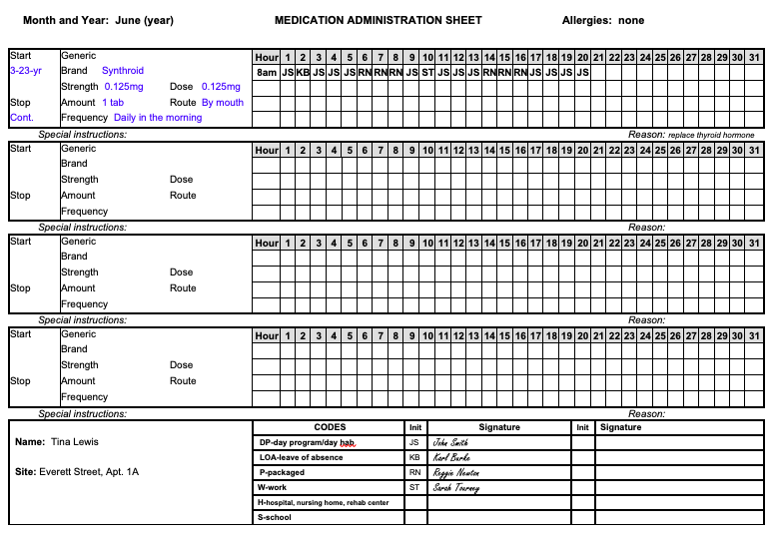
Notes:
TWB1 p. 11
Trainer to staff:
You’ll use this med sheet for the transcriptions.
You can see the med listed on the med sheet is the one the HCP has discontinued on the order.
Regarding the Synthroid, occasionally an HCP will order a brand name only medication, in that case only the brand name is required on the medication sheet.

Slide 42
Rx#139 Greenleaf Pharmacy 111-222-3434 20 Main Street Treetop, MA 00000 6/20/yr Tina Lewis Armour Thyroid 30mg I.C. Qty. 30 Take 1 tablet once daily before breakfast by mouth Dr. Smith Lot# 659 ED: 6/20/yr Refills: 3
Rx#285-97226 Greenleaf Pharmacy 111-222-3434 20 Main Street Treetop, MA 00000 6/20/yr Tina Lewis Propranolol 10mg I.C. Inderal Qty. 60 Take 2 tablets once daily in the morning by mouth Dr. Smith Lot# 323-334 ED: 6/20/yr Refills: 3
strength
Rx#285-97227 Greenleaf Pharmacy 111-222-3434 20 Main Street Treetop, MA 00000 6/20/yr Tina Lewis Amoxicillin 500mg I.C. Amoxil Qty. 30 Take 1 tablet three times daily for ten days by mouth Dr. Smith Lot# 323-335 ED: 6/20/yr Refills: 0
Notes:
TWB1 p. 12
Trainer to staff:
What is the strength in mgs per tablet of Armour Thyroid supplied by the pharmacy? Circle it.
The Inderal? Circle it.
The Amoxil? Circle it.
Then write the word strength once out to the side of the labels.

Slide 43
Notes:
TWB1 p. 13
Trainer to staff:
Here is the Generic Equivalency chart.
Let’s go back to the HCP order on p. 10, have your med sheet next to it and start by marking the med as DC’d on the med sheet.
Complete each transcription separately from beginning to end (start with the first order looking at the HCP order, then the label, then the generic equivalency chart, then choose med times, then set up the grid using the pretend date and time.)

Slide 44
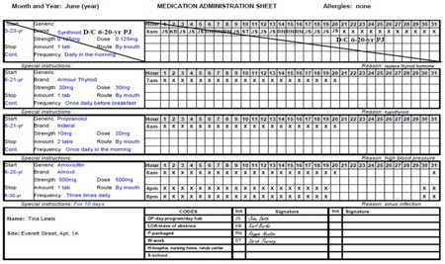
Answer
Notes:
Answer sheet transcription #2 Tina Lewis.
Trainer to staff:
This is what your med sheet should look like.

Slide 45
Transcription Practice
INSTRUCTIONS
You have taken Jane McCarthy to the doctor and have received medication from the pharmacy. Pretend that the date is August 1, year. It is 2 pm.
Use the health care provider’s order, pharmacy label and generic equivalents to discontinue the order and transcribe the new order on to the Medication Sheet.
Please Note: Do not place your initials in the medication box. You are not administering a medication at this time. This is transcription only.
Notes:
TWB1 p. 15
Transcription 3, Jane McCarthy
Trainer to staff:
What is the pretend date and time in this scenario?

Slide 46
Notes:
TWB1 p. 16
Trainer to staff:
Let’s look at the reason for the visit.
What was the ‘Health Care Provider Findings’?
Find the ‘Medication/Treatment Orders’ section of the HCP order.
What does the HCP want to happen with the current med?
How many new meds are there?

Slide 47
Notes:
TWB1 p. 17
Trainer to staff:
You’ll use this med sheet for the transcription.
You can see the med listed on the med sheet is the one the HCP has discontinued on the order.

Slide 48
Notes:
Pharmacy label and Generic equivalency chart used for transcription 3, Jane McCarthy.
TWB1 p. 18
Trainer to staff:
Let’s start by first turning to the HCP order on p. 16, place the med sheet next to it.
Now DC the Cefaclor then transcribe the new med.

Slide 49
Answer
Notes:
Answer sheet transcription 3, Jane McCarthy.
Trainer to staff:
This is what your med sheet should look like.

Slide 50
Transcription Practice
INSTRUCTIONS
You have taken Sam Lopes to the doctor and have received medication from the pharmacy. Pretend that the date is February 14, year. It is 3 pm.
Use the health care provider’s order, pharmacy label and generic equivalents to discontinue the order and transcribe the new order on to the Medication Sheet.
Please Note: Do not place your initials in the medication box. You are not administering a medication at this time. This is transcription only.
Notes:
TWB1 p. 20
Transcription 4, Sam Lopes.
Trainer to staff:
What is the pretend date and time in this scenario?

Slide 51
Notes:
TWB1 p. 21
Trainer to staff:
Look at the reason for the visit.
What was the ‘Health Care Provider Findings’?
Find the ‘Medication/Treatment Orders’ section of the HCP order.
What does the ‘Medication/Treatment Order s’ section instruct you to do?

Slide 52
Notes:
Blank med sheet for transcription 4, Sam Lopes.
TWB1 p. 22
Trainer to staff:
You can see the med listed on the med sheet is the one the HCP has discontinued on the order.

Slide 53
Notes:
Pharmacy label and Generic equivalency chart used for transcription 4, Sam Lopes.
TWB1 p. 23
Trainer to staff:
Let’s start by first turning to the HCP order on p. 21, place the med sheet next to it.
Now DC the Amoxicillin, then transcribe the new med.

Slide 54
Answer
Notes:
Answer sheet transcription 4, Sam Lopes
Trainer to staff:
This is what your med sheet should look like.

Slide 55
Transcription Practice
INSTRUCTIONS
You have taken Joe Simon to the doctor and have received medication from the pharmacy. Pretend that the date is April 17, year. It is 2 pm.
Use the health care provider’s order, pharmacy label and generic equivalents to discontinue the order and transcribe the new order on to the Medication Sheet.
Please Note: Do not place your initials in the medication box. You are not administering a medication at this time. This is transcription only.
Notes:
TWB1 p. 25
Transcription 5, Joe Simon.
Trainer to staff:
What is the pretend date and time in this scenario?

Slide 56
Notes:
TWB1 p. 26
Trainer to staff:
Look at the reason for the visit.
What was the ‘Health Care Provider Findings’?
Find the ‘Medication/Treatment Orders’ section of the HCP order.
What does the ‘Medication/Treatment Orders’ section instruct you to do?

Slide 57
Notes:
Blank med sheet for transcription 5, Joe Simon.
TWB1 p. 27
Trainer to staff:
You can see the med listed on the med sheet is the one the HCP has discontinued on the order.

Slide 58
Notes:
Pharmacy label and Generic equivalency chart used for transcription 5, Joe Simon.
TWB1 p. 28
Trainer to staff:
Let’s start by first turning to the HCP order on p. 26, place the med sheet next to it.
Now DC the Vibramycin, then transcribe the new medications.

Slide 59
Answer
Notes:
Answer sheet transcription 5, Joe Simon.
Trainer to staff:
This is what your med sheet should look like.

Slide 60
Transcription Practice
INSTRUCTIONS
You have taken Casey Forte to the doctor and have received medication from the pharmacy. Pretend that the date is May 20, year. It is 1 pm.
Use the health care provider’s order, pharmacy label and generic equivalents to discontinue the order and transcribe the new order on to the Medication Sheet.
Please Note: Do not place your initials in the medication box. You are not administering a medication at this time. This is transcription only.
Notes:
TWB1 p. 30.
Transcription 6, Casey Forte.
Trainer to staff:
What is the pretend date and time in this scenario?

Slide 61
Notes:
TWB1 p. 31
Trainer to staff:
Look at the reason for the visit.
What was the ‘Health Care Provider Findings’?
Find the ‘Medication/Treatment Orders’ section of the HCP order.
What does the ‘Medication/Treatment Orders’ section instruct you to do?

Slide 62
Notes:
Blank med sheet for transcription 6, Casey Forte.
TWB1 p. 32
Trainer to staff:
You can see the med listed on the med sheet is the one the HCP has discontinued on the order.

Slide 63
Notes:
Pharmacy label and Generic equivalency chart for transcription 6, Casey Forte.
TWB1 p. 33
Trainer to staff:
Let’s start by first turning to the HCP order on p. 31, place the med sheet next to it.
Now DC the Amoxicillin in tablet form, then transcribe Amoxicillin in suspension (liquid) form.

Slide 64
Answer
Notes:
Answer Sheet-Transcription 6, Casey Forte.
Trainer to staff:
This is what your med sheet should look like.

Slide 65
Transcription Practice
INSTRUCTIONS
You have taken Marie Sousa to the doctor and have received medication from the pharmacy. Pretend that the date is August 5, year. It is 1 pm.
Use the health care provider’s order, pharmacy label and generic equivalents to discontinue the order and transcribe the new order on to the Medication Sheet.
Required information to complete this transcription: Marie’s typical mealtimes are 8am, 12pm and 5pm.
Please Note: Do not place your initials in the medication box. You are not administering a medication at this time. This is transcription only.
Notes:
TWB1 p. 35.
Transcription Practice 7, Marie Sousa.
Trainer to staff:
What is the pretend date and time in this scenario?

Slide 66
Notes:
TWB1 p. 36
Trainer to staff:
Look at the reason for the visit.
What was the ‘Health Care Provider Findings’?
Find the ‘Medication/Treatment Orders’ section of the HCP order.
What does the ‘Medication/Treatment Orders’ section instruct you to do?

Slide 67
Notes:
Blank med sheet for transcription 7, Marie Sousa.
TWB1 p. 37
Trainer to staff:
You can see the med listed on the med sheet is the one the HCP has discontinued on the order.

Slide 68
Notes:
Pharmacy label and Generic equivalency chart used for transcription 7, Marie Sousa.
TWB1 p. 38
Trainer to staff:
Let’s start by first turning to the HCP order on p. 36, place the med sheet next to it.
Now DC the medication, then transcribe the new medication.

Slide 69
Answer
Notes:
Answer Sheet Transcription 7, Marie Sousa.
Trainer to staff:
This is what your med sheet should look like.

Slide 70
Transcription Practice
INSTRUCTIONS
You have taken Chris Star to the doctor and have received medication from the pharmacy. Pretend that the date is September 16, year. It is 3 pm.
Use the health care provider’s order, pharmacy label and generic equivalents to discontinue the order and transcribe the new order on to the Medication Sheet.
Please Note: Do not place your initials in the medication box. You are not administering a medication at this time. This is transcription only.
Notes:
TWB1 p. 40.
Transcription 8, Chris Star.
Trainer to staff:
What is the pretend date and time in this scenario?

Slide 71
Notes:
TWB1 p. 41
Trainer to staff:
Look at the reason for the visit.
Is Chris on any current medications?
What was the ‘Health Care Provider Findings’?
Find the ‘Medication/Treatment Orders’ section of the HCP order.
What does the ‘Medication/Treatment Orders’ section instruct you to do?

Slide 72
Notes:
Blank med sheet for transcription 8, Chris Star.
TWB1 p. 42.
Trainer to staff:
Notice the med sheet is blank because Chris has no current orders for medication.

Slide 73
Notes:
Pharmacy label and Generic equivalency chart used for transcription 8, Chris Star.
TWB1 p. 43
Trainer to staff:
Let’s start by first turning to the HCP order on p. 41, place the med sheet next to it.
Now transcribe the new medication.

Slide 74
Answer
Notes:
Answer Sheet Transcription 8, Chris Star.
Trainer to staff:
This is what your med sheet should look like.

Slide 75
Transcribing HCP Orders
Dose-mg HCP orders to be given each time med is administered
Strength-supplied by pharmacy
Amount-tabs, caps, mLs etc.
Dose = Strength x Amount
Notes:
Trainer to staff:
This slide is a recap of where you found the dose, strength and amount as you’ve practiced transcription.
It also reinforces that the strength of tablet(s) received from the pharmacy multiplied by the amount (number) of tabs to give as instructed on the pharmacy label, equals the dose ordered by the HCP.
Additional math is required if half tab or liquid med.

Slide 76

New HCP Orders
If med is same but existing
  Dose
  Frequency
  Route
  Parameters
  Symptoms if PRN
    Change
      It is a new HCP Order
        DC old HCP Order
        Transcribe new HCP Order
Notes:
RIA p. 103
Trainer to staff:
If any part of an existing HCP order changes, the HCP will DC the previous order and write a new order.
You must do the same, mark the old order as DC’d and transcribe the new order on the med sheet.

Slide 77
Post/Verify Process
Post
After Transcribing New Orders
On HCP Order form
Under HCP signature
  Write
    Posted
    Your signature
    Date
    Time
Verify
After first Certified staff posts
Second Certified Staff Double-Checks
Under HCP signature
  Write
    Verified
    Your signature
    Date
    Time
Notes:
RIA p. 103-104 Post/Verify Process
Trainer to staff:
You have practiced posting the HCP order after transcribing. Afterwards, a second Certified staff must double-check your work, ensuring all the information was accurately transcribed.
I have a question, What if there is no staff on duty to double check the transcription, is it okay to give the med? (yes)
If you are the next staff on duty giving meds, you must verify the order before you give the new med.
To the Trainer:
RIA p. 105 Example of order that is posted and verified.
Optional transcription exercise RIA p. 107-108.

Slide 78

Transcription Assignment
Discontinue (DC) one med
Transcribe one new med
Notes:
Trainer to staff:
Successfully passing the transcription assignment is a component of Certification training.
There are no limits on the number of times you may practice transcribing.
You must complete the transcription assignment with 80% accuracy.
To the Trainer: Decide if you prefer to explain to staff how to navigate the transcription in TMU at this point if you want staff to use it for practice.
If you prefer to do so at this time, consider accessing TMU as a ‘student’ and showing staff how to use the tool bar, make changes, submit, how you will provide feedback, etc.

Slide 79

Questions
Notes:
Q&A

