Slide 1

Responsibilities in Action
Understanding the Connections
Medication Administration Training
Notes:
Blended Certification Training
Medication Administration Skill Session
‘Responsibilities in Action’ (RIA) Unit 7 p. 111-161
To the Trainer: This optional PowerPoint may be used when training Medication Administration in the ‘Blended’ MAP Certification Training.
Consider printing out the ‘notes’ pages for reference as you click through the slides for each staff, whether the presentation is virtual or in-person.
Training materials
Responsibilities in Action curriculum
Resource Packet :
Med Book
Count Book
Tanisha Johnson blister packs
Med Cup
Trainer to Group: You have the basic knowledge of how to administer medication. After a quick review, this session is an opportunity to practice what you’ve learned.

Slide 2
Required for Medication Administration
HCP Order
Pharmacy Label
Medication (Med) Sheet
Notes:
Trainer: On the screen you see what is required for medication administration.
Why do you need an HCP Order?
An HCP order is needed for every medication you give.
Why must you check the pharmacy label?
To ensure what the HCP ordered is what the pharmacy sent.
What is the purpose of a med sheet?
To document (track) the meds you administer.

Slide 3

Medication Record Contents
  Emergency Fact Sheet
  HCP Orders
  Medication Sheets
    Med Progress Notes
  Medication Information Sheets
Notes:
To the Trainer: Using Resource Packet, review specifics of Medication Record contents:
Emergency Fact Sheet (To the Trainer: EFS not in Resource Packet but is discussed on next slide.)
HCP orders
Medication Administration Sheets
Medication Information Sheets

Slide 4
Notes:
Emergency Fact Sheet (EFS) Page 117
Trainer: Who has seen a person’s Emergency Fact Sheet in your work location?
Many times, the Medication Record is organized so that the EFS is filed before the HCP Orders and med sheets.
If it is current, the picture on the EFS may be used to identify a person you are unfamiliar with.

Slide 5
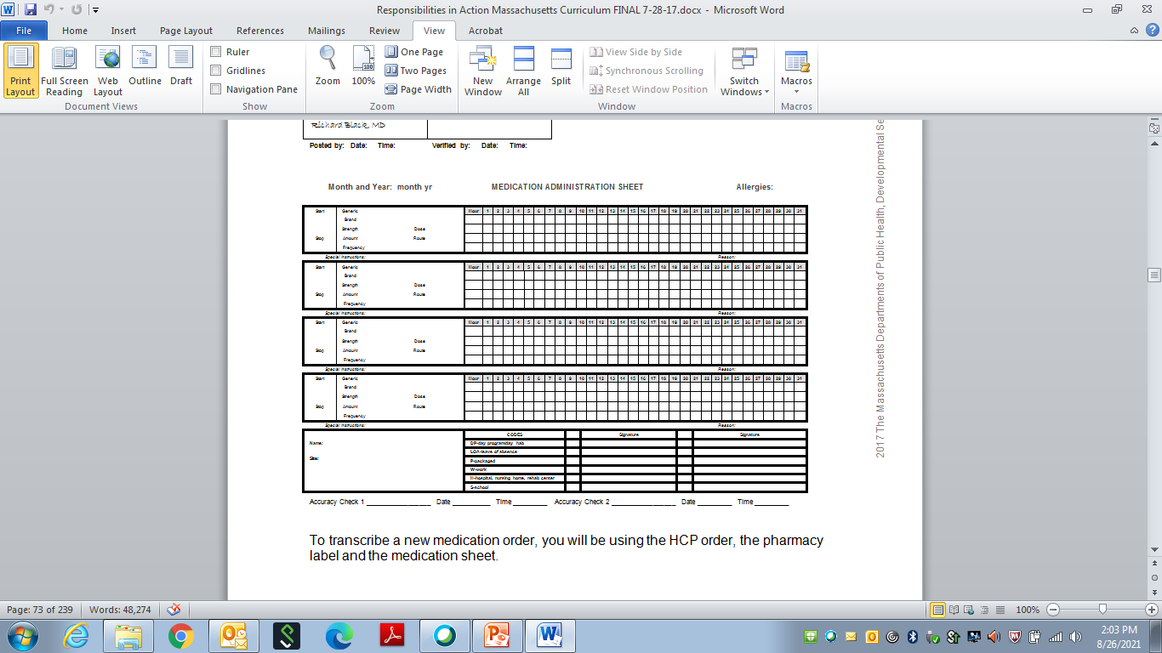
Medication Sheet
Notes:
Trainer: Ask the group, When and where do you document your initials and signature on a med sheet?
Initials are written every time after you give meds next to the name of the med across from the time given and under the corresponding date.
In the signature key you will sign your name/initial only once on each med sheet for the month.
Trainer: Acceptable Codes are at the bottom next to the signature key.
Ask the group, although not listed on this med sheet, what are the other acceptable codes you read about?
A-absent
NSS-no second staff
OSA-off-site administration
V-vacation
Trainer: Ask the group, What if an acceptable code is not on the bottom of the med sheet you are using and you need to use the code?
The code and its definition must be listed at the bottom of the med sheet if used.
Trainer: At the bottom of the med sheet are spaces for Accuracy Checks. Ask the group, What is the purpose of an accuracy check?
To ensure all HCP orders were carried over to the following month so that all meds are given as ordered.

Slide 6

Count Book Sections
Index
Count Sheets
Count Signature Sheets
Notes:
To the Trainer: Using Resource Packet, review specifics of Count Book sections…
If the medication you are administering is a countable medication you must also subtract it from the count.
Trainer: Ask the group, What’s the safest way to to locate the correct Count Sheet page?
First, use the Index to locate the person and the med to figure out the Count Sheet page number to turn to…

Slide 7
Count Sheet
Notes:
….then turn to the correct Count Sheet page to subtract the tab(s) administered.
To the Trainer: Ask the group, Why in the ‘Amount Used’ column is the number ‘1’ spelled out , (i.e., ‘one’) instead of using the actual number?
To protect the person and yourself so that another staff does not mark over your 1, make it appear as a 7, and take 6 tabs, which has your signature next to it.
To the Trainer: Although there is no requirement that staff complete a shift count for testing purposes, consider having staff double check their Resource Packet Count Book and corresponding Count Sheets to the Blister Packs for Tanisha Johnson to ensure documentation is accurate before practice later in the training. If staff are unsure that their documentation is correct, double-check it.
If you are using a virtual format, double check by asking staff raise the items to the camera.

Slide 8

Responsibilities
Medication Administration
  General Guidelines
Notes:
You will be checking the 5 rights as you compare them between the HCP order, pharmacy label and med sheet to ensure the info agrees.
You have already learned about the 5 rights….let’s do a quick review
Trainer: Ask the group, What are the 5 Rights?...after they answer, click to next slide.

Slide 9
The 5 Rights
Right Person
Right Medication
Right Dose
Right Time
Right Route
Notes:
We are going to take a quick look at each of the rights you will be comparing.

Slide 10

Right Person
If uncertain…
  Get help
  Ask another staff
  Check a picture
    Emergency Fact Sheet
Notes:
Right Person Page 116
To the Trainer: Ask the group, If you’re unsure of the person, why not ask them their name?
If you're not sure of the person, never ask them their name, such as , ‘Are you David Cook’? (Someone other than David may respond.)

Slide 11

Right Medication
If HCP writes brand name on prescription
  Pharmacist will usually substitute with generic
If unsure
  Ask pharmacist
Notes:
Right Medication Page 118
Remember, if the pharmacist substituted the brand name med ordered with the generic name medication, the label will include both names.
EXERCISE page 119

Slide 12

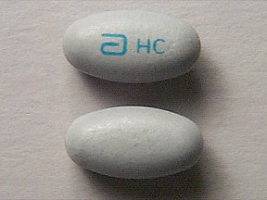
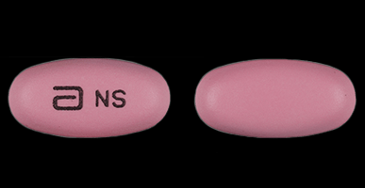
Right Medication
If familiar with med but notice a change in
  Color
  Shape
  Size
  Marking etc.
    Contact the pharmacist
Notes:
Once you begin to routinely administer medications, you will become familiar with pill sizes, shapes, colors and markings.
If you notice there has been a change, contact the pharmacy to ensure the correct medication was dispensed.
To the Trainer: Ask the group, Why might there be a change?
It may have been a change in the manufacturer being used by the pharmacy.
If there is no progress note stating there is a difference (i.e., color, shape, size , marking) in the med sent, to ensure it is the same medication, contact the pharmacy to double check, even if other staff have administered the med.

Slide 13

Right Dose
HCP orders the dose
  Usually written in ‘mg’
    Milligrams
Notes:
Right Dose Page 120
Review Page 121 Dose = Strength X Amount
EXERCISE Page 122

Slide 14

Right Time
Specific time of day
Number of times per day
Time between doses
Notes:
Right Time Page 123
Remember, the words ‘frequency’ (printed on a med sheet) and ‘time’ are used interchangeably.

Slide 15

‘On Time’
Meds may be given safely
One hour before and
Up to one hour after
time scheduled on med sheet
If unsure,
Ask a pharmacist
Notes:
Ask the group, If a med is scheduled for 5pm what is the timeframe that you must administer the med?
No earlier than 4pm and no later than 6pm.
Ask the group, What do you do if a med hasn’t been given, the med sheet hour is 7am and it is 8:05am?
Contact the MAP Consultant and ask what you should do.

Slide 16
Right Route
The form of med determines route
  Tabs, caps, liquids
    Usually, oral
  Ointments to skin
    Topical
Notes:
Right Route Page 124
The route ordered determines how the medication enters the body.

Slide 17

General Guidelines
3 Checks of the
  5 Rights
    Before medication administration
Notes:
You will complete 3 Checks of the 5 Rights between HCP order, label and med sheet.
As you practice, You will read aloud the written info between these items as you point, to ensure all agree with each other.
Trainer, ask the group, why is each check necessary before administration?
Because there is always a possibility a change (different dose, frequency, discontinued) was ordered since the last time you worked.

Slide 18
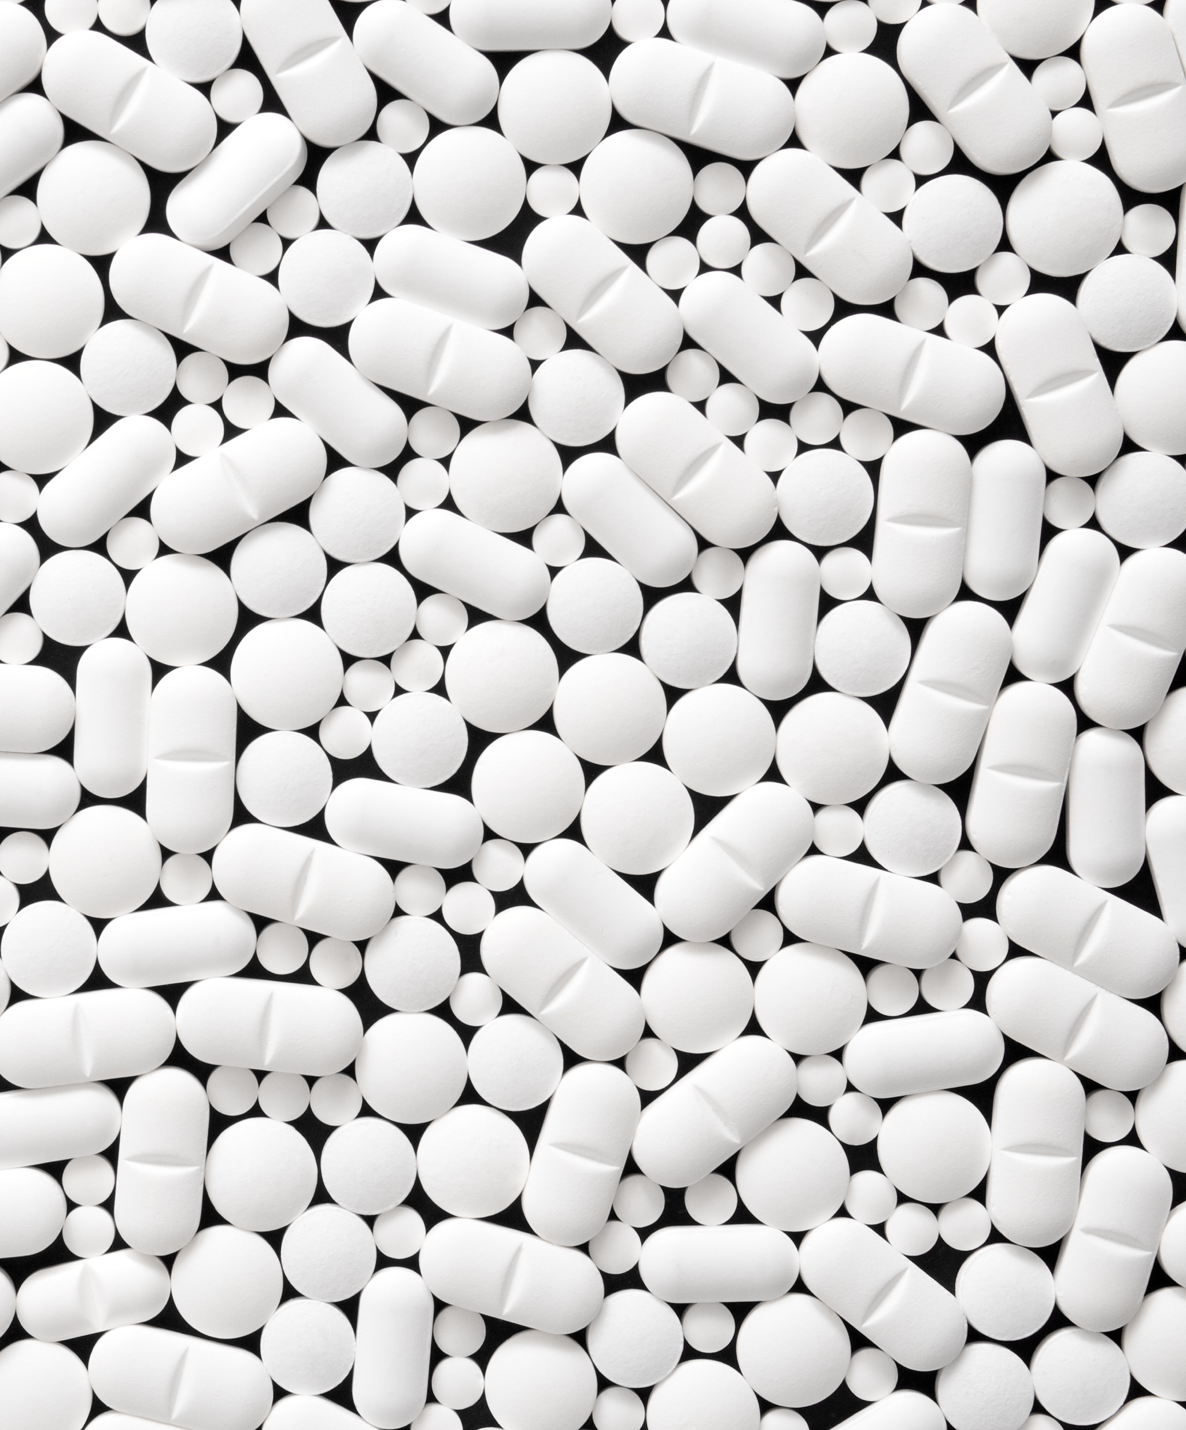
Three Checks
HCP Order-Pharmacy Label
Pharmacy Label-Med Sheet
Pharmacy Label-Med Sheet
Notes:
Page 126
Listed are the 3 checks you will be completing as you practice.

Slide 19

Check 1
Health Care Provider Order
Pharmacy
Label
HCP Order-Pharmacy Label
Notes:
Check 1 Page 127
Check 1 is comparing the info between the HCP order and Pharmacy Label
To the Trainer, ask the group, Who can tell me the reasons for Check 1?
The reason(s) for Check 1 is to make sure:
there is an HCP order for the medication you are going to administer
what the HCP ordered is what the pharmacy supplied and
the order has not changed since the last time you administered medication
.

Slide 20
Check 2
Pharmacy
Label
Pharmacy Label-Med Sheet
Notes:
Check 2 Page 128
Check 2 is comparing the info between the Pharmacy Label and the Med Sheet.
To the Trainer: Ask the group, Who can tell me the reasons for Check 2?
The reason(s) for Check 2 is to make sure:
the strength of each tablet supplied and the amount of tablets to administer printed on the pharmacy label agree with what is transcribed on the medication sheet and
that you focus on the number of tablets needed
To the Trainer: Ask the group, after Check 2, what do you do next? After they answer, click the slide…

Slide 21

Prepare
Place correct number of tabs in med cup
Notes:
After Check 2 you place the correct number of tablets in the medication cup.

Slide 22
Check 3
Pharmacy
Label
Pharmacy Label-Med Sheet
Notes:
Check 3 Page 129
Check 3 is comparing the info between the Pharmacy Label and the Med Sheet.
To the Trainer, ask the group, Who can tell me the reasons for Check 3?
The reason for Check 3 is to make sure you placed the correct number of tablets in the medication cup according to the pharmacy label directions and the amount transcribed on the medication sheet
EXERCISES Pages 130-131
We’ve reviewed the 5 Rights and the 3 Checks.
To the Trainer: Who can tell me what are the three parts of the medication administration process? (Once answered, click the slide.)
Prepare
Administer
Complete

Slide 23
Medication Administration
Process
Prepare
Administer
Complete
Notes:
Pages 134-136 (detailed written version of the medication administration process)
There are 3 parts to the process, what you do to prepare, administer and complete.

Slide 24

Prepare
Wash
  Area
  Hands
Locate Med Record
  Identify med to give
Unlock storage area
  Remove med from storage area
Open Count Book
  If needed
Notes:
Page 134 (details of preparing)
To the Trainer: Ask the group to turn to Page 138 (visual grid of medication administration process).
Review the info below as it compares to the first 3 pictures on the grid.
Prepare:
Wash area and hands
Look in Med Record to identify which med to give
Unlock storage area and take out the med you are giving
If the med is countable, using the Index, open the Count Book to the corresponding Count Sheet

Slide 25

Administer
HCP Order-Label
Label-Med Sheet
Prepare
Label-Med Sheet
Give
  Stay with person until swallowed
Silent ‘Look Back’
Notes:
Page 135 (details of administering)
To the Trainer: Review the info below as it applies to the middle 6 pictures of the visual grid on Page 138.
Administer:
Check 1 Compare HCP Order to Label
Check 2 Compare Label to Med Sheet
Put the pills in the cup
Check 3 Compare Label to Med Sheet
Give med and stay with the person until medication is swallowed
‘Look Back’ (silently review Pharmacy Label and Med Sheet in preparation for documentation)

Slide 26



Complete
Document
  Med Sheet
  Count Sheet
Secure Med
Wash Hands
Observe
Notes:
Page 136 (details of completing)
To the Trainer: Review the info below to the last 3 pictures of the visual grid on Page 138.
Complete:
Document med given on med sheet (i.e., place initials in med box in grid)
Subtract the number of tablets given on the corresponding Count Sheet in the Count Book
Secure the med in the storage area
Wash hands
Observe

Slide 27
Medication Administration Process
Notes:
To the Trainer: Remind staff if they prefer the process written out instead of the grid with pictures, that on Page 137 there is a streamlined written version of process.

Slide 28
Medication Administration Process
Prepare Administer Complete
Notes:
Page 138
To the Trainer: Review parts of process and how they correspond to rows on grid:
Prepare is the first row (When demonstrating for test purposes may do in any order)
Administer is the two middle rows (May NOT change the sequence)
Complete is the last row (When demonstrating for test purposes may do in any order)
To the Trainer: Remind staff,
You will practice how to use all this info (rights, checks, parts of process) and apply what you’ve learned to demonstrate how to give a med safely.
When comparing information aloud, read it like a book. Don’t jump back and forth (using this method staff tend to forget to read aloud a right).
Once you’ve learned the process, then as you compare you will really need to think about what you are saying regarding what you just compared to figure out if the information ‘agrees’.
To the Trainer: Consider viewing med pass demonstration video and ask the group to think about how each picture on the grid is demonstrated .
Demonstrate a med pass to the group.

Slide 29
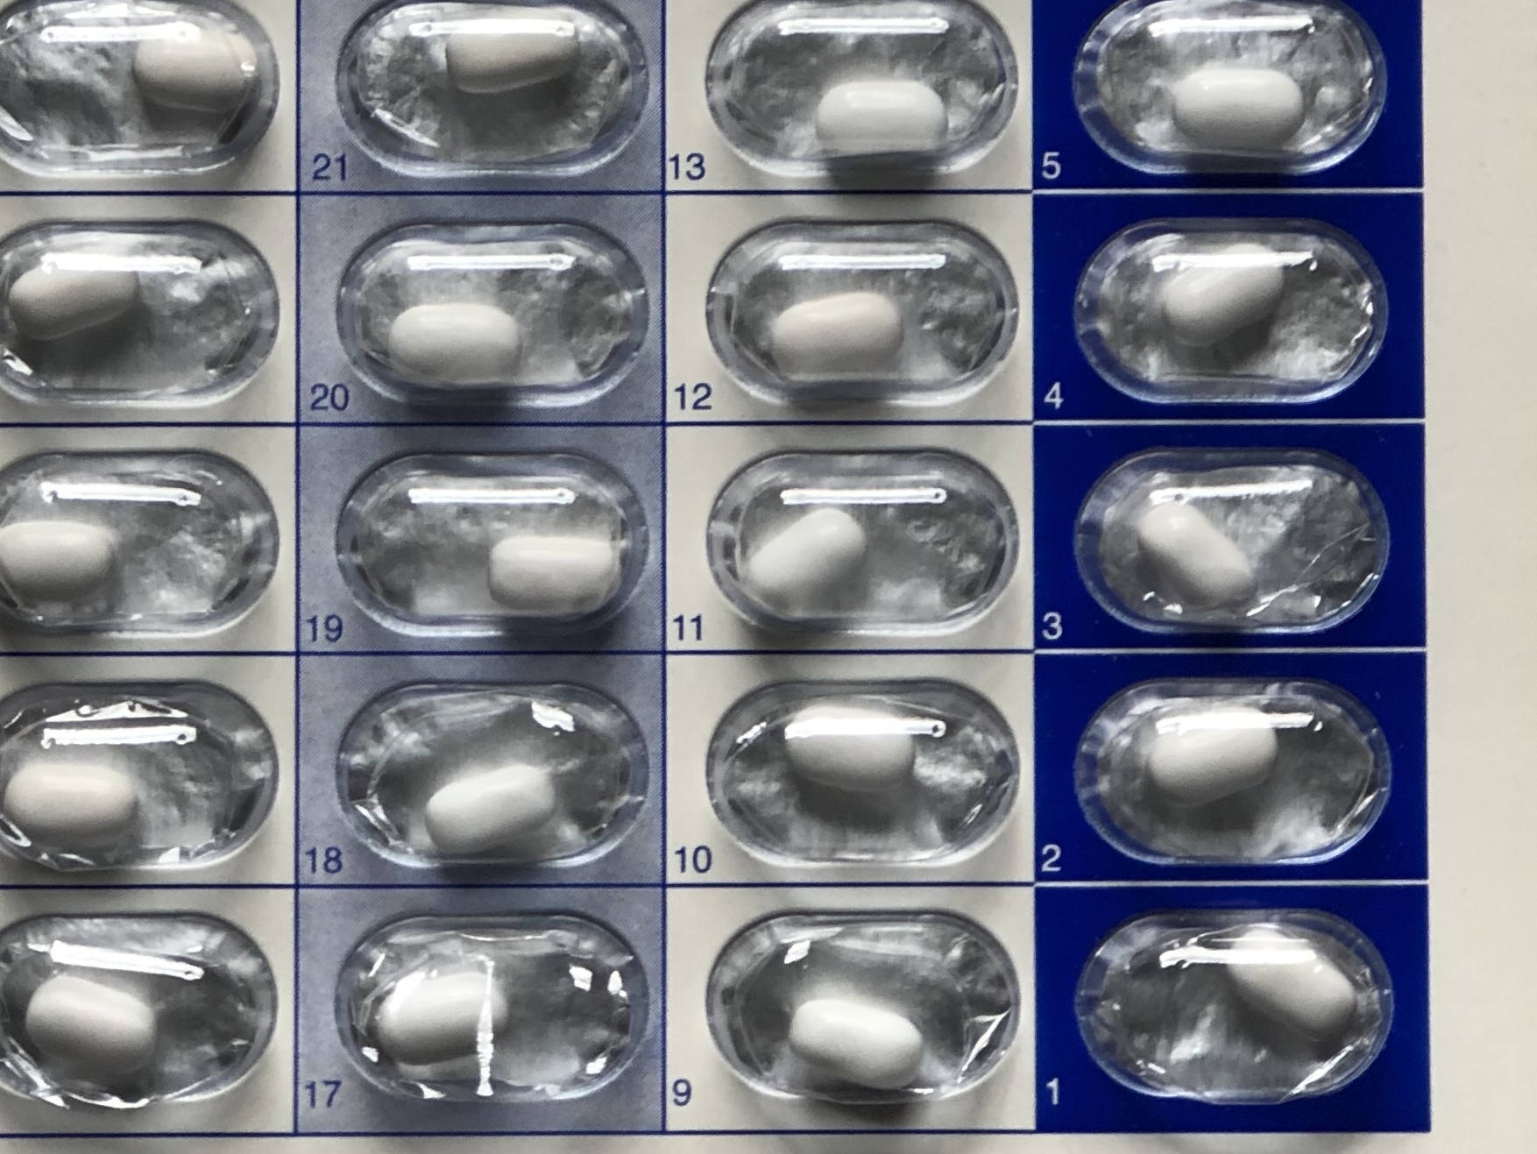
How to Use a Blister Pack
Notes:
To the Trainer:
Review and demonstrate (as if you were going to pop a tab) how to use a blister pack
Start with the highest number
Make a seal under the blister pack with the med cup
Push the tab through the backing directly into the med cup

Slide 30

Medication Administration Practice
Reminders
  Scenario
    Determine correct med to administer
  Documentation
    Med Book
    Count Book
Notes:
To the Trainer: Tell the group, there is a ‘scenario’ before you practice medication administration.
The ‘scenario’ includes:
Name of person
‘Pretend’ date and time you are administering the medication (that corresponds to med sheet, etc.)
Based on the scenario, you must determine the correct medication to administer.
The medication is a countable medication.
When documenting:
Med Book:
Document initials on med sheet
Count Book:
Use index to locate correct count sheet
Spell out ‘Amount Used’ instead of numeral
Stress to use pretend info (date/time).
To the Trainer:
Ensure there are supplies for each pair of staff, their own Med Book and Count Book, med cup, water cup, etc.
Mention to staff they may use the visual grid or the written version of the process to refer to if needed as they practice.
Pair staff off.
(If this is a virtual presentation, each staff will demonstrate the process individually and other staff will follow along with the visual grid to see if all parts of the process were competed.)
Click to next slide for first practice scenario.

Slide 31
Med Pass Scenario
Tanisha Johnson
4pm medication
March 3, yr
Notes:
To the Trainer: Read the scenario then remind staff to read steps out loud and point to what they are reading as they practice. Staff will demonstrate to their partner they can administer meds safely.
Practice
Each staff practices once all the way through with partner observing. Then have them switch roles before moving on to next scenario. While they are practicing you will move around the room, note who has been practicing and who needs extra help, etc. and check Med Book and Count Book documentation.
If there is an odd number of staff, you may need to be someone's partner.
Consider switching up pairs before next scenario.

Slide 32
Med Pass Scenario
Tanisha Johnson
8pm medication
March 3, yr
Notes:
Practice
Consider switching up pairs before next scenario.

Slide 33
Med Pass Scenario
Tanisha Johnson
8am medication
March 4, yr
Notes:
Practice
To the Trainer: you can add as many additional scenarios as you choose in preparation for a demonstration to you by each staff.

Slide 34

Medication Administration Demonstration Assignment/Pretest
  Medication Administration Demonstration
  Trainer will
    Observe you apply your knowledge of the 3 Checks of the 5 Rights
    Give you Feedback
Notes:
Trainer:
Demonstrating how to give a med safely is an assignment/pretest component.
Using a checklist, I will be observing each of you complete a med pass and provide feedback.
To the Trainer:
Select additional scenario(s) of your choice for each staff to demonstrate medication administration for the assignment/pretest purposes.

Slide 35

Questions
Notes:
Trainer to staff:
In conclusion, as you practice at home in preparation for the Certification Skills Test, you can view the med admin video you watched in Unit 7 of your online training as many times as you like.
Q&A

