Slide 1
MAP Trainer Webinar
Spring 2025
Notes:
Hello, and welcome to the Spring 2025 MAP Trainer Webinar. I am Holly Easton, a Department of Developmental Services MAP Coordinator, and I am your webinar presenter. By viewing webinars marked as required within the specified time period, you’ll meet the MAP Trainer meeting attendance requirement. After the webinar, you’re encouraged to contact your MAP Coordinator if you have any questions or need further clarification on a topic presented.

Slide 2
Who’s New in the Field?
Notes:
Let's begin by introducing your new state agency contacts.

Slide 3


State Agency Contacts
Jaime Allard-Smith, BSN, RN
  DMH MAP Director
Rakiatu Sesay, RN
  DMH MAP Coordinator
    Metro Area
Sharon Alfred, RN
  DCF MAP Coordinator
Notes:
Please welcome Jaime Allard-Smith as the new DMH MAP Director. Jaime was formerly a DCF MAP Coordinator.
Rakiatu Sesay is the new Metro Area DMH MAP Coordinator. Joanne Shea, DMH MAP Coordinator, is now covering the Southeast Area.
We would also like to welcome Sharon Alfred, the new DCF MAP Coordinator.

Slide 4
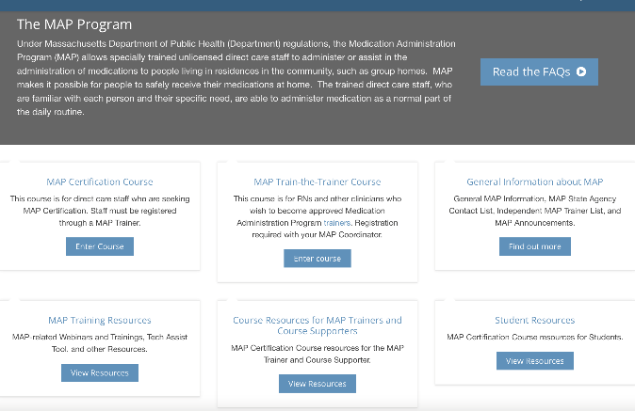
MAP State Agency Contact List
Notes:
Their contact information can be located on the “MAP State Agency Contact List” by clicking on “General Information about MAP”, located on the mapmass.com website.

Slide 5
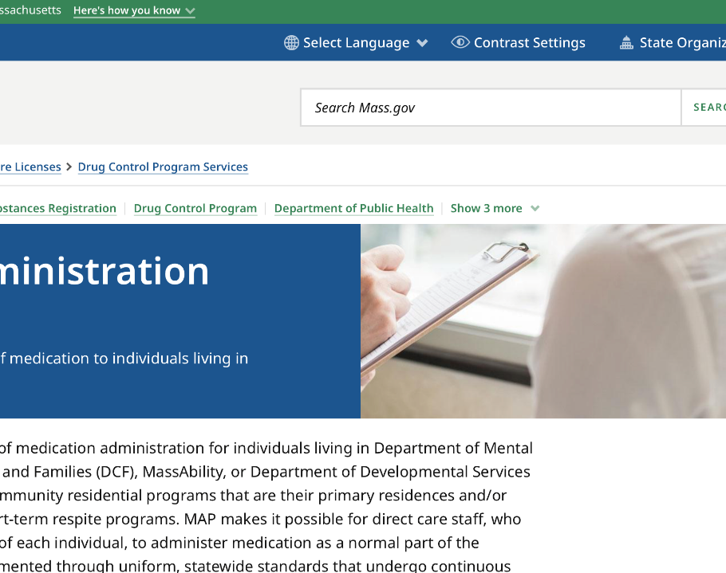
Department of Public Health (DPH)
Updates
Notes:
In the next slides, we will review revisions to MAP Policy, simplified reporting processes for Drug Incident Reports and Hotline Medication Occurrences, Patient Prescribing Directives, and archived MAP news.

Slide 6
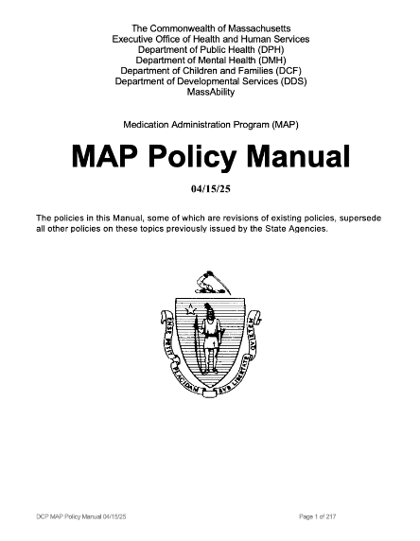
MAP Policy Manual Revisions
Notes:
The MAP Policy Manual has been updated twice since the last webinar. The current version is dated 4-15-25. The next several slides review the policy revision highlights from both updates.

Slide 7
MAP Policy 04-2 Training Direct Care Staff
MAP Certification Hybrid Training
Online MAP Certification Course
Face-to-Face
In-Person or Live Virtual
Notes:
Language was added to MAP Policy 04-2 to clarify that MAP Certification Training must be presented using the hybrid model. The hybrid model consists of the online MAP Certification course and face-to-face sessions for Transcription and Medication Administration Demonstration practice. The MAP Trainer must register students with CDDER so they can complete the online course. Students who do not complete the online course will not be eligible for MAP Certification testing. The face-to-face sessions can take place in-person in a classroom-type setting, or virtually. It is not acceptable for MAP Trainers to provide training that does not include students' enrollment in the online course and its completion.

Slide 8

MAP Policy 10-1 Acceptable Prescription Medication Packaging
Signed “Agreement”
  Service Provider and Pharmacy
Notes:
MAP Policy 10-1 now states that an “agreement” versus a “contract” is required with the pharmacy when utilizing multi-dose medication packaging.

Slide 9

MAP Policy 10-4 Exhausting the Current Supply of Medication
MAP Consultant
  Health Care Provider
  Registered Pharmacist
  Registered Nurse
Notes:
MAP Policy10-4, Exhausting the Current Supply of Medication, now reflects that any MAP Consultant, versus only the pharmacist, may verify if medication on-hand allows for proper preparation and administration.

Slide 10
MAP Policy 12-2 Schedule II-V Medication Security Measures
Day Programs
On Days Program is Closed
  Exempt from Reconciling Schedule II-V Medication
Notes:
Language in MAP Policy 12-2 now recognizes that some MAP Registered sites (e.g., Day Programs) are not operational 24-hours per day/7-days per week. These sites are exempt from reconciling the Schedule II-V medications and high-risk Schedule VI medications on the days the Program is closed.

Slide 11
MAP Policy 13-1 Medication Administration
Certified Staff Not Permitted to Administer Topical Medication
  To Skin Conditions
    open pressure ulcers
    diabetic foot ulcers
    infected wounds
    burns, etc.
  Requiring Additional Care and Treatment
    assessment
    dressing change, etc.
Notes:
Certified staff are permitted to administer topical medication to minor skin conditions such as redness, a rash, mild abrasions, etc. MAP Policy 13-1 clarifies that MAP Certified staff are not permitted to administer topical medication to certain skin conditions, such as open wounds that require additional care and treatment.

Slide 12

MAP Policy 14-1 Service Provider MAP Policies
Notes:
Language was added to MAP Policy 14-1 to reflect the need for additional Service Provider Policies if a service provider chooses to train MAP Certified staff to administer insulin or injectable Schedule VI medications as indicated in MAP Policy Section 19.

Slide 13
MAP Policy 19-4 Administration Via Gastrostomy (G) or Jejunostomy (J) Tube Route
Initial Training
  RN or HCP
Subsequent Training
  LPN
Notes:
MAP Policy 19-4 now indicates that after initial G or J tube training by an RN or HCP, an LPN who is able to demonstrate initial and continued competence in medication administration via G or J tube may provide subsequent training.

Slide 14
MAP Policy 19-8 High Alert Medication- Clozapine (Clozaril) Therapy
High-Alert Medication
One Required Competency Form
  “Clozapine Therapy Training”
Forms No Longer Required
  Clozapine Medication Sheet
  Individual-Specific Competency
  Clozapine Protocol
FDA Advisory https://www.fda.gov/drugs/postmarket-drug-safety-information-patients-and-providers/information-clozapine
Notes:
The FDA recently removed Clozapine from the Risk Evaluation and Mitigation Strategies Program, known as the REMS program. This means that pharmacies are no longer required to receive lab results prior to dispensing the medication. Clozapine remains a “high-alert” medication with additional training requirements. For further information, please see the advisory at the link on your screen. MAP Policy 19-8 has been updated to reflect these changes.

Slide 15
MAP Policy 19-9 High Alert Medication-Insulin (via Insulin Pen)Therapy
MAP Certified Staff May Administer Insulin
Current Massachusetts CNA Certification
Specialized Insulin Training
Two Insulin Trained Certified Staff Present for Administration
This Policy is Optional
Notes:
MAP Policy 19-9 and linked competency evaluation forms allow Certified staff who hold current Massachusetts CNA Certification, meet the specified criteria, and are successfully trained, to administer insulin according to an HCP order. The insulin must be in a pharmacy labeled, prefilled auto-injector pen. There must be two Insulin Trained Certified staff present for the administration of insulin. The Service Provider must ensure that adequate Insulin Trained Certified staff are available for insulin administration and have a backup plan when unable to meet this staffing requirement. The applicable MAP Coordinator must be informed prior to a site instituting this policy.
Please be aware that sites may continue to utilize licensed staff to administer insulin and are not required to institute this policy. This policy is optional.

Slide 16
MAP Policy 19-10 Schedule VI Injectable Medication
  Pen device
  Subcutaneous Route
    Exception: Epinephrine via Auto-Injector device
Notes:
MAP Policy 19-10 allows trained Certified staff to administer Schedule VI injectable medications subcutaneously via a pen device. Medication can only be administered subcutaneously, with the exception of Epinephrine via Auto-Injector device.

Slide 17
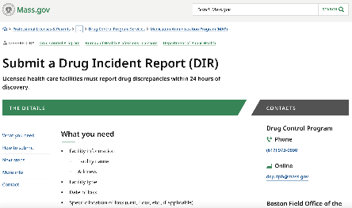
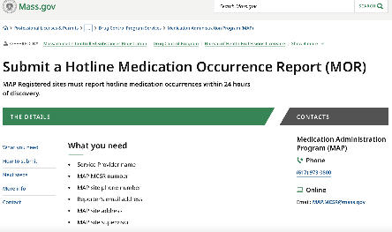
www.mass.gov/dph/map
Reporting Processes Simplified
    Drug Incident Report (DIR)
    Hotline Medication Occurrence Report (MOR)
Notes:
The Department of Public Health has simplified the online Drug Incident Report and Hotline Medication Occurrence reporting processes. When submitting a DIR or hotline MOR, please use the corresponding link found on the mass.gov website.

Slide 18
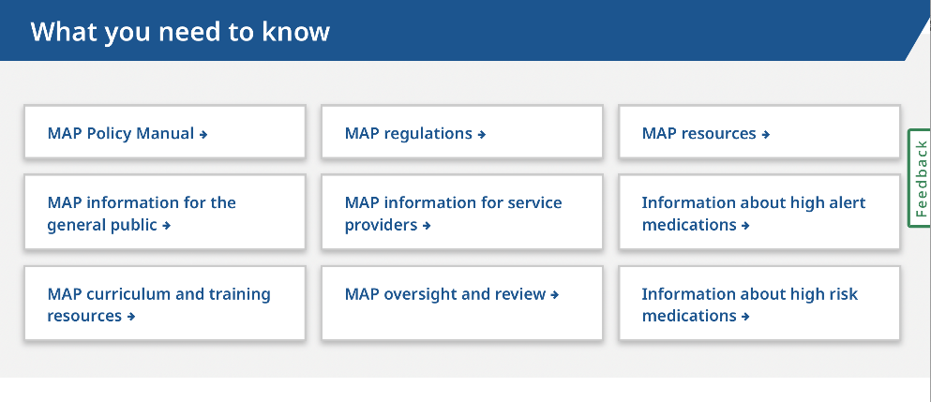
Patient Prescribing Directives
Notes:
An updated guidance circular was released on 04-22-25 for Health Care Providers and Pharmacists to ensure all the essential MAP components are included when writing HCP orders and prescriptions. The circular is located on the mass.gov website in the MAP Resources section.

Slide 19
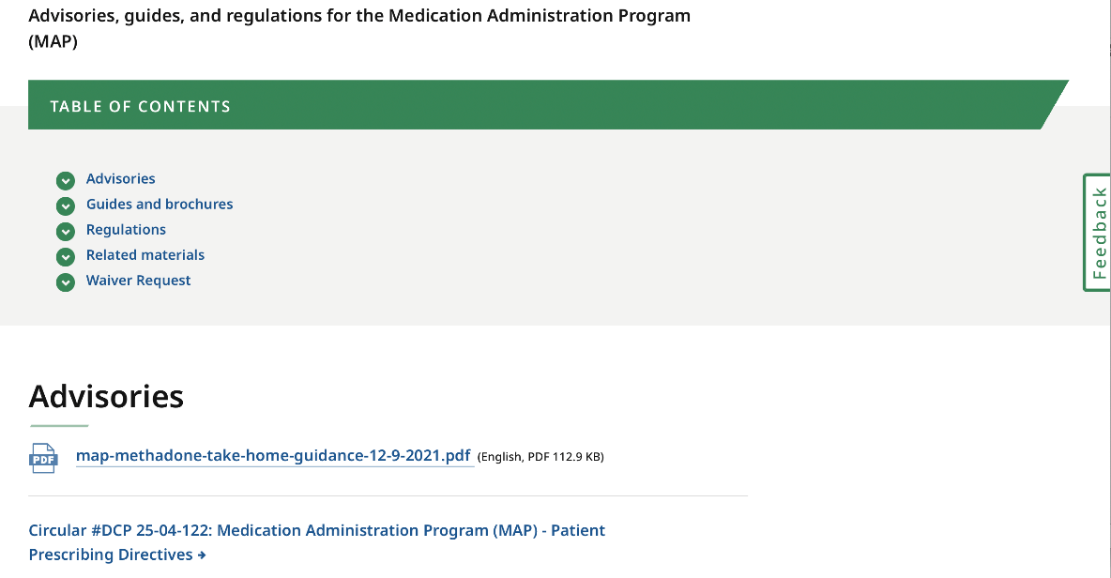
Notes:
After you click on the MAP resources section, the circular is found under Advisories.

Slide 20
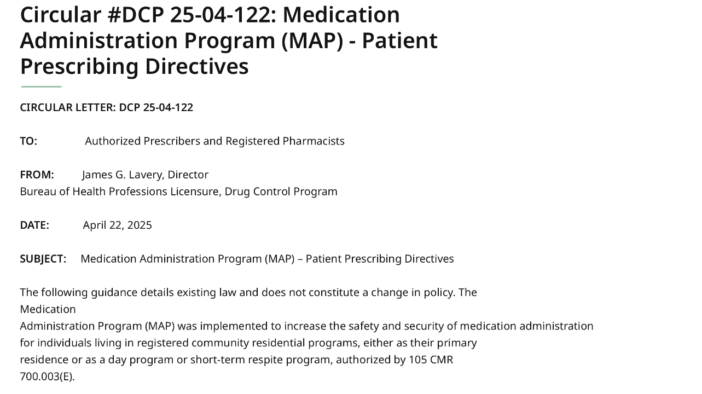
Notes:
The circular details existing law and does not constitute a change in policy.

Slide 21
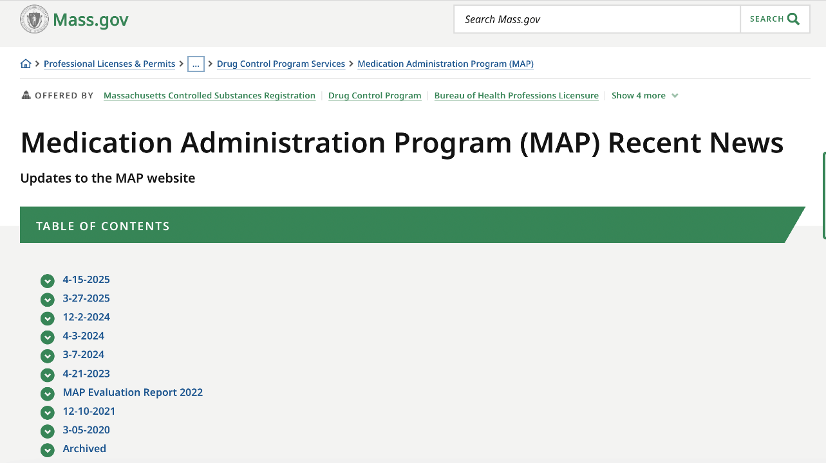
Notes:
"What's New: MAP Recent News" has been updated by moving outdated items to an archive folder.

Slide 22
DPH Reminder – MAP Policy 11-3
Transcription of Medication Management System (TMM System)
Notes:
In addition to these updates, the following is a DPH reminder: Service Providers that utilize Certified staff to complete the Transcription of HCP Orders must have a TMM System Policy. Certified staff who will be assigned the tasks of Transcription, Posting and Verifying, and Accuracy Checks must successfully complete a Service Provider TMM System Training. Staff must be Certified prior to receiving TMM System Training. TMM System Training documents, including a completed Service Provider TMM System Competency Evaluation Tool for each Certified staff trained, must be maintained at the MAP Registered site.

Slide 23
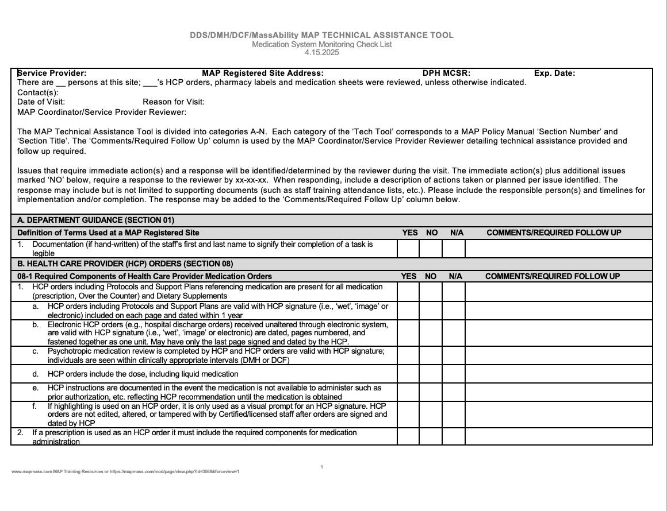
MAP Technical Assistance Tool
Located on:
www.mapmass.com
www.mass.gov/dph/map
Notes:
The MAP Policy Manual updates reviewed in this webinar have been incorporated into the current Tech Tool dated 4-15-2025. The tool is posted on both mapmass.com and the DPH MAP website. It is available as a Word version and as a fillable PDF.

Slide 24
MAP Certification Course
Updates
Notes:
Next, let's review updates to the MAP Certification Course.

Slide 25
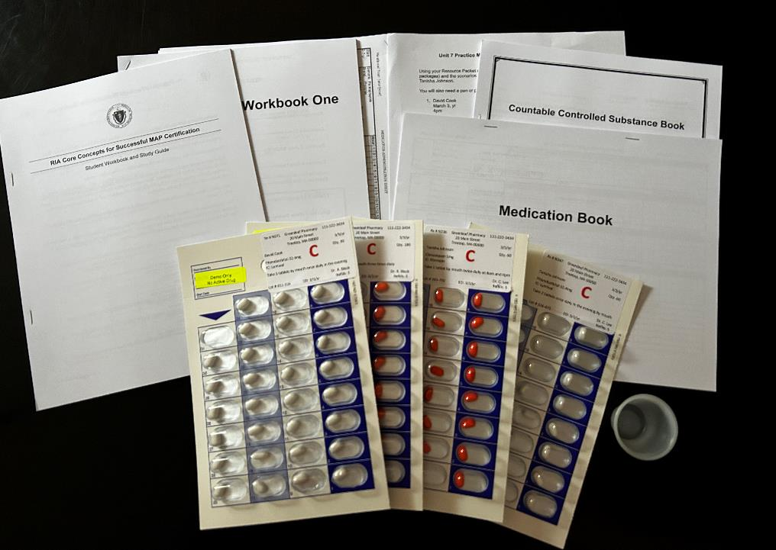
Resource Packet
New Materials
  David Cook Blister Packages
  Updated Scenario List
Notes:
Additional training materials are now included in the Resource Packets. The new materials include David Cook’s blister packs and a medication administration scenario list incorporating David Cook.

Slide 26
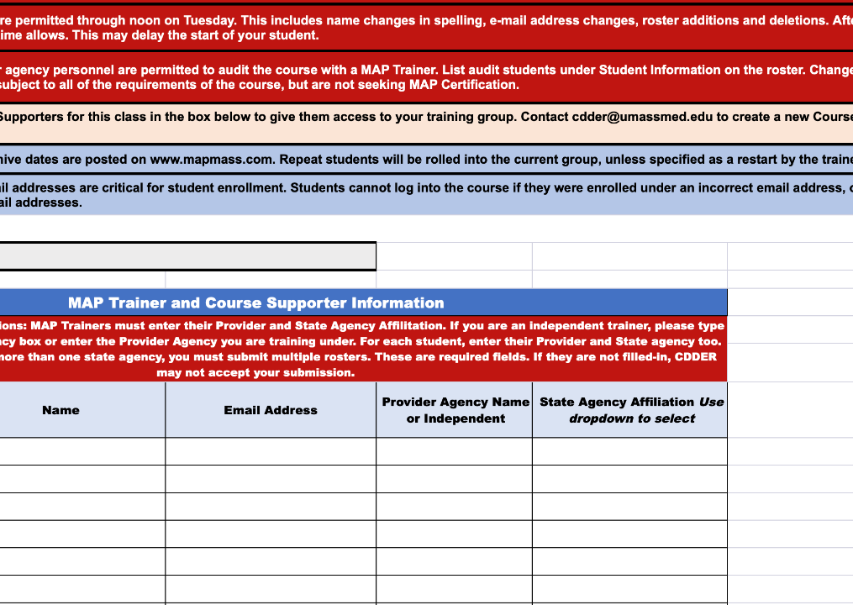
Roster Revision
Notes:
A revised roster form for student enrollment in the online course will be available on mapmass.com by June 6th, 2025. The updates include new required fields for the Provider Agency name and the state agency affiliation for each MAP Trainer, Course Supporter and student listed on the roster. Trainers should begin using the revised roster form as soon as it becomes available.

Slide 27

MAP Certification Course Access
As of August 7th
  4 Months Access
Notes:
Beginning with the August 7th online class, students' access to the RIA course will be shortened from 6 months to 4 months, for closer alignment with the testing timeline. The four months begin from the date of course enrollment. This change will not affect students enrolled prior to August 7th, 2025.

Slide 28
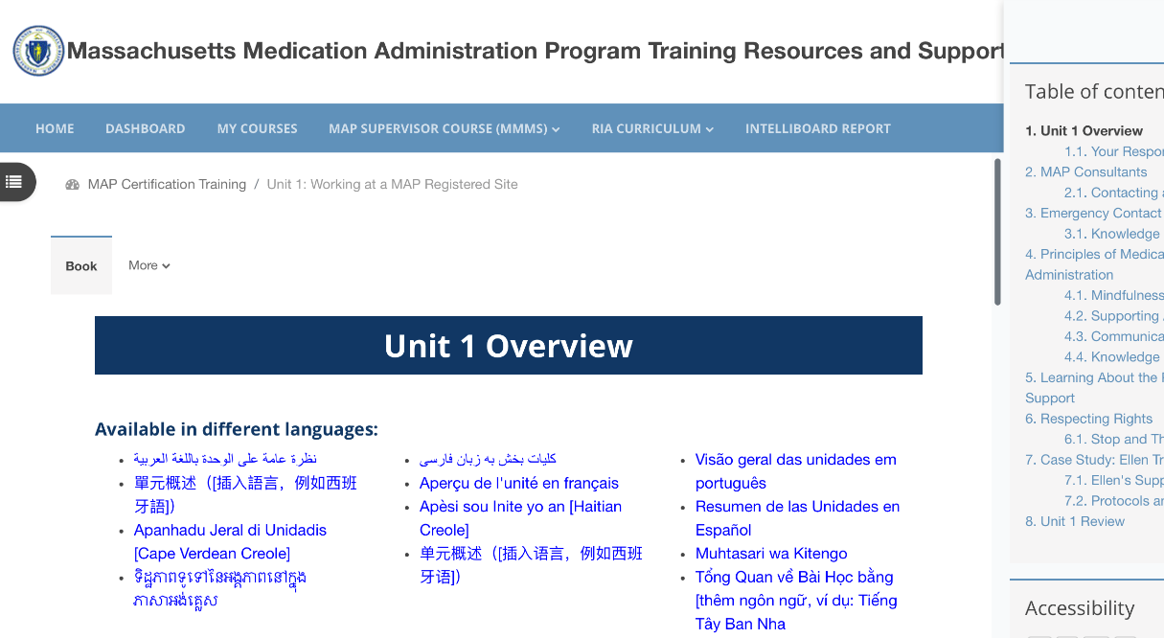
Notes:
Unit Overviews now appear in the online course at the beginning of each unit. They are translated into multiple languages as an added support for non-native English speakers. These are summaries of key content and MAP terminology covered in each Unit.

Slide 29
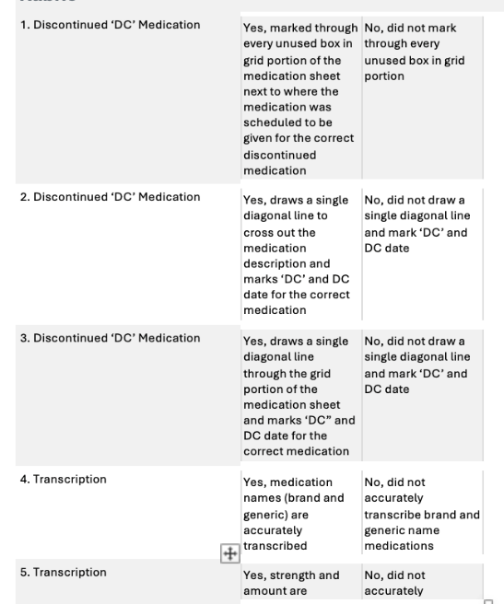
MAP Certification Course Completion
Units and Corresponding Quizzes
Transcription Assignment
  Transcription Rubric
Notes:
The definition of MAP Certification course completion has been slightly modified. Course completion is now defined as successfully completing the 9 Units and the corresponding quizzes along with the Transcription Assignment scored using the grading rubric within the course. The MAP Trainer must score a passing Transcription Assignment using the grading rubric within the course before the student is eligible to take the Unit 9 quiz and complete the course.

Slide 30
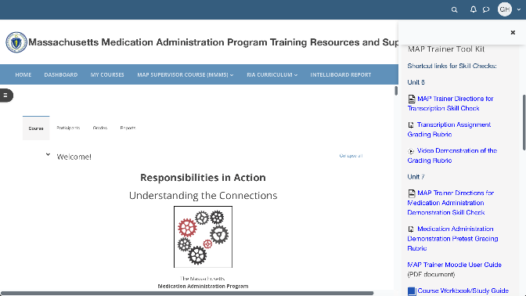
How to use Rubric to Grade Transcription Assignment
Notes:
A video demonstration of how to use the grading rubric to score the Transcription Assignment is now available in the MAP Trainer Tool Kit. Regardless of the method used to complete the Transcription Assignment (i.e., electronically in TMU or on paper), the MAP Trainer must complete the Transcription Assignment Rubric within the online course.

Slide 31

Revised February 2025
Notes:
The optional Unit 7 PowerPoint presentation for use during face-to-face (virtual or in-person) skill sessions was updated to include David Cook medication pass scenarios.

Slide 32
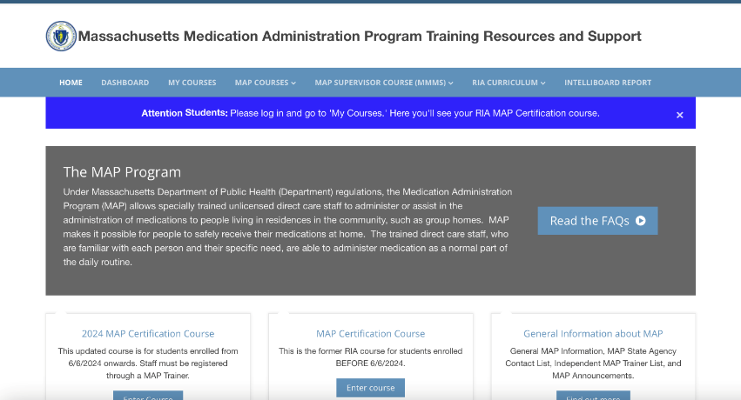
Intelliboard Report
Notes:
There is now an enhanced reporting tool available to MAP Trainers and Course Supporters on mapmass.com called Intelliboard. Intelliboard shows all of a MAP Trainer's student records, regardless of group, including when they last accessed the course, time spent, and whether they’ve completed the course.
These reports are accessed by clicking on “Intelliboard Report” in the upper menu.

Slide 33
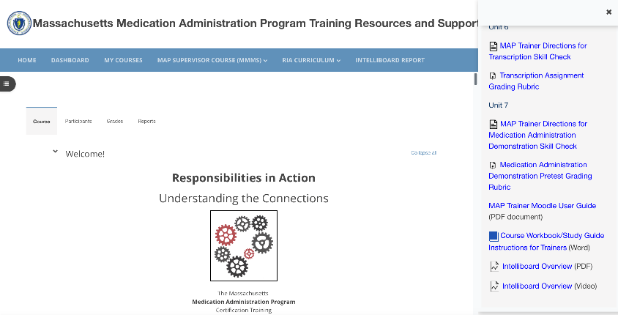
Intelliboard Report
Notes:
There are 3 dashboards under the Intelliboard Report that reflect Student Training, Student Activity Completion, and Student Submission Status.
For detailed information on what each dashboard includes, go to the MAP Trainer Tool Kit. The tool kit includes an Intelliboard Overview PDF document and a video.

Slide 34

In Process!
MAP Certification Online Course
Deaf and Hard of Hearing Students who use American Sign Language (ASL)
Notes:
The MAP Certification online course specifically designed for students that are deaf and hard of hearing continues to be developed and reviewed by ASL interpreters and MAP content experts. Expanded glossary terms are being translated into ASL. These will appear as pop-up videos when the student hovers over the word. In addition, the Unit overviews, which are currently translated into multiple languages, will be translated into ASL as well.

Slide 35
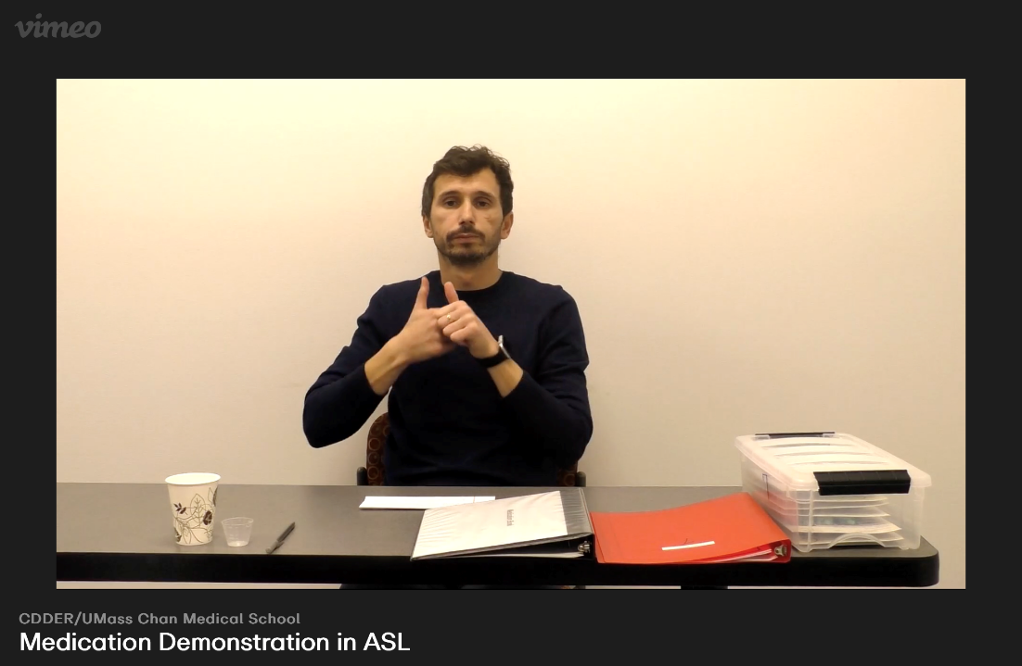
Notes:
A medication administration demonstration video conducted by Alexandru Avram is already available in the RIA Course Video collection under "Student Resources" within the MAP Certification online course.

Slide 36
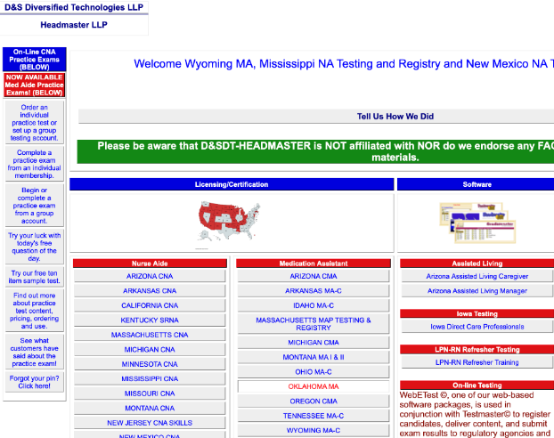
D&S Diversified Technologies
Testing Vendor
Notes:
In the next slides, we will review updates and reminders from D&S, the testing vendor.

Slide 37
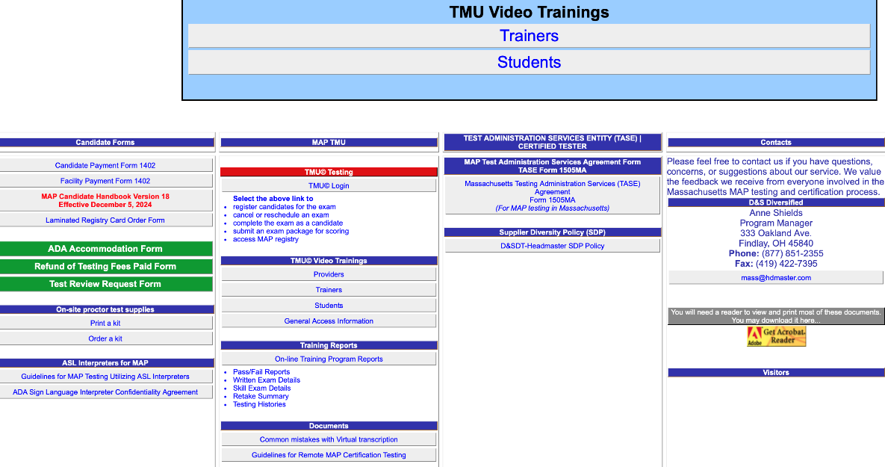
Notes:
The TMU Video Tutorials for MAP Trainers have been updated.

Slide 38
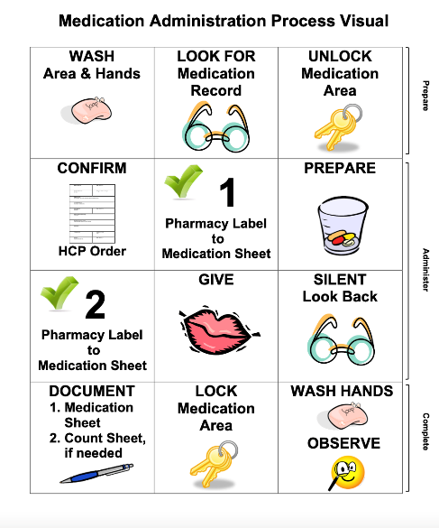
Certification Knowledge Test Questions
Revised Medication Administration Process
Notes:
As of January 2025, questions on the MAP Certification Knowledge Test reflecting the revised medication administration process were incorporated into the test question bank.

Slide 39
Test Packet Materials
Medication Book, Count Book, Blister Packages
  Do Not Use for Practice
Notes:
Service Provider Test Proctors and MAP Trainers must never provide Test Packet materials to staff for practice.

Slide 40
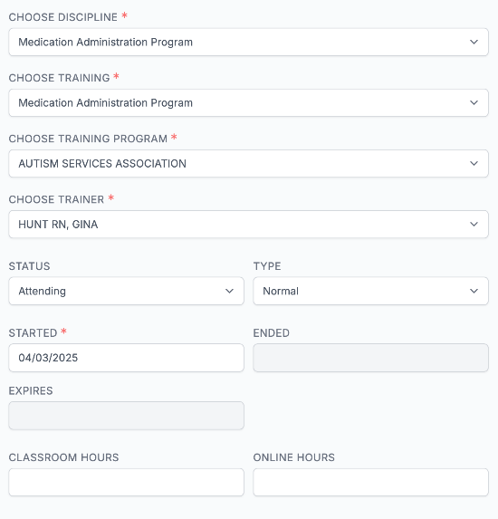
Student TMU© Record
Notes:
Training Hours in the student TMU© record are now required fields. The MAP Trainer must enter the number of training hours spent in face-to-face skill sessions under the "Classroom" field and the number of training hours spent in the online course under the "Online" field. Any questions about this requirement – or any other aspect of a student's record – should be addressed by calling D&S.

Slide 41
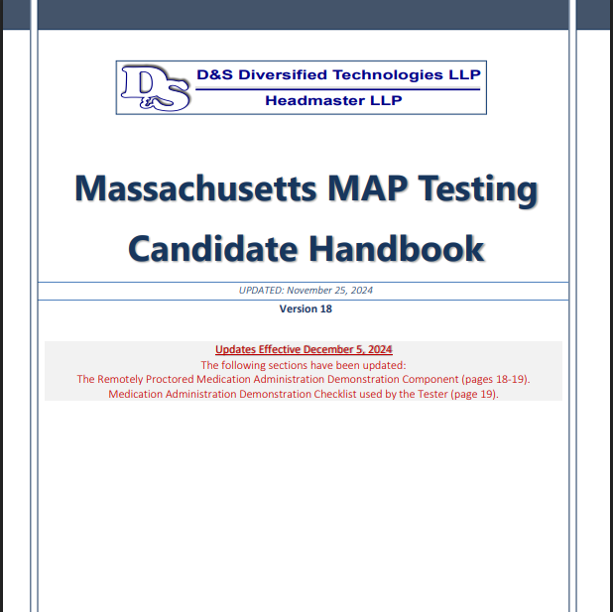
MAP Candidate Handbook
Version 18
  Updates effective December 5, 2024
Notes:
Version 18 of the MAP Candidate Handbook can be found on the hdmaster.com website.

Slide 42

No-Show Fee Structure
Notes:
When the Knowledge Test and the Medication Administration Demonstration Test are scheduled on the same day and the test candidate is a no show for both tests, the no-show fee is $45 per test missed. In this case, the total no-show fee would be $90.

Slide 43
Medication Occurrences
Reminders
Notes:
Now for some reminders about medication occurrences.

Slide 44

Hotline Reporting Requirements
Within 24 Hours via Reporting Systems
  Department of Public Health
  Applicable State Agency MAP Coordinator
Notes:
All hotline medication occurrences must be reported within 24 hours of discovery to both DPH and the applicable State Agency MAP Coordinator.

Slide 45
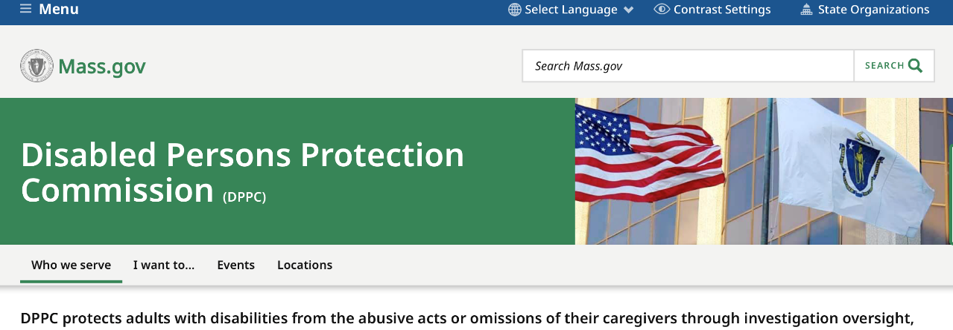
Additional Hotline Reporting Requirements
DDS and MassAbility
  DPPC Notification
Notes:
DDS and MassAbility require a DPPC report to be filed for all hotlines. The DPPC number must be forwarded to the applicable MAP Coordinator.

Slide 46
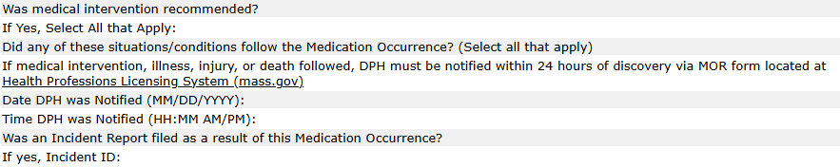
Additional DDS Hotline Reporting Requirements
Notes:
For DDS hotlines, an Incident Report ID number must be included on the HCSIS MOR form. An Incident Report ID number is generated by the service provider's report submitted in HCSIS for the intervention related to the hotline (e.g., lab work, an ER visit, unexpected hospitalization, etc.).

Slide 47

MORs
MORs must be reported to a MAP Consultant for EACH dose missed or given in error
Documentation:
name of person notified
recommendation
date/time of event
date/time of notification
Notes:
All medication occurrences must be reported to the MAP Consultant at the time of discovery. This includes each dose missed or given in error. The MAP Consultant will give guidance on steps to take regarding medication not available to give. The HCP should be contacted as soon as possible to report any medications not available from the pharmacy. A progress note should be written for every MOR that includes: the full name of the MAP Consultant contacted, recommendations given, the date and time of the event, as well as the date and time of the notification.

Slide 48
Active MAP Trainer Status
Reminders
Notes:
Finally, let's review what you need to do to keep your MAP Trainer status active.

Slide 49

MAP Trainer Contact Information
Notify CDDER
Email Changes
CDDER@umassmed.edu
Notes:
Email notification is the primary means of communication to MAP Trainers. You must report changes in your email address to CDDER. CDDER sends out regular email blasts to all trainers to provide updates, new information related to MAP, and to announce that required webinars are posted for viewing.

Slide 50
Maintain Active MAP Trainer Status
Required Webinars
One Hybrid MAP Certification Training Yearly
Notes:
To maintain your Active MAP Trainer status, you must view required webinars and conduct a minimum of one MAP Certification Training a year.

Slide 51
Maintain Active MAP Trainer Status
Required Webinars
  Specified Viewing Time Frame
Notes:
You will receive a notification via your email account on record with CDDER when a new webinar is released. You must view required webinars within the specified time frame in order meet the MAP Trainer meeting attendance requirement .

Slide 52
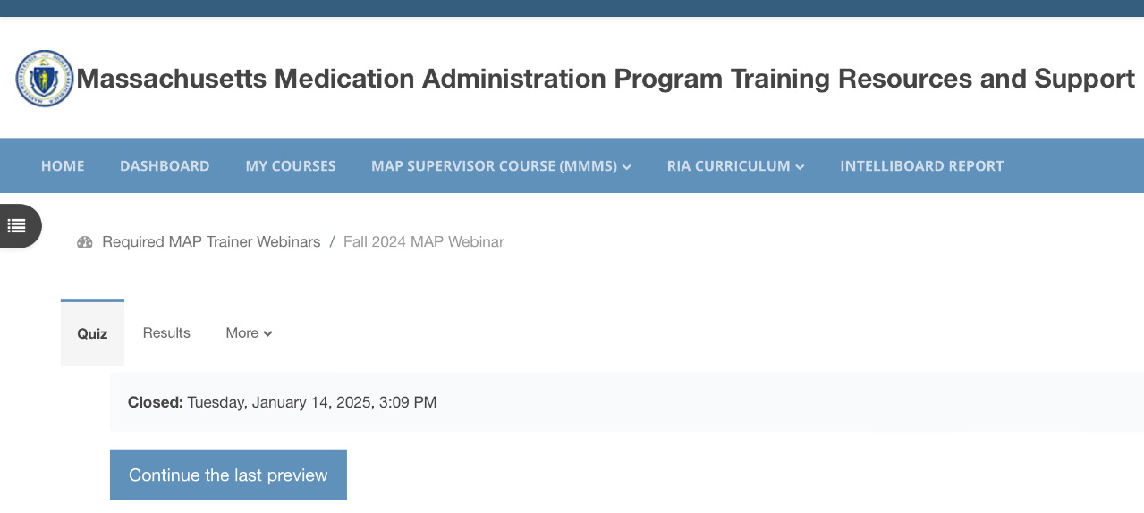
Rewatching the Required MAP Webinar
Re-attempt quiz
Notes:
If you would like to rewatch the webinar, and it’s still within the viewing period, simply click on the name of the webinar. Then, click "Re-attempt Quiz." This will bring you back to the webinar and the PowerPoint slides.

Slide 53
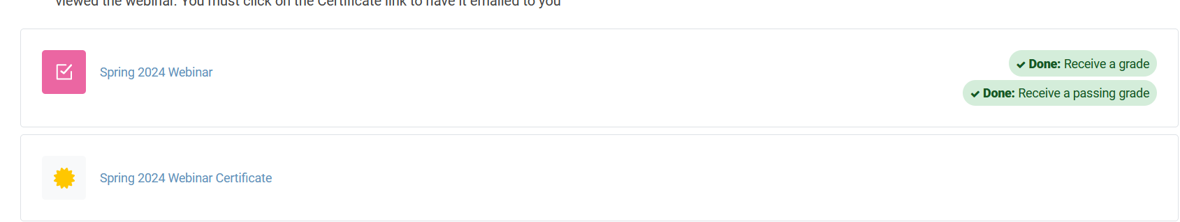
Webinar Compliance Status
Spring 2025 Webinar
Spring 2025 Webinar Certificate
Notes:
A Trainer can monitor their webinar compliance by logging onto mapmass.com and going into the Required MAP Trainer Webinars course. All webinars are listed on the dashboard. When a trainer sees “To do” in grey, this means the webinar is not yet completed. Conversely, if the trainer sees “Done” in green, this means the webinar was successfully completed.
When you have successfully completed a webinar, you will see the Certificate of Completion on the dashboard, directly under the name of the webinar. Here’s an example from the Spring 2025 webinar. The Certificate of Completion and your green completion status remain on the dashboard even after the viewing period has ended.

Slide 54
Archived Webinars
Remain in Required MAP Trainer Webinars course
  After Viewing Period Ends
    No Credit for Viewing
Posted on www.mapmass.com
  MAP Training Resources Section
    Anyone can Access
Notes:
Required MAP Trainer Webinars are archived after the specified viewing time frame has passed. They remain in the Required MAP Trainers Webinars course but can no longer be viewed for credit. The webinars are then also posted to the "MAP Training Resources" section of the mapmass.com home page, where they are accessible to all.

Slide 55
Maintain Active MAP Trainer Status
One Hybrid MAP Certification Training Yearly
    Current Trainers
      Within One Year of Date of Your Last Training
    New Trainers
      One Year from Date Your Status is Changed to “Trainer”
Notes:
In addition to the webinar requirement, you must conduct a minimum of one hybrid MAP Certification Training within one year of the date of your last training.
For current trainers, the once-a-year requirement is calculated using your last Certification Training date. You must ensure that your next training falls within 365 days of that date. For example, a trainer conducts a Certification Training beginning May 21st, 2025. To meet the requirement of training at least annually, the trainer must begin a Certification Training before May 21st, 2026.
For new trainers, your one-year clock starts when your status is changed to "Trainer" on mapmass.com.

Slide 56
Co-Training MAP Certification Course
CDDER Student Roster
Each Trainer Name is Included
TMU Student Records
Each Trainer is Assigned Separate Students
Notes:
MAP Trainers may co-train the online MAP Certification Training and skills sessions, provided that all Trainers actively participate in the training.
If you choose to co-train a MAP Certification class, the student roster submitted to CDDER must include all trainer names. Each Co-Trainer must also have separate students assigned to them to enter in TMU. If a Co-Trainer is not on a roster submitted to CDDER or does not have any students assigned to them in TMU, the trainer will not receive credit for conducting the Certification Training.
In addition, at least one of the students assigned to each trainer must complete all components of the training, and a valid training end date must be entered in TMU in order for that trainer to fulfill the training requirement. If a trainer is assigned only 1 or 2 students, and those students do not complete the training, the trainer will not receive credit for conducting a yearly Certification Training.

Slide 57

Thank you for viewing!
Notes:
This concludes the Spring 2025 MAP Trainer Webinar. Please contact your State, Regional or Area MAP Coordinator if you have any questions or need further clarification on a topic presented. Thank you for viewing!

