Slide 1
Summer 2023
MAP Trainer Webinar
Notes:
Welcome to the semi-annual MAP Trainer webinar. I’m Holly Harrison, a Department of Developmental Services MAP Coordinator and I’m your webinar presenter.
By viewing webinars marked as ‘required’ within the specified time period, you’ll meet the MAP Trainer meeting ‘attendance’ requirement.
After the webinar, you’re encouraged to contact your MAP Coordinator if you have any questions or need further clarification on a topic presented.

Slide 2
Agenda
What’s New
MAP Updates
Reminders
Notes:
The agenda for this webinar is as follows: What's New, MAP Updates, and Reminders.

Slide 3
What's new
Notes:
Let's begin with 'What's New’.

Slide 4
Please welcome
Department of Developmental Services
Heather Lake, RN, MSN, CDDN
DDS MAP Director
Brittany Schifone, RN, BSN
DDS MAP Coordinator, Southeast Region
Department of Children and Families
Jaime Allard Smith, RN
DCF MAP Coordinator
MASSACHUSETTS REHABILITATION COMMISSION
Caroline Eldred, RN
MRC MAP Coordinator
Notes:
We would like to welcome Heather Lake, the new Department of Developmental Services MAP Director. Heather has been with DDS for more than five years as the MAP Coordinator in the Southeast Region.
There are also three new MAP Coordinators, Brittany Schifone with the Department of Developmental Services, Jaime Allard Smith with the Department of Children and Families, and Caroline Eldred with the Massachusetts Rehabilitation Commission.

Slide 5
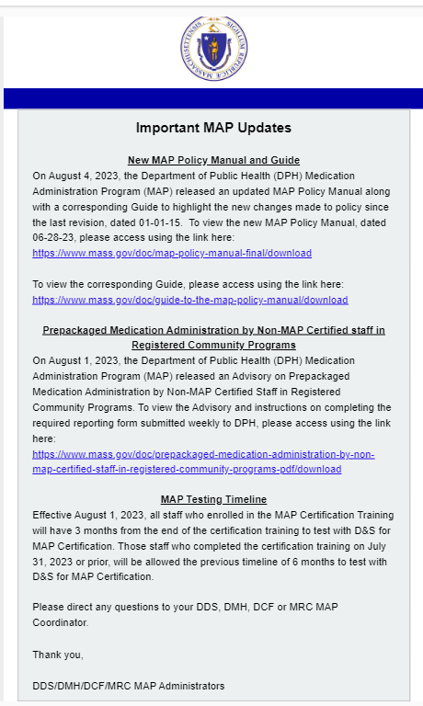
New MAP Policy Manual and guide
Updated policy released 8/4/2023
https://www.mass.gov/doc/map-policy-manual-final/download
Guide to highlight changes
https://www.mass.gov/doc/guide-to-the-map-policy-manual/download
Notes:
On August 4th, 2023, the Department of Public Health (DPH) Medication Administration Program (MAP) released an updated MAP Policy Manual along with a corresponding Guide to highlight changes made to policy since the last revision, dated January 1st, 2015.
The links on your screen will bring you to the updated policy manual and the corresponding guide.

Slide 6
END Of public health emergency 05/11/2023
End of Federal COVID-19 Public Health Emergency (PHE) Declaration
CDC info:
https://www.cdc.gov/coronavirus/2019-ncov/your-health/end-of-phe.html#:~:text=May%2011%2C%202023%2C%20marks%20the,public%20health%20data%20will%20expire.
End of COVID-19 Public Health Emergency (PHE) in Massachusetts
Massachusetts info:
https://www.mass.gov/news/healey-driscoll-administration-announces-end-of-covid-19-public-health-emergency-in-massachusetts
Notes:
Both the federal and Massachusetts COVID-19 Public Health Emergency (PHE) declarations ended on May 11, 2023.
Additional information is available at the links provided on your screen.

Slide 7
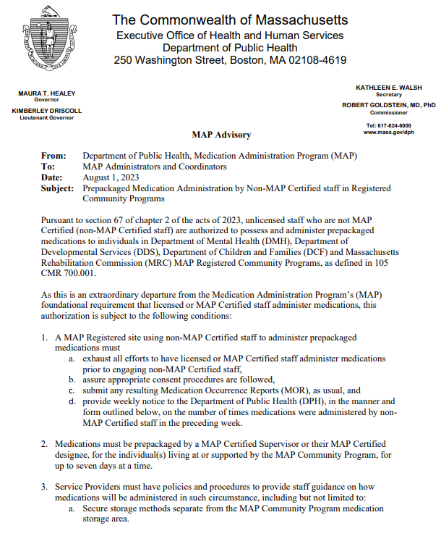
prepackaged medications administered by non-map certified staff
Limited extension of administration of Prepackaged Medication:
DPH guidance and reporting requirements in advisory 8/1/2023
https://www.mass.gov/doc/prepackaged-medication-administration-by-non-map-certified-staff-in-registered-community-programs-pdf/download
Notes:
The end of the Public Health Emergency (PHE) also ends the DPH flexibilities put in place during the pandemic.
However, with the end of the Public Health Emergency declaration on May 11th, 2023, legislation has granted an extension of the MAP authorization for unlicensed, non-MAP Certified staff to administer prepackaged medications to individuals in MAP Registered Community Programs through November 10, 2023. Please note the advisory posted on August 1st, 2023, by the Department of Public Health details the required reporting that providers must complete and submit weekly. The link on your screen will bring you to that advisory.

Slide 8
DPH Waivers
Virtual Two-Person Count
Virtual Medication Disposal
Notes:
As they are not flexibilities, the Virtual Two-Person Count and Virtual Disposal of Countable Controlled Substances are still are available by applying for a DPH waiver.

Slide 9
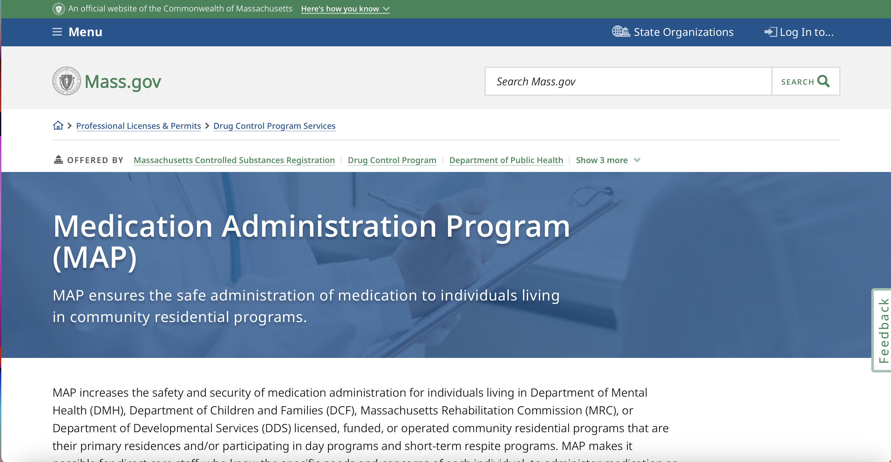
Mass.gov/dph/map
Notes:
The waiver template used to apply for these, or other alternate processes is located on the mass.gov website.
Using the MAP-friendly URL seen on your screen, scroll down...

Slide 10
Notes:
Click "MAP Resources"…

Slide 11
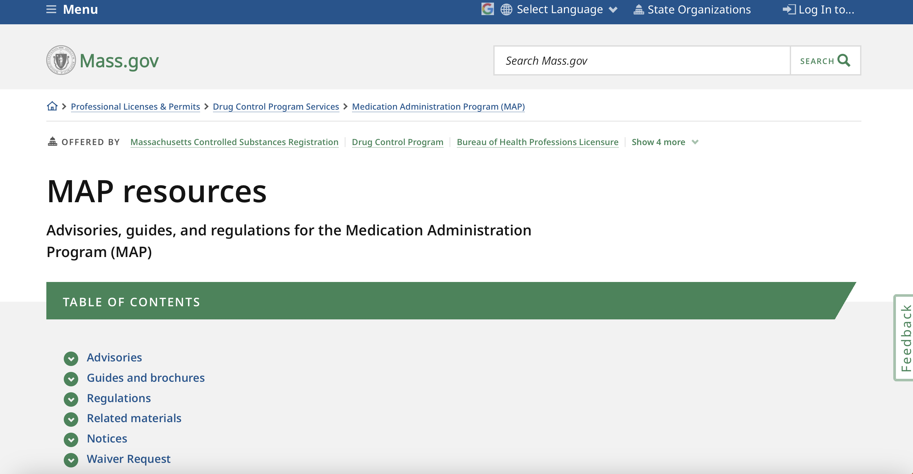
Notes:
Then click "Waiver Request" to access the waiver template.

Slide 12
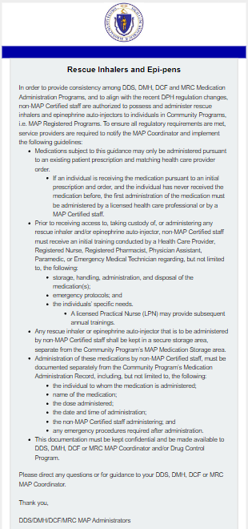
Rescue Inhalers and Epi-pens
DPH regulations promulgated for administration by non-MAP Certified staff
Training and other conditions must be met
MAP State Agencies have distributed guidance for MAP Registered Programs
Notes:
In the promulgated regulations of February 1st, 2023, DPH now allows the administration of rescue inhalers and Epi-pens by non-MAP Certified staff under certain conditions. As a result of the regulation change, the MAP State Agencies have recently developed guidance for MAP Registered Programs. This guidance was distributed by CDDER via email in July. If you have any questions about the guidance, please contact your State Agency MAP Coordinator.

Slide 13
Map packets
Resource Packet
Test Packet
No cost
Transcription Workbook One added
Cost Increase
https://mapmass.com/mod/page/view.php?id=3483&forceview=1
Notes:
MAP Packets for both Training and Testing are now available from the Center for Developmental Disabilities Evaluation and Research (CDDER).
Notification detailing the new online ordering process and vendor was emailed by CDDER to all current MAP Trainers.
The Resource Packet, used in Certification Training, now includes Transcription Workbook One, and there is no charge for the packets.
The price of the Test Packets has increased due to supply costs and is now approximately $28.00 including shipping.
Payment for a Test Packet must be with a credit card.
MAP Packet orders will be processed and mailed by CDDER once a week.
The link on your screen will bring you directly to the MAP Packet information page on mapmass.com

Slide 14
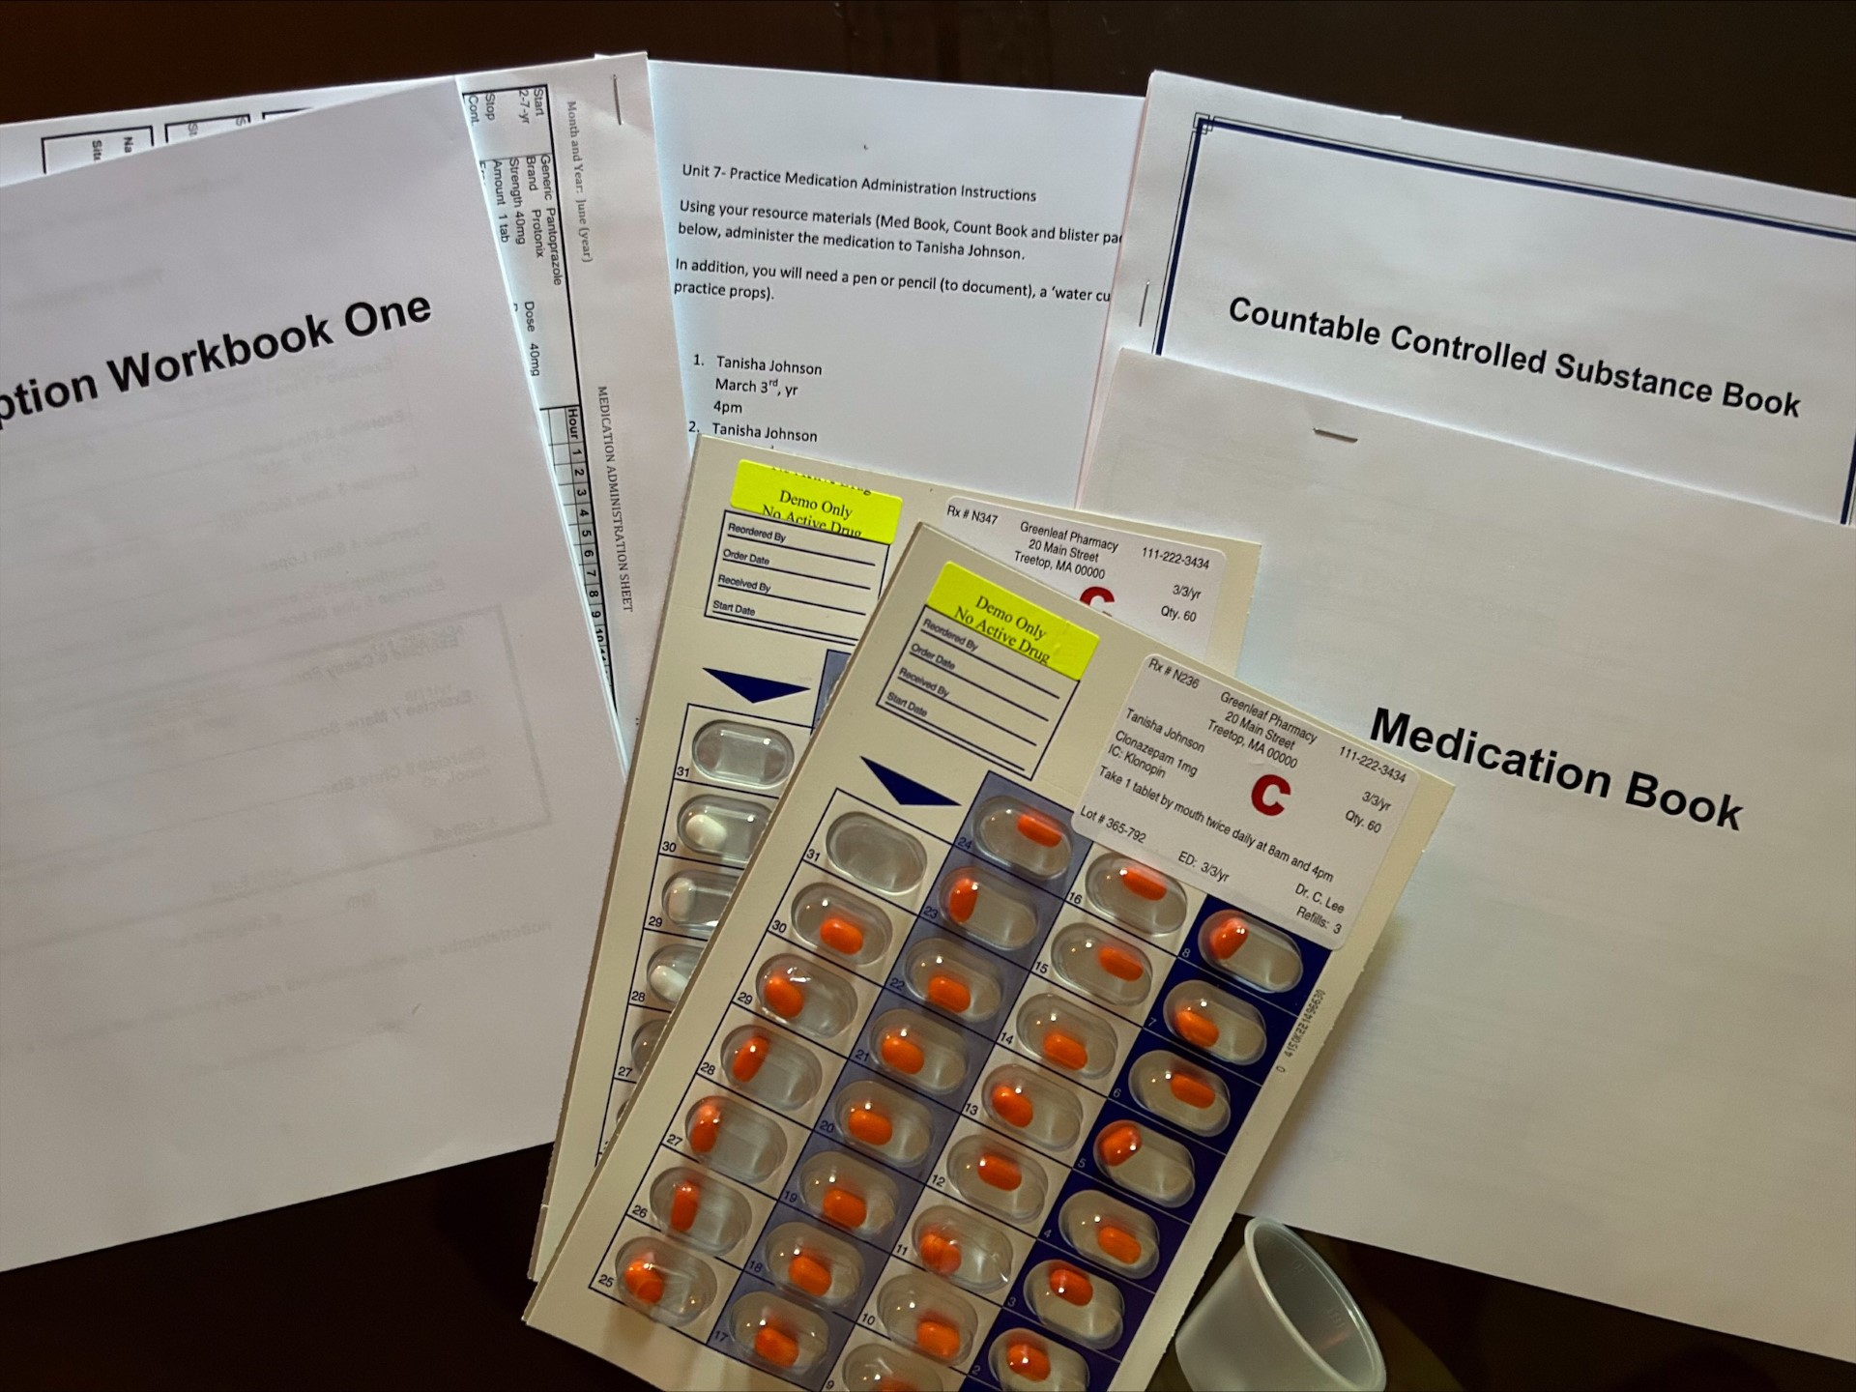
Map packets
Resource Packets
Each student must be provided with a packet
Can be ordered from CDDER or assembled by Trainer
Contain Transcription Workbook One, Medication Book, Countable Controlled Substance Book, 2 blister packs of different "medications," 2 med cups, and a list of medication administration scenarios
Notes:
Each student in the RIA MAP Certification Course needs a Resource Packet. The packet can be ordered from CDDER or assembled by the MAP Trainer. The packet contains Transcription Workbook One, a Medication Book, a Countable Controlled Substance Book, 2 labeled blister packs with 2 different colored tic tacs representing two different medications, 2 plastic graduated med cups, and Unit 7 Practice Medication Administration Instructions with a list of medication administration scenarios.​ Students will use these materials in Unit 6 for transcription practice and to complete their assignment, and in Unit 7 for medication administration practice to complete their assignment or pretest.

Slide 15
Map packets
Test Packets
Required for Medication Administration Test component
Can be re-used multiple times
Ordered through CDDER
Contain a Medication Book, a Countable Controlled Substance Book, 6 blister packs of different "medications," 2 med cups and a list of medication administration scenarios
Notes:
Service Provider Test Proctors will need testing materials for the medication administration test component for students seeking MAP Certification. Test Packets can be re-used multiple times. Each packet contains a Medication Book, a Countable Controlled Substance Book, 6 labeled blister packs with different colored tic tacs representing 6 different medications, 2 plastic graduated med cups, and a list of medication administration scenarios. Test Packets can be ordered through CDDER.

Slide 16
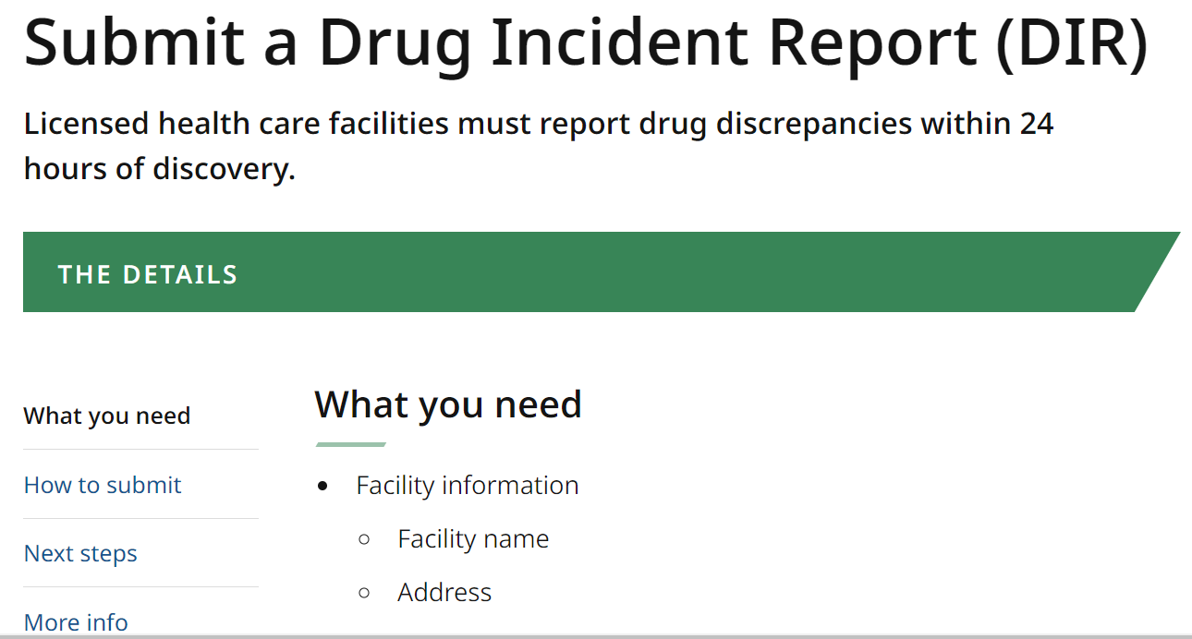
Submitting a drug incident report (dir)
Follow link to mass.gov:
https://www.mass.gov/how-to/submit-a-drug-incident-report-dir
Notes:
The process to submit a Drug Incident Report (DIR) has changed. Providers will now go to the mass.gov website link shown on your screen. Select "How to Submit" from the menu on the left.

Slide 17
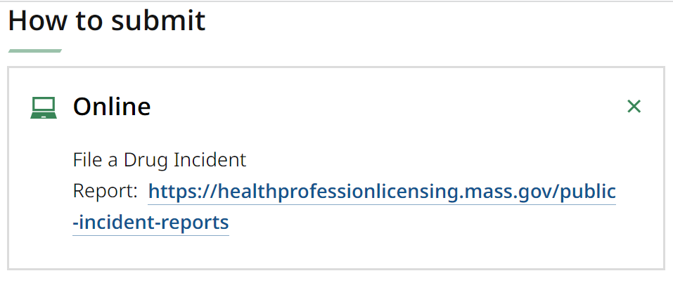
Submitting a drug incident report (dir)
Notes:
Select "Online" and then click the link that appears.

Slide 18
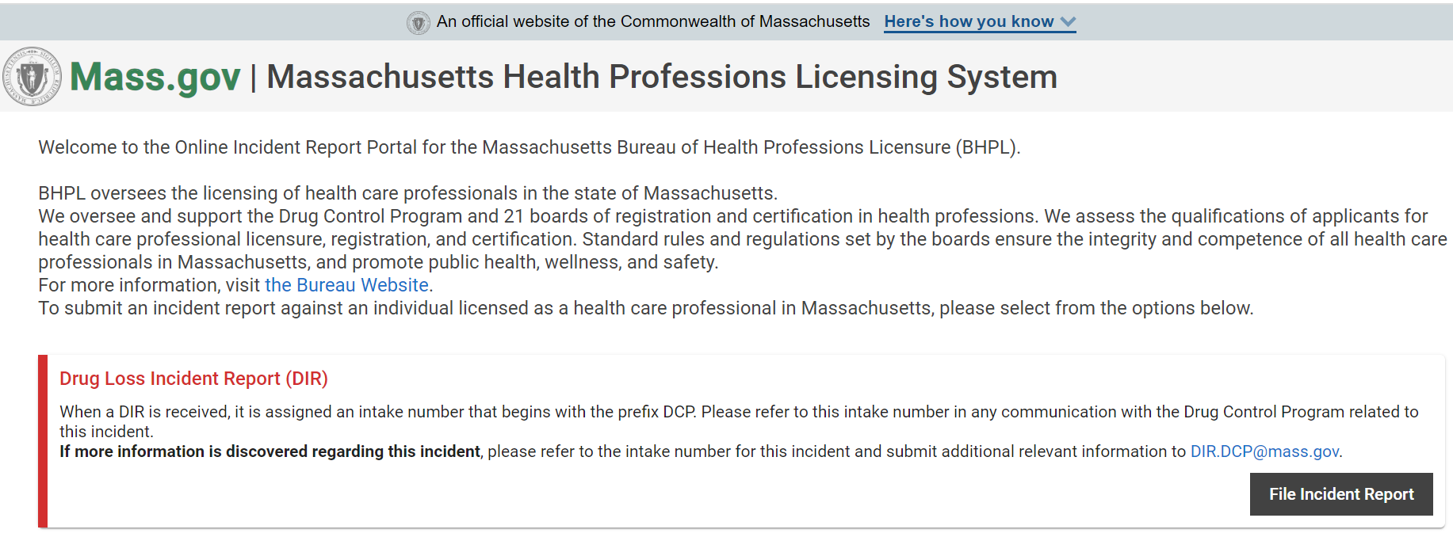
Submitting a drug incident report (dir)
Notes:
Then click on "File Incident Report" to begin the process of filing a Drug Incident Report.
Remember that any loss of controlled substances must be reported within 24 hours of discovery.

Slide 19
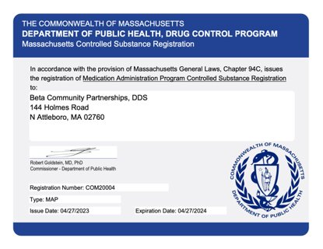
mcsrs
(Provider name and address)
Notes:
MCSRs have a new look. The image on your screen shows what MCSRs will look like upon renewal or for new applications. Please note that any program that currently has an MCSR will have a registration number that begins with "MAP." New MCSRs that are issued will have a registration number that begins with "COM."

Slide 20
Map updates
Notes:
Now, let's talk about MAP Updates.

Slide 21
MASS.GOV/DPH/MAP
Notes:
To stay informed about MAP updates, you should check the Medication Administration Program (MAP) Recent News often. It is accessed using the same MAP-friendly URL. Select "What's New: MAP Recent News"...

Slide 22
how to navigate to the map news website
https://www.mass.gov/info-details/medication-administration-program-map-recent-news
Notes:
This will bring you to the MAP Recent News page where you will find a list of recent advisories and other news, starting with the most recent and proceeding in reverse chronological order. Alternatively, you can bookmark the link on your screen for direct access.
Recent advisory topics include the removal of transcription from MAP Certification testing, prescriber's signatures, and document retention, which we will review now.

Slide 23
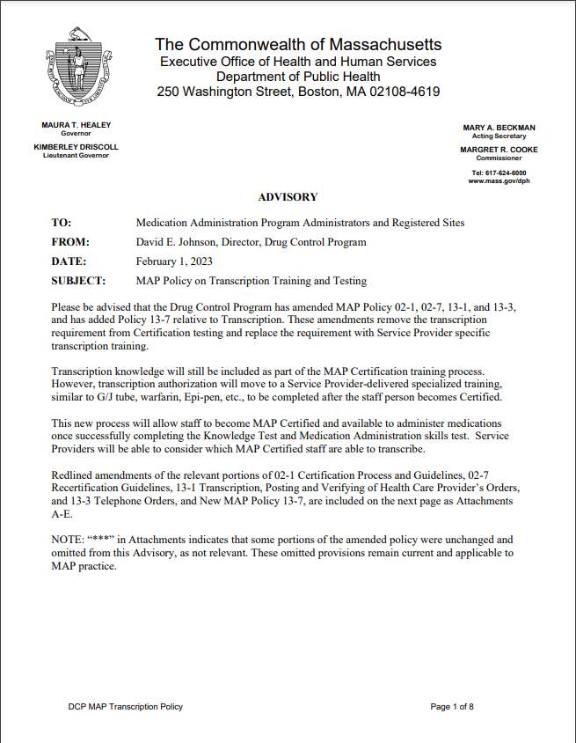
TrAnscription Removal from testing Advisory 02/01/2023
https://www.mass.gov/doc/map-policy-on-transcription-training-and-testing-pdf/download
Notes:
The Department of Public Health has amended MAP Policies and added an additional policy relative to Transcription. These amendments remove the transcription requirement from Certification testing and replace the requirement with Service Provider-specific transcription training, also called Transcription of Medication Management System (or TMM System).
Transcription knowledge will still be included as part of the MAP Certification training and curriculum. However, transcription authorization will move to a Service Provider-delivered specialized training, similar to training for G/J tubes, warfarin administration, Epi-pens, etc., to be completed after the staff person becomes Certified.
For MAP Certification, staff are now only required to pass the Knowledge Test and Medication Administration Demonstration Skill Component. For MAP Recertification, staff are now only required to pass the Medication Administration Demonstration Skill Component.
Service Providers will determine which MAP Certified staff are able to perform transcription, and they will provide the required training on their agency's TMM System. Staff who have not received TMM System training cannot perform any transcription duties. This includes posting and verifying HCP orders and monthly accuracy checks of medication administration records.
Please be aware that as of August 1st, 2023, when MAP Coordinators conduct site reviews, they will ask to review the Service Provider's Transcription of Medication Management System Policy, as well as verification that staff performing transcription duties have been trained on the Service Provider's TMM System.
The specifics regarding policy components and training and testing can be found within the advisory. The advisory can be directly located using the link on your screen.

Slide 24
Mapmass.com
Notes:
Detailed information on the Transcription Removal from Testing Advisory update can be found in the MAP Training and Testing Updates Webinar, which is available on mapmass.com, located in the "MAP Training Resources" section.

Slide 25
Mapmass.com
Notes:
Select your Training Resources based on your State Agency...

Slide 26
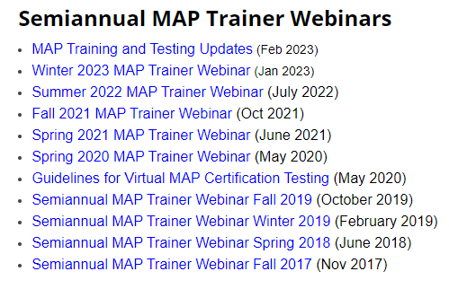
Mapmass.com
Notes:
Then select "MAP Training and Testing Updates" from the list of Webinars.

Slide 27
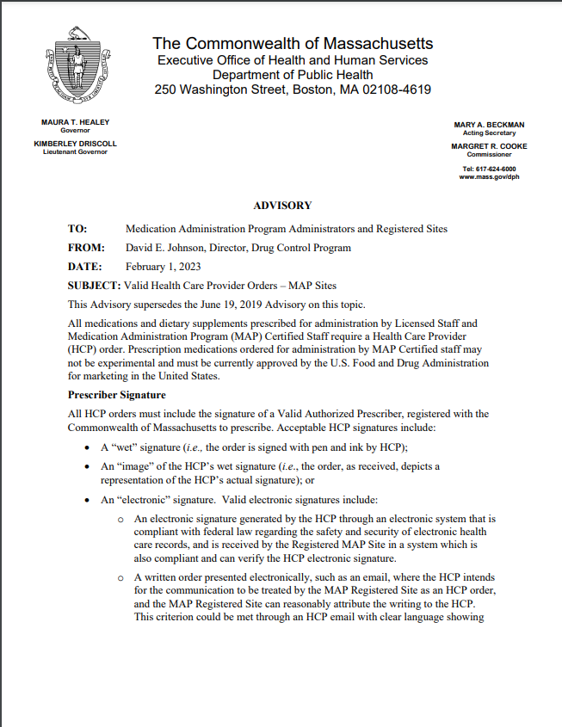
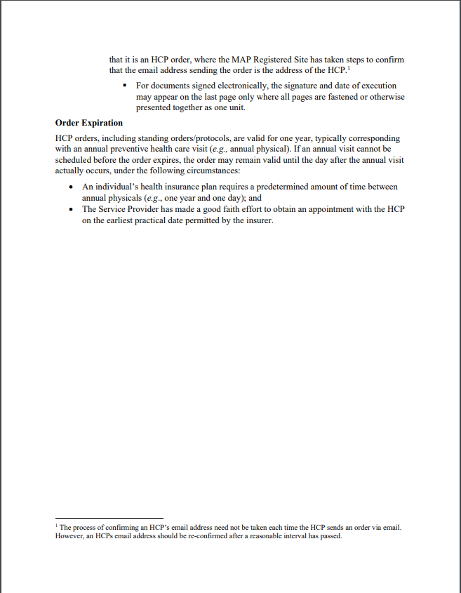
VALID Healthcare provider orders - prescriber signature advisory 02/01/2023
https://www.mass.gov/doc/valid-health-care-provider-orders-prescriber-signature-pdf/download
Notes:
Another advisory was also issued on February 1st, 2023. The Valid Healthcare Provider Orders – Prescriber Signature advisory addresses the use of electronic communication for HCP orders. It is now acceptable to obtain an HCP order electronically via email as described in the advisory. Acceptable HCP signatures continue to include a "wet" signature, an "image" of the wet signature, and an electronic signature. This advisory can be found at the link on your screen.

Slide 28
Document Record Retention Advisory 03/28/2023
https://www.mass.gov/info-details/medication-administration-program-map-recent-news#3-28-2023-
Notes:
A third new advisory was posted on March 28th, 2023, regarding the retention of MAP Documents at MAP Registered sites.
There is a two-year record retention requirement from the date of the record. Stand-alone documents, such as medication release documentation, must be maintained on site for two years from the date of the document. Records consisting of multiple entries, such as countable controlled substance books and medication administration records, must be retained for two years from the last entry date.
The full advisory can be found at the link on your screen. Check with your agency for their policy regarding off-site record retention guidelines.

Slide 29
ERG Recommendations
Streamline the Medication Administration Process
Pilot of streamlined medication administration process in progress
TBD if proposed process is safe and effective
Improvements to MAP Certification Training and Testing
Notes:
On September 30, 2022, The Eastern Research Group (or ERG) completed its report on the Medication Administration Program, with recommendations for improvements to the program. Under the guidance of DPH's project manager Jonathan Dillon, MAP Administrators and Coordinators, providers and other stakeholders formed work groups to evaluate the recommendations and implement changes to MAP. We will touch on two of those recommendations that involve medication administration and MAP training and testing.
The first recommendation is to streamline the medication administration process. The goal of this change is to maintain the safety of the individuals while reducing medication administration time. A modified process for medication administration has been developed and is currently being piloted with a group of providers to determine if the proposed process is safe and effective.

Slide 30
Map changes – additions to online RIA Certification course
Words You Should Know
Found under Student Resources
Notes:
The second ERG recommendation is for improvements to MAP Certification Training and Testing. Some changes have already been made in response to this recommendation. The first involves enhancements to the online RIA Certification Course. Several resources have been added, including a document containing the vocabulary words students need to understand as part of the course. The document is found under "Student Resources" located on the left side of the Home page.

Slide 31
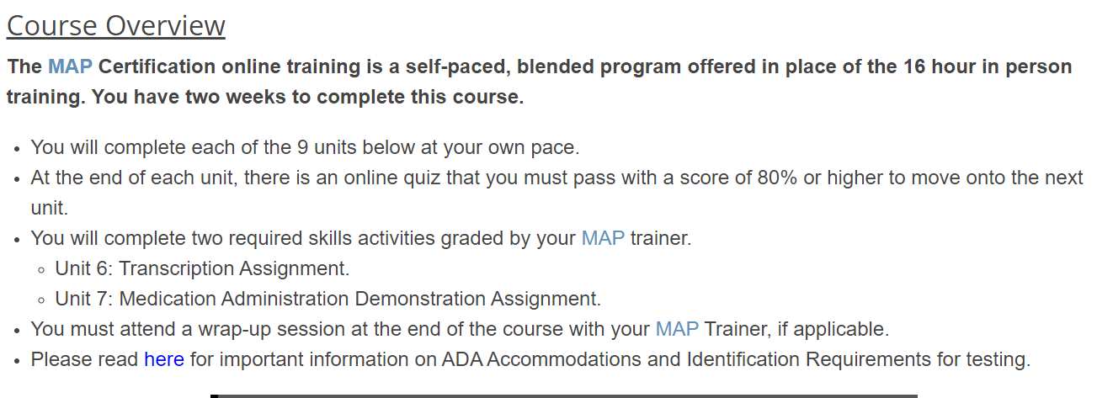
Map changes – additions to online RIA Certification course
ADA Information and ID requirements
Found under Course Overview
Notes:
Another added resource is information regarding ADA accommodations and Identification requirements. It is located on the opening page of the RIA course, under the Course Overview. Click the link for information on ADA Accommodations and ID requirements for Certification testing.

Slide 32
Map changes – additions to online RIA Certification course
Overview of Testing Accommodations
ID Requirements
Reschedule/Refund Requests
No-Show Policies
Found under "Almost Done! Next Steps"
Notes:
The information on ADA Accommodations and ID requirements can be found again at the conclusion of the RIA Certification Course, in the "Almost Done! Next Steps" section using the link identified on your screen. As noted in the title, this link also has information regarding Overview of Testing Accommodations and ID requirements, Rescheduling, Refunds of Testing Fees Paid and No-Show Policies.

Slide 33
Map changes – MAP Knowledge Pre-test
Align Pre-test with Knowledge Certification Test
Review and revision of questions
Extension of time for completing pre-test
Notes:
The final change relates to the Knowledge Certification Pre-test. Historically, the intent of the Knowledge Pre-test was to help the MAP testing candidate become familiar with how to take an online multiple-choice test. The Pre-test was not used as an indicator of how the candidate would perform on the Knowledge Certification Test. Recently, MAP Trainers have requested that the Knowledge Pre-test more accurately reflect a candidate's preparedness for the Knowledge Certification Test.
The State Agency MAP Coordinators are collaborating with D&S to make changes to the Pre-test. The questions have been reviewed and revised to more closely reflect the level of difficulty on the Knowledge Certification Test. MAP Coordinators will be monitoring the performance of the Pre-test questions, in conjunction with Knowledge Certification Test results and make changes as necessary.
In addition, the time allowed for the Pre-test has been extended to 45 minutes, to mirror the time allowed per question on the Knowledge Certification Test.

Slide 34
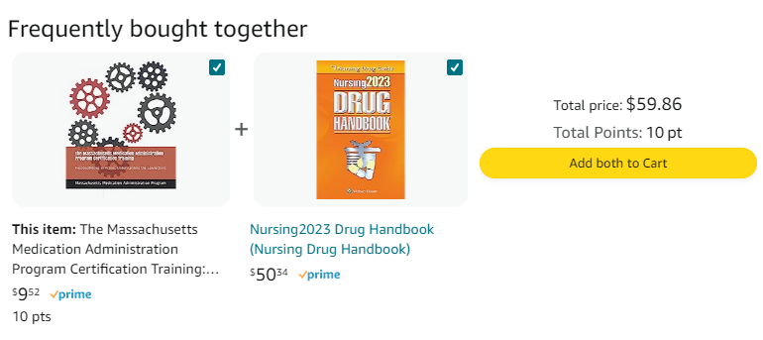
RIA Price increase
Increase in cost of RIA from $6.96 to $9.52
Purchase of the Drug Handbook is NOT required
Notes:
Recently, the price of Responsibilities in Action on Amazon increased from $6.96 to $9.52. This increase is due to manufacturing costs.
Please note that the Amazon website shows Responsibilities in Action is frequently bought with a Drug Reference book. Please make sure any students who are purchasing the RIA are aware that they do not need the Drug Reference book for the MAP Certification course.

Slide 35
Reminders
Notes:
Lastly, some friendly MAP reminders....

Slide 36
Who do I contact?
Notes:
In order to streamline questions that are often asked by trainers and/or providers, the chart on your screen was created to help guide you. For example, if you have questions regarding the Moodle Certification Course, such as submitting a roster, monitoring students' progress, or issues with username and/or password, you would reach out to CDDER, emailing them using the address on your screen.
If your questions are relative to the Certification Test Process, including the essential information needed to create and complete a student TMU record, how to schedule candidates for a test, complete employment verification, run Trainer reports, etc., you will contact D&S.
If you have MAP questions, for example, how to register nurses for Train the Trainer, MAP Trainer requirements, questions relative to MAP Policy and Procedure, where to locate MAP resources, etc., you can reach out to your State Agency Regional or Area MAP Coordinator.

Slide 37
Map Coordinator contact information
Notes:
It is also important to know who your MAP Coordinator is and how to contact them when you have questions. In order to determine the applicable MAP Coordinator contact information, first determine the State Agency that oversees the MAP registered site.
Second, if either DDS or DMH, you can use the agency-specific online interactive state map to determine the region or area of coverage. If it is MRC, DCF or ABI, those MAP Coordinators cover statewide.
Then, using the State Agency Contact List, you will be able to locate the applicable MAP Coordinator's contact information.
The document on your screen contains direct links to the applicable DDS and DMH interactive state maps and State Agency Contact List.

Slide 38
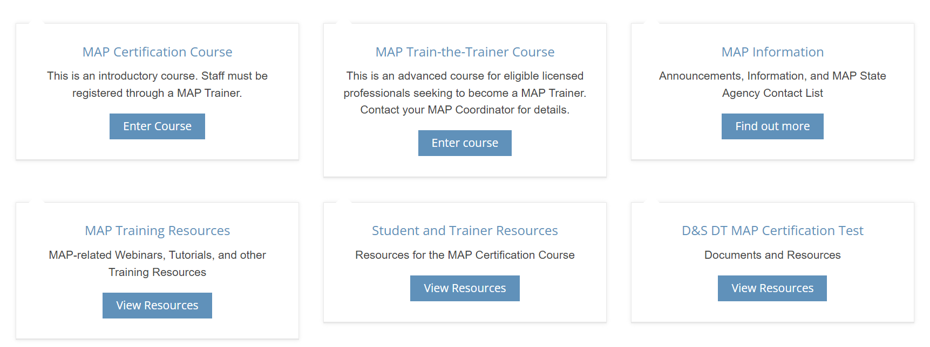
how to find "Who do I contact" guide and map coordinator contact info
Notes:
In order to find the "Who Do I Contact" Guide and the MAP Coordinator Contact information, go to mapmass.com and select the "MAP Information" tab.

Slide 39
how to find "Who do I contact" guide and map coordinator contact info
Notes:
On the next screen, select "Information."

Slide 40
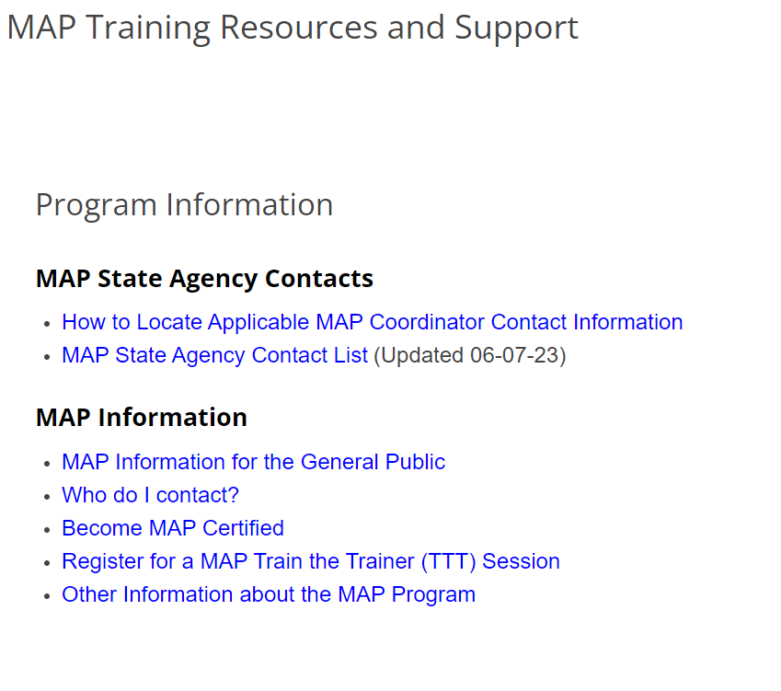
how to find "Who do I contact" guide and map coordinator contact info
Notes:
The "Who Do I Contact" guide is listed under MAP Information, and the MAP State Agency Contact List is under the MAP State Agency Contacts heading.

Slide 41
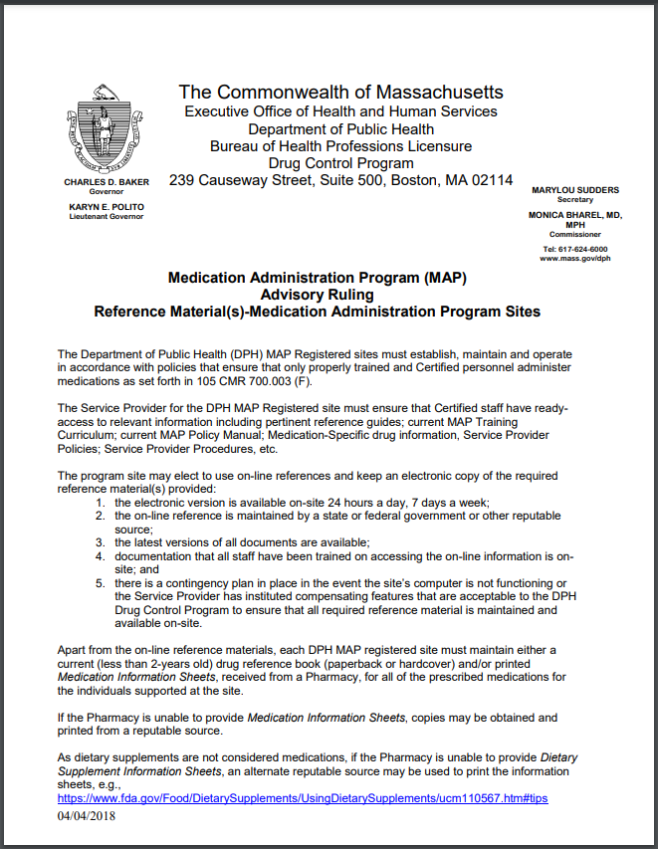
Drug information sheets or drug information book
Only one of the two is required to be available for staff reference.
Either reference must be current (dated within 2 years).
Notes:
Just a reminder that if a site is using current Medication Information Sheets in the Medication Book, there is no need for an on-site Drug Facts Book as a reference. The same is true for sites that utilize the Drug Facts Book rather than Med Info Sheets. Only one is needed for staff reference. Either reference, the Medication Information Sheet or the Drug Facts Book, needs to be current (i.e. dated) within 2 years.

Slide 42
D&s Proctor Information
Proctors should review the virtual testing guidelines. They can find all the pertinent information on D&S's website.
Found on HDmaster.com:
https://www.hdmaster.com/testing/othertesting/massachusetts_cma/forms/2023%20Guidelines%20for%20Virtual%20MAP%20cert%20testing%20-%20website.pdf
Reach out to D&S with any questions prior to testing date.
Notes:
With the transition to virtual Certification testing, it is important that test proctors are aware of the virtual testing guidelines, which can be found at the link on this slide. Test proctors should be reaching out to D&S with any questions well in advance of the student's test date.

Slide 43
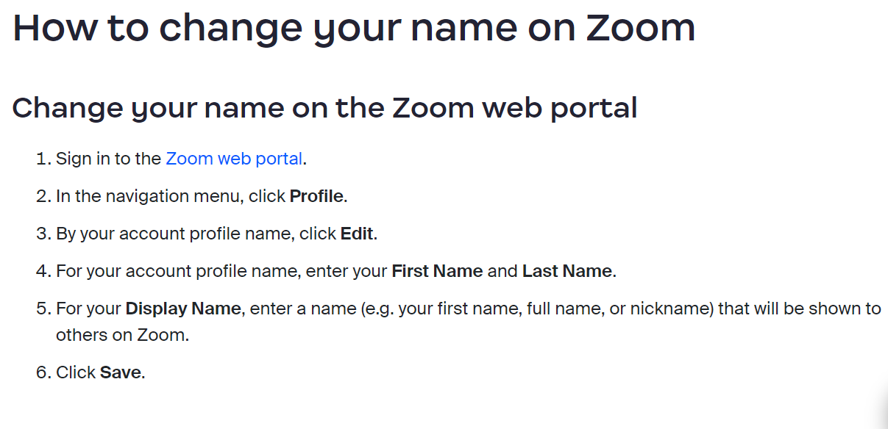
D&S Testing: Zoom Display name
Notes:
When MAP Certification candidates are taking their virtual tests, they should make sure their full names are displayed on the Zoom platform. If the candidate is logged into Zoom simply as "iPhone" or with an email address, the tester has nothing to identify who is in the virtual waiting room. Testing candidates should make any changes needed prior to their testing sign-in time.

Slide 44
When to do what...
When
Medication unavailable
Out of stock
Prior authorization or Guardian consent required, etc.
What
Immediately contact prescribing HCP and
Obtain recommendation, e.g.,
"Start medication when available. Contact HCP if still unavailable after 3 days."
Notes:
In the event a medication is not available for administration for any reason, such as requiring prior authorization or being out of stock, the expectation is that staff immediately contact the HCP and obtain a recommendation on how to proceed. An example of a recommendation would be an order to start the medication once it is received from the pharmacy, including a time limit on how long staff can wait for the pharmacy to deliver the medication, for example, "call the HCP if the medication is not available after 3 days."

Slide 45
what to do when...
HCP Recommendation Obtained
Medication Occurrence Report not required
Unless omission occurs prior to recommendation
HCP Recommendation Not Obtained
Medication Occurrence Report required
Notes:
When a recommendation is obtained prior to the time the medication is scheduled to be administered, an MOR is not required. An MOR is required for omissions that occur before obtaining a recommendation. The initial contact with the pharmacist, when the unavailability of a medication is discovered, does not meet the reporting requirements for notification of the MAP Consultant for subsequent omissions. If no recommendation is obtained from the prescribing HCP, each dose that is omitted requires a call to the MAP Consultant.

Slide 46
Blended training
A blended training utilizing the online Moodle platform with face-to-face skills training is the required format for delivering MAP training.
Additional training materials have been developed to support trainers in implementing this model during units 6 and 7.
Notes:
As described in the updated MAP Policy Manual, the required format for delivering MAP Certification training is a blended model. Trainers should use the online Moodle platform for Knowledge content with face-to-face skills training for the Unit 6 Transcription assignment and the Unit 7 Medication Administration Demonstration. The face-to-face skills training can be either in-person or virtual. Additional training materials have been developed to support trainers in implementing this blended format.

Slide 47
Map training resources and support
MAPMASS.COM
Notes:
The Unit 6 and Unit 7 blended Power Point trainings for the skills components, are located at mapmass.com. From the home page, you will click on 'MAP Training Resources', then...

Slide 48
Map training resources and support
Notes:
….you will click on the appropriate State Agency...

Slide 49
Map training resources and support
Notes:
...then under the "Responsibilities in Action" heading, select 'Unit 6 Blended Certification Training: Transcription Skill Session' or the 'Unit 7 Blended Certification Training: Medication Administration Skill Session’ PowerPoint.

Slide 50
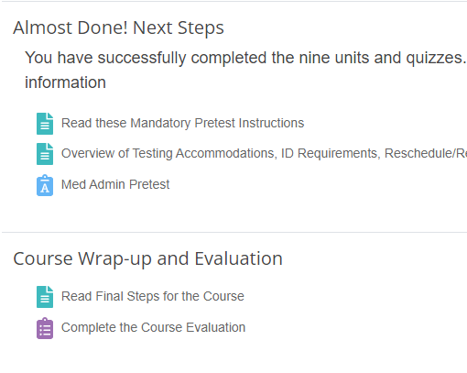
MOODLE ONLINE TRAINING - Post Course Survey
All students should be encouraged to fill out post-course survey after completing the MAP Certification Course
Notes:
Although not a requirement, all students should be encouraged to fill out the post-course survey after completing the online MAP Certification Course. Doing so provides useful feedback so that changes can be made to improve the course.

Slide 51
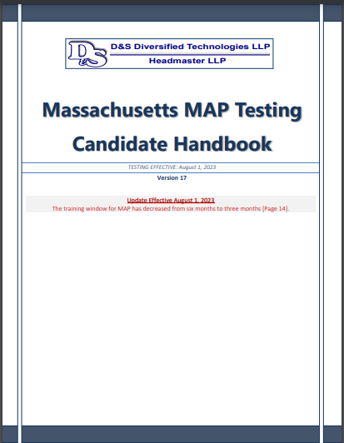
D&S candidate handbook
Current version 17
Updated August 1st, 2023​
Hdmaster.com​
Made available to each student
Notes:
The Massachusetts Virtual MAP Testing Candidate Handbook, current version 17, which can be located on the Massachusetts home page of the D&S website, hdmaster.com, is to be provided to each student taking the MAP Certification course. It can be printed and provided as a hard copy to students or students should be given instructions on where to locate the handbook on the D&S website.
Students are expected to read through the handbook in order to become familiar with all aspects of the testing process, including ADA accommodations, No Show policies, fees, etc.
Please note that version 17 of the handbook reflects a price increase in testing fees. The Knowledge Test or Retake has increased from $43 to $55. The Medication Administration Test or Retake has increased from $96 to $100.

Slide 52
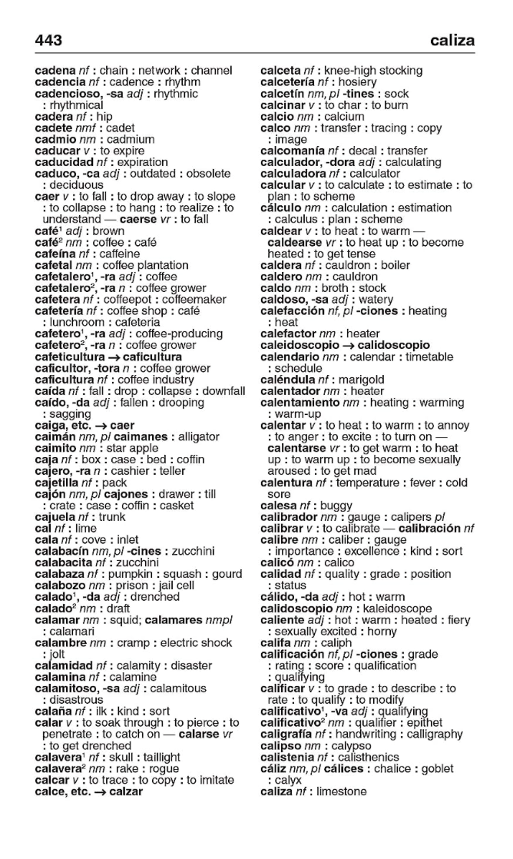
ESL Candidates
Paperback or hard cover word-for-word only language translation dictionaries are allowed during testing
Show D&S tester/proctor before test begins
Notes:
As mentioned in the Winter Webinar, for those for whom English is a second language, the Massachusetts Virtual MAP Testing Candidate Handbook, again current version 17, addresses the use of acceptable dictionaries. Paperback or hardcover, word-for-word only language translation dictionaries are allowed during testing. Candidates must show the word-for-word translation dictionary to the D&S tester or proctor before the test starts. The best time to make the D&S tester aware that a translation dictionary will be used is during the check-in process at the very beginning of the scheduled test.
The translation dictionary must be free of any documentation or writing. If any markings are present, the translation dictionary will not be allowed for use. Electronic translation dictionaries or dictionaries with definitions are not allowed during testing.

Slide 53
MAP Trainer Status
In order to maintain MAP Trainer status
Conduct one MAP Certification training annually
View all the mandatory MAP Webinars in the required time period
Notes:
In order to maintain MAP Trainer status, all Trainers must conduct one MAP Certification training annually and watch all mandatory MAP Webinars within the required viewing period. You will be notified of the availability of required webinars via email. During the required viewing period, typically 6 weeks, the webinar is ‘locked’ and MAP trainers must log in to mapmass.com using their username and password to access the webinar. This allows the tracking of those who view the webinars during the allotted timeframe.
Once the required viewing period is over, the webinar will be ‘unlocked’ for anyone to view.
Trainers who view the webinar outside the required viewing period will not receive a Certification of Completion or ‘credit’ for viewing.
In the near future, MAP Trainers must meet these requirements within a determined time period, or risk having their MAP Trainer status placed on hold.

Slide 54
www.mapmass.com
MAPMASS.COM
Notes:
To access webinars, you will use the mapmass website. You must log in using your MAP Trainer username and password. Then open your screen fully by clicking on the 3 horizontal lines in the top left-hand corner. Once there, click "Required MAP Trainer Webinars." Webinars for credit to maintain your MAP Trainer Status are initially located here.

Slide 55
www.mapmass.com
Notes:
After the timeframe has passed to receive ‘credit’, the webinars are also posted in the MAP Training Resources section.

Slide 56
Accessing webinars
Notes:
….click on the appropriate State Agency...

Slide 57
Accessing webinars
https://mapmass.com/mod/page/view.php?id=3473
Notes:
Then select the desired webinar from the list. You can also reach this page directly using the link on your screen.

Slide 58
MAP Certification
MAP Certification is only valid at
DDS adult MAP Registered sites
MRC adult MAP Registered sites
DMH youth and adult MAP Registered sites
DCF youth and adult MAP Registered sites
Notes:
Finally, MAP Coordinators have continued to get questions regarding where MAP Certification is accepted. MAP Certification is only valid in DDS adult MAP Registered sites, MRC adult MAP Registered sites, DMH youth and adult MAP Registered sites, and DCF youth and adult MAP Registered sites. A MAP Registered site is defined as a site possessing a current and valid MAP Massachusetts Controlled Substances Registration (MCSR) from the Drug Control Program (DCP).
The list of sites where MAP Certification is not valid is presented to students at the beginning of the MAP Certification Course, and it is recommended that Trainers review this with students at the completion of the course as well to ensure they know where their Certification is valid. This could be accomplished during the wrap-up meeting, either virtually or in person.

Slide 59
Next MAP Trainer Webinar
Fall 2023/Winter 2024
Notes:
This concludes the Summer 2023 MAP Trainer Webinar. Please contact your State Regional or Area MAP Coordinator if you have any questions or need further clarification on a topic presented. Thank you for viewing!

